Slide 1
SAFETY PRACTICES IN USING FARM EQUIPMENT
By:
Laurine Jane P. Undang
Daisy Jane A. Dantes
Jana Mae T. Oman
Jackin Nicole Munez
Judy Quime

Slide 2
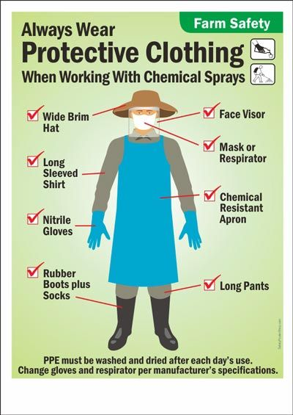
PPE(PERSONAL PROTECTIVE EQUIPMENT)
Personal Protective Equipment (PPE) is clothing or equipment designed to protect workers from physical hazards when on a worksite. PPE should only be considered as a last line of defence between a hazard and the worker. Attempts to control workplace risks and hazards should always be addressed first.

Slide 3

Head Protection
PPE includes hard hats and headgears and should be required for tasks than can cause any force or object falling to the head. When performing head protection safety checks, ensure that there are no dents or deformities on the shell and connections are tightened inside. Do not store in direct sunlight and always replace a hard hat if it was used for any kind of impact, even if damage is unnoticeable.

Slide 4

Face and Eye Protection
PPE includes safety goggles and face shields and should be used for tasks that can cause loss of vision and an eye, burns, splashes, sprays of toxic liquids etc. When conducting equipment safety checks, ensure that there are no cracks or deformities on the lenses, ensure the strap is in good working order and is firmly sealed to the cheek and forehead.

Slide 5
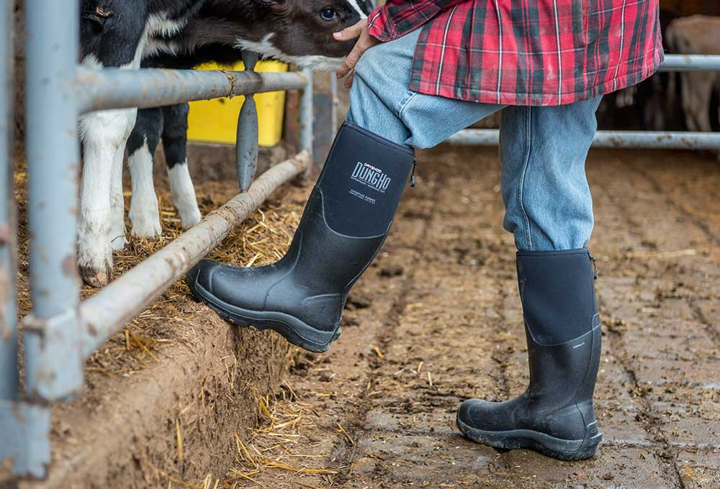
Foot Protection
PPE includes knee pads and safety boots and should be used for tasks that can cause serious foot and leg injuries from falling or rolling objects, hot substances, electrical hazards and slippery surfaces. Use boots with slip-resistant soles that protect against compression and impact.

Slide 6

Hands Protection
PPE includes safety gloves and should be used for tasks that can cause hand and skin burns, absorption of harmful substances, cuts, fractures or amputations.When inspecting hand protection equipment, ensure that they fit perfectly with no spaces and are free from cuts, burns and chemical residue. Always replace them if any sign of contamination was observed.

Slide 7

Body Protection
PPE includes safety vests and suits and should be used for tasks that can cause body injuries from extreme temperatures, flames and sparks, toxic chemicals, insect bites and radiation. Ensure that they are clean and free from cuts and burns. Always get a good fit to ensure full body protection.

Slide 8
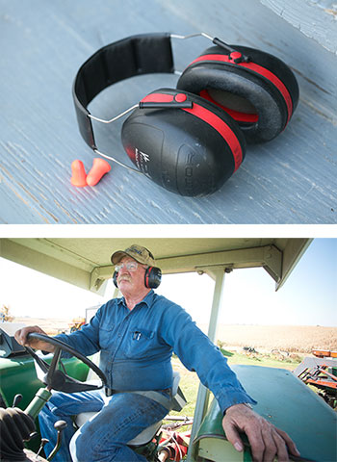
Hearing Protection
PPE includes ear muffs and plugs and should be used for tasks than can cause hearing problems and loss of hearing. When ensuring hearing safety, the equipment must fit the ear canal perfectly. Recommended types include formable earplugs to fit on different sizes of ear canals.

Slide 9
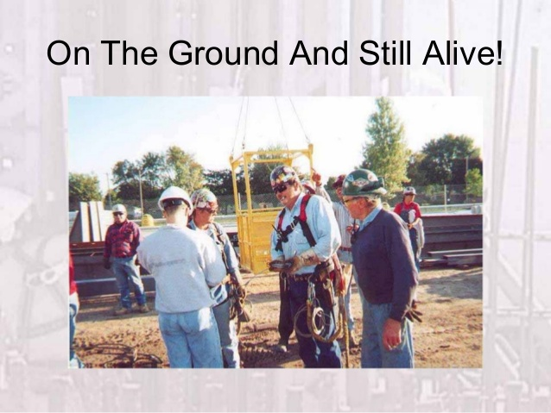
Fall Protection
PPE includes safety harnesses and lanyards and should be strictly used for task that can cause falling from heights and serious injury or death. When inspecting equipment, ensure that the straps are free from tears, deformities and burn marks and buckles are connected securely and tightly. It is very important to dispose them if used after a falling incident.

Slide 10
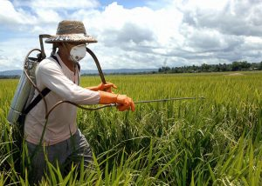
Respiratory Protection
PPE includes respirators and should be used for task that can cause inhalation of harmful materials to enter the body. When conducting respiratory protection safety, ensure that the equipment is fit-tested and the employee has undergone proper training before wearing one.

Slide 11
HOW TO REDUCE THE RISK OF TRACTOR ACCIDENTS
How to prevent a tractor roll-over
Avoid ditches, holes, and other embankments whenever possible.
Reduce speed while turning, crossing slopes, and on rough, muddy, or slick surfaces.
Avoid slopes too steep for operation.
Operate the tractor smoothly by avoiding jerky turns, starts, or stops.
Never transport passengers.

Slide 12
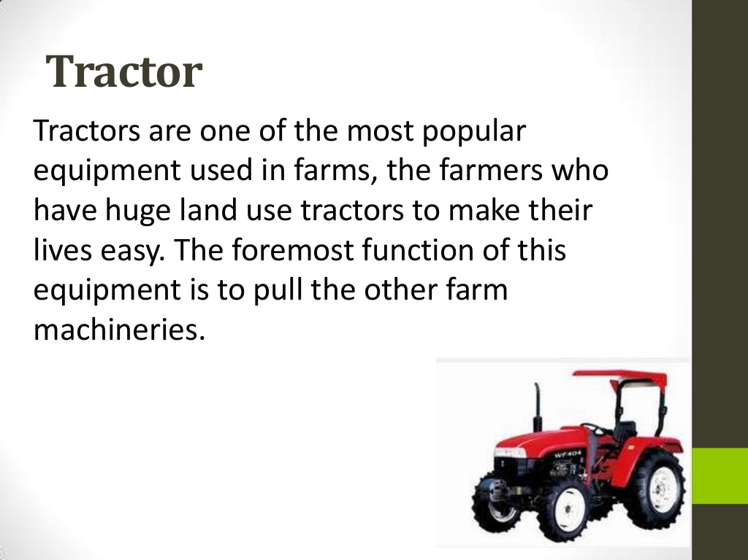

Slide 13
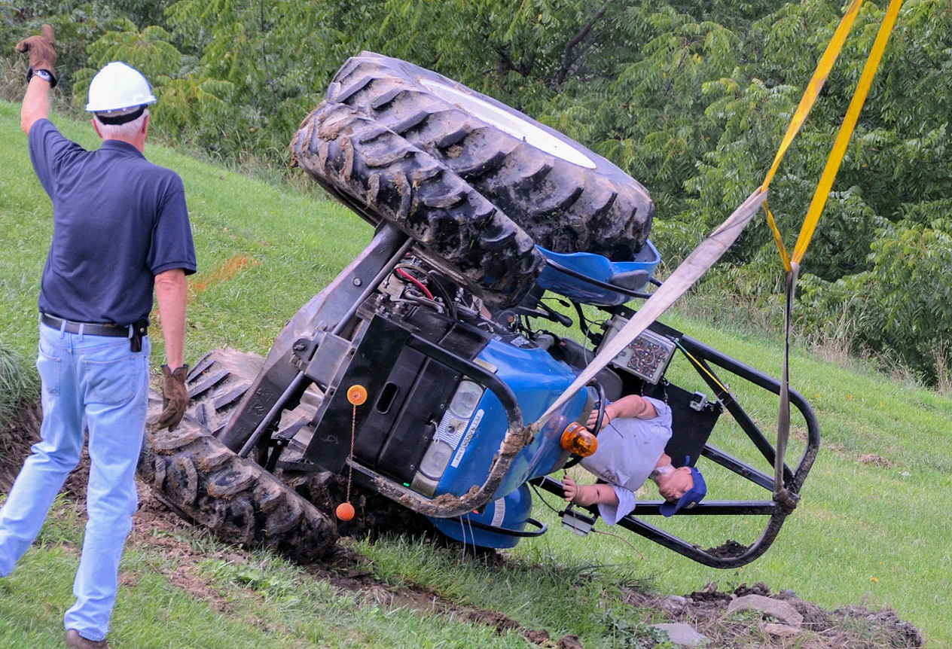
Injuries include amputations and fractures from a variety of incidents including:
Falling from moving tractors

Slide 14
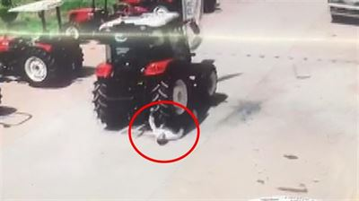
Being run over by tractors

Slide 15
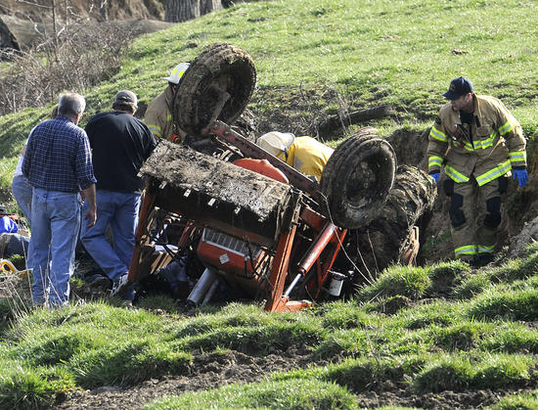
Being crushed when a tractor rolls sideways or backwards.

Slide 16
PREPAREDNESS
Always read and follow safety procedures in the manufacturer's manual.
Always plan work in advance so that the work methods are safe at all stages.
Be careful in selecting your tractor operators - Ensure that they are well trained for each type of tractor work.
Be sure your operators read and understand the manual, are familiar with the tractor and are fully aware of their responsibilities.

Slide 17
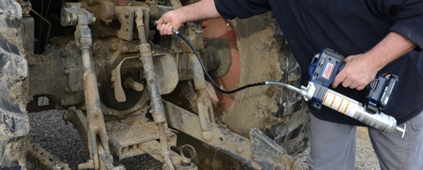
HAZARDOUS ACTIVITIES
Lubricating- if you need to remove the guard to lubricate the machine, never lubricate while the machine is in motion.

Slide 18
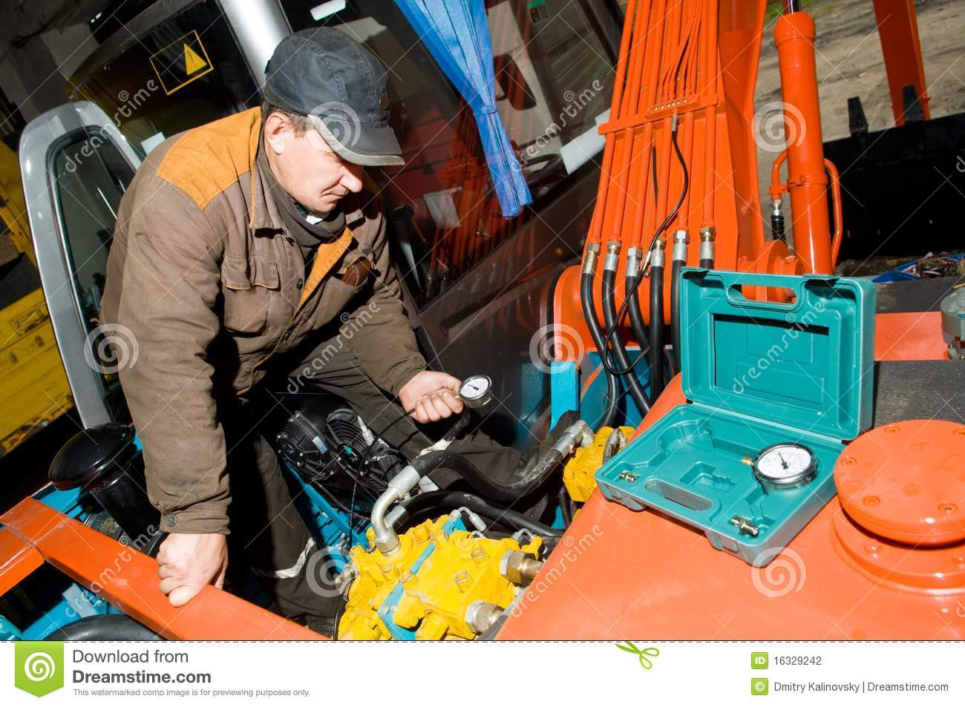
Checking hydraulic system

Slide 19
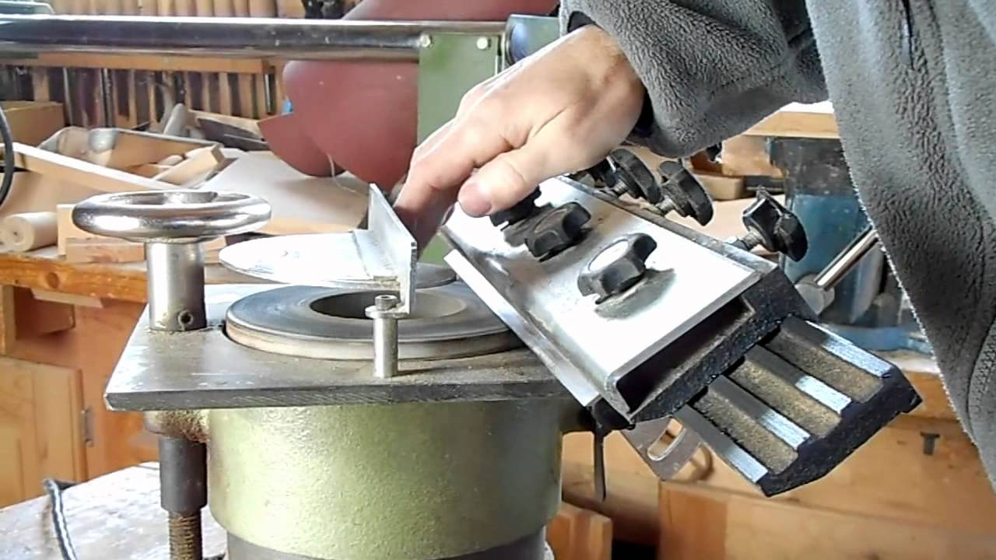
Sharpening

Slide 20
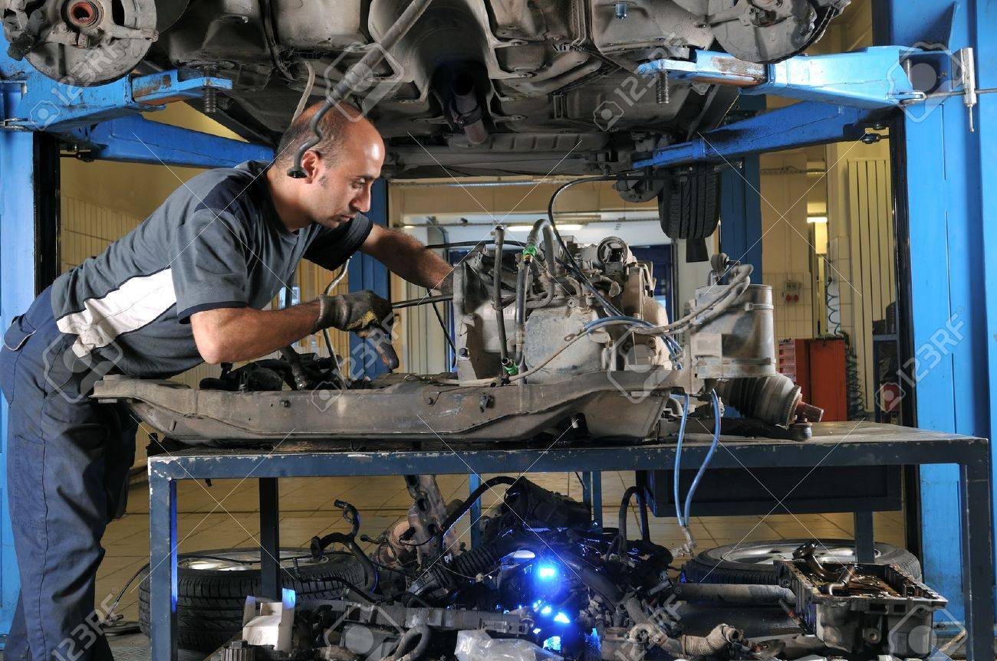
Working under machines

Slide 21
Farm Equipment Safety
New farm equipment is specifically designed for safe handling and operation. Older farm equipment is outdated and missing some of the latest standard safety features. The following sections discuss general guidelines for farm equipment safety, including farmstead equipment, farm field equipment, guards, shields, and power take-off equipment (PTOs).

Slide 22
General Equipment Safety
Keeping equipment in good working condition is half the formula for being safe. The other half is the ability and awareness of the person operating the equipment.
Safety = Good Working Equipment + Able and Aware Operator

Slide 23

Read and comply with the operator's safety manual for each piece of farm equipment.

Slide 24

Keep children and other people away from the working area.

Slide 25
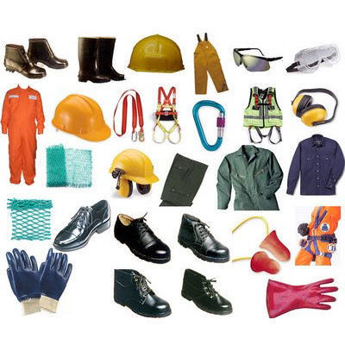
Wear protective equipment to suit the task. If worn correctly, gear such as earplugs, earmuffs, hard hat, safety goggles, gloves or full-face mask can dramatically reduce your risk of injury.

