Slide 1

mENUmap
Evelio Gonzalez – Minute Keeper,
Alfonso Oramas – Team Leader,
Andrew Lewis – Document Editor & Diagram Coordinator,
Alexandra Cozar – Time Keeper,
Kamal Ayoub – Team Member

Slide 2
Purpose of system and scope
The Goal of MenuMap is to enhance the dining discovery experience by bridging the gap between restaurants and customers, by providing user-verified menus through a GPS-enabled platform.
The MenuMap users will be using this application through the iOS and Android mobile platforms.

Slide 3
Task ID | Task Description | Duration | Milestones / Deliverables | Dependencies
T1 | Requirements Elicitation | 2 Weeks | None | None
T2 | Project Proposal | 1 Week | Approved Proposal | T1
T3 | Use Case Designs | 5 Weeks | Use Case Designs | T2
T4 | Security Use Case Designs | 4 Weeks | Security Use Case Designs | T2
T5 | Prototype Development | 7 Weeks | Working Prototype | T3, T4
T6 | Testing / Evaluation | 3 Weeks | Feedback | T5
T7 | Feedback Based Changes | 4 Weeks | Client-corrected Prototype | T6

Slide 4
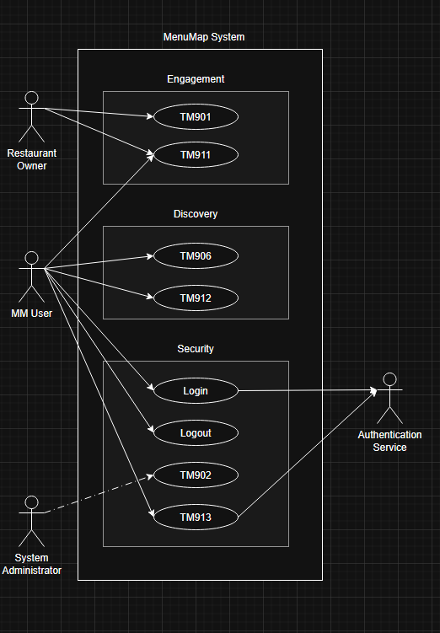
UML diagram of use cases that will be implemented

Slide 5
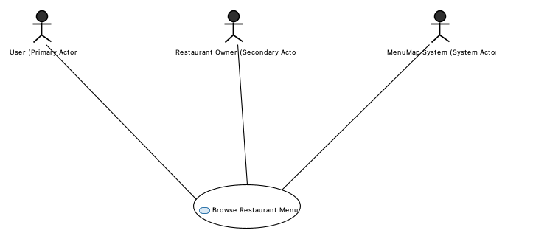
UC-001: Browse Restaurant Menus
Use Case Description:
"Allows users to search and browse restaurant menus by cuisine, location, or specific items"
Actors:
User (Primary Actor)
Restaurant Owner (Secondary Actor)
MenuMap System (System Actor)
Key Scenarios:
"Sarah searches for Italian restaurants"
"Mike browses by cuisine type (Mexican)"
"Lisa searches for specific menu items (vegetarian burger)"

Slide 6
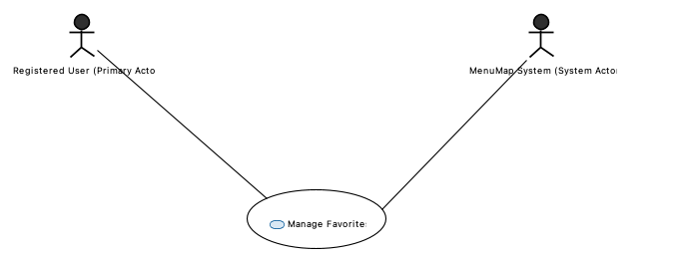
UC-002: Manage Favorites
Use Case Description:
"Enables registered users to save and organize their favorite restaurants and menu items"
Actors:
Registered User (Primary Actor)
MenuMap System (System Actor)
Key Scenarios:
"David adds restaurant to favorites"
"Maria organizes favorites into categories"
"Alex adds menu items to favorites"

Slide 7
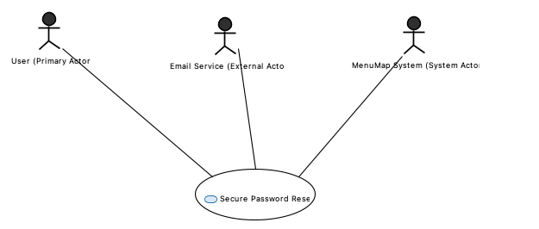
UC-003: Secure Password Reset (Security Use Case)
Use Case Description:
"Provides secure password reset functionality with fraud prevention and abuse protection"
Actors:
User (Primary Actor)
MenuMap System (System Actor)
Email Service (External Actor)
Security Features:
"Token-based security (24-hour expiration)"
"Rate limiting to prevent abuse"
"Audit logging for security monitoring"
"Fraud prevention (no email enumeration)"
Key Scenarios (from your scenarios document):
"Jennifer successfully resets password"
"Tom attempts reset with invalid email (security protection)"
"Robert clicks expired reset link (time limit enforcement)"

Slide 8
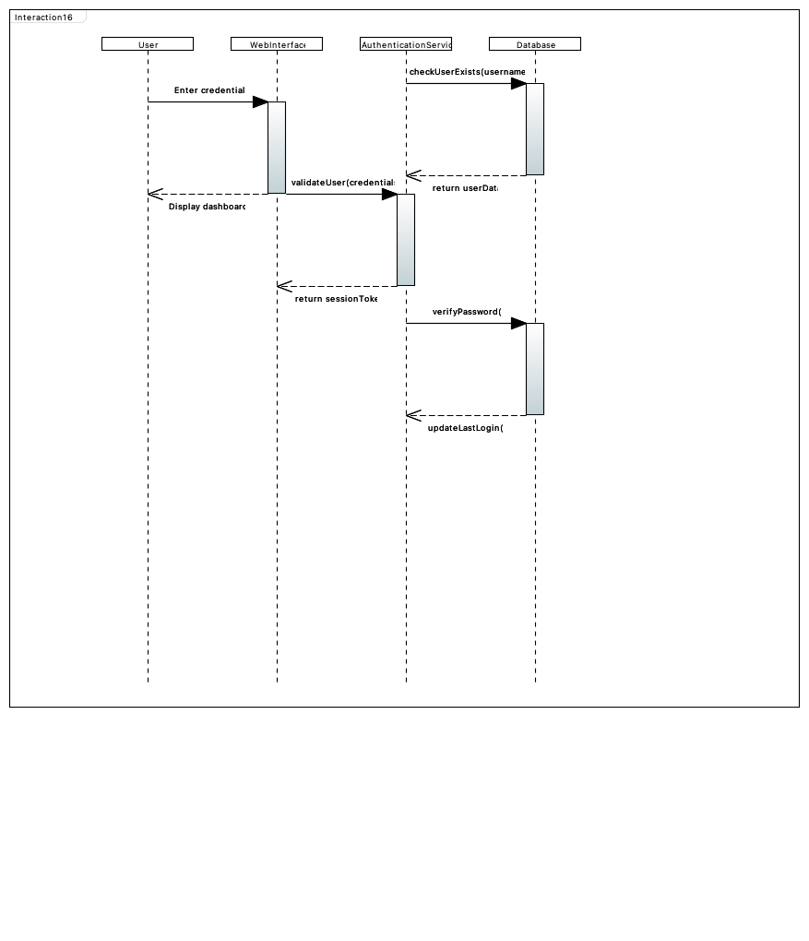
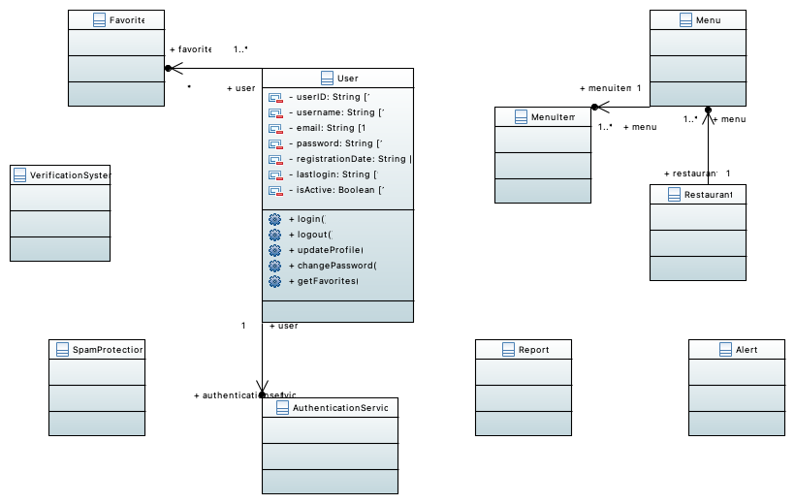
UML Diagrams Overview
Content:
"Individual Use Case Diagrams for each use case"
"Class Diagram showing system structure"
"Sequence Diagram for user login process

Slide 9
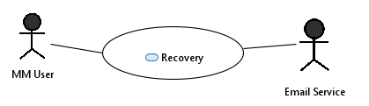
[Security] TM905- Recovery Use Case
Use Case Description: Provides MenuMap users with an account recovery method when they are unable to log in.
Actors: MM User, User's Email Service
Security Features:
Email access requirement.
One-time use recovery information.
Updated password must be different to previous password.
Key Scenarios:
"Roger forgot his password, so he selected 'Need help logging in?'"
"Emma updated her password for MenuMap after providing recovery information."
"George received an email containing his account information after recovering his account."

Slide 10
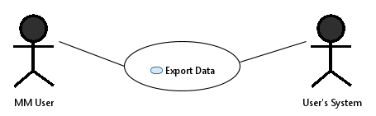
TM907- Export Data
Use Case Description: Allows MenuMap users to export data associated with their individual account.
Actors: MM User, User's System.
Key Scenarios:
"Grace wants to save her meal data to her device, so she exports her MM data."
"Lionel only wants to save his nutrition data for future reference, so he selects this preference and exports his data."
"Paige exports her data to her device every week to keep track of her nutrition and how it changes."

Slide 11
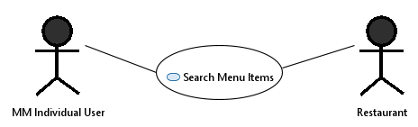
TM908- Search Menu Items
Use Case Description: Allows users to find meals based on their nutrition goals.
Actors: MM Individual User, Restaurant.
Key Scenarios:
"Stacy wants to keep a gluten-free diet, so she searches for menu items that fall under this category."
"Bob is looking to consume a high-protein and low sugar diet, so he searches for menu items that conform to both his selected options."
"Because Regina is diabetic, she wants to make sure her diet is diabetic-friendly, so she makes that her only preference in the MenuMap app."

Slide 12
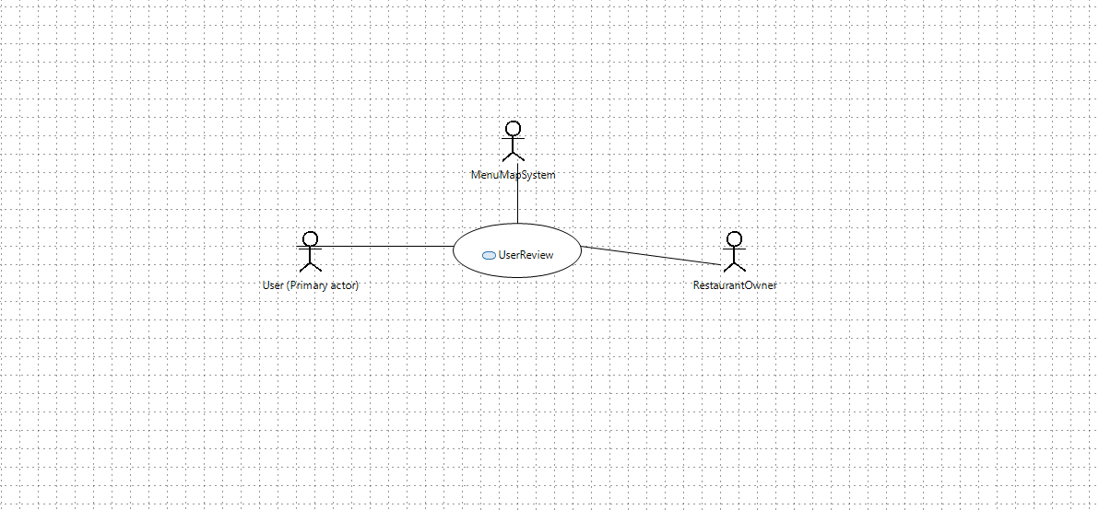
TM911: User Review & Rating System – Use Case Diagram
“Allows registered users to write a text review and give a 1–5-star rating for a restaurant; the system validates and stores the review, updates the restaurant’s average rating, and displays reviews to all users.”
Actors:
Registered User (Primary Actor)
Restaurant Owner (Secondary Actor – read-only access to reviews)
MenuMap System (System Actor)
Key Scenarios (from your scenarios document):
“Eve writes a 4-star review for Green Fork and adds a short comment about service speed.”
“Andre edits his previous review to correct a typo; rating remains 5 stars.”
“Alfonso flags an offensive review; the system hides it pending moderator action.”
“Kamal opens Taco Loco and sees the average rating update after new reviews.”

Slide 13
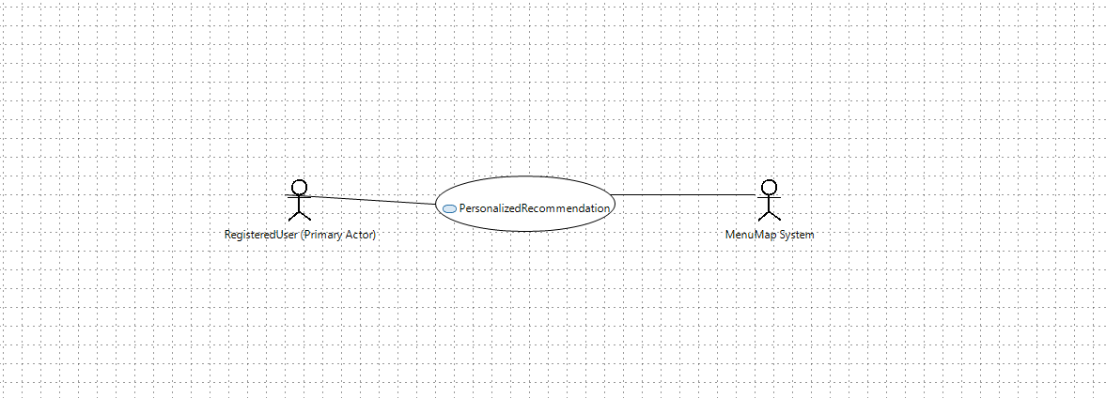
TM912: Personalized Recommendation Engine
Use Case Description: “Generates personalized restaurant recommendations for a user based on favorites, past searches, dietary preferences, and location; the user can refine results with filters (price, distance, cuisine/dietary) and open a suggested restaurant.”
Actors:
User (Primary Actor)
MenuMap System (Recommendation Engine) (System Actor)
Key Scenarios (from your scenarios document):
“Eve opens Recommended for You; sees vegan-friendly lunch spots within 5 miles based on her favorites.”
“Andre applies filters ($$, ≤2 miles, Mexican) and the recommendations refresh instantly.”
“Kamal marks a suggestion as Not Interested; future recommendations adapt and hide similar places.”
“Alfonso taps a recommended restaurant to view its menu and saves it to his Lunch Spots collection.”

Slide 14
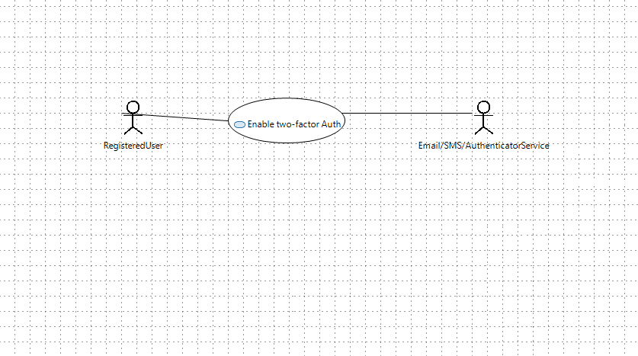
TM913: Two-Factor Authentication (Security)
Use Case Description: “Enables users to protect their accounts with Two-Factor Authentication (2FA). The user turns on 2FA (via authenticator app or SMS/email OTP), verifies a one-time code, receives recovery codes, and thereafter must provide an OTP after password at login. System validates OTP, handles throttling/lockouts, and supports recovery-code login if the device is unavailable.”
Actors:
User (Primary Actor)
Email/SMS/Authenticator Service (External Actor – delivers/generates OTP)
MenuMap System (System Actor – stores 2FA state, verifies OTP, issues recovery codes)
Key Scenarios (from your scenarios document):
“Eve opens Security Settings → Enable 2FA, scans a QR in her authenticator app, enters the 6-digit code, and the system confirms 2FA enabled with downloadable recovery codes.”
“Andre signs in from a new device: enters password, then the 6-digit OTP; the system validates with the authenticator service and grants access.”
“Kamal’s phone is unavailable; he selects Use a recovery code, enters one valid code, logs in, and the system rotates remaining recovery codes.”
“Alfonso mistypes OTP repeatedly; after 5 failed attempts the system enforces a short cooldown and sends a security alert email.”

Slide 15
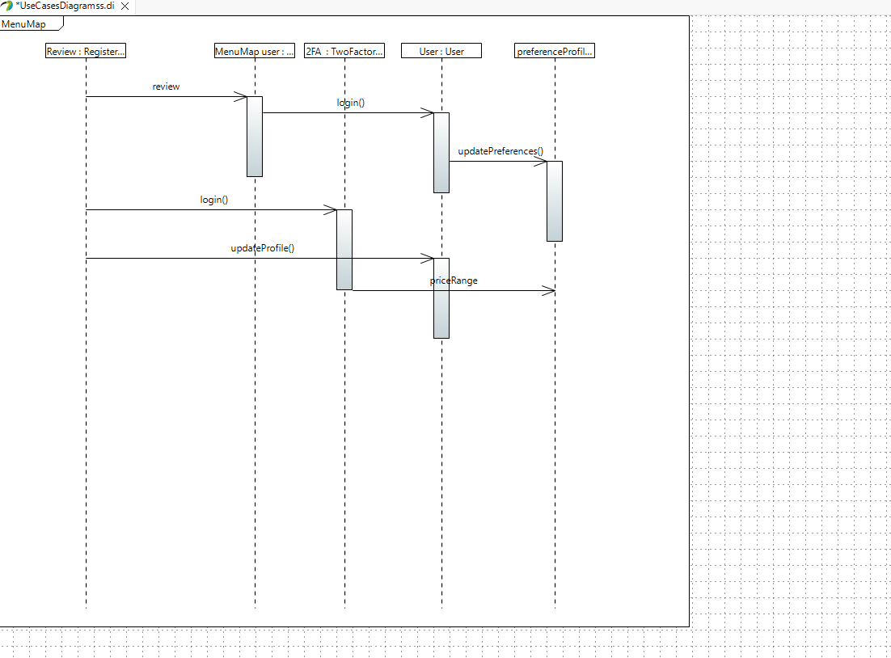
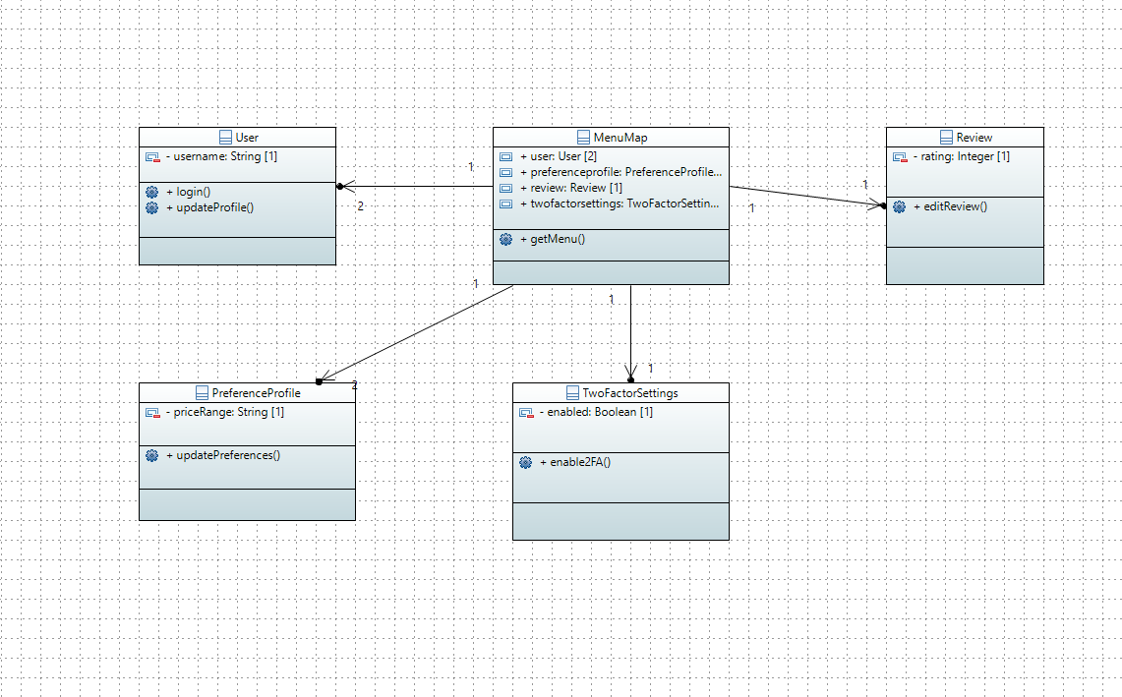
UML diagram overview

Slide 16
PART 5 Use Case TM911: User Review & Rating
Goal: Let users post a review (1–5★) on a restaurant/menu item to improve discovery & quality. Primary Actor: Registered User Stakeholders: Other diners (relevance), Restaurant owners (feedback), MenuMap (integrity) Preconditions: User is identified; restaurant/menu item exists Trigger: User taps “Write a review” Main Flow (happy path):
User selects restaurant/menu item
Enters rating, title, text, optional photos
System runs spam/toxicity checks & PII redaction
Review saved; average rating recalculated; feed updates Alternate/Exceptions: – Fails checks → send for manual moderation / request edits – Duplicate/brigading detected → throttle/flag Postconditions: Review visible; audit log written
Use Case TM911: User Review & Rating
Goal: Let users post a review (1–5★) on a restaurant/menu item to improve discovery & quality.

Slide 17
TM911 Non-Functional Requirements
Performance: Create/retrieve review ≤ 300 ms p95; list first 20 reviews ≤ 500 ms p95
Scalability: Support 50 writes/sec & 500 reads/sec with horizontal read replicas + caching
Security/Privacy: Auto-redact emails/phone/credit cards; sanitize HTML (XSS)
Reliability: 99.9% monthly availability; durable writes (WAL + 3 replicas)
Integrity/Anti-abuse: Rate-limit (per user/IP/device); ML spam/toxicity score ≥ threshold; one rating per user per venue per 30 days (configurable)
Usability/Accessibility: WCAG 2.1 AA; mobile-first, clear stars & character counter
Auditability: Immutable moderation log; reviewer history traceable (internal)
Legal/Compliance: Takedown workflow (owner & user requests); data retention policy (e.g., 24 months for flagged content)

Slide 18
Security Use Case TM913: Two-Factor Authentication (2FA)
Goal: Reduce account takeover by requiring a second factor for sensitive actions Primary Actor: Account Owner Scope (not login/logout itself): Enable 2FA & Verify OTP for sensitive actions (e.g., posting first review, changing email, deleting account) Preconditions: User identity verified; at least one factor available (email/SMS/app) Trigger: User chooses “Enable 2FA” or performs a protected action Main Flow (Enable):
User selects factor (TOTP app, SMS, or email)
System shows QR/secret or sends code
User enters code → system verifies & marks 2FA enabled; issues recovery codes Main Flow (Verify for protected action): Prompt → enter OTP → proceed Alternate/Exceptions: Code expired/invalid → retry; lost device → recovery codes / support Postconditions: 2FA active; sensitive action executed only after successful OTP

Slide 19
TM913 Non-Functional Requirements
Security: TOTP (RFC 6238); codes 30 s window; 6–8 digits; max 5 attempts then cool-down
Storage: Secrets hashed/peppered or encrypted at rest; recovery codes one-time, hashed
Transport: All OTP, QR, and recovery flows over TLS 1.2+; HSTS enabled
Availability: 99.9% for 2FA verification API; fallback channel (email if SMS down)
Performance: OTP verify ≤ 200 ms p95; enable flow ≤ 800 ms p95
Usability: Clear setup wizard; 2 backup codes shown + downloadable; time-drift help text
Audit: Log enable/disable, verification successes/failures, channel used, IP/device
Compliance: Respect user locale/phone rules; opt-in messaging; accessible error states

