Slide 1
MenuMap - Deliverable 3 Presentation
MenuMap - Deliverable 3 Presentation
Team 9
CEN 4010 - Software Engineering
Fall 2025

Slide 2
Restaurant Menu Management System
Team 9 Members:
Andre Lewis - Team Lead
Alexandra
Alfonso
Kamal
Roles for Three Phases:
Deliverable 1 (Requirements): [Team member roles]
Deliverable 2 (Design): [Team member roles]
Deliverable 3 (Implementation): [Team member roles]
CEN 4010 - Software Engineering Florida International University Fall 2025

Slide 3
MenuMap System Purpose
Primary Purpose:
Restaurant menu verification and management platform
Enables restaurant owners to create and manage digital menus
Allows customers to browse, search, and view restaurant menus
System Scope:
Web-based application supporting multiple user roles
Restaurant menu browsing and search functionality
Menu management for restaurant owners
User authentication and account management
Menu verification and content accuracy
Target Users:
Restaurant customers (browse menus)
Restaurant owners (manage menus)
System administrators (verify content)

Slide 4
Complete Project Timeline
Phase 1: Requirements (Weeks 1-3)
Requirements gathering and documentation
Use case development
Deliverable 1 submission
Phase 2: Design (Weeks 4-10)
Architecture design
UML diagram creation
Design document completion
Deliverable 2 submission
Phase 3: Implementation (Weeks 11-15)
System implementation
Comprehensive testing (33 test cases)
Final documentation
Deliverable 3 submission

Slide 5
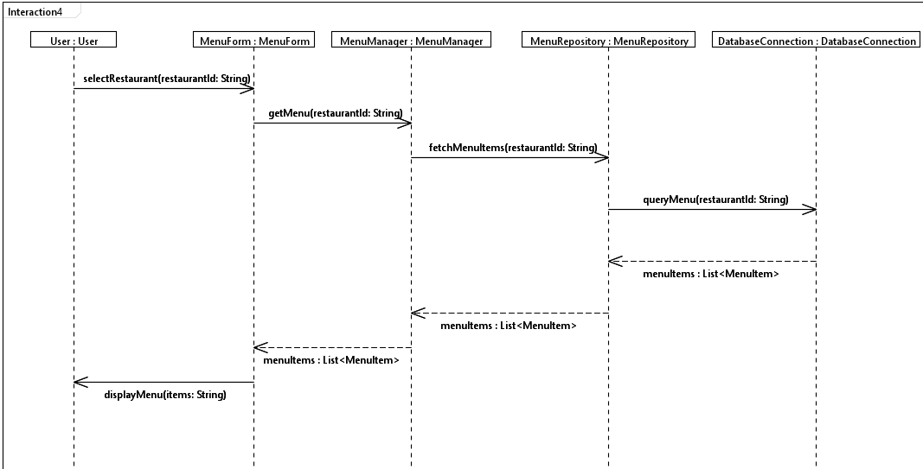
UML Use Case Diagram showing all implemented use cases in the MenuMap system.
UC-001: Browse Restaurant Menus

Slide 6
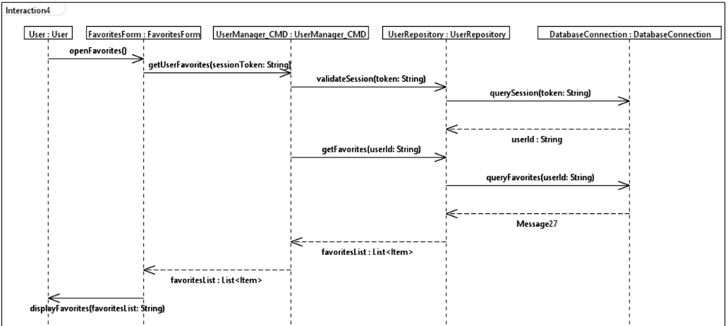
UC-002: Manage Favorites

Slide 7
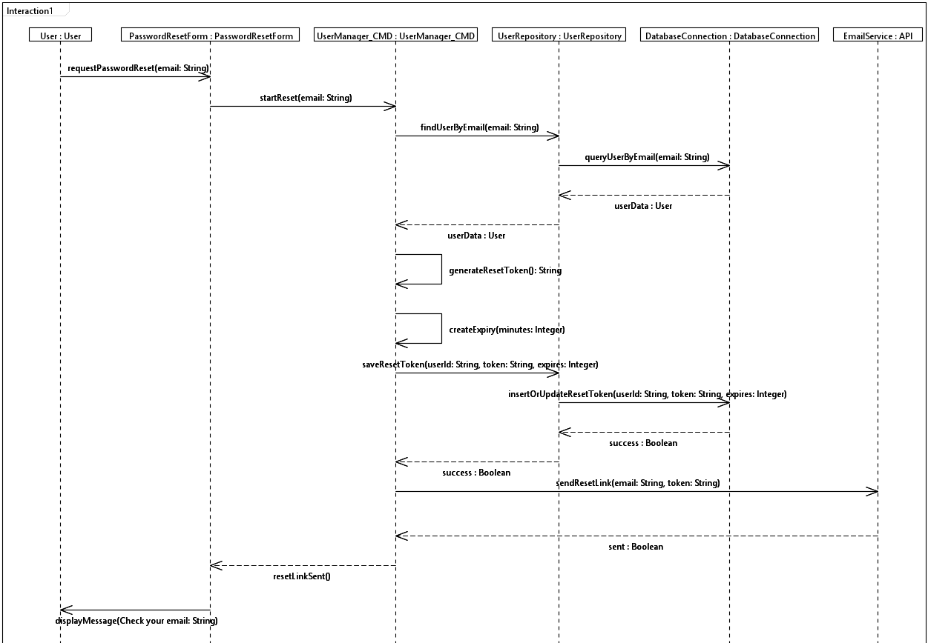
UC-003: Secure Password Reset (Security)

Slide 8
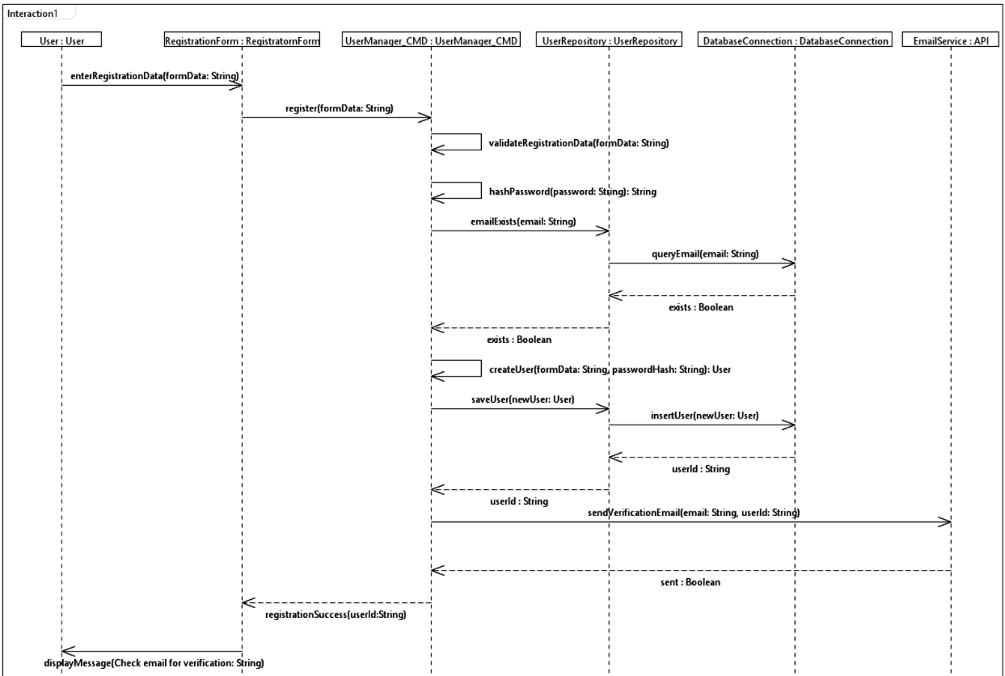
UC-004: User Registration

Slide 9
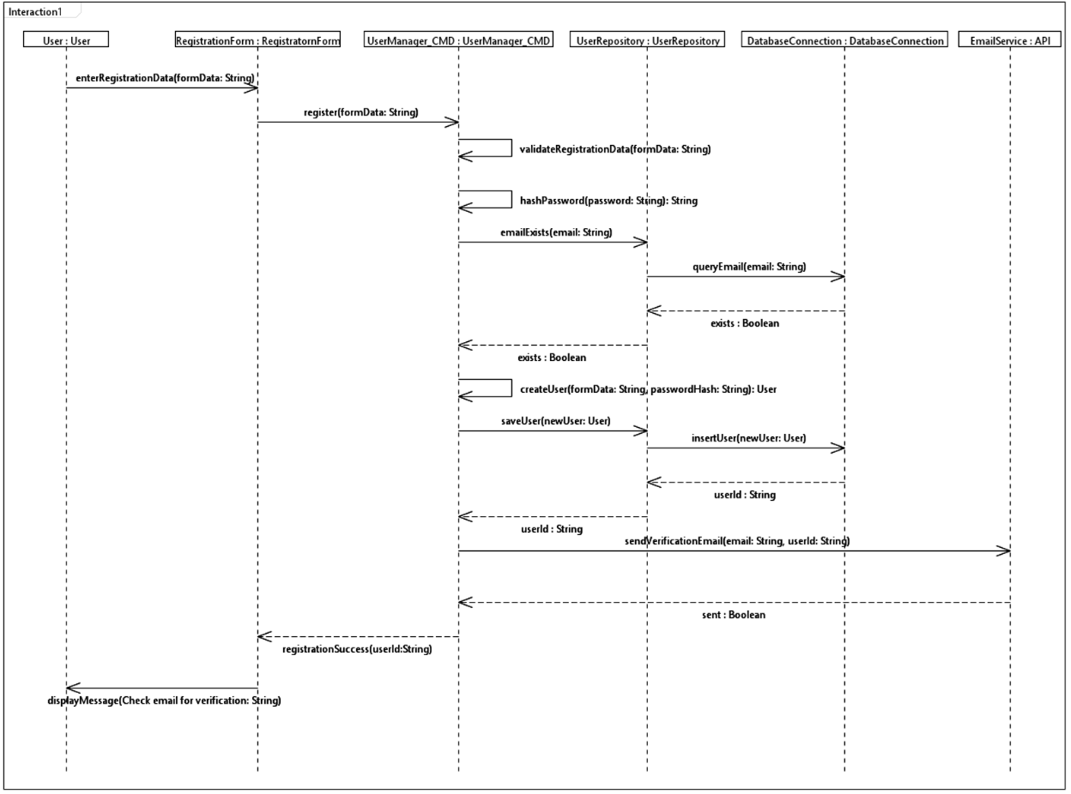
UC-005: User Login

Slide 10
UC-001: Browse Restaurant Menus
UC-001: Browse Restaurant Menus
Description: Customer searches for and views restaurant menus with items, descriptions, and prices.
Main Flow:
User enters restaurant name in search field
System displays matching restaurants
User selects a restaurant
System displays restaurant menu with items and prices
User can filter items by category
Functional Requirements:
FR-005: System allows users to search for restaurants by name
FR-006: System displays restaurant menus with items, descriptions, and prices
FR-007: System supports filtering menu items by category
FR-008: System handles cases where restaurants or menus are not found
Non-Functional Requirements:
NFR-001: System response time for menu browsing shall be less than 2 seconds
NFR-006: User interface shall be intuitive and easy to navigate
NFR-007: System shall provide clear error messages to users

Slide 11
UC-001: Browse Restaurant Menus (Continued)
Alternative Flows:
Restaurant not found: System displays appropriate message
Menu not available: System indicates menu is not available
Database error: System displays user-friendly error message
Preconditions:
User is on MenuMap application
System is accessible
Postconditions:
Menu is displayed (if found)
User can browse menu items
User can apply filters
Business Rules:
Only active restaurants are displayed
Menu items must have valid prices
Categories must be predefined

Slide 12
UC-003: Secure Password Reset
Description: User securely resets forgotten password through email verification process.
Main Flow:
User requests password reset
System validates user email
System generates secure reset token
System sends reset link to user email
User clicks reset link
System validates token
User enters new password
System validates and updates password
System invalidates reset token
Functional Requirements:
FR-012: System allows users to request password reset
FR-013: System validates user email before sending reset link
FR-014: System generates secure, time-limited reset tokens
FR-015: System validates reset tokens before allowing password change
Non-Functional Requirements:
NFR-003: User passwords shall be hashed and stored securely
NFR-004: System shall prevent SQL injection attacks
NFR-005: System shall validate and sanitize all user inputs
NFR-010: Reset tokens shall expire after 24 hours

