Slide 1
A Little Deep Into Deep Neural Networks
Suprotik Dey

Slide 2
Outline
A Brief Introduction to Machine Learning and Multi Layer Neural Networks.
Transition from ANNs to Deep Neural Networks
Deep Belief Networks, Convolutional and Recurrent Neural Networks.
A Generative Model
Introduction to Tensorflow – an easy ML library
What’s the future - DNC

Slide 3
Machine Learning
According to Arthur Samuel in 1959 :
“it gives computers the ability to learn without being explicitly programmed.“
Has two parts-
Training
Prediction
Learning Approaches –
Supervised – training using labeled data
Unsupervised – Discovering patterns in unlabeled data
Reinforced – Goal/Reward based training
Problems that can be solved-
Classification
Regression
Clustering

Slide 4
What is a Deep Neural Network?
A special class of Machine Learning.
Inspired by human nervous system.
“Deep learning allows computational models that are composed of multiple processing layers to learn representations of data with multiple levels of abstraction.”
Consists of an input layer, numerous hidden layers, and an output layer.
Layers act in hierarchy:
Lower layers understand simple things
The upper layers understand more complex, concrete things.
Each layer contains a finite number of neurons or nodes.
Input is fed as raw data through the input layer, which is propagated through the hidden layers successively and output is taken from the output layer.
The artificial neurons must be non linear.
For Deep Neural Networks to work, we need :
Huge datasets of labeled data.
Powerful GPUs for training.

Slide 5
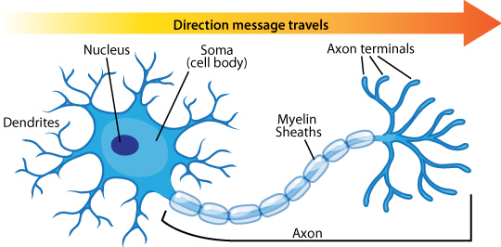
A Neuron

Slide 6
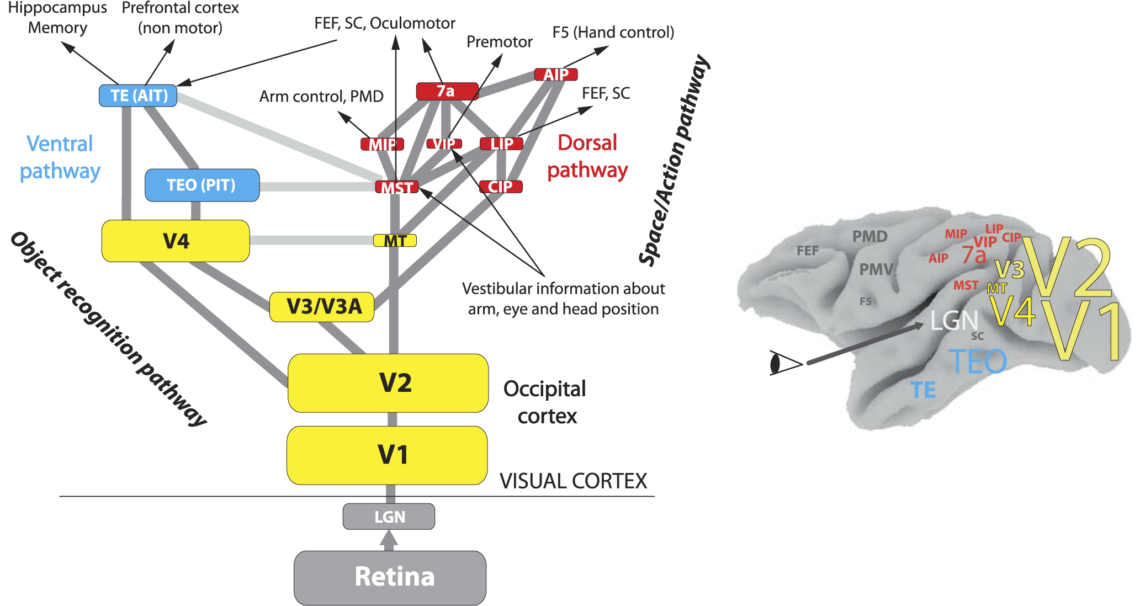
Image Recognition Hierarchy in Nervous System

Slide 7
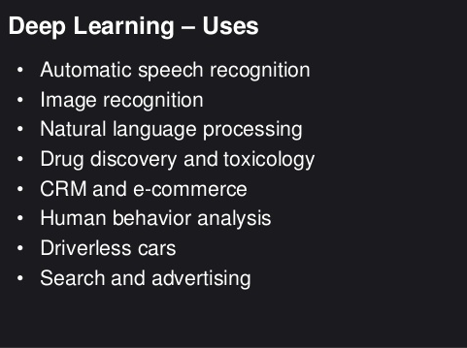

Slide 8
Multi Layer Neural Networks

Slide 9
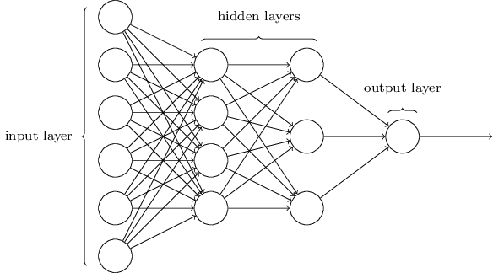
Visualizing a Multi Layer Neural Network

Slide 10
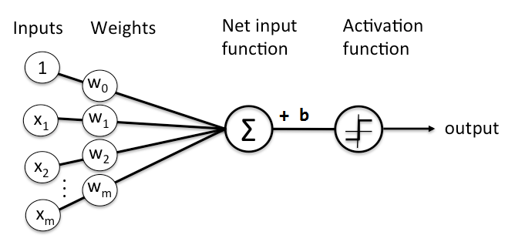
How does an artificial neuron work?
Each neuron takes input from the nodes of the previous layer and passes it through a classifier(for e.g. Logistic Regression) and then through an activation function.

Slide 11
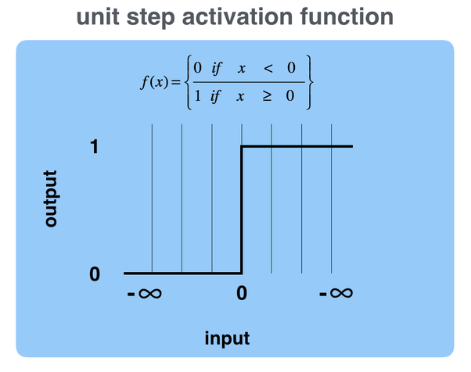
Activation Function
Linear Functions are somewhat limited, but computers are well optimized to do them.
Thus, a non linear function called Activation function is used which will trigger outputs based on inputs.
Easiest one is a step function.
Others are tanh, sigmoid, etc.

Slide 12
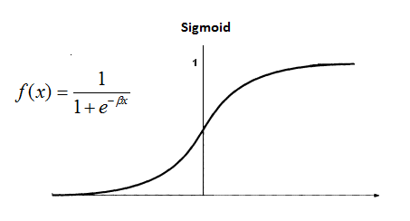
Sigmoid Function
Most commonly used activation function.
Real-valued and differentiable (for gradients)
It nearly mimics a neuron firing.

Slide 13
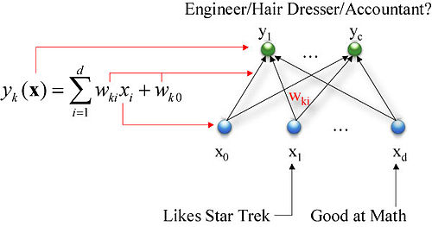

Slide 14
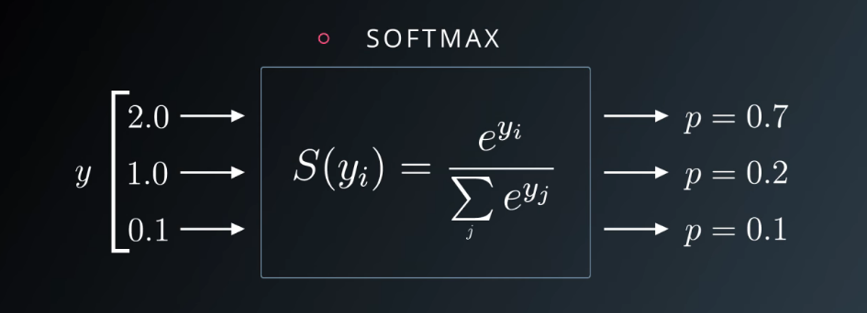
Softmax
At the end of the output layer, there is a Softmax function which converts all values to probabilities.

Slide 15
How to Learn?
The neural network contains a huge number of hyperparameters (weights, biases, etc.) which make up each individual neuron.
The model tries to find the exact hyperparameter values which will give the correct outputs.
The model finds them out by training the model with several instances of the same type of input with their known output.
It starts off with random values of weights and biases and varies them until it gets close to the desired output by calculating the loss function, and reduce it by using an optimizer.

Slide 16
Loss Function
To optimize the neural network, the error between the labels(L) and the outputs(S) from the neural network is to be found out.
A simple example is mean square error :
½ ∑(L-S)²
MSE faces trouble during backpropagation so,
a good example is cross entropy:
Loss(S, L) = ∑(L_{i} * log(S_{i} ))

Slide 17
Optimizer
Aim: Reduce the error found out from the loss function.
Solution: Find out the global minimum in the loss function.
Examples of optimizers are: Gradient Descent, SGD, Adam, etc.
Gradient Descent is the function which tell the direction in which the loss will be minimum in the loss function:
ϴ = ϴ - α(∂/ ∂ ϴ)Loss(S,L) where ϴ are parameters

Slide 18
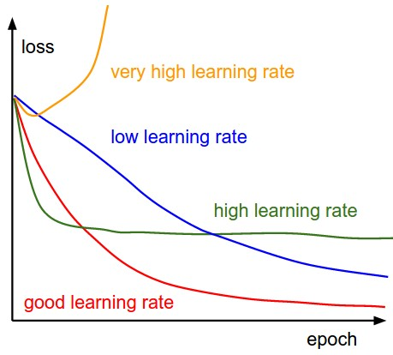
Learning Rate
Learning rate is the rate at which we will be doing the gradient descent in.
High rates can result into fast training with low rates of accuracy.
Low rates can result into slow training with higher rates of accuracy.

Slide 19
Back Propagation
On most machine learning libraries, the chain rule of differentiation is exploited to calculate the gradient descent by the optimizer.
(f(g(x))′ = f ′(g(x))*g′(x)
Gradient: W = W - α∇W
Thus, the individual components are fed to calculate the gradients much more efficiently by only knowing the derivatives of each individual function.
Thus, any necessity to compute complex derivatives is removed.

Slide 20
Lets See A Demo! http://playground.tensorflow.org

Slide 21
Previous Neural Network Models were Dumb
Multi layer neural networks are present for three decades now.
Universal approximation theorem, proved by Cybenko in 1989 states that a single hidden layer with non linear neurons can approximate any function.
Also, it was found that increasing layers did not improve efficiency, but made systems much more complex, mostly because of vanishing and/or exploding gradients, and early layers took long times to train.
This is because there was no proper algorithm to train multi layer networks.
Features had to be extracted at first then fed to the neural network to be trained.
Feature extraction was not learnt automatically – it was a tedious task using complex algorithms.

Slide 22
How did things change?
New algorithms solved problems of vanishing, exploding and unstable gradients.
Also unsupervised pre-training per layer was introduced.
Rectified Linear Units (ReLU) instead of sigmoid or tanh.
Use of cross entropy as cost function.
Availability of labelled datasets.
Fast GPUs were available to public.
Improved training algorithms and network architectures.
The Leaders in these are Lecun, Bengio, Geoffrey Hinton, Goodfellow.

Slide 23
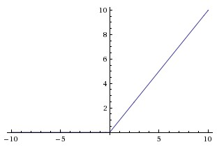
Rectified Linear Unit (ReLU)
In contrast to Sigmoid function, a ReLU removes variably decreasing gradient and gives a constant gradient thus removing vanishing gradient in activation functions. Also, it starts to fire from zero.
Still ReLU faces some issues, so a good alternative is a leaky ReLU.
F(x) = 0, for x < 0
F(x) = x, for x >= 0

Slide 24
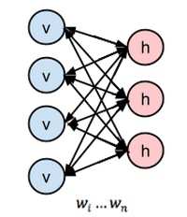


Restricted Boltzmann Machines
An undirected graphical model with a Visible Layer and a Hidden Layer.
No interlink in layers.
It has a forward pass and a backward pass.
The forward pass takes unlabeled data from the visible layer and gives output at the hidden layer.
The backward pass called reconstruction takes the output generated at the hidden layer back to regenerate the output.
The weights and biases are optimized by comparing the actual data and the data reconstructed using KL Divergence.
This gives the model enough unsupervised pre training from unlabeled data to understand the features of the dataset.
A successive training with labeled data will give a high accuracy.
Forward pass
Backward pass

Slide 25
Deep Belief Networks
Deep Belief Network is where several RBMs are stacked one on another.
Layers learn successively starting from bottom upto the top.
This solves the problems of backprop.

Slide 26
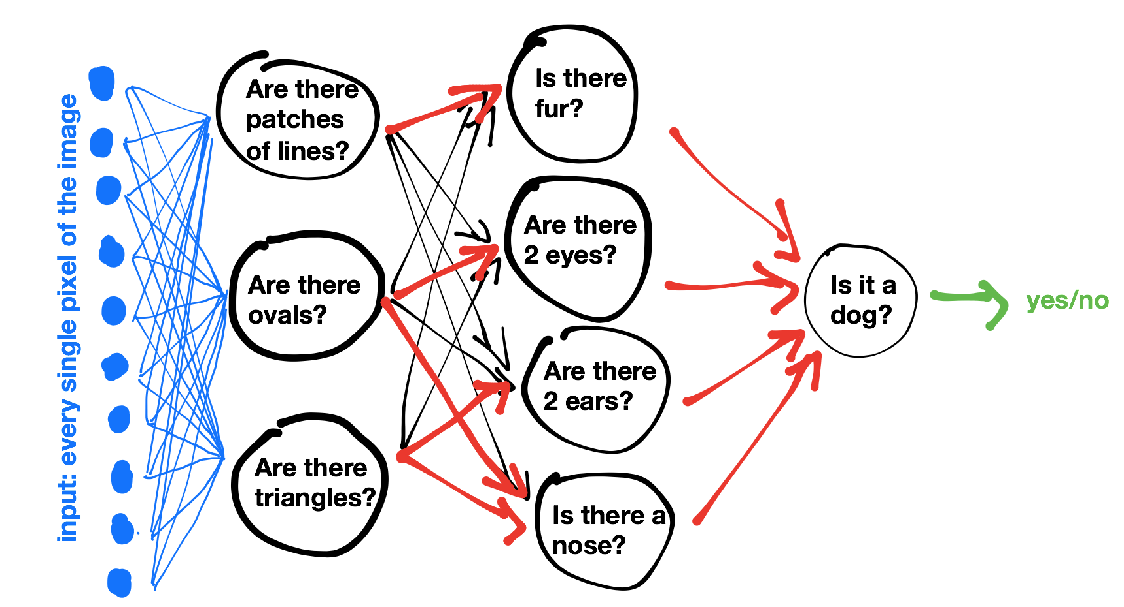
What Does a Deep Neural Network See?

Slide 27
Problems faced
Classifier stumbles when new data comes for test.
Solution: Rank classifier by dividing the training set into training, validation and test sets.
Simple gradient descent takes a huge time to compute for a large dataset.
Solution: Take small batches and compute the gradient descent. (Stochastic Gradient Descent)
Overfitting towards the train data.
Solution: Regularization – e.g. : L1, L2, Dropout, etc.
Images having a simple object at any position in it or a text having a phrase at any place requires huge training data.
Solution: Convolutional and Recurrent neural networks

Slide 28
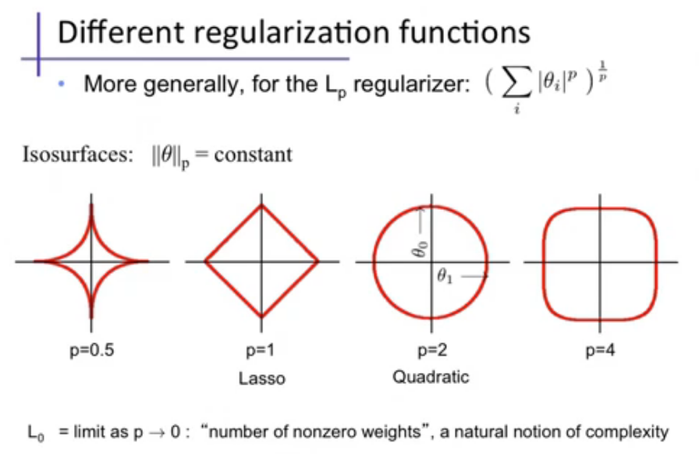

Slide 29
Dropout
A better regularization technique, which emerged recently, and has been very successful is dropout.
Dropout randomly drops out some of the nodes from the layers so that different redundant representations can be present to prevent overfitting.
Dropout also reduces training time.

Slide 30
Convolutional Neural Networks
A convolutional neural network runs a small patch through a feature set by striding few positions each time and creates a new feature map of different size and depth.
Typically, it:
Accepts a volume of size W1×H1×D1
Requires four hyperparameters:
Number of filters K,
their spatial extent F,
the stride S,
the amount of zero padding P.
Produces a volume of size W2×H2×D2 where:
W2=(W1−F+2P)/S+1
H2=(H1−F+2P)/S+1 (i.e. width and height are computed equally by symmetry)
D2=K
Problem: If the stride size is a bit large, huge amounts of data are lost.
Solution: Use pooling.

Slide 31
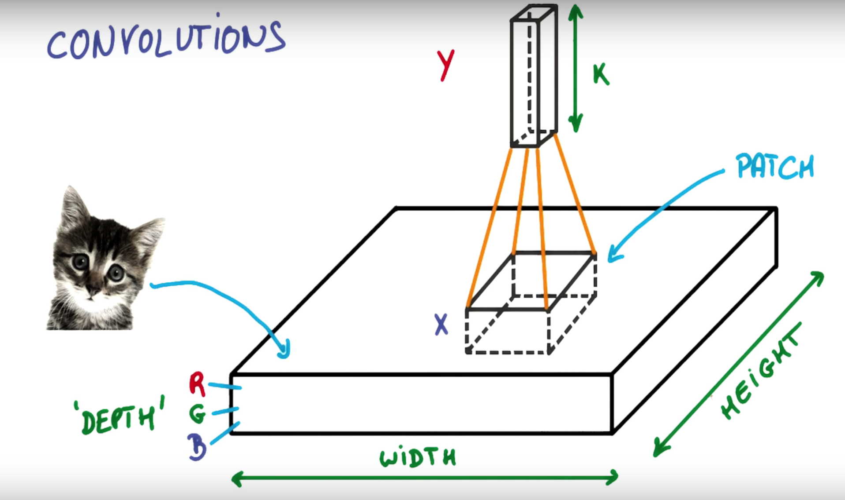

Slide 32
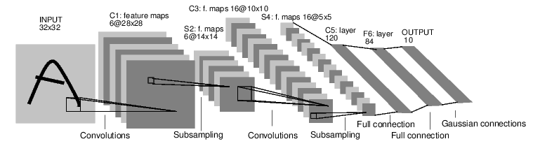
LENET 5 – Yan Lecun - 1998

Slide 33
An Example of CNN

Slide 34
1x1 Convolutions
Pooling
A variation of convolution where instead of doing a simple convolution, the filter operates on the neighborhood and gives output.
Example: Max and Average Pooling
A very inexpensive method to convert linear convolution into non linear one using a convolution of size one.

Slide 35
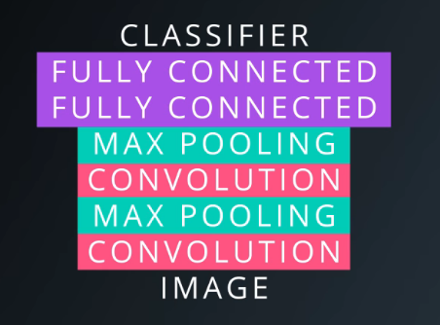
A Typical CNN

Slide 36
Problems faced
All of the previous models analyzed only a single frame of events. Non of them accounted for the history or the sequence of events which is very important for video, voice and text analysis. None of them had a memory cell.
Solution: Recurrent Neural networks and LSTM.
All the models are good at discrimination, they are not generative.
Solution: Generative Adversarial Neural Network

Slide 37
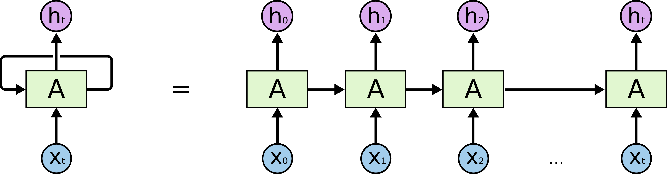
Recurrent Neural Networks
A recurrent neural network consists of a classifier and a recurrent component recursively over time. The recurrent component takes input the output of the previous classifier.
As a result the neural network now takes into account the history of previous outputs.
Inputs can be singular or sequential, as well as outputs can also be singular or sequential.

Slide 38
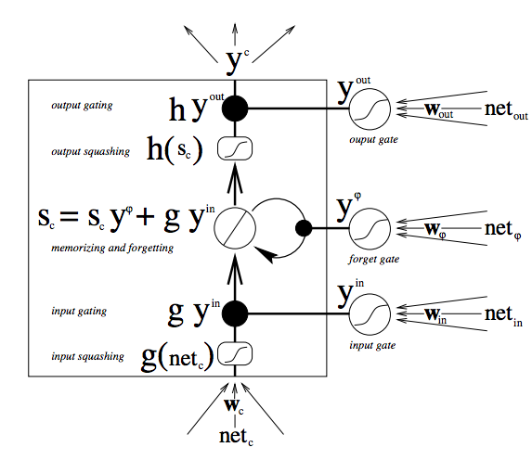
Long Short Term Memory
A LSTM contains read, write and forget heads controlled by a logistic classifier where each gate can be partially opened. Of course, it has input and output heads. The whole structure is also differentiable. This is used as the unit in an RNN.

Slide 39
Generative Adversarial Neural Network
It contains two separate models:
A Generative Model similar to a counterfeiter.
A Discriminative Model similar to a police.
The generative model generates new samples, and the discriminative model checks if it came from the former one or the training set.
With time, both improve and thus the generative model evolves.
The discriminative model was first trained with the training set together with their labels as a single input.

Slide 40
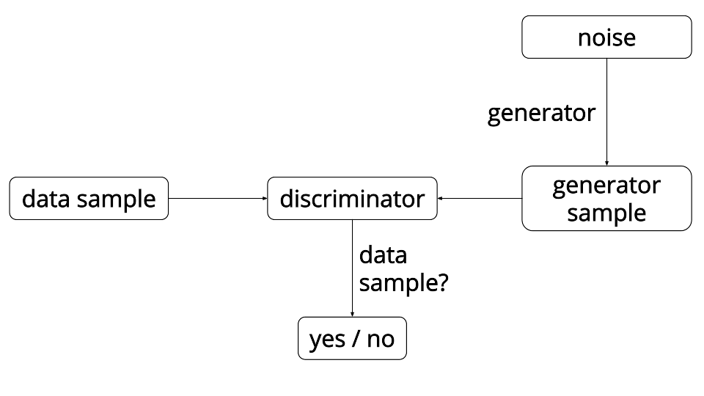
A GANN

Slide 41

Tensorflow – a ML library
TensorFlow is an open source software library for machine learning across a range of tasks, and developed by Google to meet their needs for systems capable of building and training neural networks to detect and decipher patterns and correlations, analogous to the learning and reasoning which humans use.
Pros:
Robust
Easy to use
Multi-GPU support
Cloud training available at low cost
Visualize the graph itself using TensorBoard.
Wrappers like Keras and TFLearn provide easy methods to learn ML.
Cons:
Proper documentation required
OpenCL support missing, thus not available on AMD GPUs.
Lack of examples
Proper RNN support missing

Slide 42
More Models To Train!
We may train a neural network model to perfectly do a single specific type of job, but it will fail when a new kind of job comes.
The solution to this was given by Google’s Deepmind as a:
Differentiable Neural Computer
https://deepmind.com/research/dnc/
The DNC depends on an external memory control to read/write data to it.

Slide 43
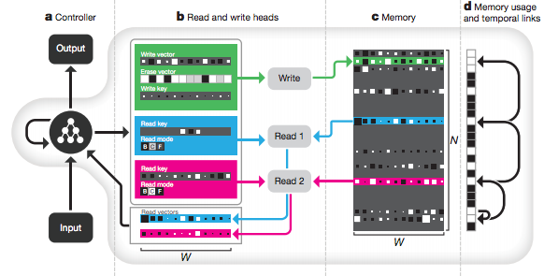
DNC Structure

Slide 44
References
MOOC on Deep Learning by Vincent Vanhoucke, Principal Scientist at Google Brain at Udacity
Deep Learning tutorials by Harrison Kinsley
Intro to Deep Learning by Siraj Raval
Google Images
Tensorflow
https://indico.io/blog/the-good-bad-ugly-of-tensorflow/

