Slide 1
Programming project FSSD
Gregor Best
Andre Mann

Slide 2
Features
Reading HFT from file
Support of multiple top-events in HFT
Graphical output
Batch system with pipelining

Slide 3
Languages, IDE and Tools
Languages:
Java
Kotlin (JVM-based Language)
Python (only for plotting with plotly)
IDE: IntelliJ Community Edition
Tools:
Graphviz (BDD/HFT Visualization)

Slide 4
Libraries
BDD: https://bitbucket.org/vahidi/jdd/wiki/Home
Matrices: http://commons.apache.org/proper/commons-math/
JSON parser: https://sites.google.com/site/gson/
CSV parser: http://super-csv.github.io/super-csv/
Graph: http://jgrapht.org/
Plotting: https://plot.ly/

Slide 5
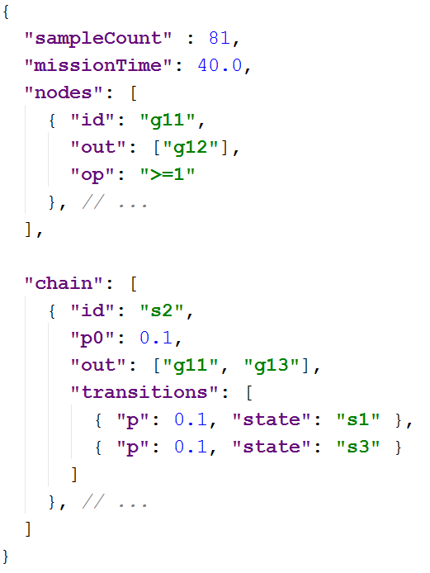
HFT-Format
JSON
Human readable ✓
Easy to parse ✓

Slide 6
HFT → (BDD, Markov)
HFT built right from JSON file
HFT
Connected components (variable order)
BDD construction
Markov chains
Error handling: Fail-Fast

Slide 7



Top-event evaluation
P(F)$=\left\{\begin{aligned}P(g_{2})+P(x)⋅\left(P(g_{1})−P(h_{2})\right) if x_{1} and x_{2} same Component \\ P(g_{2})+P(x)⋅\left(P(g_{1})−P(g_{2})\right) otherwise \end{aligned}\right.$
X_1
$$g_{2}$$
X_2
X_2
$${h_{2}|}_{x_{1}=1}$$
$${g_{1}|}_{x_{1}=1}$$
X_3
X_3
X_3
X_1, X_2 same component;
X_3 different component
0
1

Slide 8

Top-event evaluation
P(F)$=\left\{\begin{aligned}P(g_{2})+P(x)⋅\left(P(g_{1})−P(h_{2})\right) if x_{1} and x_{2} same Component \\ P(g_{2})+P(x)⋅\left(P(g_{1})−P(g_{2})\right) otherwise \end{aligned}\right.$
X_1
$$g_{2}$$
$$g_{1}$$
X_2
X_2
X_3
X_3
X_3
X_1, X_2 and X_3 different components
0
1

Slide 9
Markov chain
Per connected component one markov chain
Performance improvement (smaller matrices)
CTMC with uniformization:
Stop-Criteria: or

Slide 10
Testing
Excel file → CSV → Test data
Decoupled tests:
Uniformization
Evaluation

Slide 11
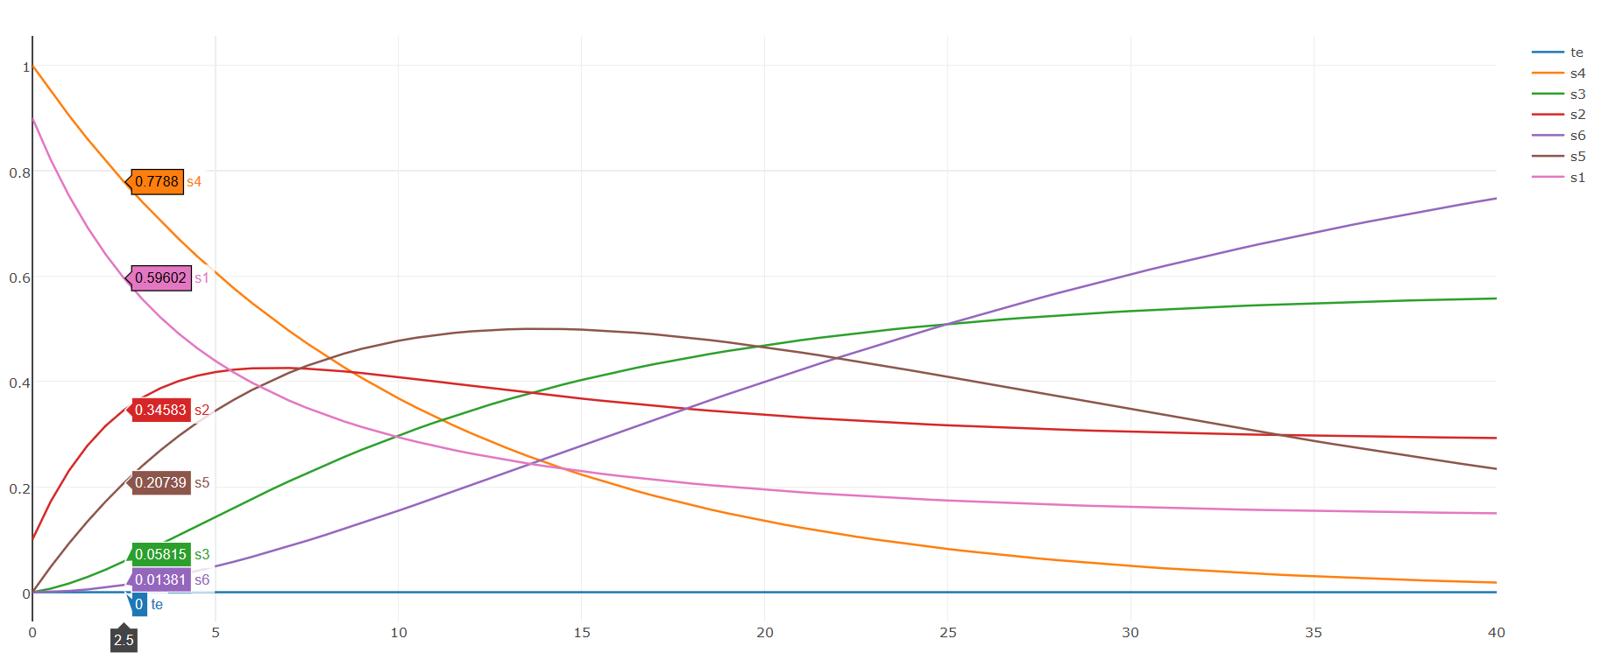
Visualization

Slide 12
Problems encountered
BDD library not easy to understand
Very cumbersome API, since everything is referenced by integers
Wrapper around constructed BDD
Calculation of distribution (uniformization)
171! does not fit into Double Precision Float
Stop-Criteria adapted correspondingly
Sequence API to build up formula for hole tree
But: Not suitable for computed-table (as Java Stream only „one-shot“)
Per node the sequence is collected to a list
Elegance of approach lost ☹
Solution could be a self-made Sequence-like API with caching of last element

Slide 13
Top-event evaluation
val current = node.probabilities.asSequence() val g2 = constructFormulaTopDown(node.lowChild) val g1_x1 = getHigh(node) if (node.isLowStateDependent) { val h2_x1 = getIndependentLow(node) return zip(g1_x1, g2, h2_x1, current) {g1, g2, h2, x -> g2 + x * (g1 - h2)} } else { return zip(g1_x1, g2, current) {g1, g2, x -> g2 + x * (g1 - g2)} }

Slide 14
Top-event evaluation
private fun constructFormulaTopDown (node: BDDNode?): Sequence<Float> { if (node == null || node.isZero) { return generateSequence(zeros) } else if (node.isOne) { return generateSequence(ones) } else if (computedTable.containsKey(node)) { return computedTable[node]!!.asSequence() } else { val result = formulaFromChildes(node).toList() computedTable.put(node, result) return result.asSequence() // Eleganz vom Ansatz weg... } }

