Slide 1
Tutorial 1 - Week 2
CME538
We’ll be starting at the 10 minute mark

Slide 2
Agenda
Tutorial Overview
Some Resources
Important Dates
Data Science Toolbox
Introduction to Python and File Formats
Anaconda and Jupyter Notebooks
PyCharm
JupyterHub
Questions?

Slide 3
Hello!
Katia Ossetchkina, Civil EIT
ekaterina.ossetchkina@mail.utoronto.ca
About me:
MASc Year 2, applying image processing to rock masses and geomaterials
3.5 years work experience at Procter & Gamble (P&G), 1 year at Suncor
Previous TA experience in Introductory Programming; private tutor in C, Java and Python programming
Excited to work with all of you this semester!

Slide 4
How do these tutorials work?
1st Hour: Tutorial
What is officially on Quercus
Cover content from lecture, preparation for assignments
Everything is recorded and made available
2nd Hour: Office Hours
Not happening this week!
In general, extra help time, also time for check-ins for course project later in the term

Slide 5
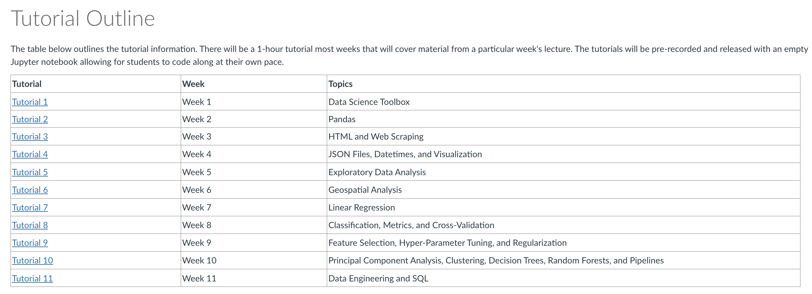
Tutorial Schedule for the Semester
With the exception of this week, you will have an empty notebook to follow along in future weeks with the tutorial!

Slide 6
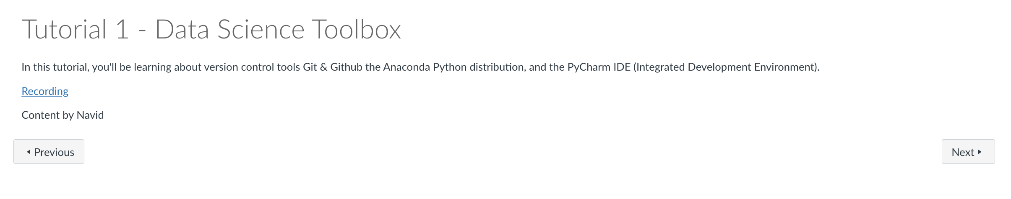
Tutorial Schedule for the Semester
With the exception of this week, you will have an empty notebook to follow along in future weeks with the tutorial!

Slide 7
Some Resources
APS106: Introduction to Computer Programming
Week 1: Intro, Variables
Week 2: Functions, Importing Modules
Week 3: Conditionals and Comparisons
Week 7: Lists, Indexing, Slicing
Each lecture includes lecture slides, a starter notebook and a completed notebook!
It’s always encouraged to re-use code samples!

Slide 8
Some Resources
W3 Schools
General knowledge about programming
Python overview
Pandas functions
SQL (but that’ll be later :) )
Kaggle MicroCourses
Pandas, Seaborn and Matplotlib Official Documentation
Stack Overflow
I recommend searching your error messages directly here – 99.99% of the time someone has encountered the same issues as you!
Copy and pasting code is ok!

Slide 9
Important Dates
Assignment #1: Pandas
Due next Friday September 22nd at 11:59 PM
The Big Project: Team Names
Share team names and members by Friday September 22nd at 11:59 PM
Use the Quercus pages “People” and ”Discussions” to help you out!

Slide 10
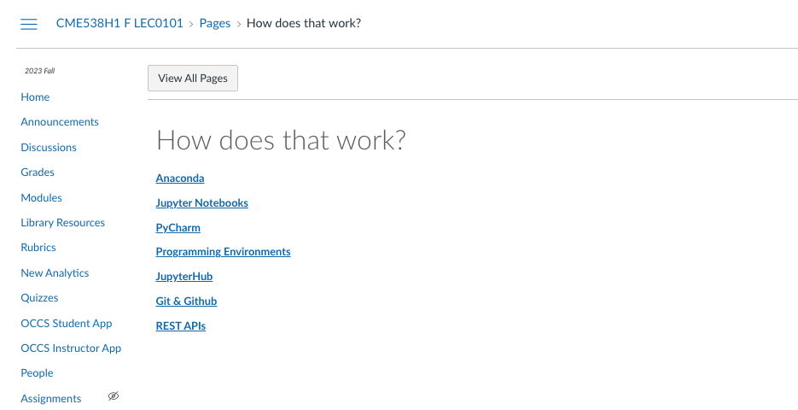
Coming soon: How does that work?
Will include the topics covered today! Short 10 minute videos, will be posted later this week, before Assignment 1 is due.

Slide 11
The Data Science Toolbox
CME538

Slide 12




IDE – Integrated Development Environment
A software application that helps you develop code efficiently
For a plain Python executable file, you could use a text editor (such as notepad), but an IDE will include highlighting rules for the language syntax, can help you debug errors, and help refactor/complete your code.
Some IDEs we know:

Slide 13

Anaconda
Anaconda is a Python distribution (not an IDE)
Has a collection of IDEs, environment manager and additional Python learning resources you can use.
Takes care of everything you need, including installing a base Python version for you, managing your installs, and much more.

Slide 14
Notebooks? Python?
Jupyter Notebooks (.ipynb):
Consists of multiple cells
A cell can contain regular Python code or plain text (markdown)
Very good for visually explaining what is happening in your code, plots
You can also run samples of code at a time
Lecture code and assignments are in this format in this course
Python File (.py):
Executable file. You can even run these on your machine without installing any IDE’s!
Run in a linear format, from start to file.
Good for computation, or batching tasks, like a data engineering pipeline!
No intermittent output saved, no formatted text/figures like in a notebook.

Slide 15
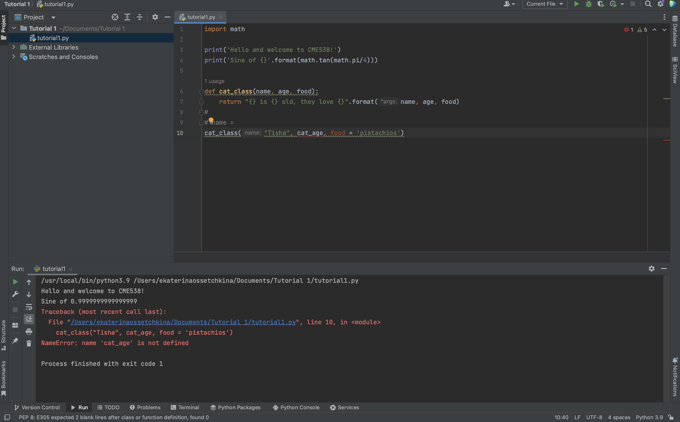
The Anatomy of a Python File (.py) in
File explorer
Your code!
Console (run results)
Python version (or virtual environment*)

Slide 16
PyCharm
Community edition – is free, but will give you read-only to notebooks (.ipynb)!
Can get Professional PyCharm with UofT email – need to get form approved (or a 30 day trial without this)

Slide 17
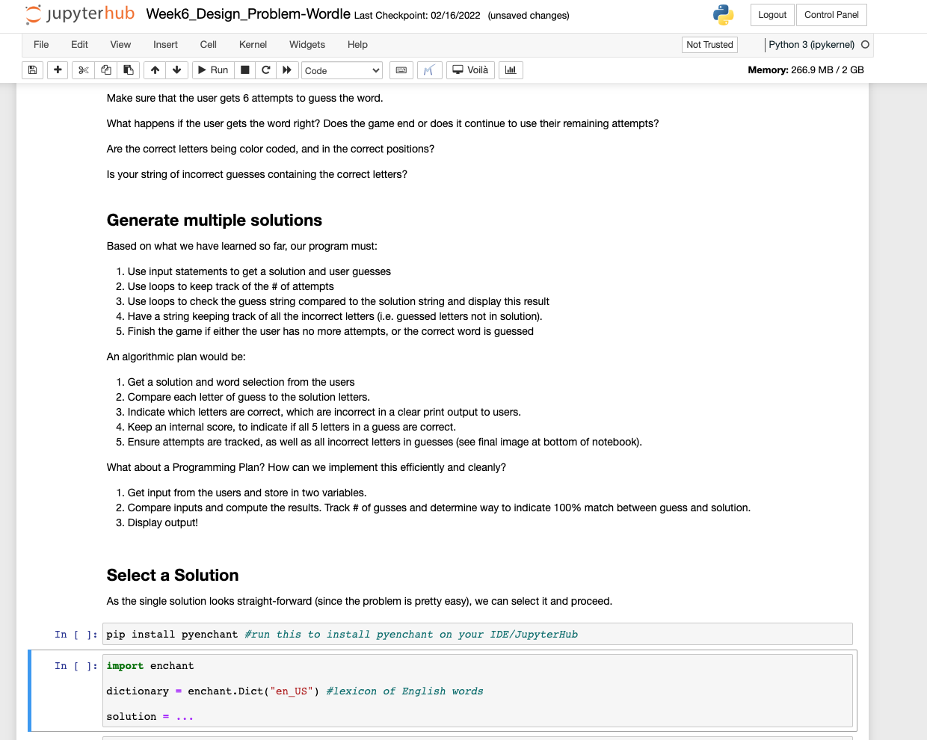
The Anatomy of a Jupyter Notebook (.ipynb)
Cell controls (run, restart, format, copy/paste…)
Kernel information (Python version + memory)
Markdown (.md) Text Cells
Python Code!

Slide 18
JupyterHub
Cloud version to run your code online, available for UofT students!
Link: jupyter.utoronto.ca
Works the exact same way Jupyter/Anaconda would work locally on your machine, but stored in the cloud.
Great way to run your work, especially for big computing tasks if your computer doesn’t have a lot of memory/cores.

Slide 19
Demo.
CME538

Slide 20
Questions?
CME538

