Slide 1
Year 9 Math Investigation
Computational Algorithms for Modeling Population Growth
André

Slide 2
1.1 document used modules
Tabulate for printing the projections in a clean table
Termcolor for coloured text in the terminal
Maplotlib for graph
Datetime for timestamps on graph file names
Mpl_toolkits for inset zoom on graphs
Os is just for making graph folder if it doesn’t exist

Slide 3
1.2 Reusable means of converting time periods
def time_conversion(unit, amount):
'''
Converts a time quantity from a unit to seconds.
It takes the unit and the number of those units as arguments and returns the equivalent number of seconds.
'''
seconds_per_unit = {
"year": 31536000,
"quarter-year": 7884000,
"month": 2592000,
"week": 604800,
"day": 86400,
"half-day": 43200,
"quarter-day": 21600,
"hour": 3600,
"minute": 60,
"second": 1
}
return seconds_per_unit[unit] * amount

Slide 4
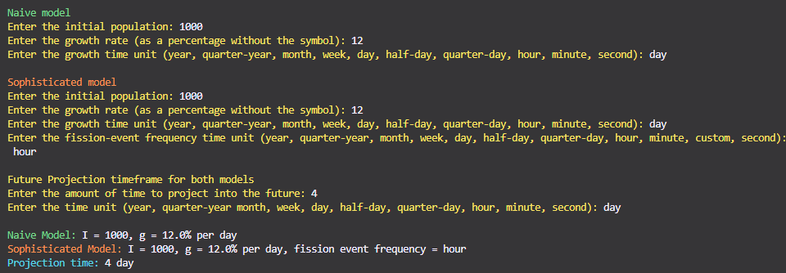
2.1 Prompts and summary of input

Slide 5
Time Conversion Design
Used a dictionary in Python to convert any time unit into seconds. This allowed all models to work consistently regardless of input.
def time_conversion(unit, amount):
'''
Converts a time quantity from a unit to seconds.
It takes the unit and the number of those units as arguments and returns the equivalent number of seconds.
'''
seconds_per_unit = {
"year": 31536000,
"quarter-year": 7884000,
"month": 2592000,
"week": 604800,
"day": 86400,
"half-day": 43200,
"quarter-day": 21600,
"hour": 3600,
"minute": 60,
"second": 1
}
return seconds_per_unit[unit] * amount

Slide 6
Module 1: Naive vs Sophisticated
Naive model uses simple growth: Final = I + (I × g × t)
Sophisticated model uses compound growth: Final = I × (1 + r)^n, adjusted by fission frequency.
Insanely simplified version of the code:
naive = I * (1 + (g / 100) * t) sophisticated = I * (1 + r_per_fission) ** fissions

Slide 7
Module 2: Time to Reach Target
Runs a loop adding growth until the population reaches the target. Records every population step.
while population < target:
added = population * rate_per_fission
population += added
populations.append(round(population, 2))
time_elapsed += fission_unit_seconds

Slide 8
Module 3: Compare Two Models
Takes input for two sophisticated models, runs both with the same timeframe, and prints both final values. Useful for analysing frequency differences.

Slide 9
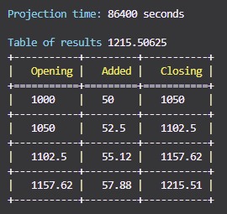
Module 4: Projection Table
Each step is logged into a table showing opening population, amount added, and new total. Printed with the module tabulate for clean formatting.
rows.append([round(population, 2), round(added, 2), round(new_pop, 2)])

Slide 10
Module 5: Fission Frequency Simulation
This module models how population growth changes when the frequency of fission events increases.
The initial population is 1000 and the growth rate is 100% per day.
Fission intervals range from every 6 hours down to every second.
For each interval, the population is updated at that frequency for 1 day.
A compound growth calculation is used at each fission step.
All results are stored and graphed using the module Matplotlib
Graphs show clear trends.
For minute and second intervals, a zoomed-in inset shows how small the individual steps become.
The final population approaches a fixed limit due to continuous compounding.
The only reason theres so many lines in this is because of the graph making

Slide 11
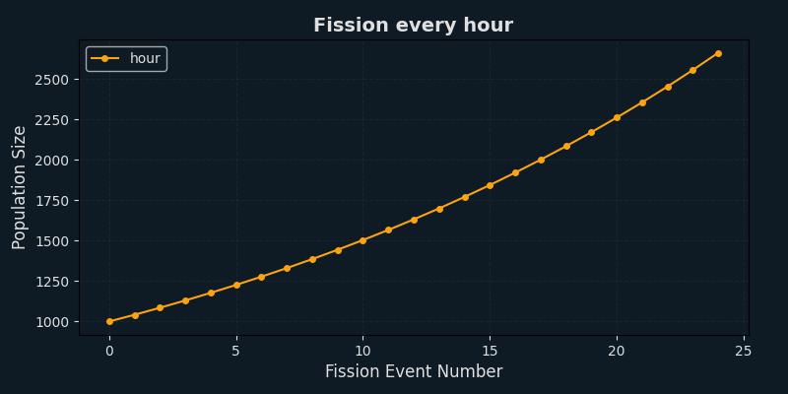
Graph: Hourly Fission

Slide 12
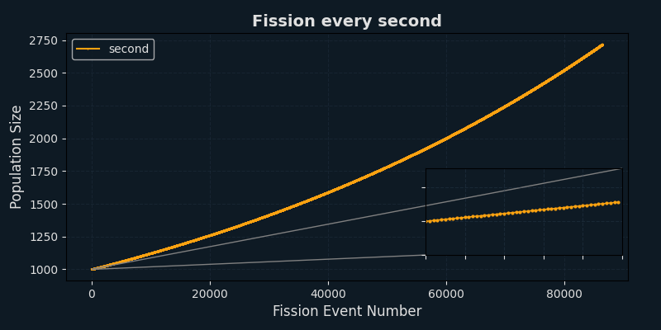
Graph: Second Fission
Growth step dots are almost invisible without inset zoom in lower right.

Slide 13
Population Growth Limit
As frequency increases, population size approaches a fixed limit, not infinity. This matches continuous growth using Euler's number ≈ 2.718.

Slide 14
Code Design & Flow
The code is modular, clean, and menu-driven. Functions are reused between modules to avoid repetition. Input is always validated.

Slide 15
Git Workflow & Submission
Used Git to save after each working change. Final commit includes all graphs, code, README (for Github), and .gitignore. Also uploaded to Github for personal saving and backup.

