Slide 1
Year 9 Math Investigation
Computational Algorithms for Modeling Population Growth
André

Slide 2
Ignore the fact that the code is 600 lines, that only happened because I decided to make my code PEP 8 compliant. PEP 8 is the formatting guidelines that python developers usually use. It gives the code easier readability for the user.

Slide 3
Time Conversion Design
Used a dictionary in Python to convert any time unit into seconds. This allowed all models to work consistently regardless of input.
def time_conversion(unit, amount):
'''
Converts a time quantity from a unit to seconds.
It takes the unit and the number of those units as arguments and returns the equivalent number of seconds.
'''
seconds_per_unit = {
"year": 31536000,
"quarter-year": 7884000,
"month": 2592000,
"week": 604800,
"day": 86400,
"half-day": 43200,
"quarter-day": 21600,
"hour": 3600,
"minute": 60,
"second": 1
}
return seconds_per_unit[unit] * amount

Slide 4
Module 1: Naive vs Sophisticated
Naive model uses simple growth: Final = I + (I × g × t)
Sophisticated model uses compound growth: Final = I × (1 + r)^n, adjusted by fission frequency.
Insanely simplified version of the code:
naive = I * (1 + (g / 100) * t) sophisticated = I * (1 + r_per_fission) ** fissions

Slide 5
Module 2: Time to Reach Target
Runs a loop adding growth until the population reaches the target. Records every population step.
while population < target:
added = population * rate_per_fission
population += added
populations.append(round(population, 2))
time_elapsed += fission_unit_seconds

Slide 6
Module 3: Compare Two Models
Takes input for two sophisticated models, runs both with the same timeframe, and prints both final values. Useful for analysing frequency differences.

Slide 7
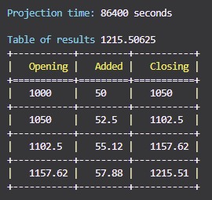
Module 4: Projection Table
Each step is logged into a table showing opening population, amount added, and new total. Printed with the module tabulate for clean formatting.
rows.append([round(population, 2), round(added, 2), round(new_pop, 2)])

Slide 8
Module 5: Fission Frequency Simulation
This module models how population growth changes when the frequency of fission events increases.
The initial population is 1000 and the growth rate is 100% per day.
Fission intervals range from every 6 hours down to every second.
For each interval, the population is updated at that frequency for 1 day.
A compound growth calculation is used at each fission step.
All results are stored and graphed using the module Matplotlib
Graphs show clear trends.
For minute and second intervals, a zoomed-in inset shows how small the individual steps become.
The final population approaches a fixed limit due to continuous compounding.
The only reason theres so many lines in this is because of the graph making

Slide 9
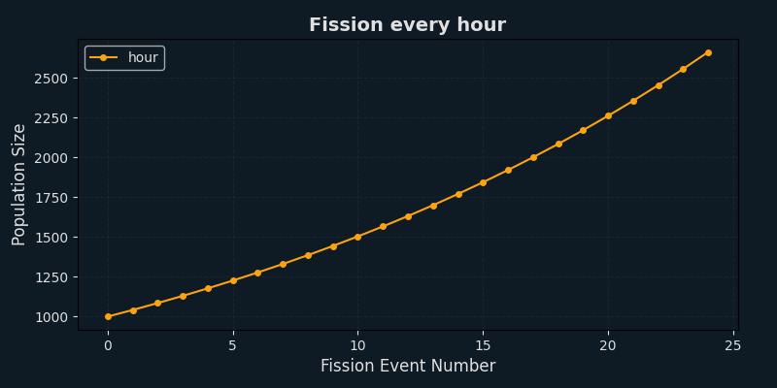
Graph: Hourly Fission

Slide 10
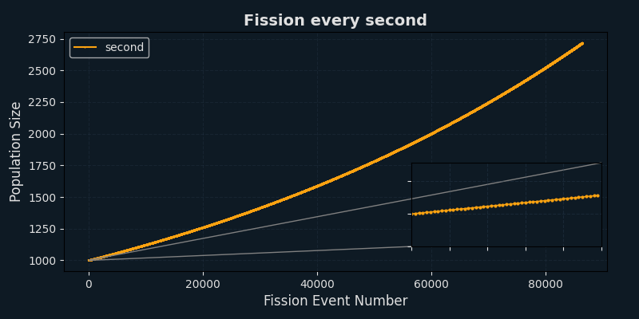
Graph: Second Fission
Growth step dots are almost invisible without inset zoom in lower right.

Slide 11
Population Growth Limit
As frequency increases, population size approaches a fixed limit, not infinity. This matches continuous growth using Euler's number ≈ 2.718.

Slide 12
Code Design & Flow
The code is modular, clean, and menu-driven. Functions are reused between modules to avoid repetition. Input is always validated.

Slide 13
Git Workflow & Submission
Used Git to save after each working change. Final commit includes all graphs, code, README (for Github), and .gitignore. Also uploaded to Github for personal saving and backup.

Slide 14
All modules used
Tabulate for printing the projections in a clean table
Termcolor for coloured text in the terminal
Maplotlib for graph
Datetime for timestamps on graph file names
Mpl_toolkits for inset zoom on graphs
Os is just for making graph folder if it doesn’t exist

