Slide 1
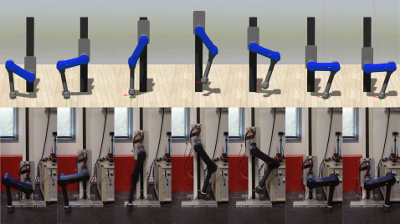


Optimal Design of Agile Jumping Maneuvers for a Single Leg System
Andrea Patrizi, Francesco Ruscelli, Arturo Laurenzi and Nikos G. Tsagarakis Humanoids and Human Centered Mechatronics (HHCM), Italian Institute of Technology (IIT), Italy
Development of
Two-stage pipeline for jump planning, Trajectory Optimization (TO) - based
embedding
Accurate calibrated actuation model
Energy regeneration model
Optimizing for
Take-off trajectory (max. jump height)
Landing + braking (mitigate impact, max
reg. energy)

