Slide 1
Mite
Lovers
TEAM A
LABPROJ - SWitCH

Slide 2


SUMMARY
1
Sprint review 3: Goals
2
Planning:
3
Overview:
4
Implementation: Factories and Mock testes
5
Results
6
Achievements

Slide 3



SPRINT GOALS
OBJETIVO 1
OBJETIVO 2
OBJETIVO 3
OBJETIVO 4

Slide 4
SPRINT GOALS
OBJETIVO 1
OBJETIVO 2
OBJETIVO 3
OBJETIVO 4

Slide 5
SPRINT GOALS
OBJETIVO 1
OBJETIVO 2
OBJETIVO 3
OBJETIVO 4

Slide 6
SPRINT GOALS
OBJETIVO 1
OBJETIVO 2
OBJETIVO 3
OBEJTIVO 4

Slide 7


PLANNING
28 User Stories
✓
SPRINT 2
Implementation
100% US implemented
Tests coverage >95%
DTOs

Slide 8
PLANNING
28 User Stories
✓
SPRINT 2
Implementation
100% US implemented
Tests coverage >95%
DTOs
SPRINT 3
Factories
Mock Tests

Slide 9
PLANNING
Factories
Mock Tests
Quantidade total de factories a serem criadas
O membro responsável pela US seria responsável por criar sua FACTORY

Slide 10

PROCESS STANDARDIZATION
Issues management
REFINEMENT
FACTORIES
MOCK TESTS
Main: Refinement - [Domain Class] - [Brief Description of Change]
Sub-issue: US# - Analysis & Design
Sub-issue: US# - Implementation and Unit Tests
Acceptance Criteria:
        Architecture & Responsibilities
        Documentation & Diagrams
        Quality & Validation
Main: Creation of [Name]Factory Class
Sub-issue: Refactor SD & CD diagrams to include Factory in the design
Sub-issue: Implement Factory Class methods & tests
Acceptance Criteria:
        Diagrams are reviewed and approved by the team
        Factory methods were implemented following OOD best practices
Main: Mock implementation related to US#
Sub-issue: Implement mocking to domain class tests
Sub-issue: Implement mocking to repository class tests
Sub-issue: Implement mocking to controller class tests.
Acceptance Criteria:
        Mocks simulate realistic success, validation errors, and system failures.

Slide 11
PROCESS STANDARDIZATION
Issues management
REFINEMENT
FACTORIES
MOCK TESTS
Main: Refinement - [Domain Class] - [Brief Description of Change]
Sub-issue: US# - Analysis & Design
Sub-issue: US# - Implementation and Unit Tests
Acceptance Criteria:
        Architecture & Responsibilities
        Documentation & Diagrams
        Quality & Validation
Main: Creation of [Name]Factory Class
Sub-issue: Refactor SD & CD diagrams to include Factory in the design
Sub-issue: Implement Factory Class methods & tests
Acceptance Criteria:
        Diagrams are reviewed and approved by the team
        Factory methods were implemented following OOD best practices
Main: Mock implementation related to US#
Sub-issue: Implement mocking to domain class tests
Sub-issue: Implement mocking to repository class tests
Sub-issue: Implement mocking to controller class tests.
Acceptance Criteria:
        Mocks simulate realistic success, validation errors, and system failures.

Slide 12
PROCESS STANDARDIZATION
Issues management
REFINEMENT
FACTORIES
MOCK TESTS
Main: Refinement - [Domain Class] - [Brief Description of Change]
Sub-issue: US# - Analysis & Design
Sub-issue: US# - Implementation and Unit Tests
Acceptance Criteria:
        Architecture & Responsibilities
        Documentation & Diagrams
        Quality & Validation
Main: Creation of [Name]Factory Class
Sub-issue: Refactor SD & CD diagrams to include Factory in the design
Sub-issue: Implement Factory Class methods & tests
Acceptance Criteria:
        Diagrams are reviewed and approved by the team
        Factory methods were implemented following OOD best practices
Main: Mock implementation related to US#
Sub-issue: Implement mocking to domain class tests
Sub-issue: Implement mocking to repository class tests
Sub-issue: Implement mocking to controller class tests.
Acceptance Criteria:
        Mocks simulate realistic success, validation errors, and system failures.

Slide 13
PROCESS STANDARDIZATION
Naming Classes
Factories
Mock Tests
Name Standard:
EXEMPLO com imagem
Acceptance Criteria:
        Protected no constructor da classe de dominio
Name Standard:
EXEMPLO com imagem
Acceptance Criteria:
        Todos os métodos deverão ser implementados mocks

Slide 14
PROCESS STANDARDIZATION
Title

Slide 15
PROCESS STANDARDIZATION
Commits

Slide 16

QUALITY CONTROL
Step one
Step two
Distribute the US in groups of two, regarding:
Sequence Diagram
Class Diagram
User Case
Goals:
        Analyze and manage the US
        Confirm the classes for future development
        Standardization of the Diagrams
New distribution of the US for implementation:
Each member will implement a US that had already been assigned to them
Each member will also implement a US from another Actor
Goals:
Reassure the global understanding of the project by all members
Implement the US

Slide 17
QUALITY CONTROL
Step one
Step two
Distribute the US in groups of two, regarding:
Sequence Diagram
Class Diagram
User Case
Goals:
        Analyze and manage the US
        Confirm the classes for future development
        Standardization of the Diagrams
New distribution of the US for implementation:
Each member will implement a US that had already been assigned to them
Each member will also implement a US from another Actor
Goals:
Reassure the global understanding of the project by all members
Implement the US

Slide 18

QUALITY CONTROL
Step one
Step two
Distribute the US in groups of two, regarding:
Sequence Diagram
Class Diagram
User Case
Goals:
        Analyze and manage the US
        Confirm the classes for future development
        Standardization of the Diagrams
New distribution of the US for implementation:
Each member will implement a US that had already been assigned to them
Each member will also implement a US from another Actor
Goals:
Reassure the global understanding of the project by all members
Implement the US

Slide 19

IMPLEMENTATION
Factory Class

Slide 20
IMPLEMENTATION
Mock Tests

Slide 21


ACHIEVEMENTS
✓
Successfully created all sequence and class diagrams for every User Story;
✓
Refined and restructured the Domain Model, achieving a clearer and more complete architecture;
✓
Implemented approximately 80% of the defined user stories;
✓
Improved time management skills throughout the second sprint;
✓
Acquired more knowledge regarding good programming practices, project organization, and teamwork;
✓
Established clear deadlines for user story implementation, enabling better prioritization and workflow management.

Slide 22
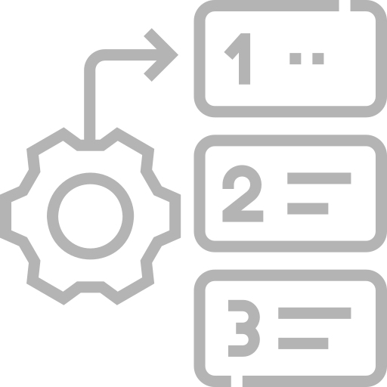

WHAT’S NEXT?
Finish the implementation of the remaining user stories
Strengthen communication during implementation phases
Maintain consistent coding and diagram standards across the team
Increase cross-review of code and tests among team members

Slide 23



