Slide 1
Sit718 – REAL WORLD ANALYTICS: ASSESSMENT2
Andre Rampono
s224906702

Slide 2
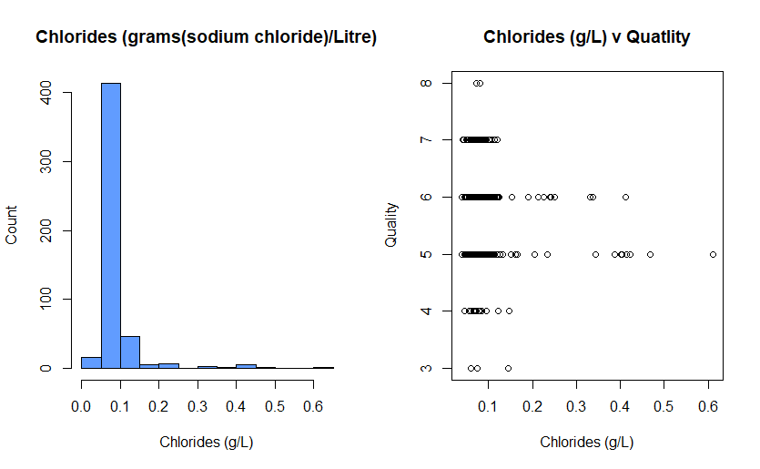
chlorides

Slide 3
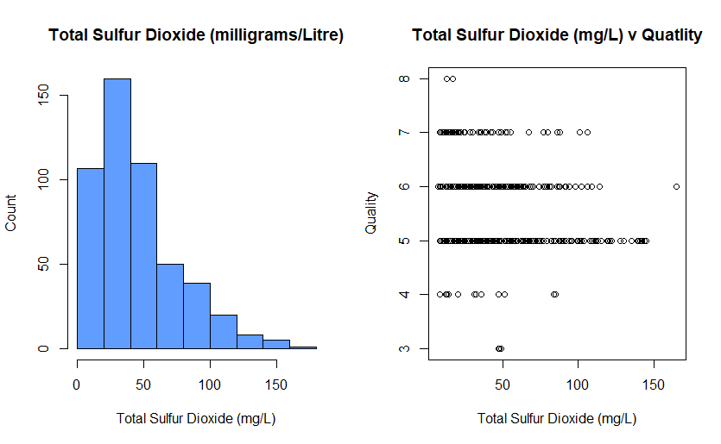
Total sulfur dioxide

Slide 4
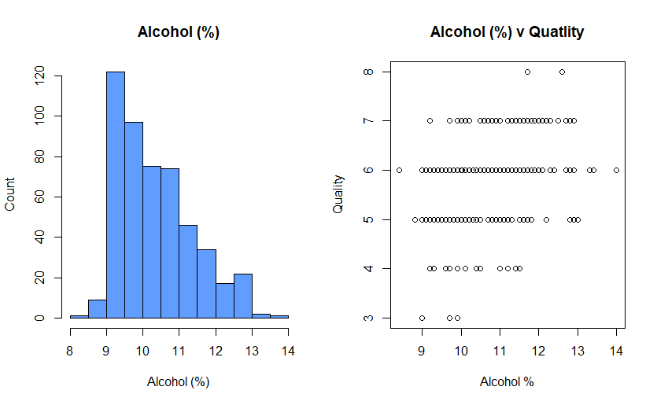
alcohol

Slide 5
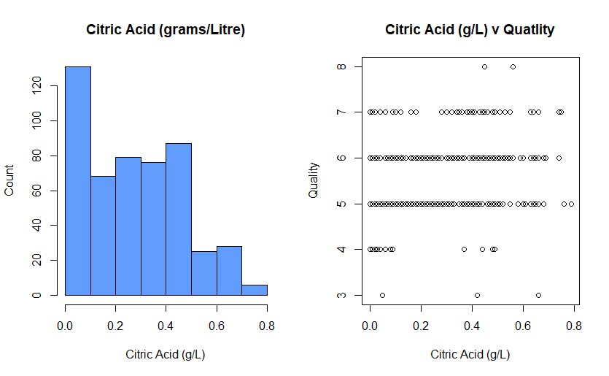
Citric acid

Slide 6
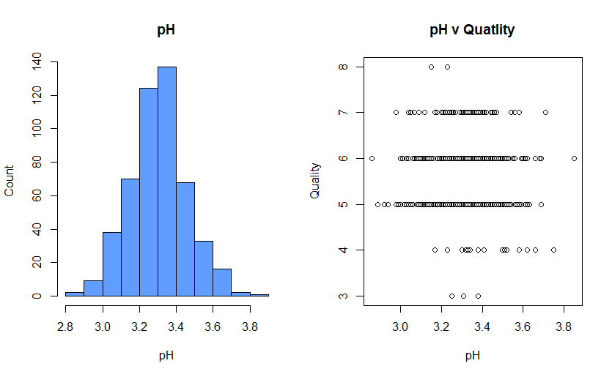
Ph Levels

Slide 7
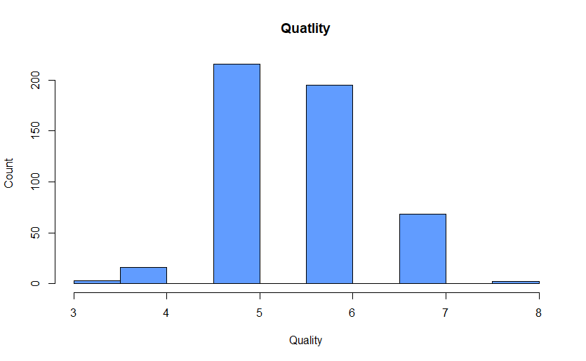
Quality

Slide 8
Central Tendency, Correlation and K-S Test Results (ascending p-value)

Slide 9
Data transformation

Slide 10
MEARSURES OF ACCURACY AND FIT

Slide 11
MODEL PREDICTION

Slide 12
conclusion
Limitation of the model (inputs used and the quality value ).
Cortez el al in 2009 relied on 11 attributes – I used four.
The quality variable: determined sensory assessors grading on a range from 0 to 10 – bad to excellent.

