Slide 1
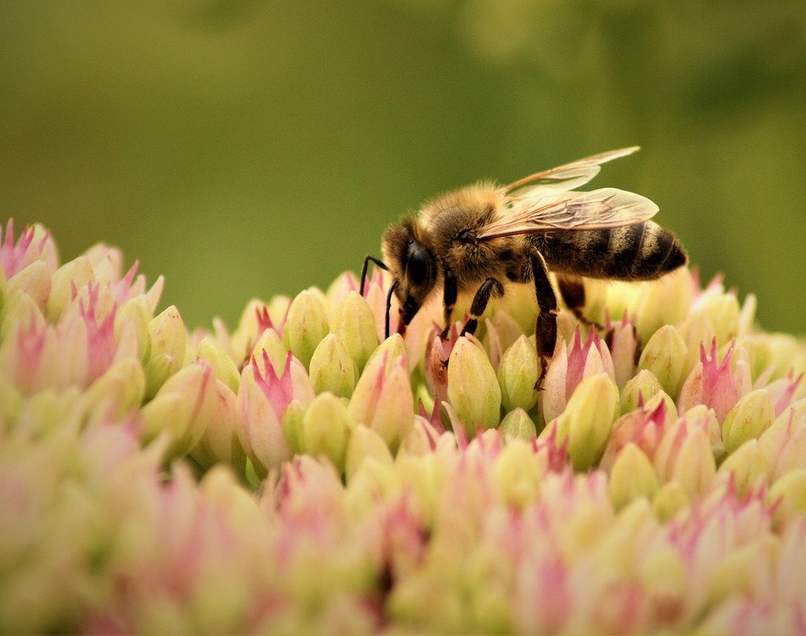
Assessing Biodiversity in Natural Areas
Insights into Conservation and Species Distribution
André Ribeiro
Codecademy
Biodiversity Portfolio Project
Data Scientist: Machine Learning: Carreer Path

Slide 2
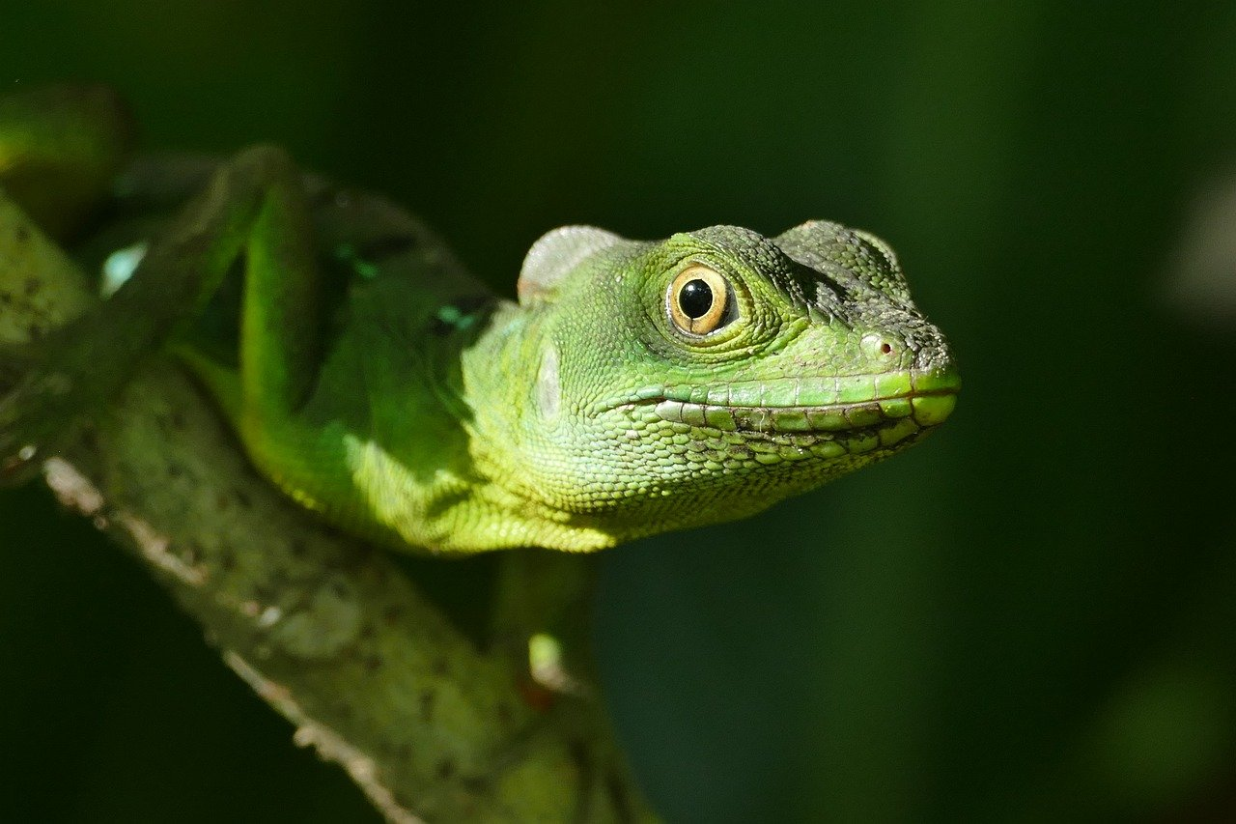
Abstract & Objectives
Biodiversity supports ecosystem stability and human health
Goal: Examine species diversity and protection levels through park data
Tools: Python, Pandas, Matplotlib, Seaborn
Note: Since there is no oral presentation, reader should use the project notebook.

Slide 3
Dataset Overview
species_info.csv: 5,000+ species, categories, conservation status;
observations.csv: 100,000+ species sightings across parks;
Data from Codecademy, focused on U.S. national parks (7 days);

Slide 4

Methodology
Exploratory Data Analysis (EDA)
Visualization of species richness, protection status, and park representation
Statistical tests for significance (Chi-square)

Slide 5
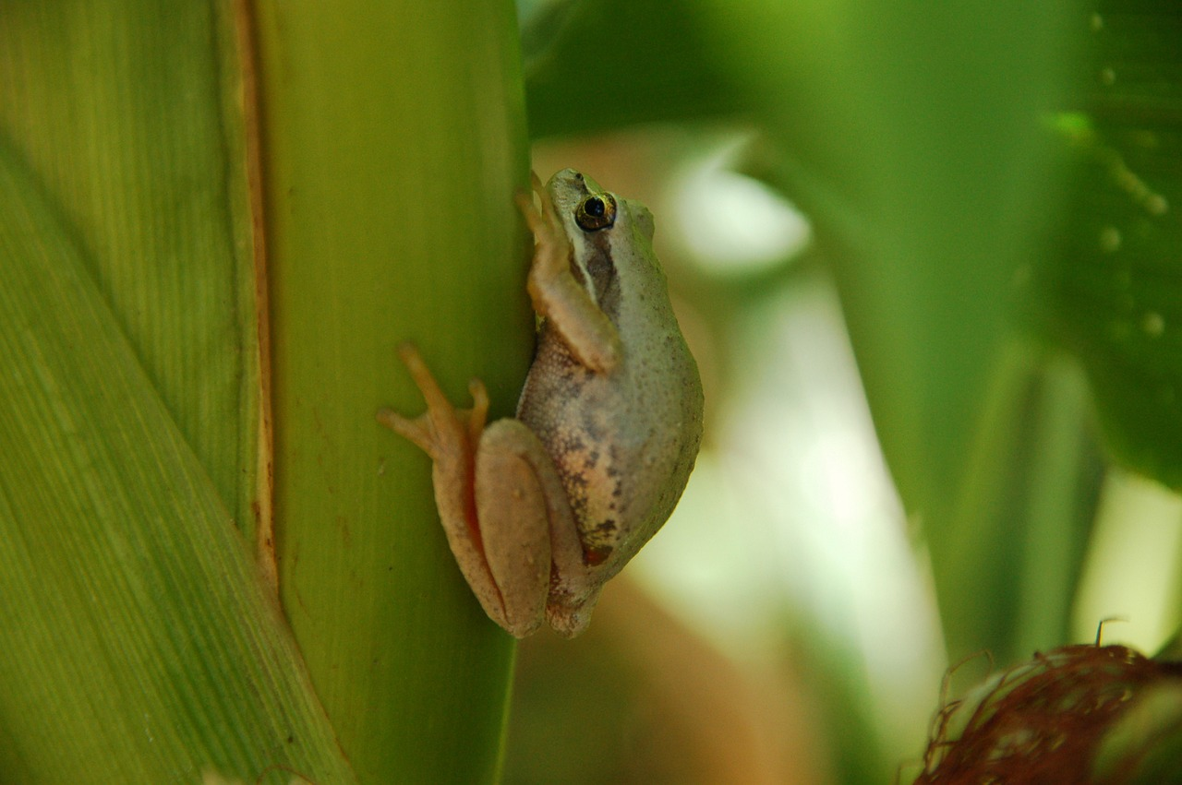
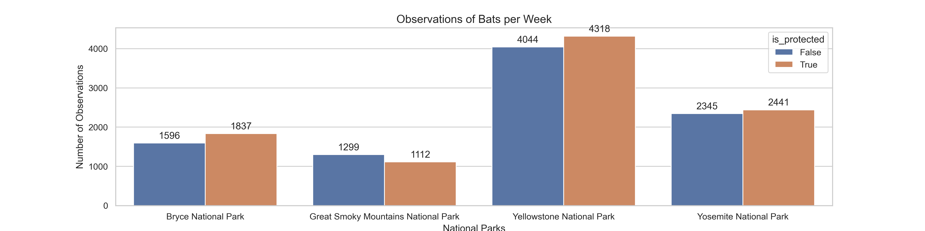
Species in Parks: most prevalent animals

Slide 6
Species in Parks: most prevalent animals
Key Insights:
Yellowstone National Park shows the highest total bat observations, with a relatively balanced count between protected and non-protected individuals.
Bryce National Park and Yosemite National Park also exhibit substantial bat activity, with protected bats slightly outnumbering non-protected ones.
Great Smoky Mountains National Park has the lowest overall bat observations, but still maintains a near-even split between protection statuses.

Slide 7
Species in Parks: most prevalent animals
Ecological Interpretation:
The presence of protected bats across all parks suggests active conservation measures and monitoring.
Parks with higher counts of protected bats may reflect successful habitat preservation or targeted conservation programs.
Comparing protected vs. non-protected populations helps assess the effectiveness of protection policies and identify parks where further intervention may be needed.

Slide 8
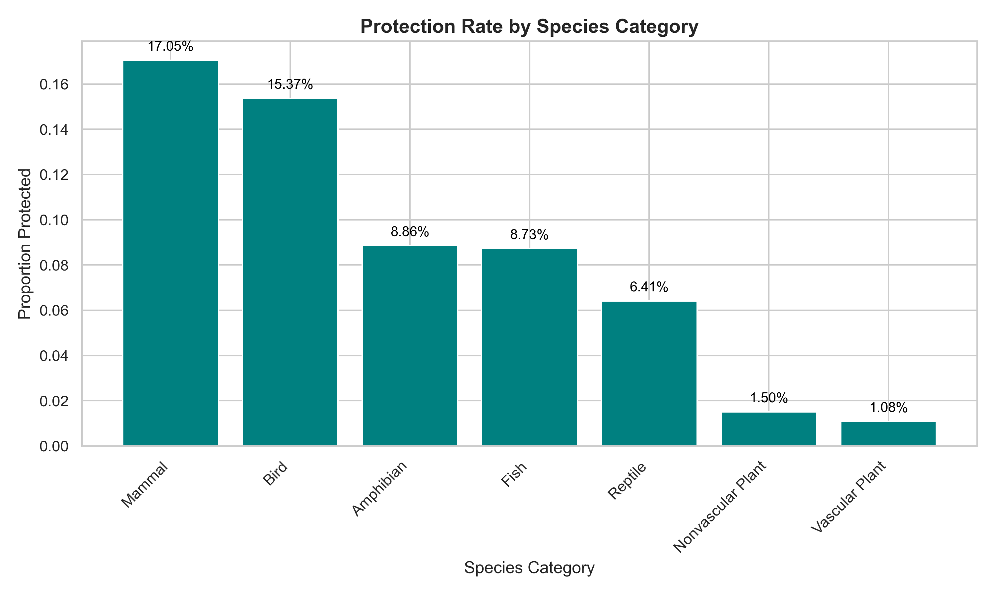
Protection rate by species category

Slide 9
Protection rate by species category
The chart reveals clear disparities in conservation attention across biological categories. Mammals and Birds exhibit the highest protection rates, with over 17% and 15% of species respectively receiving formal protection. In contrast, categories like Reptiles and Amphibians show significantly lower rates, often below 9%, suggesting potential underrepresentation in conservation policies.
These findings align with the Chi-Square test results, confirming that protection status is not evenly distributed across categories. The elevated protection rates in certain groups may reflect public interest, ecological importance, or policy bias — while lower rates highlight areas where conservation efforts could be strengthened.
This insight supports targeted biodiversity planning by identifying which categories may require increased monitoring, funding, or legal protection.

Slide 10
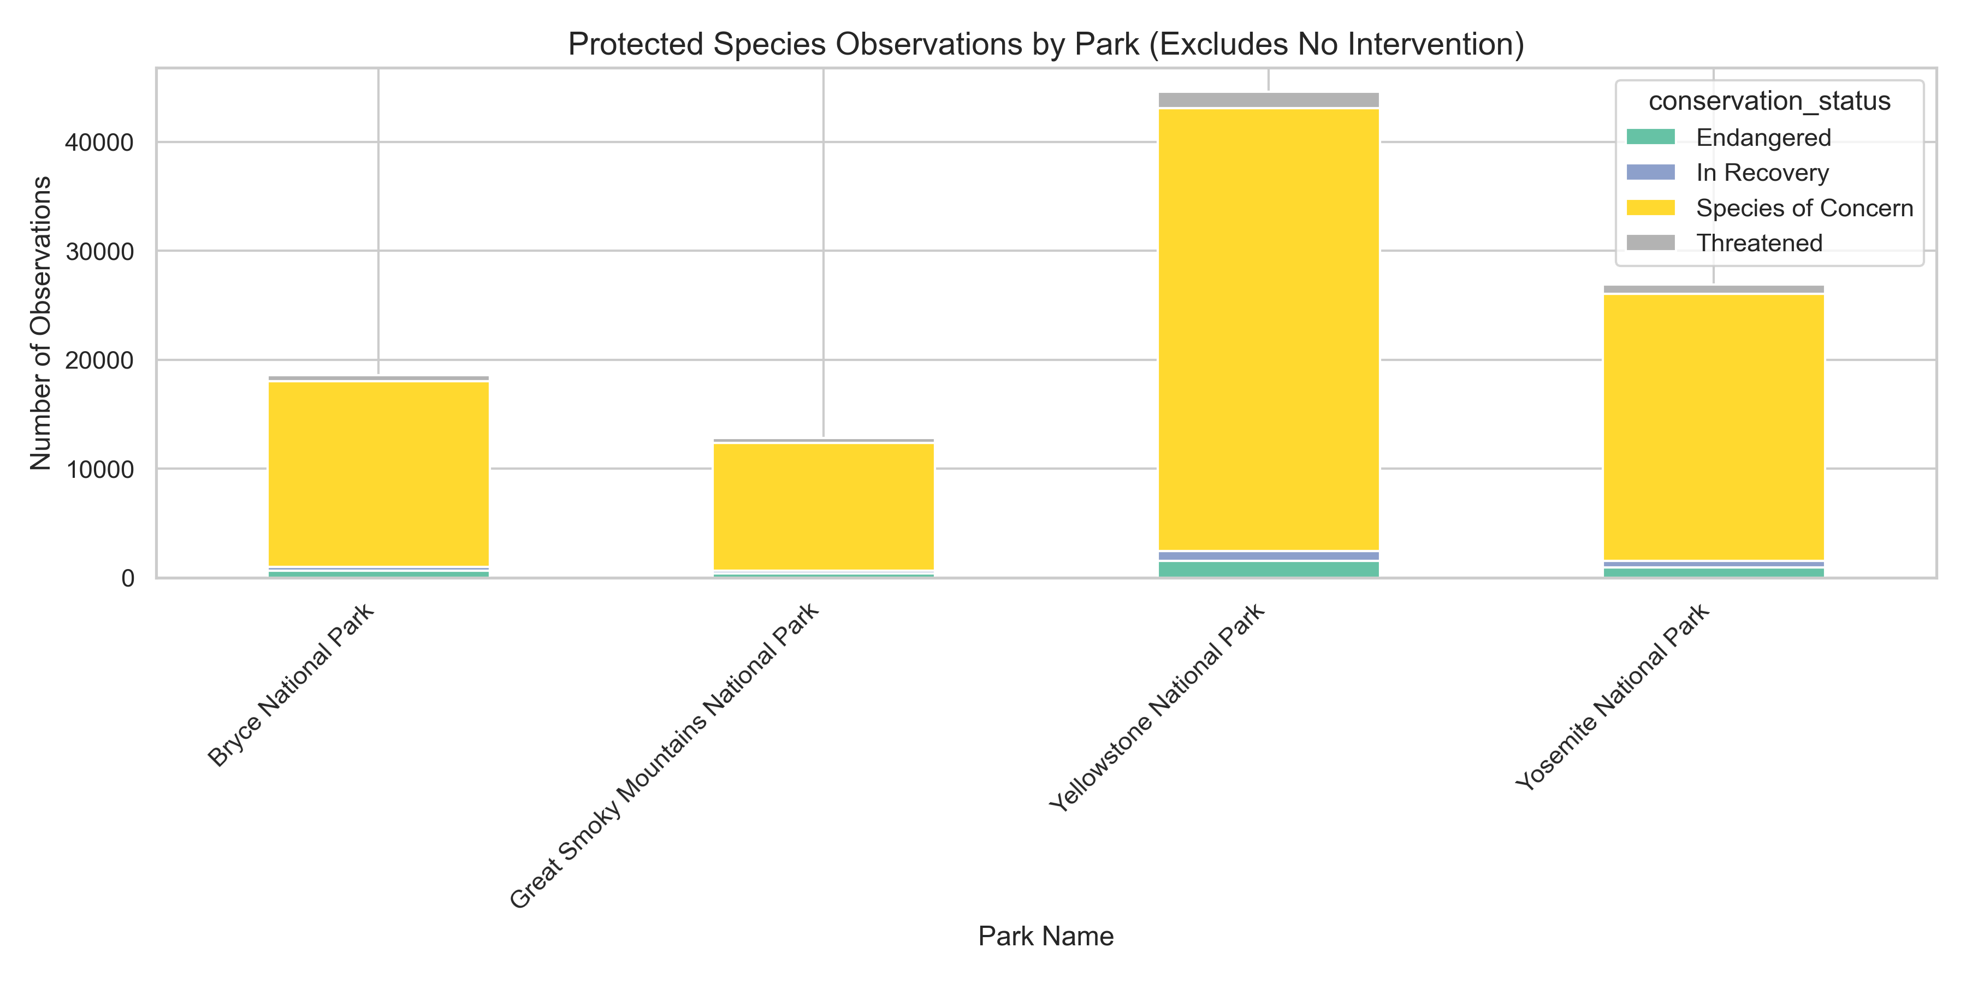
Protected Species by Park

Slide 11
Protected Species by Park
Yellowstone National Park and Yosemite National Park show the highest number of observations for protected species, indicating strong conservation engagement and monitoring effort.
Parks like Bryce National Park, despite high overall observation counts, show relatively low proportions of protected species, suggesting a monitoring bias toward non-threatened groups.
The protection rate metric reveals which parks are not just biodiverse but actively contributing to conservation goals — a more ecologically meaningful indicator than raw observation volume.
The stacked bar chart visually emphasizes these differences, showing how some parks concentrate their monitoring on species with urgent conservation status, while others may require strategic realignment.

Slide 12
Statistical Significances: Protection Status vs. Category
Null Hypothesis (H₀):
Protection status is independent of species category. In other words, the likelihood of a species being protected does not vary by its biological category (e.g., Mammal, Bird, Reptile).
Alternative Hypothesis (H₁):
Protection status is dependent on species category. This means that some categories are more or less likely to include protected species than others.
We tested whether protection status is independent of species category.
Chi-Square Statistic: 426.53
Degrees of Freedom: 6
p-value: 5.5108e-89
✅ Conclusion:
Since the p-value is less than 0.05, I reject the null hypothesis. This means that protection status is significantly associated with species category — some categories are more likely to be protected than others.
This insight helps conservation planners prioritize efforts based on biological classification.

Slide 13
Standardized Residuals
Standardized residuals measure how much the observed counts in each category deviate from the expected counts under the assumption of independence. They are calculated as:
Values above +2 or below –2 are typically considered statistically significant deviations.
Ecological Interpretation
Birds (+14.92) and Mammals (+10.20) show strong positive residuals in the protected column, meaning they are protected far more often than expected. This likely reflects their visibility, public appeal, and prioritization in conservation policies.
Vascular Plants (–7.81) and Nonvascular Plants (–1.75) show negative residuals in the protected column, indicating they are underprotected relative to expectation. Despite their ecological importance, these groups may be overlooked in policy frameworks.
Amphibians (+2.78) and Fish (+3.43) also show moderate positive deviations, suggesting some conservation attention, though less pronounced than for birds and mammals.
Reptiles (+1.56) fall below the significance threshold but still lean toward underrepresentation.

Slide 14
Cramér’s V (Association Strength)
The calculated Cramér’s V value of 0.277 indicates a moderate association between species category and protection status.
This means that the likelihood of a species being protected is not random across categories — certain biological groups are more systematically favored or neglected in conservation efforts.
Ecologically, this moderate association suggests that conservation policies may be influenced by species traits, visibility, or perceived importance.
For example, mammals and birds often receive more protection due to their ecological roles or public appeal, while reptiles, amphibians, or invertebrates may be underrepresented despite their ecological significance.

Slide 15
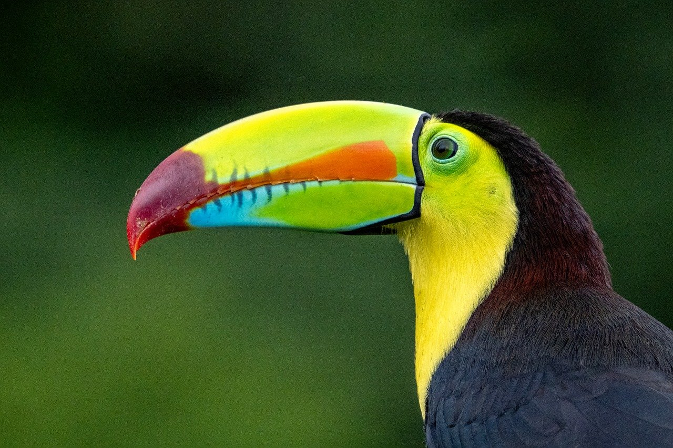
Portugal vs Global Trends
Portugal’s biodiversity strategy (Estratégia Nacional para a Conservação da Natureza e da Biodiversidade 2030) emphasizes habitat protection and species monitoring, aligning with CBD goals. However, recent research suggests that local species richness alone may not reliably reflect global biodiversity trends, due to sampling biases and spatial limitations.
Comparative insight:
Portuguese parks like Peneda-Gerês show strong monitoring efforts, but global biodiversity assessments require broader, standardized datasets.
This project’s use of species richness and protection status contributes to bridging this gap, especially if expanded to include temporal trends or cross-country comparisons.

Slide 16
Conclusions & Global Relevance
Data-driven conservation reveals gaps and opportunities;
Aligns with UN SDG 15 (Life on Land) and IUCN goals;
Supports reproducible, scalable biodiversity monitoring;
This project played a key role in developing skills in data science, data analysis, and data visualization, all applied to a real-world case study.

Slide 17

References
Codecademy, biodiversity datasets;
United Nations (n.d.); Climate Action; *Biodiversity - our strongest natural defense against climate change*. Retrieved October 24, 2025, from https://www.un.org/en/climatechange/science/climate-issues/biodiversity;
Pereira, H. M. (2023). The undetectability of global biodiversity trends using local species richness. BIOPOLIS-CIBIO & iDiv / University of Halle-Wittenberg. Retrieved October 29, 2025, from http://www.biopolis.pt/en/news-and-events/the-undetectability-of-global-biodiversity-trends-using-local-species-richness;
IUCN. (2025). The IUCN Red List of Threatened Species (Version 2025-2). International Union for Conservation of Nature. Retrieved October 29, 2025, from https://www.iucnredlist.org
Convention on Biological Diversity. (1992). Text of the Convention. United Nations. Retrieved October 29, 2025, from https://www.cbd.int/convention/text;
Convention on Biological Diversity. (2022). Kunming-Montreal Global Biodiversity Framework. Retrieved October 29, 2025, from https://www.cbd.int/gbf;
WWF International, What is Biodiversity?. Retrieved October 31, 2025, from https://www.youtube.com/watch?v=b6Ua_zWDH6U;

Slide 18
References
Bee: Picture by Max from Pixabay;
Basilisk: Picture by Iris Willecke from Pixabay;
Frog: Picture by Kirsty Fletcher from Pixabay;
Lake: Picture by Alain Audet from Pixabay;
Lizard: Picture by Myléne from Pixabay;
Puma: Picture by NathalieBurblis from Pixabay;
River: Picture by Alain Audet from Pixabay;
Toucan: Picture by Herbert Bieser from Pixabay;
Reibeiro. A; Assessing Biodiversity in Natural Areas - Insights into Conservation and Species Distribution: A Data-Driven Exploration Using U.S. National Park Observations; Jupyter notebook; 2025; 💻

Slide 19
Acknowledgments
Codecademy – For providing the foundational datasets (species_info.csv and observations.csv) that enabled this biodiversity exploration.
U.S. National Park Service – For their ongoing efforts in species monitoring and conservation, which inspired the analytical framework of this project.
Python Ecosystem – Special thanks to the developers of Pandas, Matplotlib, and Seaborn, which empowered the data analysis and visualization.
Portuguese Environmental Institutions – In recognition of their continued commitment to biodiversity protection and ecological stewardship, contributing to global conservation efforts.
Academic and Open Science Communities – For promoting reproducibility, transparency, and global alignment in ecological research.
Personal Support Network – Gratitude to mentors, peers, and collaborators who contributed feedback and motivation throughout the development of this notebook.
“Preserving biodiversity is not just a scientific endeavor—it’s a commitment to future generations.”

Slide 20
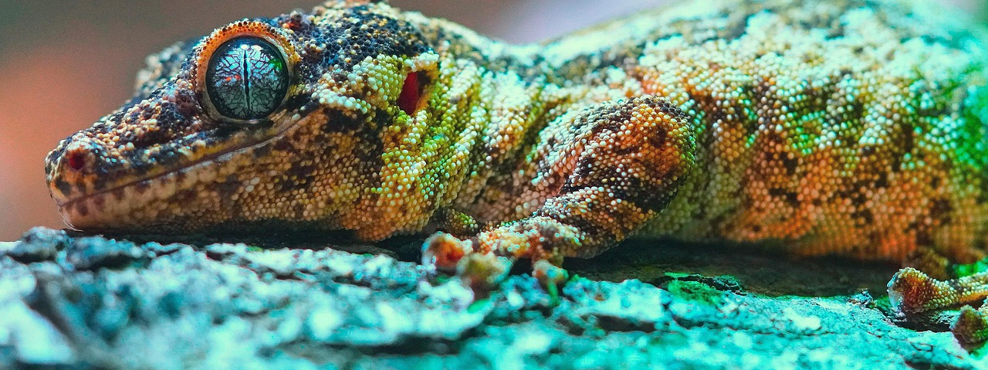
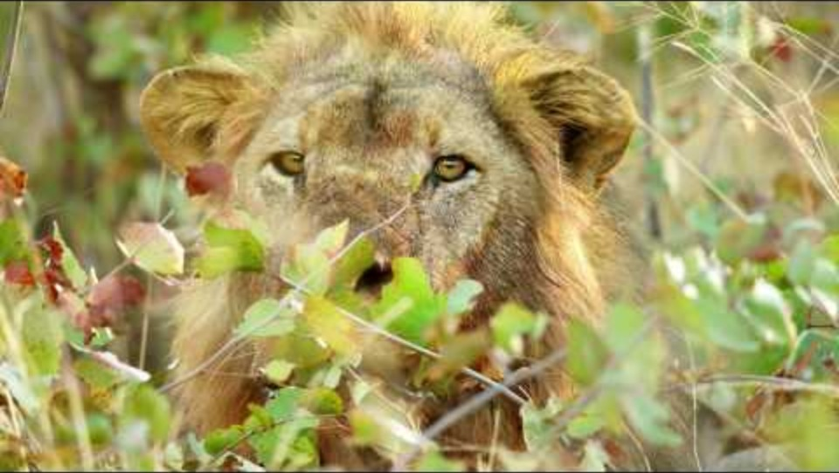
To Reflect

Slide 21
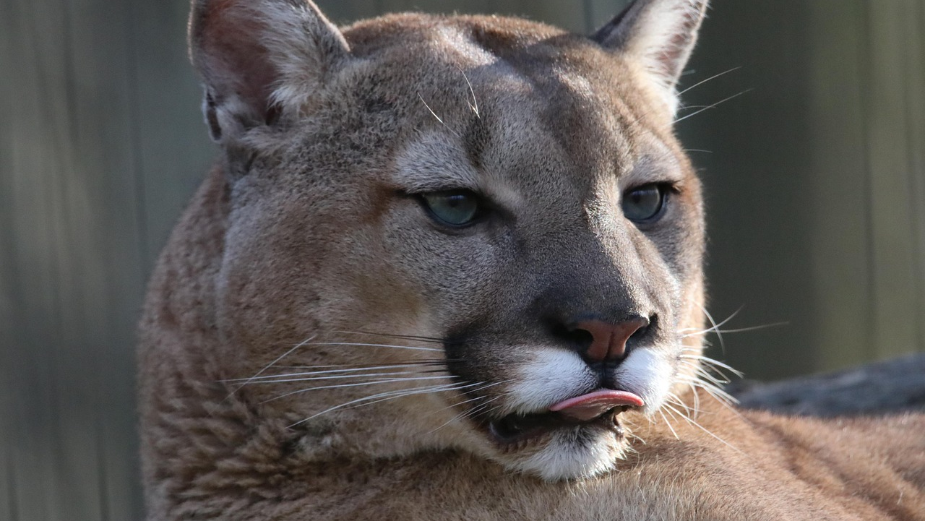
Thank you for your attention!

