Slide 1

Benfica case study
Last updated: 21/12/2022

Slide 2
Business Task How to maximize team’s performance?
What should we look for?
What influences a wining team?
Which is the best formation?
Teams best qualities?
More impactful players?

Slide 3
The Data
Data was collected from the beggining of the 2022/2023 season until 2022/11/13.
Data was colllected from players with at least one game played at the current season.
For simplicity player’s positions were categorized in one of four categories (Goalkeepers, Defenders, Midfielders and Forwards)
Players who play in more than one category were inserted in the one they play the most.
The player role inside the position is not considered (they may have a more defensive or offensive role).

Slide 4
What will we look at?
The team data as a whole
The players data individually

Slide 5
Team Data
GF/G -> Goals for/ Goals = The goals scored by the team (Benfica)
xG -> Expected goals = It is a statistical measurement of the quality of goalscoring chances and the likelihood of them being scored.
GA -> Goals against = Goals scored by the opponent team
xGA -> Expected goals against = Chances and likelihood of suffering a goal

Slide 6
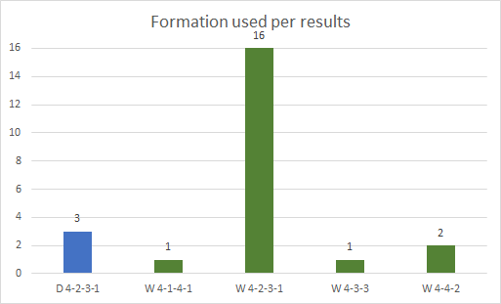
The formation most use is the 4-2-3-1, having the most victories and being the only one with draws.
Benfica did not lose any game.

Slide 7
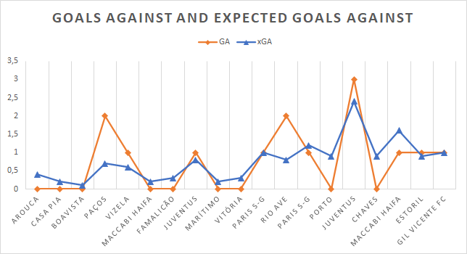
Benfica has more goals against than expected, but not a significant amount.
GA= 15
xGA = 14,5
Comparing the games the GA vs xGA it’s very inconsistent.
The defense sector may have a problem of concistent performances.

Slide 8
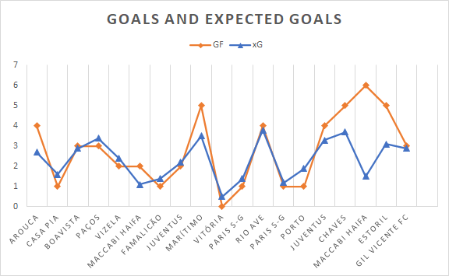
Benfica has more goals scored than expected
GF= 61
xG = 44,5
Even though there is a large difference in values there are still several games with a GF lower than the xG

Slide 9
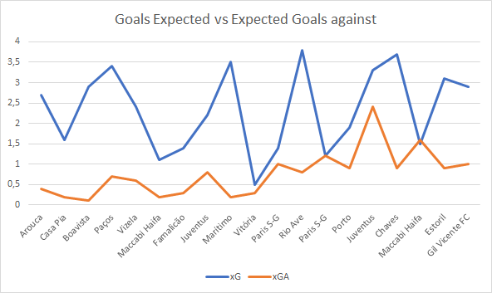
The expected goals are superior to the expected goals against in every game except the second one against Maccabi Haifa where:
xG = 1,5
xGA = 1,6
And the first one against Paris S-G where:
xG = 1,6
xGA = 1,6
xG -> Expected Goals for the team
xGA -> Expected Goals against the team

Slide 10
Player Data
General statistics
Atacking statistics
Possesion statistics
Defensive statistics

Slide 11
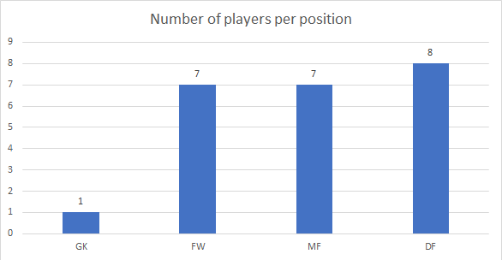
Only one goalkeeper played this season, despite the team having other goalkeepers
Other positions are balanced but there is still players who haven’t played

Slide 12
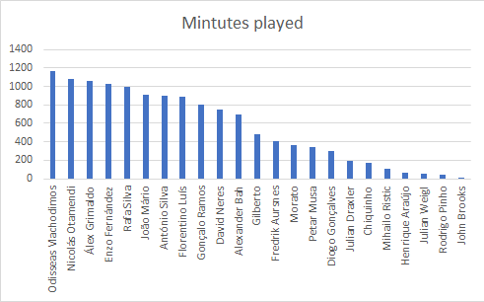
*Only considering players who have played*

Slide 13
Atacking statistics
Only players who play forward or midfield will be considered in this section.
There are several qualitative factors that could affect the statistics shown, so they should not be the only consideration.
There are absolute statistics (total) and we should have in mind that there are players with more playtime than others.

Slide 14
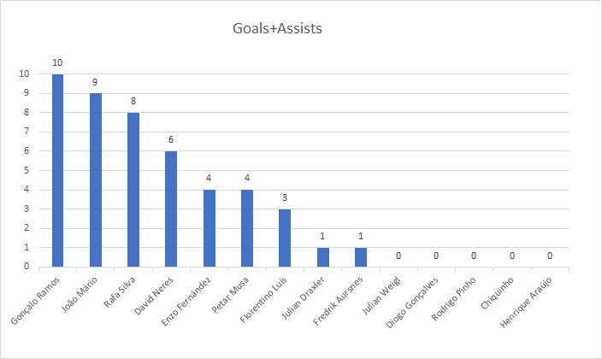
Gonçalo Ramos (forward) is the most directly envolved in goals.
The midfielder most involved in goals is João Mário.
In between the players with 0 goals+assists, Chiquinho (midfielder) is the one with more playtime

Slide 15
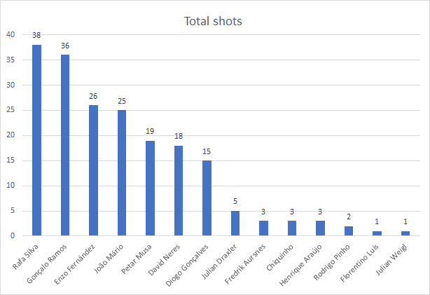

Slide 16
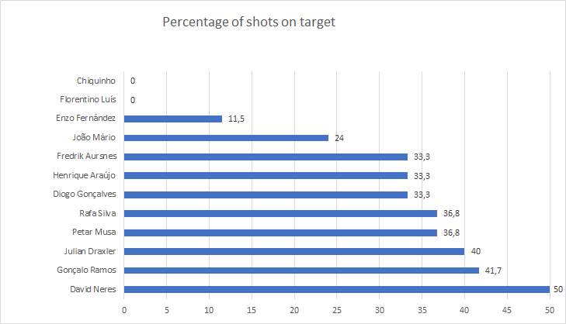
David Neres is the player with better shot accuracy;
Gonçalo Ramos is in 2nd with more accuracy and is the 2nd player with more total shots;
Chiquinho missed all three of his shots;
Florentino did not hit the target, but has only one atempt;
Enzo fernandes is the 3rd player with more attempted shots and is the 3rd player with less percentage of shot on target

Slide 17
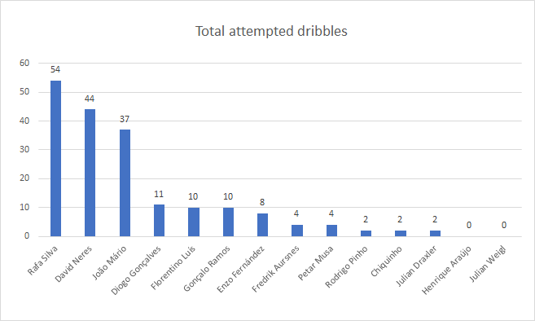

Slide 18
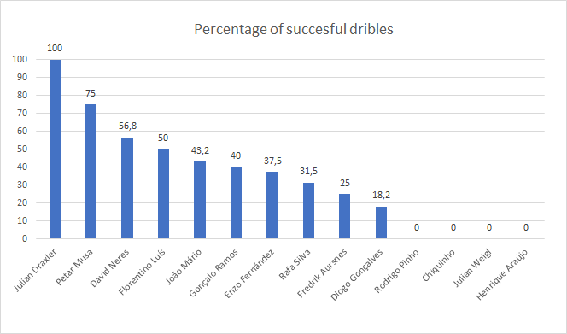
Julian Draxler has 100% of drible success. He attempted 2 dribles.
David Neres is the 2nd player with more attempted dribbles and the 3rd most successful.
Rafa Silva, the player with the most attempted dribbles, has less than a 3rd of success rate.
Both Henrique Araújo and Julian Weigl did not attempt any kind of dribble, therefore they have no success rate.

Slide 19
Possesion statistics
All positions were considered for this section.
There are several qualitative factors that could affect the statistics shown, so they should not be the only consideration.
There are absolute statistics (total) and we should have in mind that there are players with more playtime than others.

Slide 20
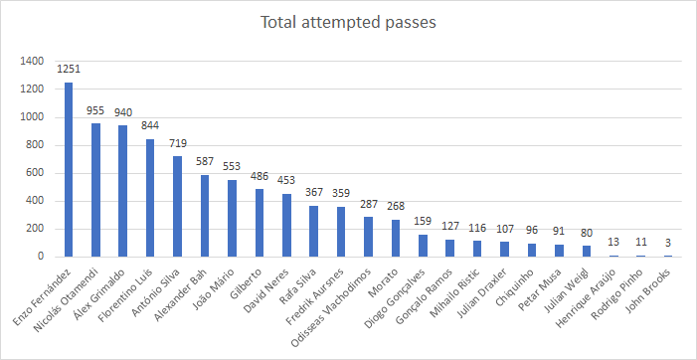

Slide 21
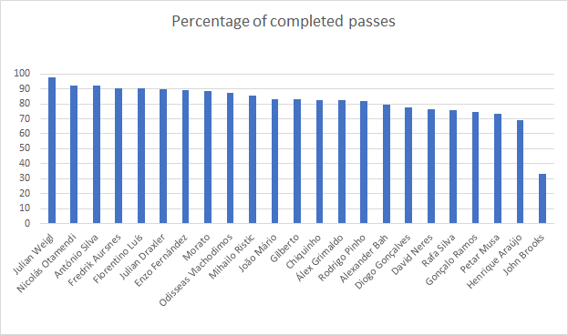
Julian Weigl has the best pass accuracy, but has under 100 attempted passes.
Nicolás Otamendi has the 2nd higher completed pass percentage and is the 2nd highest passer in the team
John Brooks has the lowest accuracy, missing 2 of his 3 attempted passes.
Rafa Silva and David Neres are the players with less acuraccy that have more than 150 passes.

Slide 22
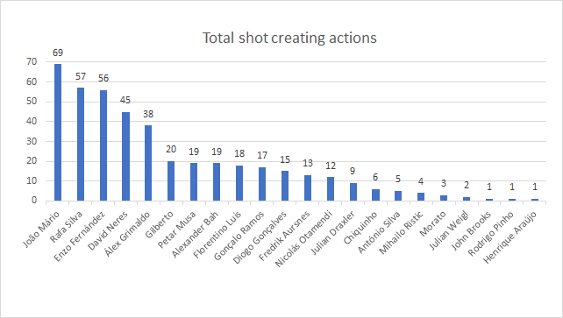
The forwards with less shot creating actions are Hernique Araújo, followed by Rodrigo Pinho.
The midfielders with less shot creating actions are Julian Weigl, followed by Chiquinho.
João Mário is the player with more shot creating actions, follow by Rafa Silva and Enzo Fernández.

Slide 23
Defense statistics
Only players who play defender or midfield will be considered in this section.
There are several qualitative factors that could affect the statistics shown, so they should not be the only consideration.
There are absolute statistics (total) and we should have in mind that there are players with more playtime than others.

Slide 24
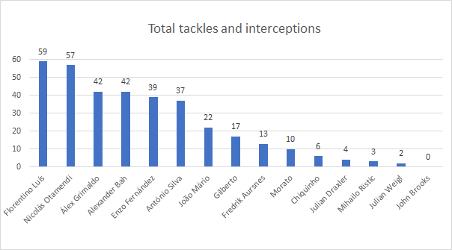
Florentino Luís, a midfielder, is the player with most tackles and interceptions
The defender with most tackles and interceptions is Nicolás Otamendi
John Brooks is the defender with least tackles and interceptions (0)
Chiquinho has only 6 tackles + interceptions and the players with less have half the playtime he has

Slide 25
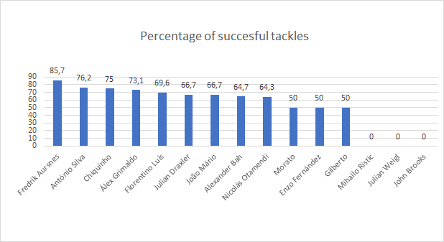
Fredrik Aursenes is the player with the best tackles succes rate.
The defender with the highest percentage is António Silva with 76,2%
John Brooks, Julian Weigl and Mihailo Ristic have 0% of success rate
Gilberto, Enzo and Morato are after the players with 0% of tackle sucess with 50%

Slide 26
Team Insights
The formation 4-2-3-1 is the best shot, as it is the most used and the others were not used enough to be validated.
A lot of players do not get enough playing time to make a fair judgment on their performance.
The team is conceding the same number of goals as expected. However, in some games, the defense is underperforming based on the GA and xGA
The team is scoring a lot more goals than expected. Meaning that the players are overachieving with their finishing.
Chiquinho seems to be underperforming. His statistics are very low when compared to other players that have less than half his playtime.
Even though Diogo Gonçalves' playing time is in the bottom third, it is a significant amount. As a forward his offensive statistics, even the relative (%) ones, are below those of his peers.

Slide 27
Players Insights
Chiquinho seems to be underperforming. His statistics are very similar to other players that have less than half his playtime.
Even though Diogo Gonçalves' playing time is in the bottom third, it is a significant amount. As a forward his offensive statistics, even the relative (%) ones, are below those of his peers.
Odisseas Vlachodimos is the only goalkeeper that played in this season, so there is not any other possible substitute to analyze.
Gonçalo Ramos and Rafa Silva have been the two players posing the greatest threat to the opposition's goal.
David Neres has been the most successful dribbler, causing a lot of problems for defenders.
Florentino Luís is dominating the defensive action in the midfield.
Nicolás Otamendi is leading the defense in tackles and interceptions, protecting our goal.

Slide 28
Next steps
The data is not enought to make any decision as there is a lot of factors that could affect the statistics.
It’s essencial to work with the coach and other staff members from now on, they can act on the data and on other variables not considered here, as age, personality, training performance and many others.
There’s a lot of players who have not played enought time to be avaliated, an opportunity should be given to them.
In the meantime there should not be major changes in the tatic and players used, because it seems to be working.

