Slide 1

Cycling
Case Study
Last updated in: 15/12/2022

Slide 2
The problem and the objective
The company’s future depends on maximizing the number of annual memberships.
The objective is to understand how annual members and casual riders use the bikes differently.

Slide 3
THE DATA
Data was collected between 2021/12 and 2022/11;
Duplicate, invalid, incorrect and blank Data was removed/corrected;
Data format and type was corrected;

Slide 4
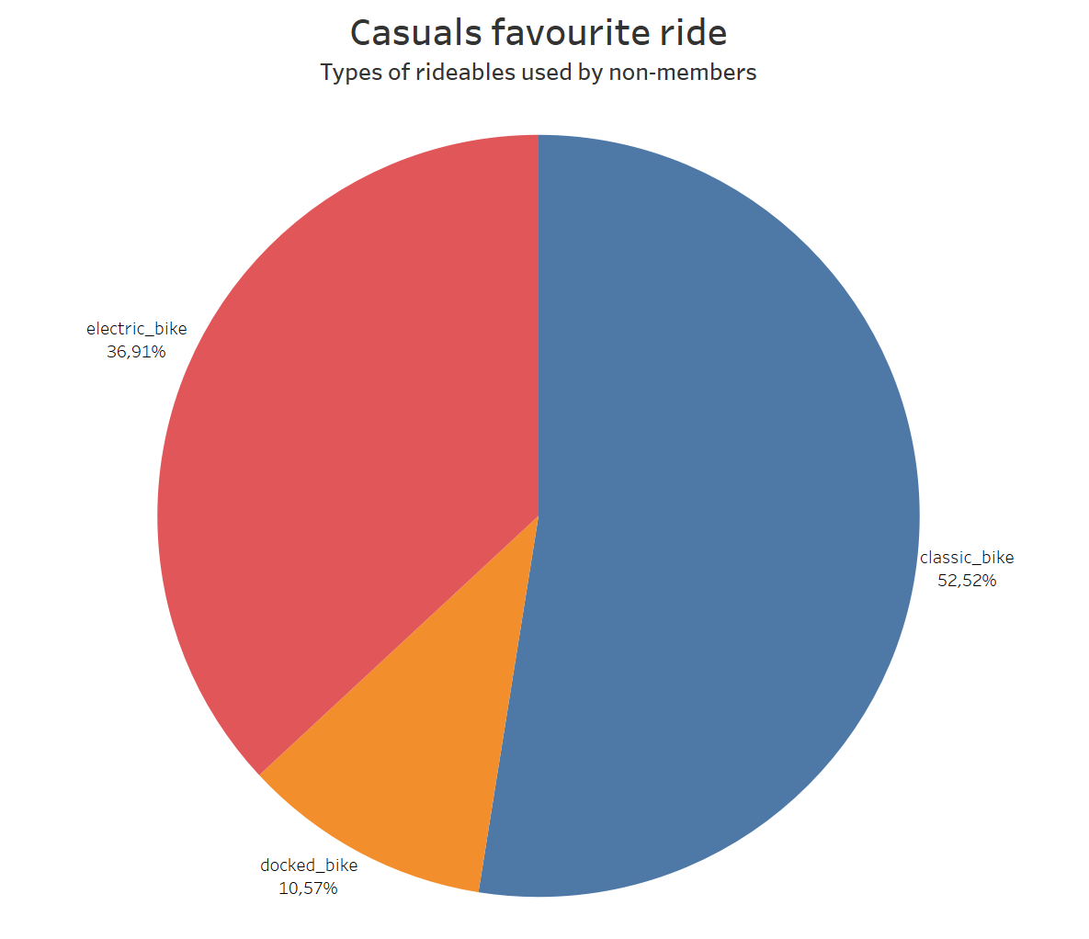
the classic bike is the most popular among causal riders;
Electric bike is very popualr too;
Docked bike IS the the least used;
Notes:
The classic bikes are the used in the majority of cases, with the eletric bikes behind, being very popular too. And docked bikes are the least popular among casual members

Slide 5
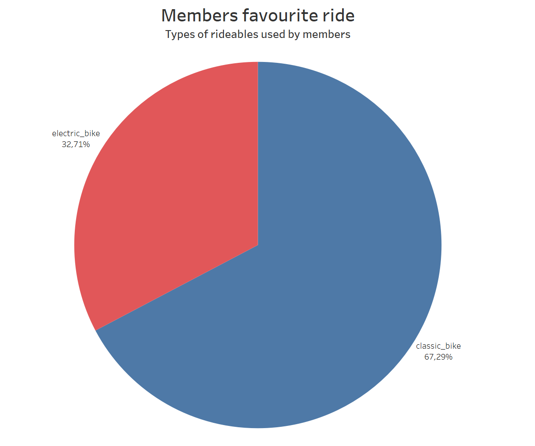
The majority of rides by members are with classic bikes;
Electric bikes are used in a little more than a quarter of the rides;
Notes:
The classic bike is used in almost three quarters of the rides by anual members. With the other only choise being the eletric bikes. Even tho the docked bikes do not appear in the pie chart it does not mean they were never used by members.

Slide 6
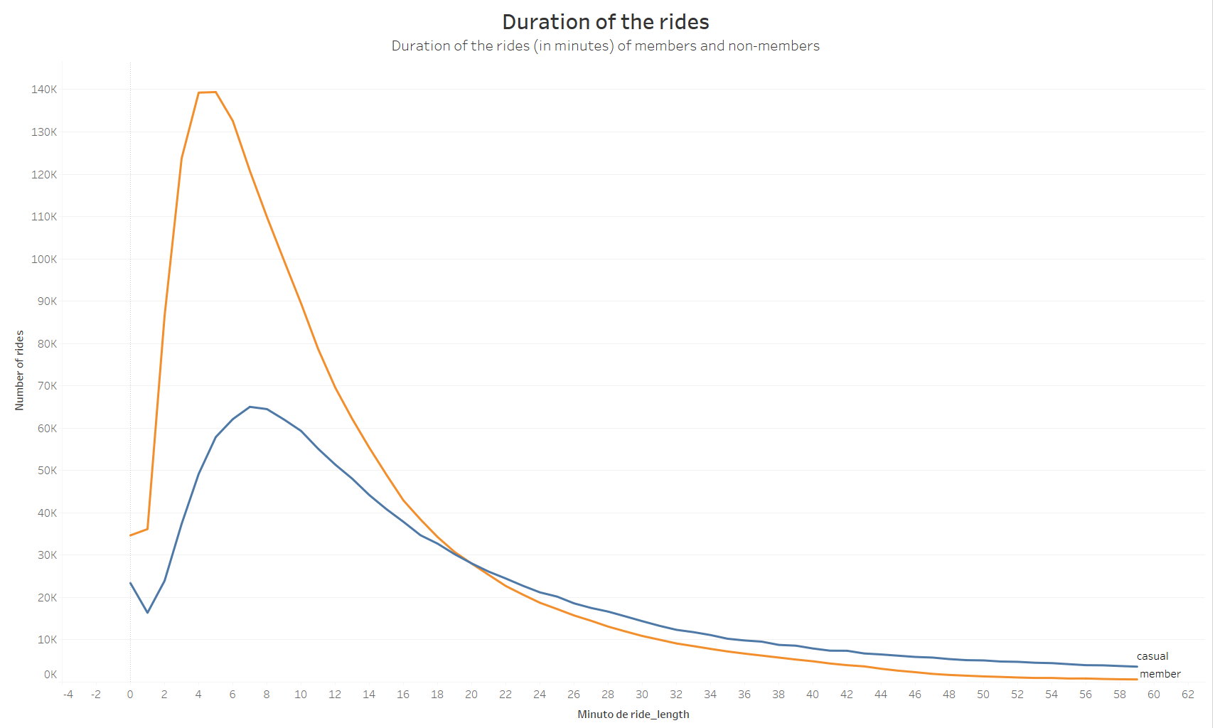
The most common duration of rides is under 10 minutes.
Notes:
We can see that in both cases prople prefer to use the bikes in rides shorter than 10 minutes. But the members using it a lot more in shorter rides compared to longer ones.

Slide 7
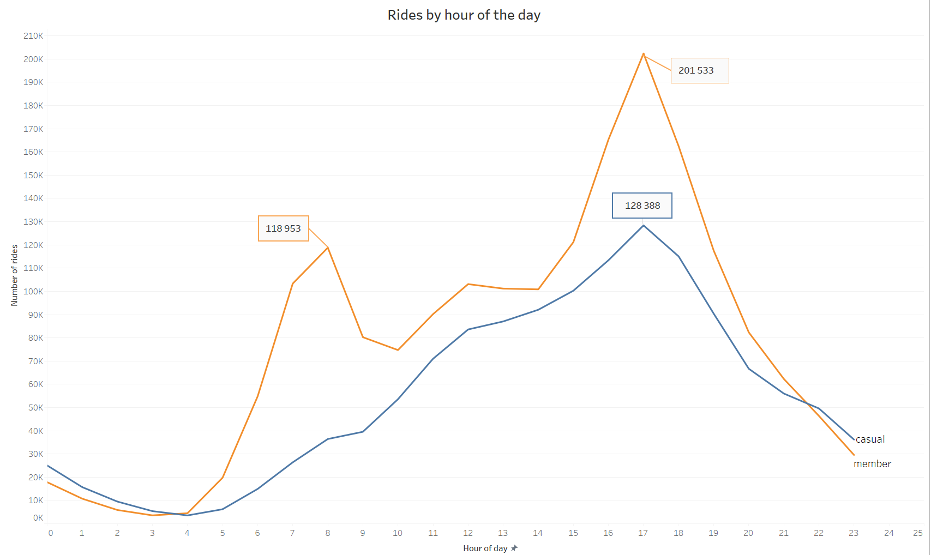
Notes:
We can see that in both cases prople prefer to use the bikes in rides shorter than 10 minutes. But the members using it a lot more in shorter rides compared to longer ones.

Slide 8
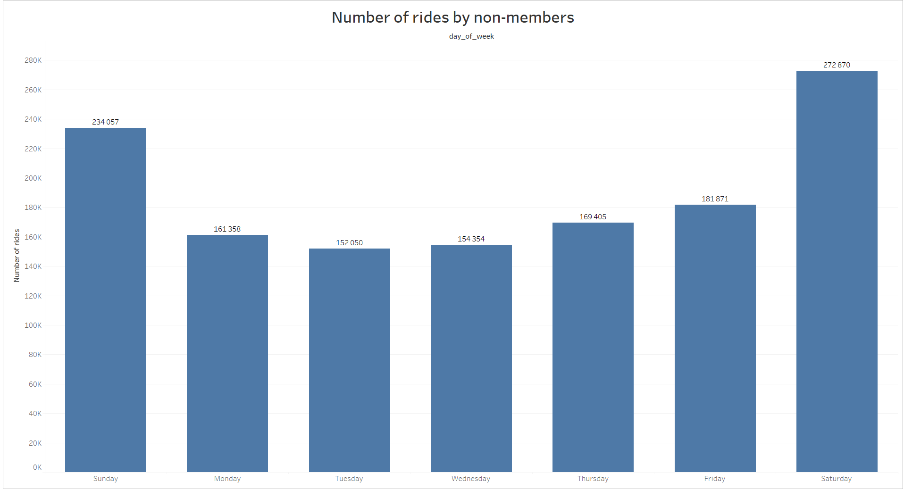
Notes:
We can see that in both cases prople prefer to use the bikes in rides shorter than 10 minutes. But the members using it a lot more in shorter rides compared to longer ones.

Slide 9
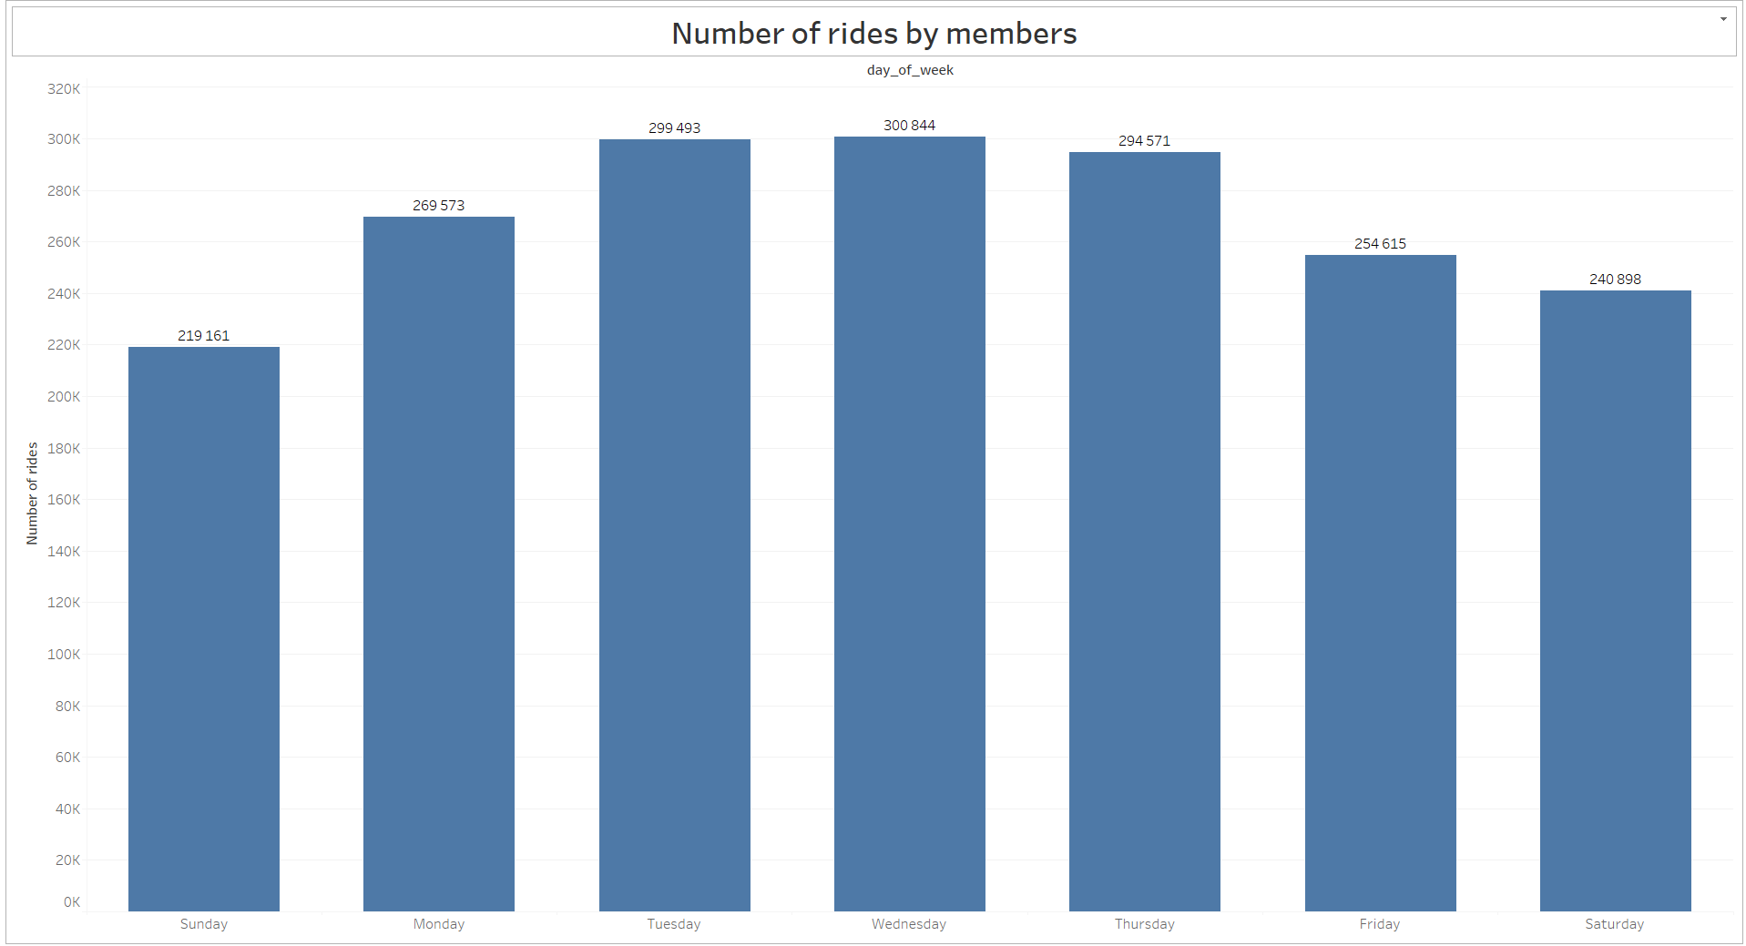
Notes:
We can see that in both cases prople prefer to use the bikes in rides shorter than 10 minutes. But the members using it a lot more in shorter rides compared to longer ones.

Slide 10
Summary
We know some diferences on the use of members and non-members;
We can’t know why members and non-members use the bikes diferenttly
We can’t understand why would someone buy a membership, with only this data;
The evidence it’s not conclusive enought to make a big move;

Slide 11
Next steps
Get data that is more relevant to the business task
Use the insights we got to initiate the process of increase membership;

Slide 12
Get more data
Collect qualitative data by surveying the users, members and casual riders;
Collect users income Data;
Collect users fitness data;
Get user unbias feedback about the service;

Slide 13
Hypothesis
As indicated by the data, members tend to use the rides more on week days and in the morning (7:00-9:00) and in the afternoon/evening (17:00-19:00), thay may mean that members use the rides to commute to work.
On the other hand non-members tend to use the rides on weekends and more spread throughout the day, that may mean they use it for leisure
These hypotheses should be investigated further, more data should be collected and a surveying the users would be important.

Slide 14
Initiate the process
Consider a monthly subscription;
Consider casuals needs and act on it;
Reward more expensive offerings;

Slide 15
Conclusions
We know how casual and members are different but not why
Consider casuals needs and act on it;
Reward more expensive offerings;

