Slide 1
RNA-Seq: a revolutionary tool for transcriptomics
Zhong Wang, Mark Gerstein, and Michael Snyder
Presentation by Christos Kozanitis

Slide 2
Purpose of transcriptomics
To catalog all pieces of transcript (mRNA, ncRNAS etc)
To quantify gene expression levels
To determine the transcriptional structure of genes
Start sites
5’ and 3’ ends
Splicing patterns

Slide 3
In the old days
Microarray based solutions
Reliance upon existing knowledge about genome
Limited range of expression level detection (due to background signals)
Sanger sequencing based solutions
Expensive
Low coverage
Only a portion of a transcript gets analyzed

Slide 4
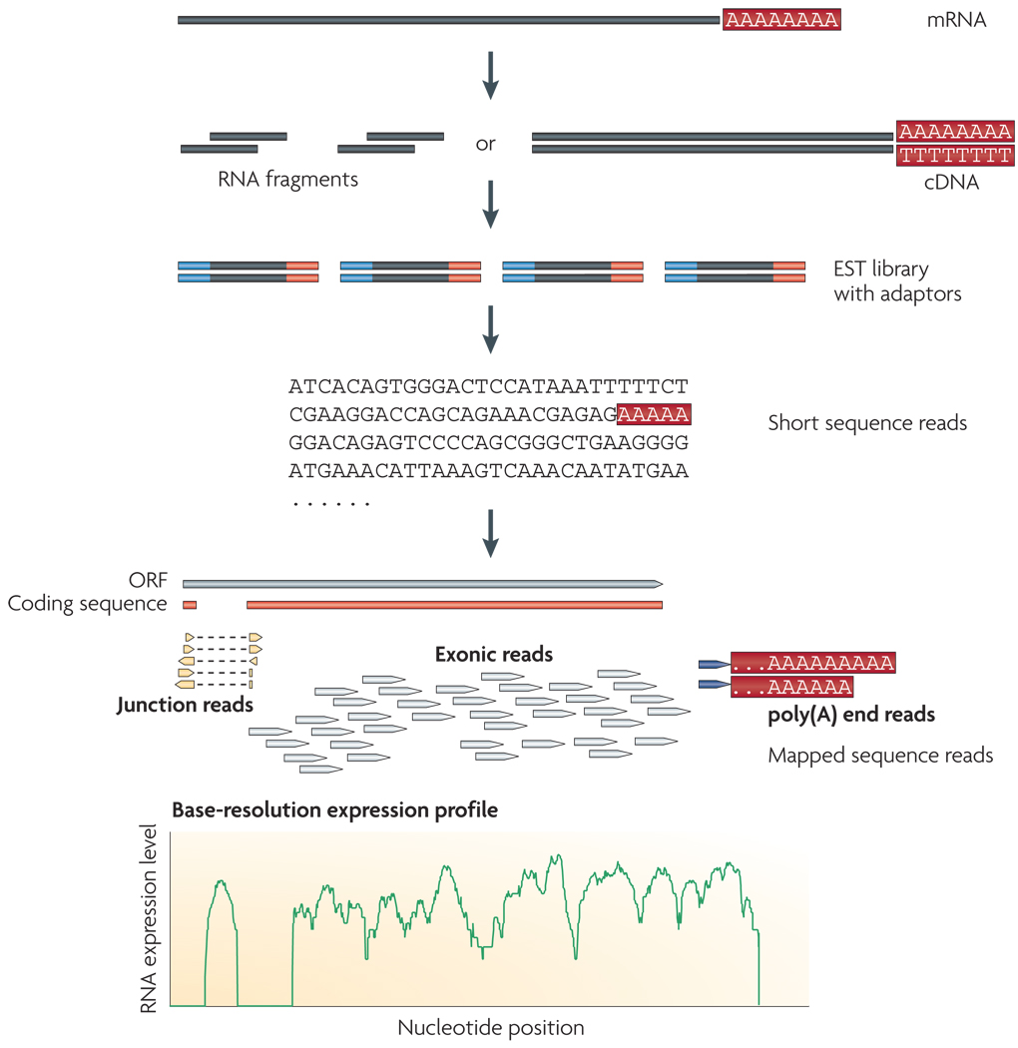
RNA-Seq

Slide 5
Benefits
Applies to non-model organisms
Base level resolution
Reveals connectivity of how exons are connected
Sensitivity on extremely low and high gene expression levels

Slide 6
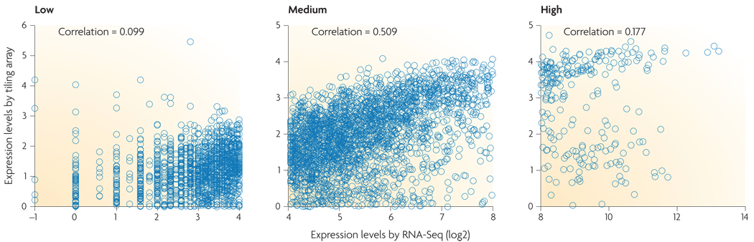

Slide 7
Library construction challenges
Bias from different fragmentation methods
RNA fragmentation is depleted at transcript ends
cDNA fragmentation adds strong bias at 3’ ends
PCR artifacts
Strand specific libraries are hard to produce

Slide 8
Bioinformatics challenges
Poly(A) tails
Solution: Look for multiple A’s or T’s at the end of some reads
Exon-exon junctions
Can be identified by specific context (GT-AG)
How do we know which exons are involved?
Map reads against a junction library
Repeated regions
Use pair ended information

Slide 9
Coverage vs cost
Coverage=% of transcripts surveyed
Complex transcriptomes ➔ more seq depth
How do we calculate coverage?
The true number of isoforms is not known
Transcription activity varies across the genome
Partial solution: # unique start sites
It does not address alternative splicing
Complexity in termination sites

Slide 10
Research findings due to RNA seq
Mapping gene and exon boundaries
85% of all yeast genes have been mapped
Examine splicing diversity
94K splice junctions confirmed in human. 4K novel
Novel transcript units
30-40% of reads map to unannotated regions
Defining transcription level
It can capture transcriptome dynamics across different tissues or conditions
This will allow comparison between diseased and normal tissues

Slide 11
Future directions
Target more complex transcriptomes
Identify rare RNA isoforms

