Slide 1

Figure 1.A.U.Th. logo. Retrieved from
https://www.auth.gr/en/logo
Natural Language Processing
Andrei Volodin
January 2020
DIM102

Slide 2
NATURAL LANGUAGE PROCESSING (NLP)
CLOSEST NEIGHBORS
Computer Science (CS)
Speech Processing
Artificial Intelligence (AI)
Machine Learning (ML)
Computational linguistics
Notes:
Computer Science: The discrete and recursive nature of natural language invites the application of theoretical ideas from computer science. Linguists such as Chomsky and Montague have shown how formal language theory can help to explain the syntax and semantics of natural language;
Computational Linguistics: Most of the meetings and journals that host natural language processing research bear the name “computational linguistics”;
Machine Learning: Contemporary approaches to natural language processing rely heavily on machine learning;
Speech Processing: Natural language is often communicated in spoken form, and speech recognition is the task of converting an audio signal to text. From one perspective, this is a signal processing problem, which might be viewed as a preprocessing step before natural language processing can be applied. However, context plays a critical role in speech recognition by human listeners: knowledge of the surrounding words influences perception and helps to correct for noise (Miller et al., 1951)
(Eisenstein, 2019)
Artificial Intelligence: The goal of artificial intelligence is to build software and robots with the same range of abilities as humans (Russell and Norvig, 2009)

Slide 3
“is the set of methods for making human language accessible to computers” (Eisenstein, 2019)
Easy
• Spell Checking • Keyword Search • Finding Synonyms
Medium
• Parsing information from websites, documents, etc.
Hard
• Machine Translation (e.g. Translate Chinese text to English)
• Semantic Analysis (What is the meaning of query statement?)
• Coreference (e.g. What does "he" or "it" refer to given a document?)
• Question Answering (e.g. Answering Jeopardy questions).
NATURAL LANGUAGE PROCESSING
DEFINITION:
Example tasks
source: s224d.stanford.edu

Slide 4
“is used to count the total number of bytes, words, and lines in a text file.”
“When used to count bytes and lines, wc is an ordinary data processing application.”
However, when it is “used to count the words in a file it requires knowledge about what it means to be a word, and thus becomes a language processing system.”
(Jurafsky, 2008)
NATURAL LANGUAGE PROCESSING
Unix wc program

Slide 5
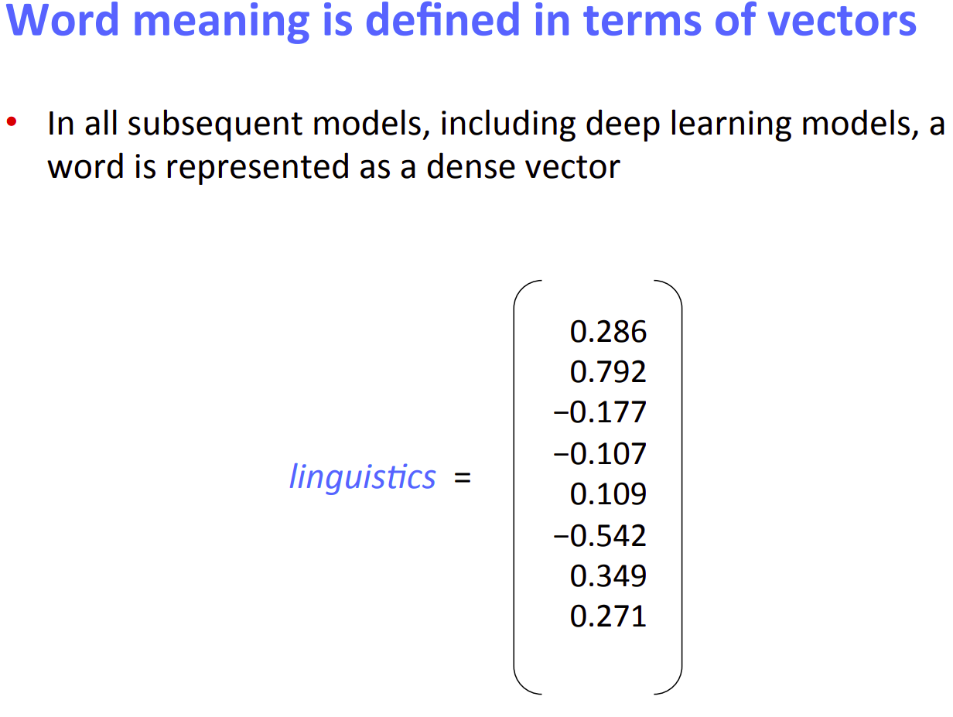
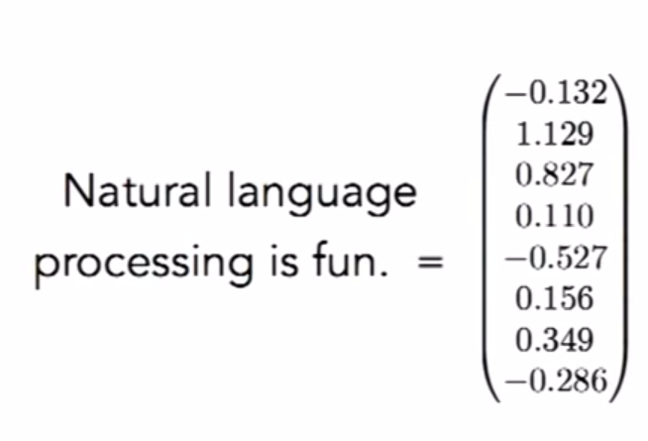
NATURAL LANGUAGE PROCESSING
Word to Vector representation
Figure 5. Word2vec. Retrieved from https://cs224d.stanford.edu/lectures/CS224d-Lecture2.pdf

Slide 6
“an extensible pipeline that provides core natural language analysis. This toolkit is quite widely used, both in the research NLP community and also among commercial and government users of open source NLP technology”
“a Java (or at least JVM-based) annotation pipeline framework, which provides most of the common core natural language processing (NLP) steps, from tokenization through to coreference resolution” (Manning, 2014).
The toolkit was designed for internal use and was released to opensource in 2010.
NATURAL LANGUAGE PROCESSING
Stanford CoreNLP toolkit
(Manning, 2014)

Slide 7
$ cat sentiment.txt
I liked it.
It was a fantastic experience.
The plot move rather slowly.
$ java -cp "*" -Xmx2g edu.stanford.nlp.pipeline.StanfordCoreNLP -annotators tokenize,ssplit,pos,lemma,parse,sentiment -file sentiment.txt
$ grep sentiment sentiment.txt.xml
<sentence id="1" sentimentValue="3" sentiment="Positive">
<sentence id="2" sentimentValue="4" sentiment="Verypositive">
<sentence id="3" sentimentValue="1" sentiment="Negative">
NATURAL LANGUAGE PROCESSING: Stanford CoreNLP toolkit
Example inputs
Outputs

Slide 8
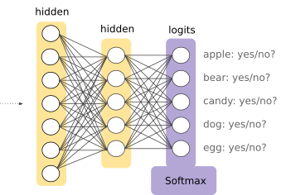
Google uses DeepMind’s Wavenet
And DeepMind’s Wavenet uses Softmax
which helps classifying
NATURAL LANGUAGE PROCESSING
Google Cloud: Text-to-Speech API https://cloud.google.com/text-to-speech/
Google Assistant: Speech Recognition
INPUTS
Figure 2. Softmax. Image. Retrieved from https://developers.google.com/machine-learning/crash-course/multi-class-neural-networks/softmax

Slide 9
In 2016, Rajpurkar released the the Stanford Question Answering Dataset(SQuAD 1.0) which consists of 100K question-answer pairs each with a given context paragraph and it soon becomes a standard test for the reading comprehension task with public leaderboard available. In 2018, the team further released SQuAD 2.0, which contains over 50,000 unanswerable questions that post a much harder requirement on model development
(Zhang)
NATURAL LANGUAGE PROCESSING
Stanford Question Answering Dataset (SQuAD)
is a reading comprehension dataset, consisting of questions posed by crowdworkers on a set of Wikipedia articles, where the answer to every question is a segment of text, or span, from the corresponding reading passage, or the question might be unanswerable
(Rajpurkar, 2019)

Slide 10
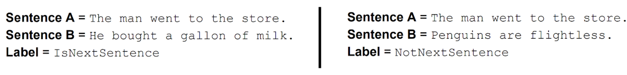
a new technique for NLP pre-training
“BERT also learns to model relationships between sentences by pre-training on a very simple task that can be generated from any text corpus:”
(Devlin, 2018)
NATURAL LANGUAGE PROCESSING
Google BERT: Bidirectional Encoder Representations from Transformers
Google ALBERT: A Light BERT for Self-Supervised Learning of Language Representations

Slide 11
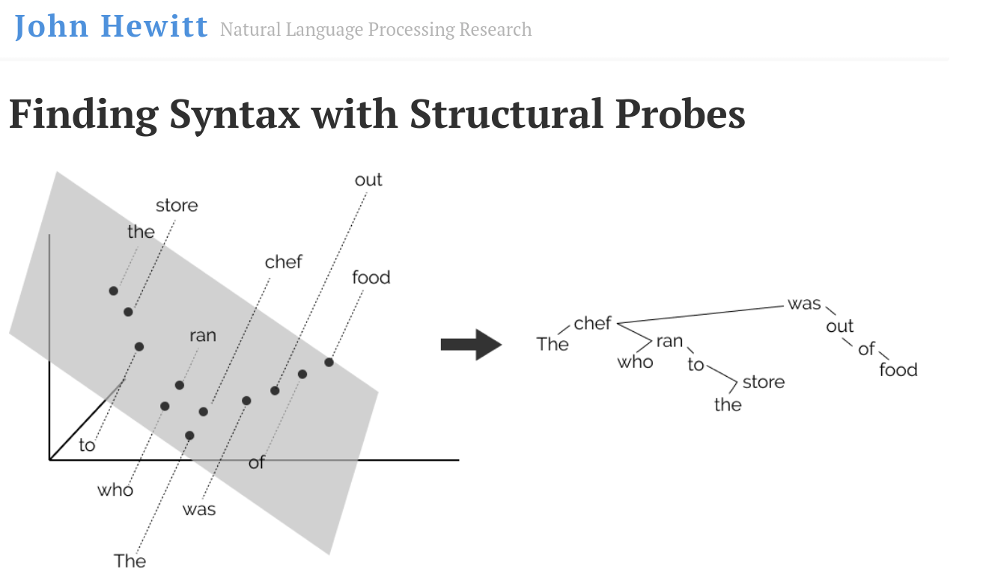
NATURAL LANGUAGE PROCESSING
Figure 3. Finding Syntax. Retrieved from https://nlp.stanford.edu/~johnhew/structural-probe.html
Notes:
“open questions remain as to whether deep contextual models encode entire parse trees in their word representations.” (Hewitt, 2019)

Slide 12
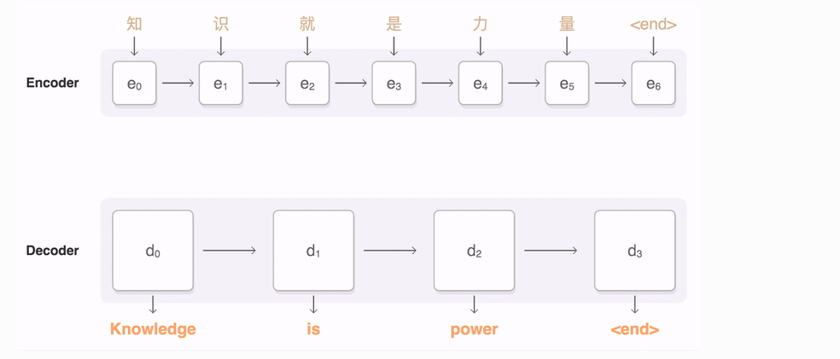
NATURAL LANGUAGE PROCESSING
Sequence - to - Sequence (Seq2Seq)
Figure 4. Seq2Seq. Retrieved from https://google.github.io/seq2seq/
Notes:
“tf-seq2seq is a general-purpose encoder-decoder framework for Tensorflow that can be used for Machine Translation, Text Summarization, Conversational Modeling, Image Captioning, and more.” ()https://google.github.io/seq2seq/

Slide 13
REFERENCES
Figure 1.A.U.Th. logo. Retrieved from https://www.auth.gr/en/logo
Manning, C., Surdeanu, M., Bauer, J., Finkel, J., Bethard, S., & McClosky, D. (2014, June). The Stanford CoreNLP natural language processing toolkit. In Proceedings of 52nd annual meeting of the association for computational linguistics: system demonstrations (pp. 55-60).
Lecture Notes. CS224d. Retrieved from http://cs224d.stanford.edu/lecture_notes/notes1.pdf
Li, Y., & Zhang, Y. Question Answering on SQuAD 2.0 Dataset.
Devlin, J., & Chang, M. W. (2018). Open Sourcing BERT: State-of-the-Art Pre-training for Natural Language Processing. Google AI Blog, November, 2.
Figure 2. Softmax. Image. Retrieved from https://developers.google.com/machine-learning/crash-course/multi-class-neural-networks/softmax
Eisenstein, J. (2019). Introduction to natural language processing. Mit Press.
Daniel Jurafsky and James H. Martin. 2008. Speech and Language Processing: An Introduction to Natural Language Processing, Computational Linguistics and Speech Recognition. Second Edition. Prentice Hall.

Slide 14
REFERENCES
Figure 3. Finding Syntax. Retrieved from https://nlp.stanford.edu/~johnhew/structural-probe.html
Hewitt, J., & Manning, C. D. (2019, June). A structural probe for finding syntax in word representations. In Proceedings of the 2019 Conference of the North American Chapter of the Association for Computational Linguistics: Human Language Technologies, Volume 1 (Long and Short Papers) (pp. 4129-4138).
Figure 5. Word2vec. Retrieved from https://cs224d.stanford.edu/lectures/CS224d-Lecture2.pdf
Figure 4. Seq2Seq. Retrieved from https://google.github.io/seq2seq/

