Slide 1

Figure 1.A.U.Th. logo. Retrieved from
https://www.auth.gr/en/logo
Journal article presentation: Netflix streaming service example
Andrei Volodin
January 2020
DIM107
By Andrei Volodin DIM101 November 2019

Slide 2
Anders Fagerjord & Lucy Kueng (2019):
Mapping the core actors and flows in streaming video services: what Netflix can tell us about these new media networks,
Journal of Media Business Studies,
DOI: 10.1080/16522354.2019.1684717

Slide 3
The article observes recently emerged streaming services and platforms. The notion includes but not limited to the listed below:
Netflix (switched to streaming service in 2007)
Spotify
Hulu
Amazon Video
Youtube (launched in 2005)
HBO Now
Standalone businesses
Divisions of large conglomerates

Slide 4
Streaming services compete with:
national linear broadcasts (radio and television),
services for downloading and saving media content (iTunes),
purchase of media content (CDs, boxed sets).

Slide 5
Netflix
Founded in 1997 as an online DVD mail-order rental service, Netflix is now a global movie and TV series entertainment network, offering streamed content on a subscription basis on any internet-connected screen (Finn, 2017)
Netflix has expanded internationally progressively and now operates in 190 countries, reaching 125 million subscribers worldwide as of April 2018
In 2018 it plans to spend $8 bn on content which will include 700 original TV shows, including 80 non-English language original productions from outside the US.

Slide 6
It invests heavily into content acquisition
It bids for exclusive rights to SVOD rights against cable and broadcast networks and online suppliers, typically buying multi-year exclusive SVOD licences. At the time of renewal, it evaluates viewing, as well as number of similar titles, to determine whether it will rebuy and how much it is willing to pay. Payments are fixed and not scaled according to number of subscriptions or viewership figures.
It produces its own content (House of Cards)
In the US, over half of all households subscribed to a paid streaming service and Netflix has half of it

Slide 7
Computational Resources - Amazon AWS
Distribution - Content Delivery Networks (CDN) & “Last mile” Internet Service Providers (ISP)
“Netflix alone is reported to account for over a third of all internet traffic”
“is financed through long-time debt”

Slide 8
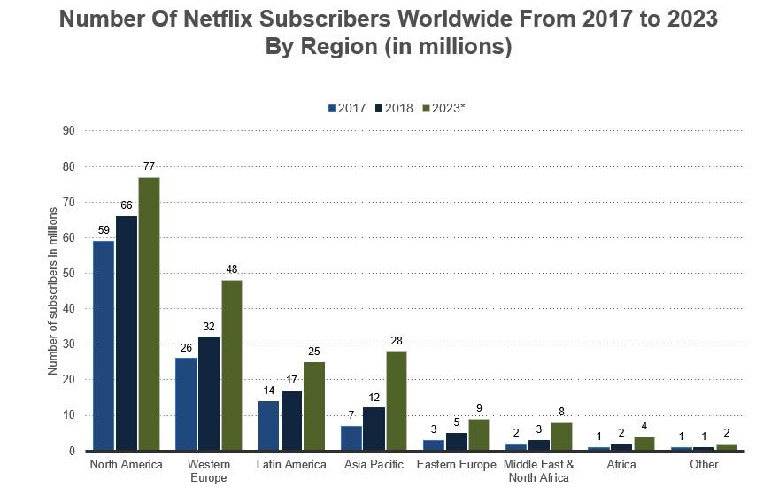
Notes:
source : Forbes

Slide 9
References:
Fagerjord, A., & Kueng, L. (2019). Mapping the core actors and flows in streaming video services: what Netflix can tell us about these new media networks. Journal of Media Business Studies, 1–16. doi:10.1080/16522354.2019.1684717
Figure 1.A.U.Th. logo. Retrieved from https://www.auth.gr/en/logo
Chart 1. Number of users. Retrieved from https://www.forbes.com/sites/louiscolumbus/2018/07/12/10-charts-that-will-change-your-perspective-of-netflixs-massive-success-in-the-cloud/#508936e42303

