Slide 1
ETL MINi-PROJEcT
GROUP: bde (Big data energy)
André Westerberg, David krylstedt & Jinshu Pan

Slide 2
introduction
API-SOURCE: MET NORWAY LOCATIONFORECAST
ETL PIPELINE
API REQUEST
RAW JSON
HARMONIZED
CLEANSED
STAGED

Slide 3
INTRODUCTION
LOCATIONS
STARTED WITH ONE → MANY
STOCKHOLM, GOTHENBURG, MALMOE, BERGEN, REYKJAVIK
VISUALIZATION

Slide 4


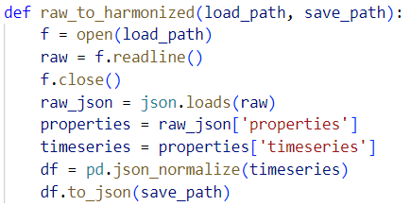
CODE

Slide 5
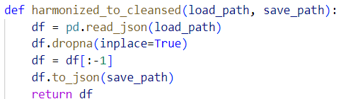
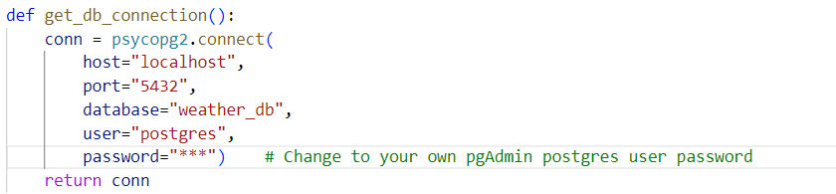
CODE

Slide 6
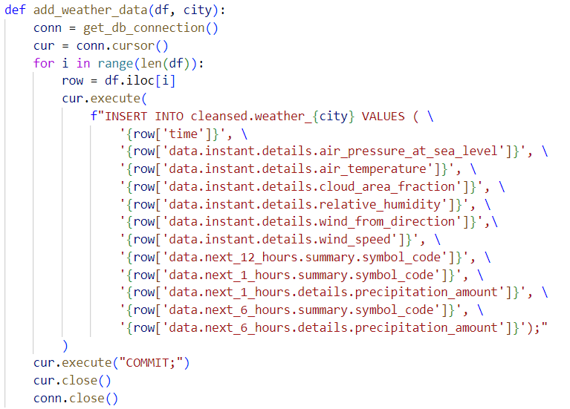
CODE

Slide 7
demo

Slide 8
Experiences
ROLES
GIT
DAG/AIRFLOW
CODE REVIEW
PYTHON
SQL

Slide 9
Experiences
PROBLEMS
PANDAS
DAG/AIRFLOW
LISTS & DICTIONARIES
USE EVERYONES BEST SKILLS
REGROUP AND PRIORITIZE OFTEN
GITHUB-REPO: https://github.com/AndreWesterberg/MET.git

Slide 10
QUESTIONS?

