Slide 1
ETL MINi-PROJEcT
GROUP: bde (Big data energy)
André Westerberg, David krylstedt & Jinshu Pan

Slide 2
introduction
API-SOURCE: MET NORWAY LOCATIONFORECAST
ETL PIPELINE
API REQUEST
RAW JSON
HARMONIZED
CLEANSED
STAGED

Slide 3
INTRODUCTION
LOCATIONS
STARTED WITH ONE → MANY
STOCKHOLM, GOTHENBURG, MALMOE, BERGEN, REYKJAVIK
DAG/AIRFLOW
VISUALIZATION

Slide 4


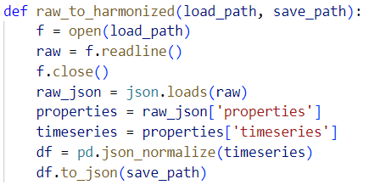
CODE

Slide 5
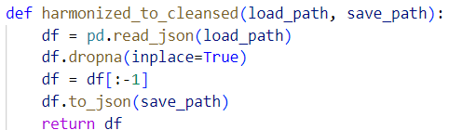
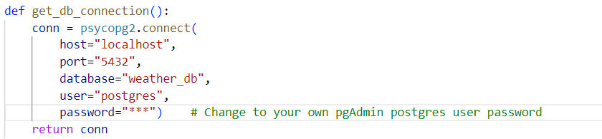
CODE

Slide 6
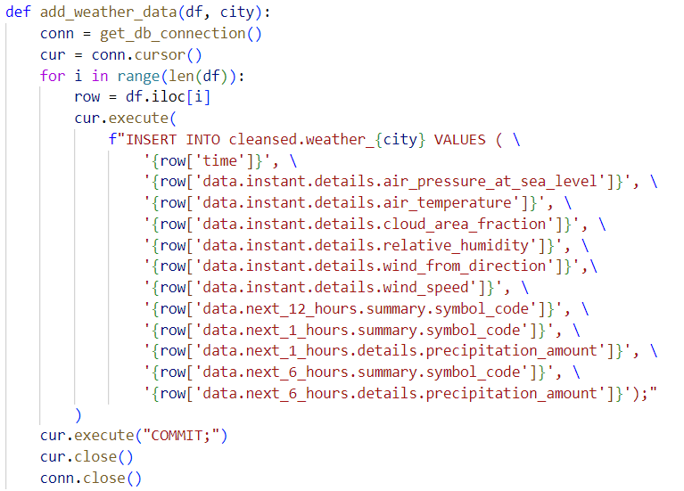
CODE

Slide 7
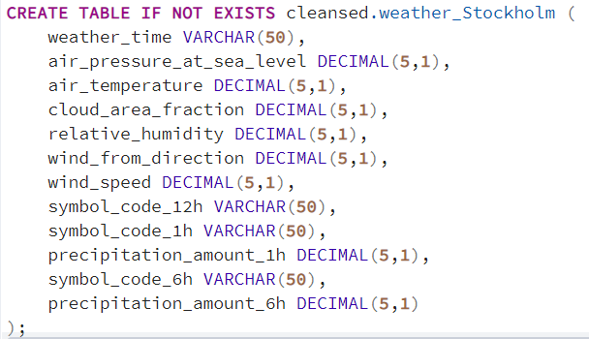
SQL example

Slide 8
demo

Slide 9
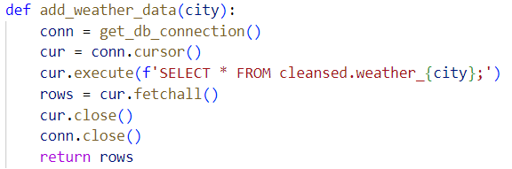
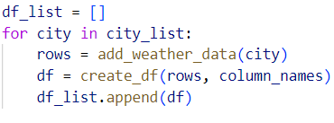
visualization

Slide 10
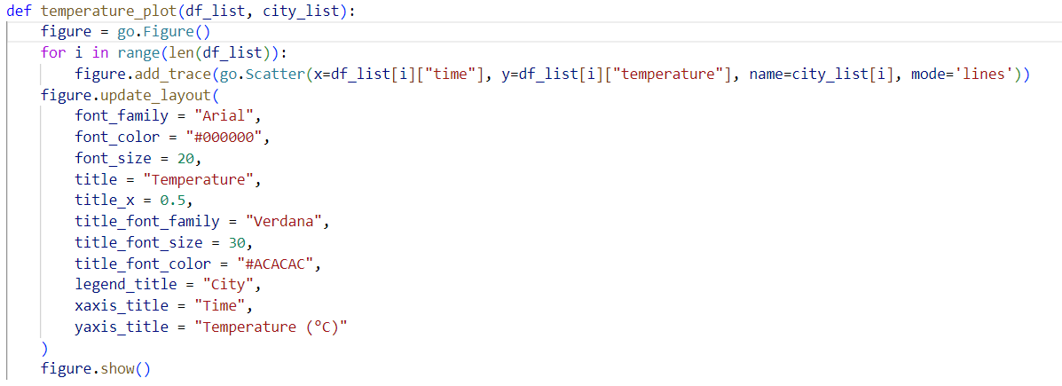
visualization

Slide 11
Plotting

Slide 12
Experiences
ROLES
GIT
DAG/AIRFLOW
CODE REVIEW
PYTHON
SQL
Notes:
En till flera städer

Slide 13
Experiences
PROBLEMS
PANDAS
DAG/AIRFLOW
LISTS & DICTIONARIES
USE EVERYONE’S BEST SKILLS
REGROUP AND PRIORITIZE OFTEN
GITHUB-REPO: https://github.com/AndreWesterberg/MET.git

Slide 14
QUESTIONS?

