Slide 1
Multiprocessing-Enhanced Parallelization for LSB Image-in-Image Steganography
Faculty of Computer Sciences & Engineering, St Cyril and Methodius University, Skopje
Andrea Stevanoska 226001

Slide 2
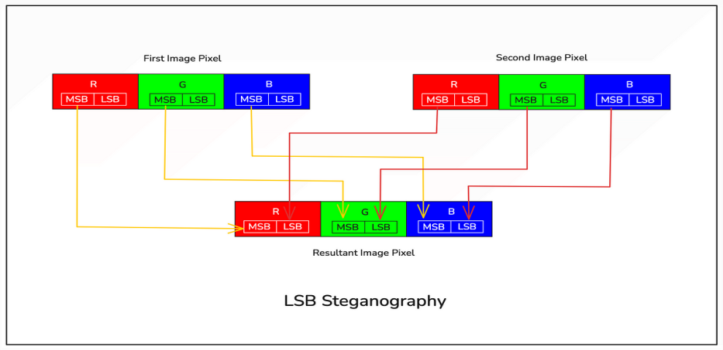
What is steganography?
Definition: The practice of hiding information within other data (e.g., images, audio, video).
Used for secure communication and data protection.
Image Steganography: Hiding data within images in a way that is imperceptible to the human eye.
LSB technique replaces the least significant bits of an image’s pixel values with the most significant bits of the secret image’s pixels.

Slide 3
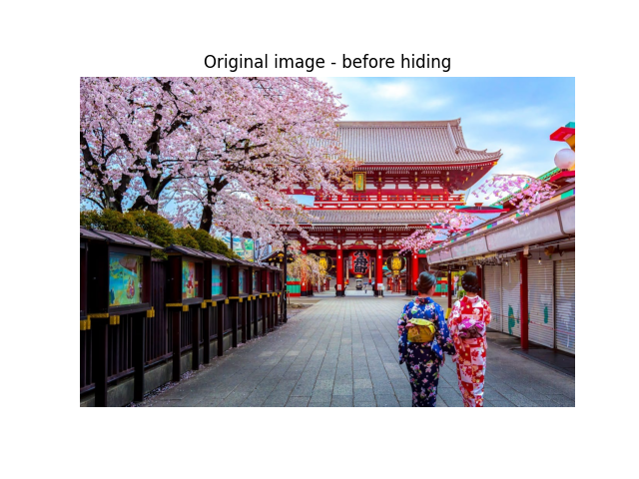
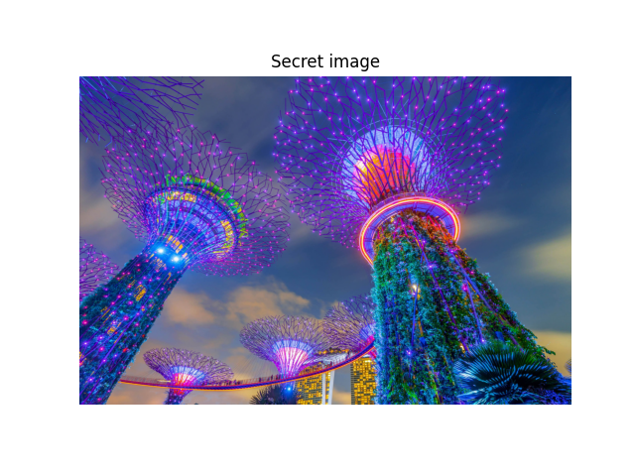
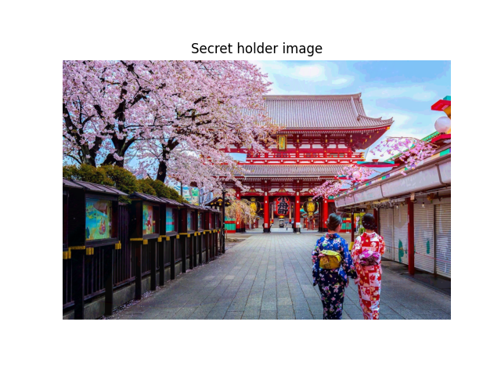


Slide 4
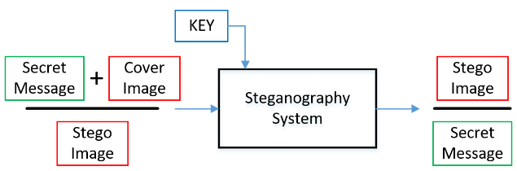
Motivation
Challenges with traditional sequential LSB
Enabling faster image steganography encoding and decoding.
Starter Questions:
Does a parallelized approach significantly reduce encoding and decoding time compared to sequential processing?
Do the final images have the same quality as in the non-parallel approach?

Slide 5
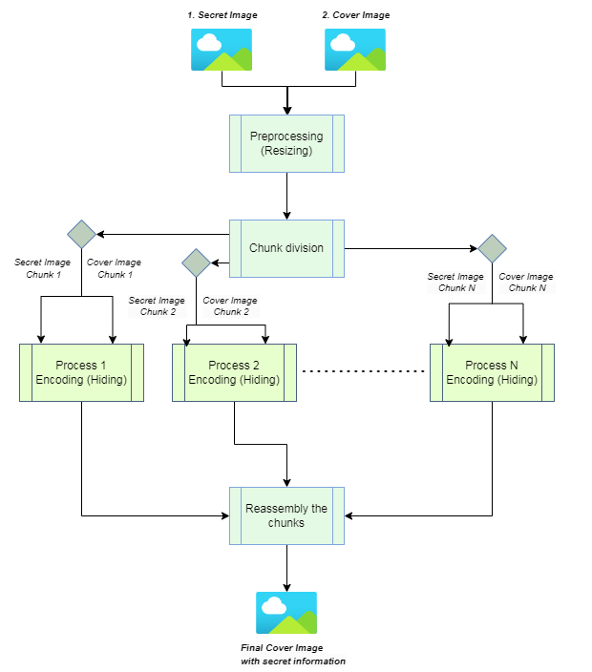
Solution Architecture 1.0
Sequential Approach – one pixel at a time
Parallel Approach: Encoding
Preprocessing
Chunk division
Encoding each pair of chunks
Reconstruction

Slide 6
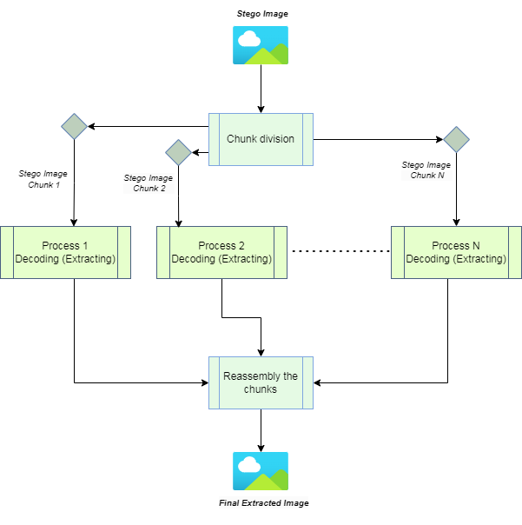
Solution Architecture 2.0
Parallel Approach: Decoding
Chunk division
Decoding each chunk
Reconstruction

Slide 7
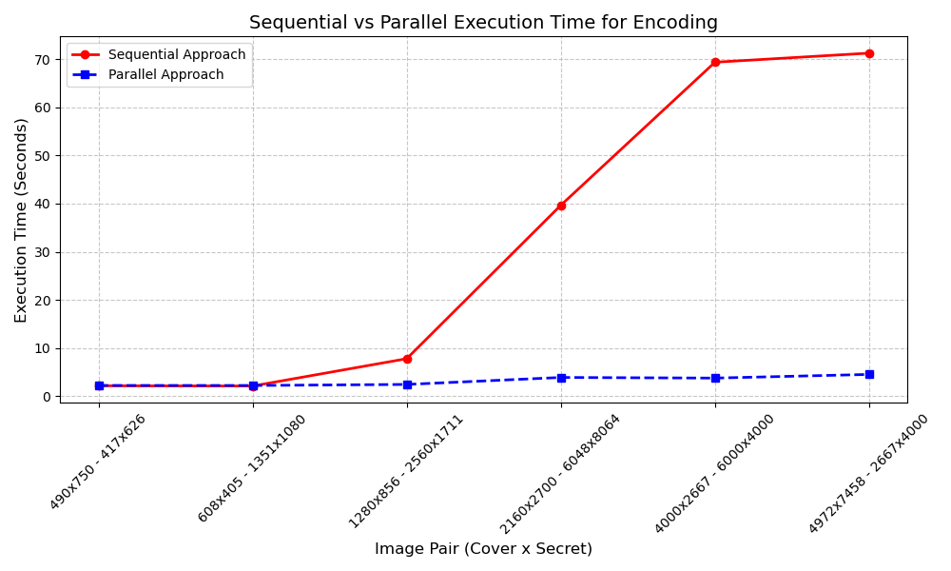
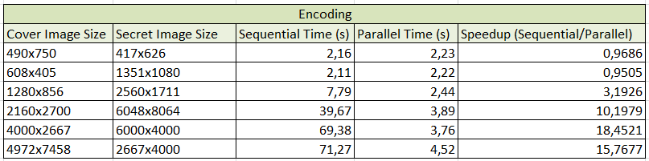
Results 1.0
Encoding Performance Analysis
Speedup = Sequential Time / Parallel Time

Slide 8
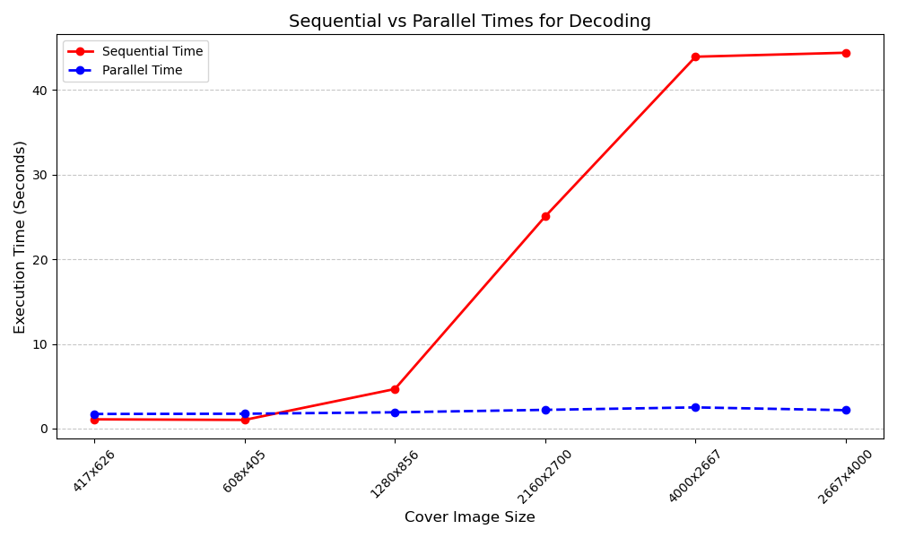
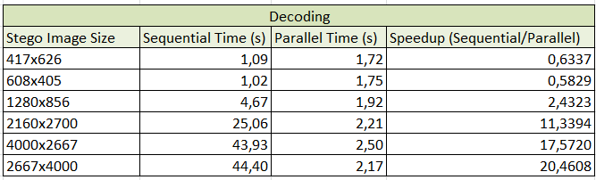
Results 2.0
Decoding Performance Analysis
Speedup = Sequential Time / Parallel Time

Slide 9
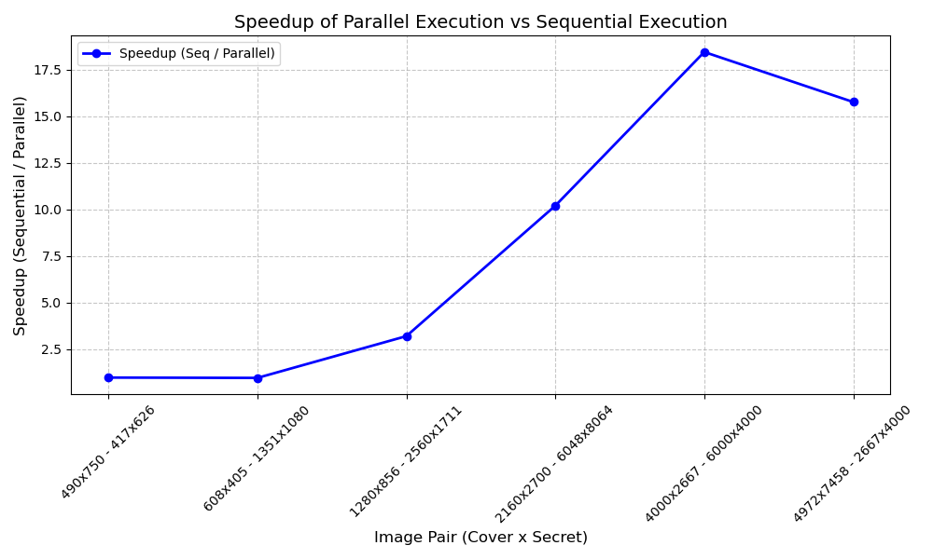
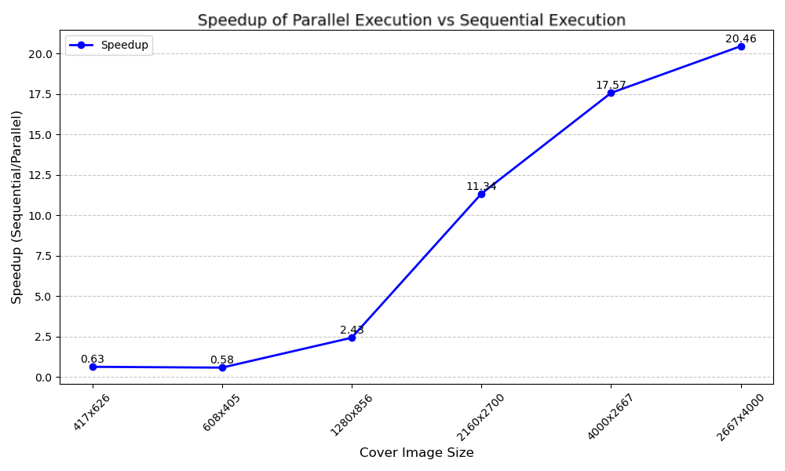
Results 3.0
Speedup plots side by side
Encoding Speedup
Decoding Speedup

Slide 10
Conclusion
Conclusion: Parallelization improves efficiency while maintaining image quality.
Up to 17 times faster for encoding and 20 times for decoding.
Future Work:
Explore distributed computing frameworks for large-scale applications.

Slide 11

Thank you for your attention!

