Slide 1


Grounding Dino
Facoltà di Ingegneria dell’Informazione, Informatica e Statistica
Corso di Laurea Magistrale in AI & Robotics
Yusupha Juwara
A.Y 2024

Slide 2
1/3 Grounding Dino
https://www.youtube.com/watch?v=o1t8s5innZ8&ab_channel=WhyML
For each (Image, Text) pair,
we first extract vanilla image features and vanilla text features using an image backbone and a text backbone, respectively.
The two vanilla features are fed into a feature enhancer module for cross-modality feature fusion.
After obtaining cross-modality text and image features, we use a language-guided query selection module to select cross-modality queries from image features.
Like the object queries in most DETR-like models, these cross-modality queries will be fed into a cross-modality decoder to probe desired features from the two modal features and update themselves.
The output queries of the last decoder layer will be used to predict object boxes and extract corresponding phrases.

Slide 3
2/3 Grounding Dino
Open-set object detector can detect arbitrary objects with human inputs such as category names or referring expressions. -> language + closed-set object detector
REC typically involves understanding and localizing objects in an image based on natural language descriptions or references, such as "the red ball" or "the object on the left.” -> Describing objects with attributes
3 important modules, a backbone for feature extraction, a neck for feature enhancement, and a head for box prediction (cross modality).
Dual-encoder-single-decoder architecture
Image backbone -> image feature extraction
Text backbone -> text feature extraction
contrastive loss between object regions/queries and text features
encourages the model to learn to associate the object queries with relevant text information
Bounding box regression loss
measures how well the predicted bounding box coordinates align with the ground truth bounding boxes.
Losses used: L1 loss and Generalized Intersection over Union (GIOU) loss

Slide 4
3/3 Grounding Dino
To make the closed-set detector capable of detecting “novel objects”, it needs to learn "language-aware region embeddings." This implies that the model should understand the relationship between language (human-provided descriptions or labels) and regions of interest within an image.
Each region of interest to “novel categories”
Outputs multiple pairs of object boxes and noun phrases for a given (Image, Text) pair
The classification of regions into novel categories is done in a "language-aware semantic space." This means that language descriptions and image regions are connected in a way that enables the model to understand and use language to categorize or identify objects.
Language-Guided Query Selection
Aim -> Detect objects from an image specified by an input text
select features that are more relevant to the input text as decoder queries.
outputs num-query (900) indices to extract features to initialize queries.

Slide 5
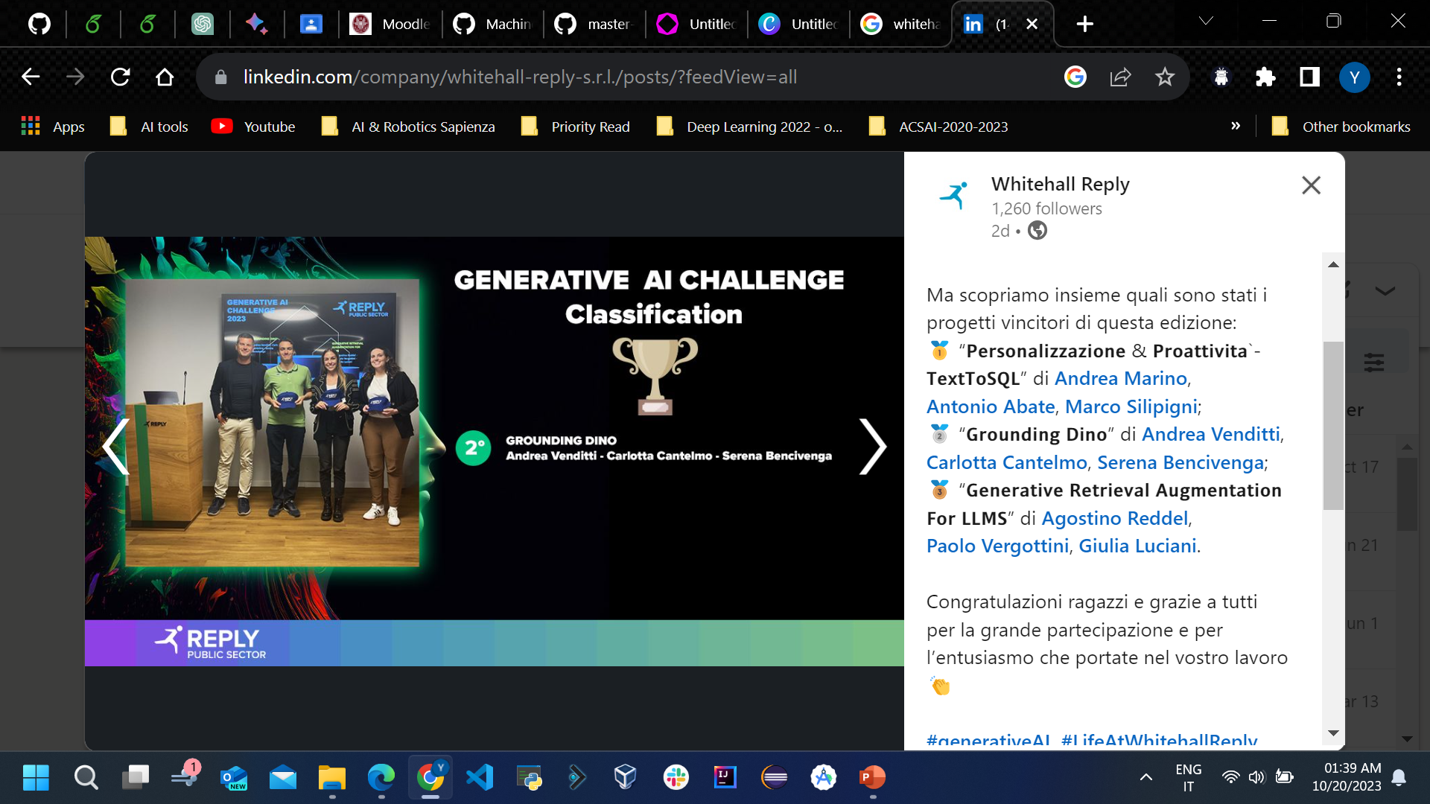
Implementation

Slide 6
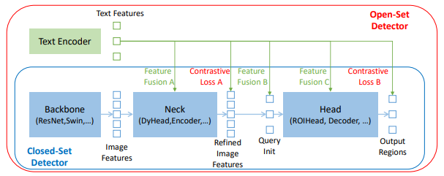
Grounding Dino
Open-set object detector
Referring expression comprehension (REC)
Describing objects with attributes (noun phrases)
Zero-Shot Transfer for Model Generalization
Dual-encoder-single-decoder architecture
Next page
Cross-Modality Feature Fusion
Feature Extraction
Feature Enhancer
Cross-Modality Decoder
Language-Guide Query Selection

Slide 7
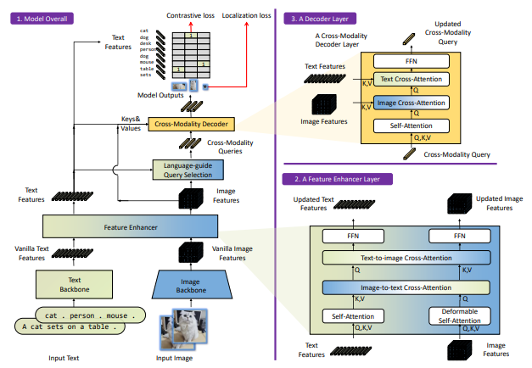
Grounding Dino Architecture
Outputs multiple pairs of object boxes and noun phrases
select cross-modality queries from image features
cross-modality feature fusion

Slide 8
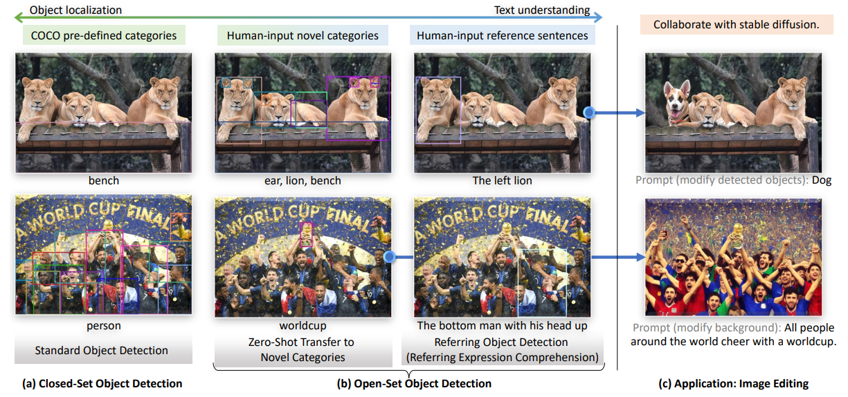
Grounding Dino Example

Slide 9
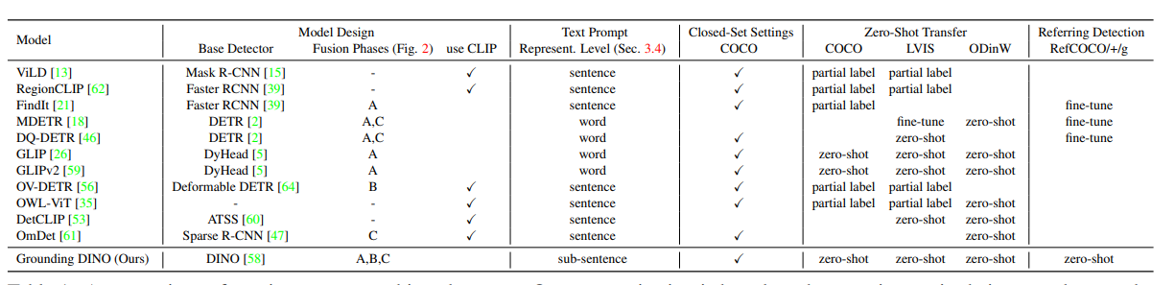
Grounding Dino Summary
A comparison of open-set object detectors.

Slide 10
References
Liu, Shilong, et al. "Grounding dino: Marrying dino with grounded pre-training for open-set object detection." arXiv preprint arXiv:2303.05499 (2023).

