Slide 1
AI/ML based Intelligence framework in ONOS

Slide 2

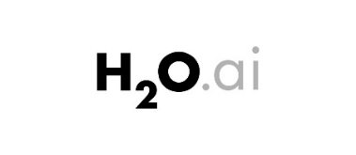




Artificial Intelligence framework at ONOS
Automation Workflows
Analytics Manager
AI-as a Service (AIaaS)
ML Adapter
Data Monitor
Netflow
Sflow
Data Source
New blocks in ONOS

Slide 3
Sequence Diagram – 1. Activation of Netflow/Sflow
Device
NetFlow
Monitoring Data Store
activation
Data Sampling
Stores the data and maintain for latest interval(configurable)

Slide 4
Sequence Diagram – 2. Initiate Data Monitoring
Data Monitor
NetFlow
ML Adapter
AI Agent
Set Source
Fetch Data information
Create Data Base Request
Create Data Base
DB Creation
Fetch Data
At Scheduled Interval
Insert Data Request
Insert Data
Stores the data

Slide 5
Sequence Diagram – 3. Initiate Data Training
Workflow [UsecaseApp]
Analytics Manager
ML Adapter
AI Agent
Third Party AIML tool
Training Template Creation
Training Template push Request
Training Template push and Training
Data Training
Notification
Notification
Event Publisher
Event Listener

Slide 6
Sequence Diagram – 4. Prediction
Workflow [UsecaseApp]
Analytics Manager
ML Adapter
AI Agent
Third Party AIML tool
Prediction Request
Prediction Request
Prediction request
Data Prediction
Notification
Notification
Event Publisher
Event Listener

