Slide 1

Netconf South-Bound Interface

Slide 2
summary
North Bound / South Bound
Netconf
Capabilities Exchanges
Remote Procedure Call
Working environment
TestON
Configuration files
TestON results
To do
Useful links
Q&A

Slide 3
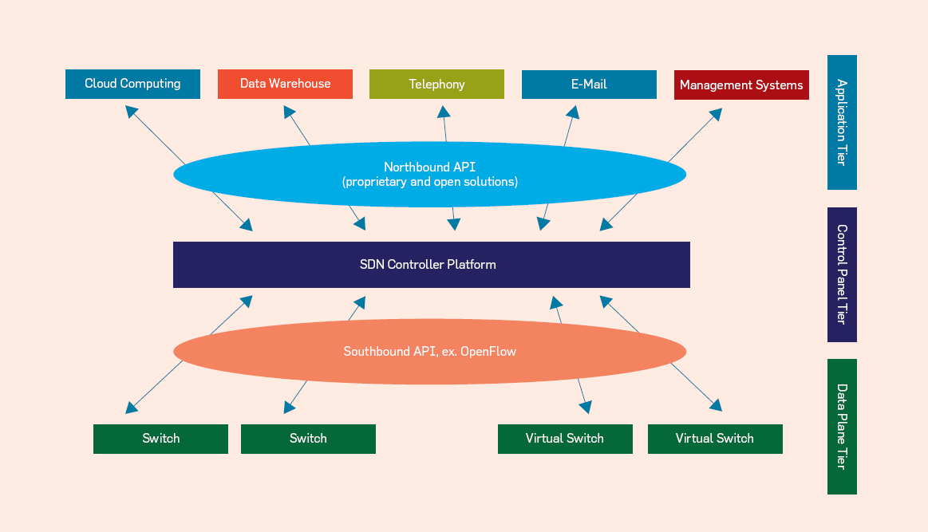
North bound / South bound

Slide 4
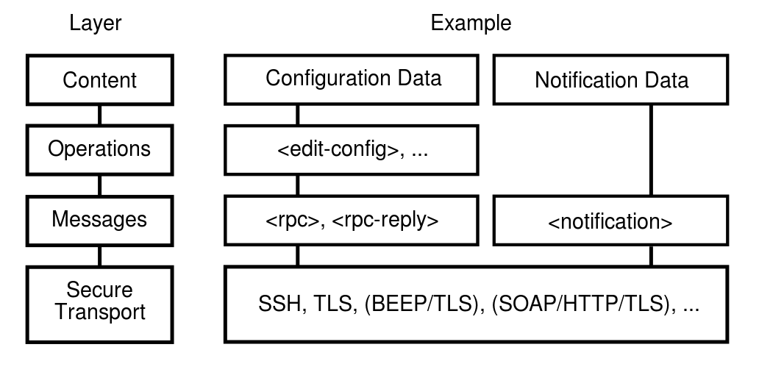
Netconf 1.0 RFC 4741

Slide 5
Capabilities exchanges
From the device :
<hello xmlns="urn:ietf:params:xml:ns:netconf:base:1.0">
<capabilities>
<capability>urn:ietf:params:netconf:base:1.0</capability>
<capability>urn:ietf:params:netconf:base:1.1</capability>
<capability>urn:ietf:params:netconf:capability:writable-running:1.0</capability>
<capability>urn:ietf:params:netconf:capability:candidate:1.0</capability>
<capability>urn:ietf:params:netconf:capability:startup:1.0</capability>
<capability>urn:ietf:params:netconf:capability:rollback-on-error:1.0</capability>
</capabilities>
</hello>

Slide 6
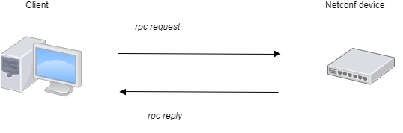
Remote Procedure Call
<rpc xmlns="urn:ietf:params:xml:ns:netconf:base:1.0" message-id="1">
<get-config>
<source>
<running/>
</source>
</get-config>
</rpc>

Slide 7


Work station
CentOS 7 system, 3.20 GHz 8-core CPU, 5.7 Go
Virtual Machine

Slide 8
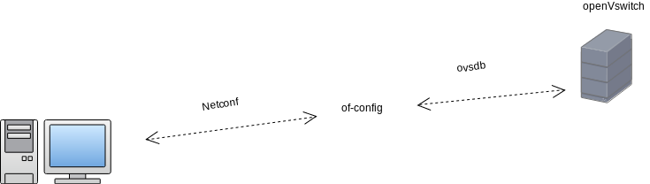
Description of the VM
HOST
VM

Slide 9
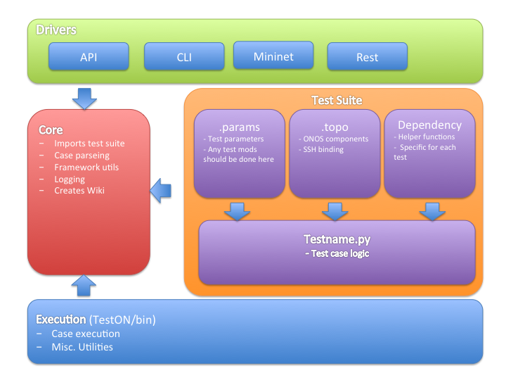
TestON

Slide 10
topo
<ONOScell>
<host>192.168.3.10</host>
<user>sdn</user>
<password></password>
<type>OnosClusterDriver</type>
<connect_order>1</connect_order>
<COMPONENTS>
<cluster_name></cluster_name>
<diff_clihost></diff_clihost>
<karaf_username></karaf_username>
<karaf_password></karaf_password>
<web_user>onos</web_user>
<web_pass>rocks</web_pass>
<rest_port></rest_port>
<prompt>onos</prompt>
<onos_home>~/onos</onos_home>
<nodes> 1 </nodes>
</COMPONENTS>
</ONOScell>

Slide 11
<Mininet1>
<host>192.168.3.12</host>
<user>mininet</user>
<password>mininet</password>
<type>MininetCliDriver</type>
<connect_order>2</connect_order>
<COMPONENTS>
<home>~/mininet</home>
</COMPONENTS>
</Mininet1>

Slide 12
param
<PARAMS>
<!--
CASE0: pull onos code - this case should be skipped on Jenkins-driven prod test
CASE1: setup and clean test env
CASE2: get onos warnings, errors from log
CASE10: start a 1-node ONOS Cluster
CASE11: Start Mininet and assign controllers
CASE12: Connect to a physical network and assign controllers
CASE20: Sample case of using onos cli
CASE30: Sample case of using onos rest
CASE40: Configure fwd apps and run pingall
Sample testcases for physical network: 0,1,10,12,20,2
-->
<testcases>0,1,10,11,20,2</testcases>

Slide 13
<CASE1>
<SleepTimers>
<onosStartup>60</onosStartup>
<onosCfg>5</onosCfg>
<mnStartup>15</mnStartup>
<mnCfg>10</mnCfg>
</SleepTimers>
</CASE1>

Slide 14
TestON results
Case 1: Constructing test variables and building ONOS package - PASS
For loading from params file, and pull and build the latest ONOS package
1.1 Constructing test variables - PASS
Case 10: Starting up 1 node(s) ONOS cluster - PASS
Set up ONOS with 1 node(s) ONOS cluster
10.1 Start ONOS cluster with basic (drivers) app. - No Result
10.2 Apply cell to environment - PASS
10.3 Uninstalling ONOS package - PASS
10.4 Creating ONOS package - PASS
10.5 Set up ONOS secure SSH - PASS
10.6 Checking ONOS service - PASS
10.7 Starting ONOS CLI sessions - PASS
Case 12: Test some onos commands through CLI. - PASS

Slide 15
*************************************
Test Execution Summary
*************************************
Test Start : 30 Mar 2018 18:00:13
Test End : 30 Mar 2018 18:00:23
Execution Time : 0:00:10.277623
Total tests planned : 4
Total tests RUN : 4
Total Pass : 4
Total Fail : 0
Total No Result : 0
Success Percentage : 100%
Execution Result : 100%
Case Executed : [0, 1, 10, 12]
Case Not Executed : []

Slide 16
To do
Test on a larger topology
Test the set command
Add timers on more code portion
Test on a physical device
Timer on more code portion

Slide 17
Useful links
RFC NETCONF 1.0 : https://tools.ietf.org/html/rfc4741
Wiki ONOS NETCONF overview https://wiki.onosproject.org/display/ONOS/NETCONF
Wiki ONOS TestON tutorial https://wiki.onosproject.org/pages/viewpage.action?pageId=2133836
Github Paxterra TestON : https://github.com/Paxterra/TestON
VM NETCONF simulator OFC and OVS : http://downloads.onosproject.org/vm/onos-ofconfig-netconf.ova

Slide 18
Q&A
Any questions ?

