Slide 1
ONOS EMU Release
December 2015
Bill Snow
bill@onlab.us

Slide 2
The Virtuous Cycle has made ONOS deployment ready
Community Growth is strong and accelerating
ONOS Community Contributions are Diversifying

Slide 3
Platform and Solutions: The Virtuous Cycle
Enable
Platform
Solutions
SDN OS: ONOS
Enrich
CORD
R-CORD
E-CORD
M-CORD
Packet-Optical
SDN-IP Peering
Anchor Stack
Multicast content dist
…
Notes:
ONOS is the SDN OS platform that enables many solutions and that is the value of ONOS or any platform for that matter.
We are in the process of creating the following solutions with ONOS.
And as we build these solutions and make them more and more real, we find new requirements and opportunities to make ONOS better.
This has been a very powerful cycle – it has been true for other platforms in the past.

Slide 4
ONOS Journey
Clean Slate Design ➔ Service Provider Deployment
Central Office Re-architected as Datacenter
Packet Optical Convergence
SDN-IP Peering
Anchor Stack
Whitebox Router
Lab Trials and Deployments
CORD
Emu Release
Best in class performance
3M+ Flow Ops/sec
Sub 100ms to react to network events
HA: non-stop operation with component failures
OPNFV
Security
Drake Release
SDN/NFV Solution POCs
Cardinal Release
CORD POD
OPNFV L3 support
Service Function Chaining
BGP LS
Yang defined L3VPN
Well architected & modular
Easy to use GUI
Tutorial VM
Videos: ONOS + Use Cases
Scalability Performance, HA
Blackbird Release
OPNFV, OpenStack, Atrium, CloudRouter
Login, GUI, REST security
Security Mode ONOS
Device Configuration
PCEP, DHCP, Multicast…
Open Source
Avocet Release
2+ Years R&D
Clean-slate Design
Dec, 2014
Feb 2015
May 2015
Aug 2015
Dec 2015

Slide 5
Rapid ONOS Platform Evolution
Minimal Features and Functions
Many Features and Functions
Solid Architecture Foundation
Strengthened Architecture/Core
Skeleton Platform
Dec, 2014
Closer to Production Readiness
Dec, 2015

Slide 6
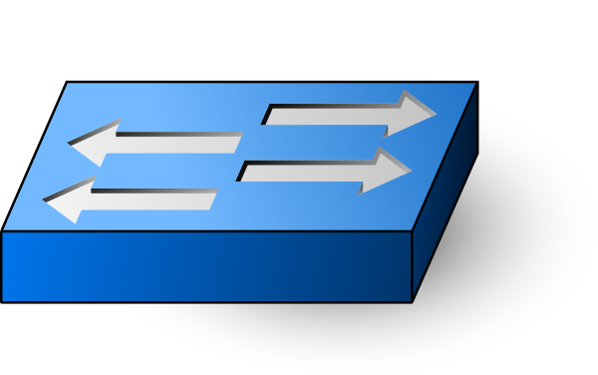
ONOS Carrier Grade Architecture
Scaleout Design
Apps
Apps
Northbound Abstractions Application Intent Framework
Flow Objectives
Network Graph
Core
Southbound Abstraction
Protocol Plug-ins
Northbound - Application Intent Framework
(policy enforcement, conflict resolution, virtualization, slicing)
Distributed Core
(scalability, availability, performance, persistence)
Southbound
(discover, observe, program, configure)
OpenFlow
NetConf
. . .

Slide 7
Rapid ONOS Platform Evolution
ONOS Release | Avocet | Blackbird | Cardinal | Drake | Emu
Northbound | Basic App Intent Framework (AIF) | AIF, cluster-wide app deployment | MPLS + tunnel intents, performance, conflict resolution, flow objectives | Login authentication, virtualization basics | gRPC, resource reservation, security mode onos perf
Core | Distributed state management for scale, performance, HA | Eventually, strongly (RAFT) consistent maps | Dropped Hazelcast, dist primitives, | TLS for security, metering support, multicast, | Multicast, Flowrule store persistence
Southbound | OpenFlow (OF) | Multi-table OF | TL-1, NETCONF | Device config, OVSDB, NETCONF/Yang, PCEP, VXLAN | NETCONF/Yang, Optical support
GUI | GUI: developer & user | Modularized GUI | GUI support for all POCs, multiple GUI views | Topology overlays, link highlighting | New overlays, GUI archetypes, docs, samples
Overall | Arch + functional + GUI + use cases clean arch + quality modular code + protocol independence | Demonstrated scale, HA, performance; increased robustness | Support for use cases: CORD, packet-optical, SDN-IP, … Additional SB | Security mode ONOS, Integration with OPNFV, OpenStack, CloudRouter | Much app work, deployments, many partner contributions

Slide 8
Emu Enhancements
Apps, UI | CORD OPNFV - IETF Service Function Chaining, VTN enhancements for L2, L3 VPNs SDN-IP - dynamic configuration of peers, reactive routing, default route support DPI/Flow Monitoring SONA - Simplified Overlay Networking Architecture - Ease deployment of software defined data centers - OpenStack switching and interfaces GUI archetypes for views, badged nodes | AT&T, Ciena, Ericsson, ON.Lab, SK Telecom Huawei ON.Lab ETRI SK Telecom ON.Lab
NB | Generalized resource reservation (links, lambdas, …) Security Mode ONOS performance enhancements gRPC (high performance RPC - mobile/http/2 environments) | Fujitsu KAIST/SRI ON.Lab
Core | Multicast infrastructure - MFWD app, PIM-SSM prune/join, static routes Flowrule store persistence | DirecTV ON.Lab
SB | ONF optical transport protocol extensions, Optical Channel Data Unit (ODU) Multiplexing and ODU Cross connect services LLDP based LinkDiscovery now configurable via Network Configuration subsystem | ECI Telecom NEC
Deploy | AARNET, KISTI/KREONET-S | AARNET, KISTI
Notes:
The southbound interfaces are based on OpenFlow. This enhancement includes support in creation , deleting and restoration of data paths.
ECI has successfully demonstrated these features with ONOS over ECI Optical Equipment (Apollo and Neptune product families) , this will apply to any equipment that supports OpenFlow Optical extensions.
ECI plans to continue and contribute to ONOS and ONF communities in the following areas:
· Enhanced Optical Modeling: adding physical limitations and restrictions including real-time network status, to enable the configuration of optical networks (in conjunction with ECI's work at ONF)
· Enhanced programmability of the data path, with strong emphasis on OpenFlow enhancements
· Enhanced the Northbound interfaces: to enable the creation of a wide range of SDN applications that can take full advantage of all of the capabilities of the data path and of the services provided by the controller.
"GUI archetypes" allow a developer to quickly set up skeleton code that they can use as the basis for adding GUI functionality from their application.

Slide 9
Platform and Solutions: The Virtuous Cycle
Enable
Platform
Solutions
SDN OS: ONOS
Enrich
CORD
R-CORD
E-CORD
M-CORD
Packet-Optical
SDN-IP Peering
Anchor Stack
Multicast content dist
…
Notes:
ONOS is the SDN OS platform that enables many solutions and that is the value of ONOS or any platform for that matter.
We are in the process of creating the following solutions with ONOS.
And as we build these solutions and make them more and more real, we find new requirements and opportunities to make ONOS better.
This has been a very powerful cycle – it has been true for other platforms in the past.

Slide 10

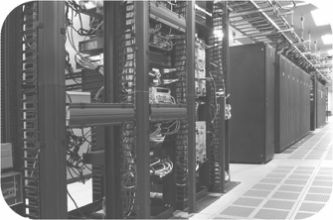
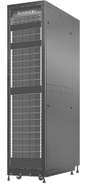
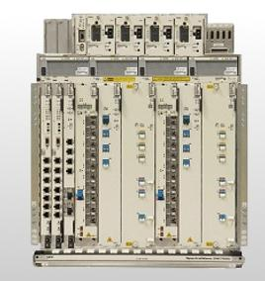

CORD: Central Office Re-architected as Datacenter
SDN Control Plane - ONOS
NFV Orchestration w/XOS
White Box
White Box
White Box
White Box
Leaf-Spine
Fabric
Large number of COs
SDN enabled DC Fabric
White Box
White Box
White Box
White Box
White Box
White Box
White Box
White Box
White Box
White Box
White Box
White Box
Evolved over 40-50 years
Access
(Core)
300+ Types of equipment Huge source of CAPEX/OPEX
Commodity servers, switches, and network access

Slide 11
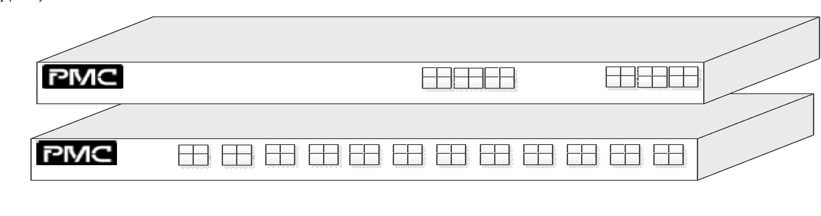




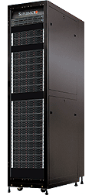
R-CORD – Hardware Architecture
48-port, 1RU, I/O Board
Leaf-Spine
Fabric
ROADM
(Core)
PON
OLT MACs
PON
OLT MACs
GPON
(Access)
Commodity Servers, Storage, Switches, and I/O

Slide 12
CORD – Software Architecture
VNFs/Network Control Apps
. . .
. . .
Manage
VNFsNet Control Apps
XOS
Manage Fabric and
Host Control Apps
OpenStack
Control
Applications
Nova
Keystone
Neutron
. . .
. . .
ONOS
Virtual Machines
(instantiated on
commodity servers)
Manage Virtual
Infrastructure
Virtual Networks and other Flow Rules
(programmed into switching fabric)

Slide 13

Generalization of CORD: Domains of Use
Residential
Virtual infra + ONOS + vOLT, vSG, vRouter, vCDN
Mobile Edge
Customized mobile proc
Disaggregated EPC
Disaggregated eNodeB /5G
Enterprise
VPNs, TE, vCDN, packet-optical convergence
Infra Slices
ONOS (Virtualization, Slicing) + OpenStack + XOS
Leaf-Spine
Fabric
ROADM
(Core)
Enterprise
Metro Ethernet
BBUs (Multi-RATs)
PON
OLT MACs
Commodity Servers, Storage, Switches, and I/O

Slide 14

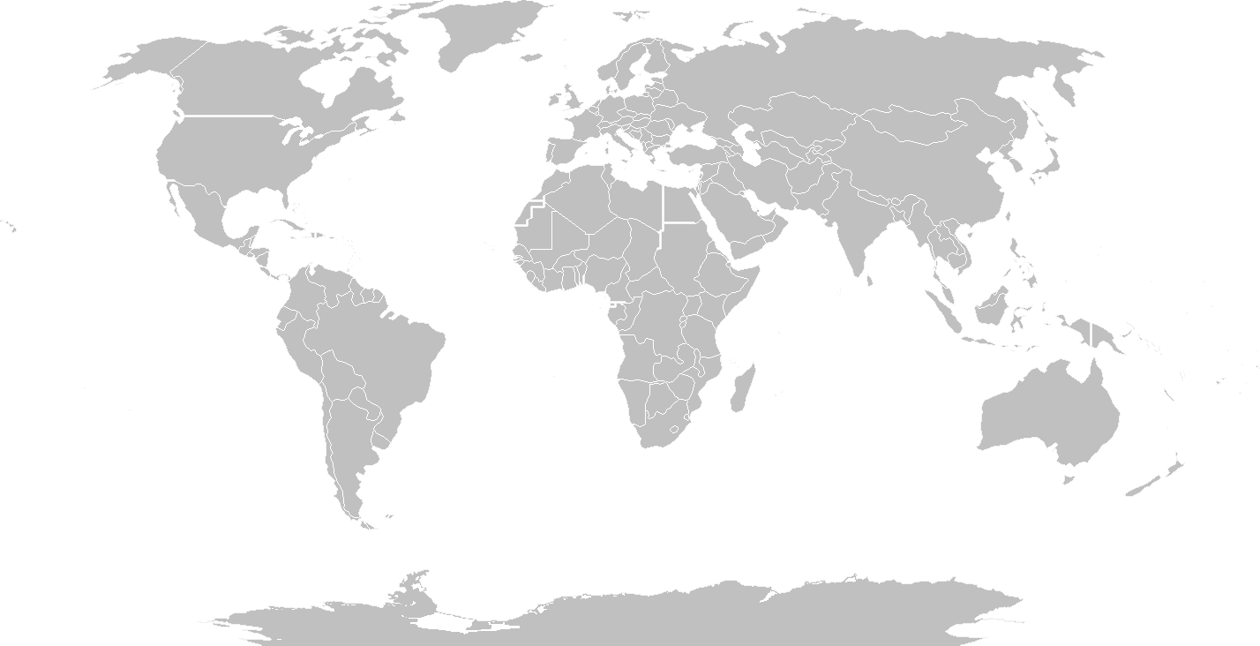

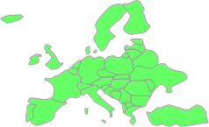



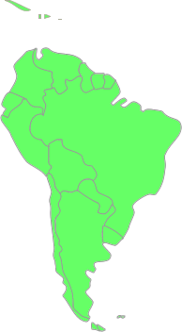





ONOS/SDN-IP Deployment in 2015: From Nothing to Global Footprint in R&E Nets
OF
Q3 2015
Korea announces the first
ongoing ONOS deployment
OpenFlow
Q1-Q2 2015
First ONOS Deployments
Q4 2015
ONOS deployed in Korea
Q4 2015
Creating connections
Sidney – Seattle
Sao Paolo - Amsterdam
OpenFlow
Q4 2015
First ONOS
production deployment
in South America
OpenFlow
Q3 2015
First ONOS Deployments in Australia

Slide 15








ONOS Partnership and Community at Launch
ON.LAB
SERVICE PROVIDER
PARTNERS
VENDOR
PARTNERS
COLLABORATORS
VOLUNTEERS
Notes:
Here is our community today….
It includes ON.Lab, a set of leading service providers, leading vendors, and a large group of collaborating organizations, and the larger community.
It is really important to understand the role of all these stack holders.
Read each bullet
o
o
Another way to understand the ONOS partnership is that it is by the service providers and for the service providers. They play a vey important role. BTW there is high probability Verizon will also join the partnership… Hope Bell will too.
o
o

Slide 16

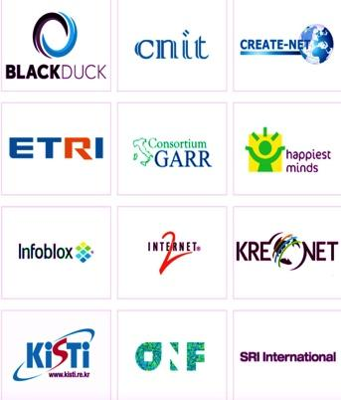







ONOS Partnership and Community
ON.LAB
SERVICE PROVIDER
PARTNERS
VENDOR
PARTNERS
COLLABORATORS
VOLUNTEERS
Added three service providers and two vendors as partners
Added 15+ collaborating organizations -- many R&E network operators
One more tier one service provider already signed up
One more integrator partner likely by end of the year
Great Partnership &
Community
Notes:
Here is our community today….
It includes ON.Lab, a set of leading service providers, leading vendors, and a large group of collaborating organizations, and the larger community.
It is really important to understand the role of all these stack holders.
Read each bullet
o
o
Another way to understand the ONOS partnership is that it is by the service providers and for the service providers. They play a vey important role. BTW there is high probability Verizon will also join the partnership… Hope Bell will too.
o
o

Slide 17
Growing Community Contributions
More than a dozen major contributions from different partners in Emu
New partner(s) - Alcatel Lucent - service definition/mgt
1 more TBA…stay tuned
New collaborators
ECI Telecom, FNLab/BUPT, ClearPath Networks
>15 in the pipeline..stay tuned

Slide 18
The Virtuous Cycle has made ONOS deployment ready
Community Growth is strong and accelerating
ONOS Community Contributions are Diversifying

Slide 19
Backup

Slide 20
Emu Community Contributions
AARNET
deployment
AT&T
CORD vCPE, hardware, market trial readiness...
AT&T/DirecTV
Multicast infrastructure - MFWD app, PIM-SSM prune/join, static routes...
ECI Telecom
ONF optical transport protocol extensions
ODU Multiplexing and ODU Cross connect services
Notes:
Optical Transport Protocol Extensions support ODU Multiplexing and ODU Cross-Connect services

Slide 21
Emu Community Contributions
ETRI
DPI and flow monitoring
Fujitsu
Northbound resource reservation subsystem
Huawei
OPNFV - IETF Service Function Chaining
VTN enhancements for L2, L3 VPNs
KAIST/SRI
Performance improvements security mode ONOS
KISTI
Deployed ONOS in KREONET-S
Notes:
Optical Transport Protocol Extensions support ODU Multiplexing and ODU Cross-Connect services

Slide 22
Emu Community Contributions
ONF
CORD Fabric integration
ON.Lab
SDN-IP - dynamic configuration of peers, reactive routing, global deploy
GUI - archetypes for views, badged nodes
R-CORD - vOLT, vRouter, operator UI, integration
Flowrule store persistence
SK Telecom
SONA - Simplified Overlay Networking Architecture - Ease deployment of software defined data centers - OpenStack switching and interfaces
Notes:
archetypes for views (custom, tabular, topology, overlay) as well as a new overlay for Badged nodes. Both make it much easier to customize the user's view of the network.

