Slide 1
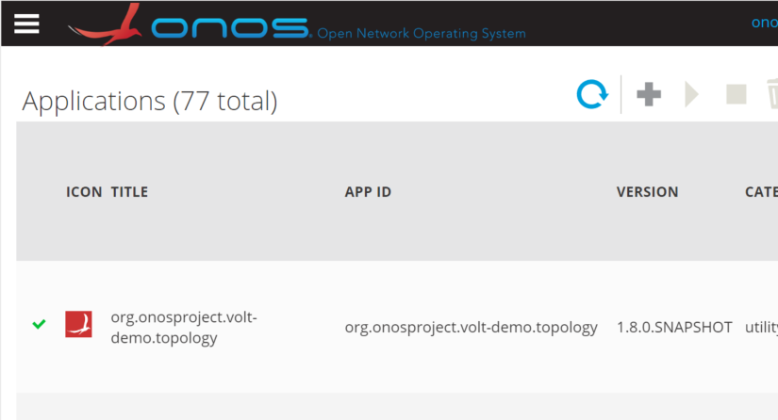
Progress report
Tried to build my application (copied files from ‘tenbi’)
Put volt yang files into project, java files generated successfully
Maven builds it successfully, but Buck not. Does Yang-tools supports buck build?
Installed & activated the APP into ONOS
Demo scenario (see next slides)
I can see my APP is activated.

Slide 2


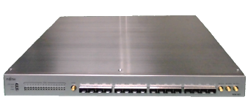

External System
Components provided by others
Web Browser
Components provided by Fujitsu
ONOS
RESTCONF
Messages
(by WebSocket)
YMS
Generate
by Yang-tools
Device Model (Yang)
GUI APP
OLT Config API
OLT GUI APP
OLT Config APP
Augment
Topology view
ConfigNode
ConfigPath
TopologyProvider
Add performance monitor view
ElasticConfig Service
NETCONF Drivers
ONU
OLT
ONU

Slide 3
vOLT Application Demo
Turn on an OLT device and ONOS discovers it
Set up a path (PONLINK between OLT and ONU)
Get performance stats from a OLT device and show it
(optional) Reboot ONU device

