Slide 1
ONOS Benchmarking with
NETCONF Protocol Sessions
Date: April 11th 2018
TRAN Quang Huy , PHAM Van Quan, Dominique VERCHERE
quang-huy.tran@polytechnique.edu, quan.pham_van@nokia.com, dominique.verchere@nokia-bell-labs.com

Slide 2
INTRODUCTION
Network Configuration Protocol: NETCONF
The Network Configuration Protocol (NETCONF) provides mechanisms to install, manipulate, and delete the configuration of network devices
NETCONF uses a remote procedure call (RPC) paradigm
A NETCONF session is the logical connection between a network administrator or a SDN controller (the client) and a network device (the server)
Messages are encoded in Extensible Markup Language (XML) and exchanged on top of a secure transport protocol (SSH)
Specified and standardized by IETF in RFC 6241: https://tools.ietf.org/html/rfc6241
Notes:
*****A NETCONF session is the logical connection between a network administrator or network configuration application (the client) and a network device (the server)
A client encodes an RPC in XML and sends it to a server using a secure, connection-oriented session. The server responds with a reply encoded in XML. The contents of both the request and the response are fully described in XML DTDs or XML schemas, or both, allowing both parties to recognize the syntax constraints imposed on the exchange.*****
[BRIDGE]
We performed two experiments on ONOS.
The first experiment is to evaluate the NETCONF connection establishment time between ONOS and NETCONF network devices.
The second one observes the CPU and memory utilization of ONOS when it retrieves the configuration between different interval through the NETCONF GET operation.

Slide 3


EXPERIMENTS
Benchmarking Scenario
Control Plane
Data Plane
LINC
LINC
LINC
LINC
LINC
LINC
Notes:
The test-bed has two parts the control plane and data plane.
On the control plane, ONOS controller runs on a machine.
On the data plane, multiple NETCONF devices are emulated by LINC switches, which is a software written in Erlang functioning language. Each LINC switch is dockerized in a Docker container so that it can be easy to be deployed on another machine.

Slide 4
EXPERIMENTS
System environment
CPU: 2 cores
RAM: 2 GB
OS: Ubuntu 16.04 LTS
ONOS 1.13 (master release)
Notes:
We are interested in the performance of ONOS with the minimum specification of 2 CPU and 2 GB of RAM

Slide 5
EXPERIMENTS
NETCONF control session establishment time performance
{
"devices": {
"netconf:192.168.1.10:50001": {
"netconf": {
"ip": "192.168.1.10",
"port": 50001,
"username": "linc",
"password": "linc"
},
"basic": {
"driver": "netconf"
}
},
……….
"netconf:192.168.1.10:50100": {
"netconf": {
"ip": "192.168.1.10",
"port": 50100,
"username": "linc",
"password": "linc"
},
"basic": {
"driver": "netconf"
}
}
}
}
Configure the data plane with multiple LINC switches running each a NETCONF server: 100, 200, 300, 400, 500 containers
Start the controller and activate the NETCONF driver (org.onosproject.drivers.netconf)
Compose and upload the configuration file to ONOS controller
Calculate the NETCONF control session establishment time
Repeat the test with the same number of switches for three times
Restart the test with different number of switches: 100, 200, 300, 400 & 500 switches
Notes:
We perform the first test to calculate the establishment time of NETCONF connections with a given number of network devices.
Configure the IP address and port of network devices
3. The configuration file in json format which specifies the ID, IP address, ports and other parameters of network devices.
4. The connection establishment time is calculated from the time the configuration file is uploaded to the time the last device is connected to ONOS

Slide 6
EXPERIMENTS
NETCONF control session establishment time performance
ONOS
Device
<?xml version="1.0" encoding="UTF-8"?>
<hello xmlns="urn:ietf:params:xml:ns:netconf:base:1.0">
<capabilities>
<capability>urn:ietf:params:netconf:base:1.0</capability>
<capability>urn:ietf:params:netconf:base:1.1</capability>
<capability>urn:ietf:params:netconf:capability:startup:1.0</capability>
<capability>urn:ietf:params:netconf:capability:writable-running:1.0</capability>
</capabilities>
<session-id>53</session-id>
</hello>
SSH
Hello
Hello
<?xml version="1.0" encoding="UTF-8"?>
<hello xmlns="urn:ietf:params:xml:ns:netconf:base:1.0">
<capabilities>
<capability>urn:ietf:params:netconf:base:1.0</capability>
<capability>urn:ietf:params:netconf:base:1.1</capability>
</capabilities>
</hello>

Slide 7
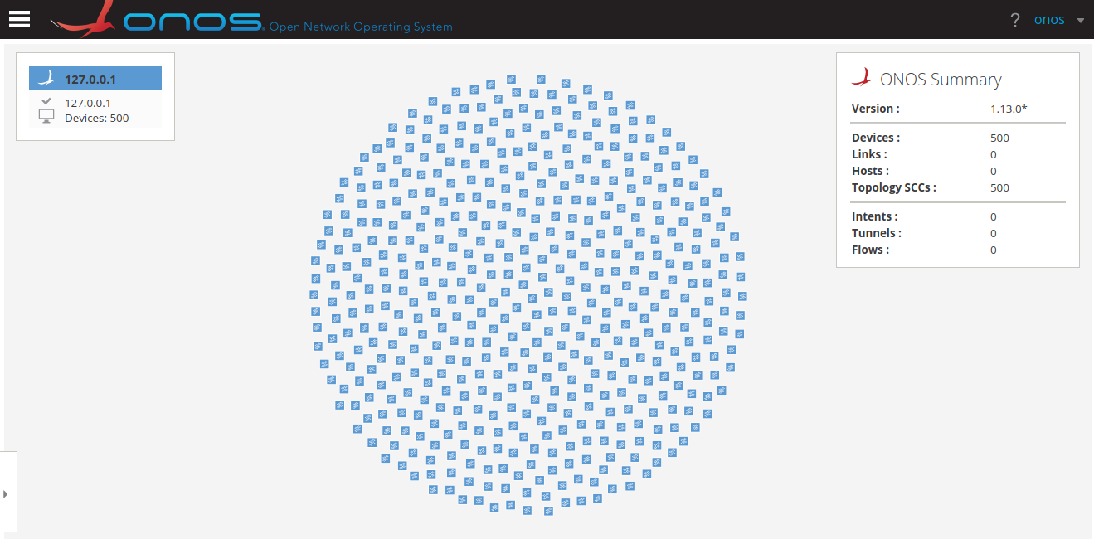
EXPERIMENTS
Notes:
If all devices are successfully connected to ONOS, they will appear on the Web GUI like this.

Slide 8
EXPERIMENTS
NETCONF control session establishment time
Devices | Time (s)
 | First | Second | Third | Average
100 | 12.65 | 12.84 | 13.04 | 12.84
200 | 25.68 | 24.56 | 23.68 | 24.64
300 | 35.29 | 36.85 | 35.62 | 35.92
400 | 45.7 | 46.89 | 48.69 | 47.09
500 | 62.74 | 62.6 | 63.01 | 62.78
Notes:
The connection establishment time is linearly increase with the number of devices

Slide 9
EXPERIMENTS on device configuration monitoring
GET message exchange
Configure the data plane with multiple LINC switch instances running NETCONF servers (100, 200, 300, 400, 500 containers)
Start the controller and activate the NETCONF driver (org.onosproject.drivers.netconf)
Compose and upload the configuration file to ONOS controller
Send netconf-get message from the controller to get the configuration of NETCONF devices
Measure the percentage of memory and CPU used by the controller
Repeat the test with the same number of switches for three times
Restart the test with various number of switches : 100, 200, 300, 400 & 500 devices

Slide 10
EXPERIMENTS
NETCONF GET message exchanges
<rpc xmlns="urn:ietf:params:xml:ns:netconf:base:1.0">
<get>
</get>
</rpc>
onos> netconf-get netconf:192.168.1.55:50001
ONOS
Switch
<?xml version="1.0" encoding="UTF-8"?>
<rpc-reply message-id="2" xmlns="urn:ietf:params:xml:ns:netconf:base:1.0">
<data>
<capable-switch xmlns="urn:onf:of111:config:yang">
<id>CapableSwitch0</id>
<resources />
<logical-switches>
<switch>
<id>LogicalSwitch0</id>
<capabilities>
...
</capabilities>
<datapath-id>00:00:00:00:00:00:00:01</datapath-id>
<enabled>true</enabled>
<check-controller-certificate>false</check-controller-certificate>
<lost-connection-behavior>failSecureMode</lost-connection-behavior>
<controllers />
<resources />
</switch>
</logical-switches>
</capable-switch>
</data>
</rpc-reply>
GET
GET response
Notes:
We modified the codes so that we can send the netconf-get command automatically and simultaneously to all devices.

Slide 11
EXPERIMENTS
NETCONF GET message exchanges

Slide 12
Next Steps
Performing the tests on ONOS cluster mode
Developing and Performing new benchmarking on the optical network operation use-cases.

