Slide 1
ONOS Falcon Release
Bill Snow

Slide 2
Takeaways
Community growing rapidly: 50+ members
Good diversity of contributions
Global deployment accelerating
Multiple vendors building commercial products based on ONOS
ONOS is production ready
Increasing impact on “standard” SDN, NFV distributions
ONOS enabled solutions gaining lot of traction/momentum
Especially CORD
ONOS capabilities strong at all levels - Apps, UI, NB, CORE, SB

Slide 3
Themes
Community - growing and diversifying
Deployment - increasing the global footprint
Distribution - SDN and NFV Ecosystem
ONOS Improvements

Slide 4
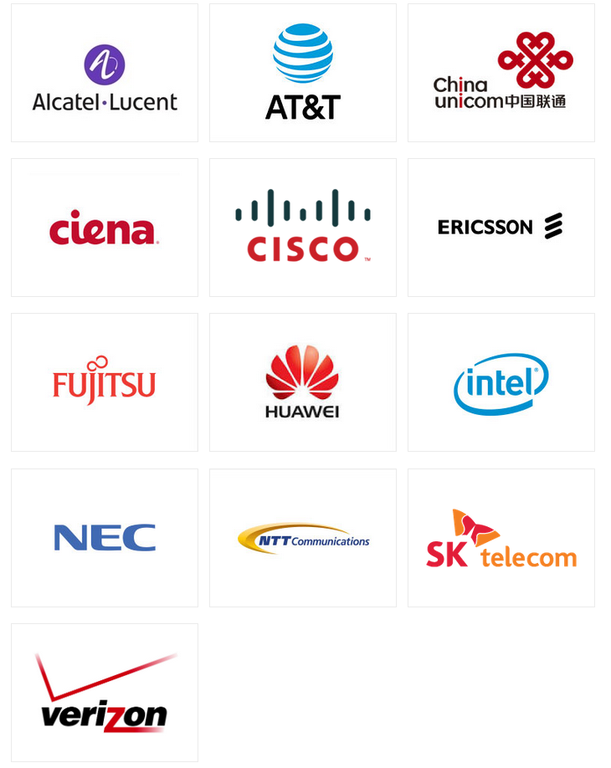

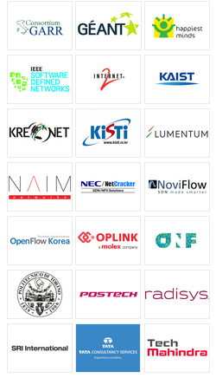
Collaborators
Partners

Slide 5
Community Metrics
13 partners
5 service providers (up from 1 a year ago)
8 vendors (up from 6 a year ago)
50+ collaborators (up from just a few a year ago)
950 ONOS registered
250+ code contributors
ON.Lab 44%, but declining rapidly with onboarding of community
Huawei 19%
Fujitsu, NEC, SK Telecom, ONF, Create-Net, Ericsson, BTI (1-5% ea)
15 others (.2-1% ea)
unknown org/independent 12%
Full blog post with more detail: http://onosproject.org/2016/02/19/how-has-the-onos-community-changed-in-its-first-year/

Slide 6
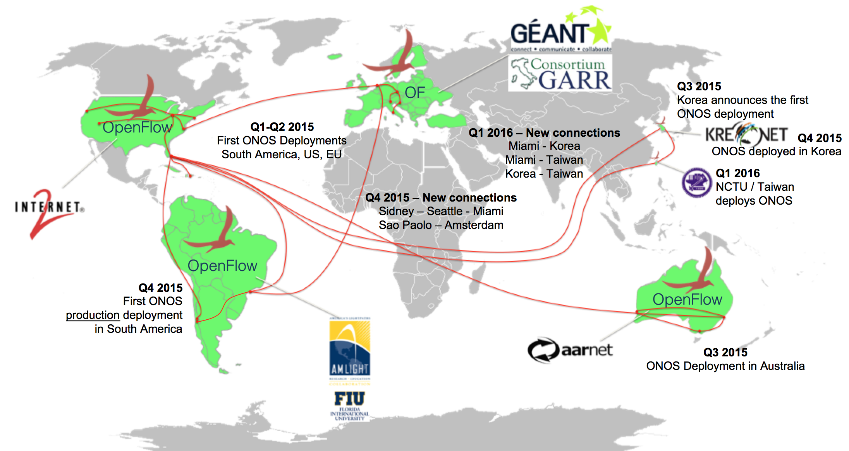
L2 SDX App
L2/L3 SDX App

Slide 7









Deployment contributions

Slide 8

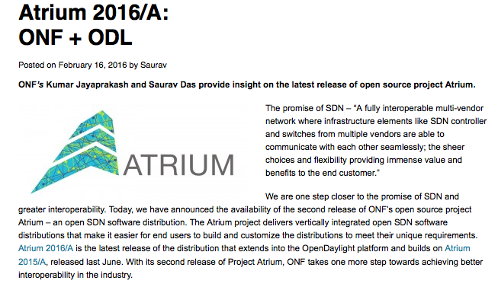
Distribution
ONOS from 2015 + ODL

Slide 9
ONOS Improvements
ONOS is enabling CORD Field trials and PoC
Residential field trial with AT&T
Mobile and Enterprise PoCs at ONS
SDN/IP deployments, IP/Optical PoCs
Apps
VPLS (ON.Lab)
Routing loop detection and Blackhole tracking (FNLab/BUPT)
YANG Utils (Huawei) - auto generation of Java
Metrics database (POSTECH)
BGP Flowspec (Huawei)
Peering design/prototypes (Create-Net, TATA)
Load balancer (Fujitsu)
GUI - meter table view, driver matrix view, application view, +more

Slide 10
ONOS improvements
NB
REST apis for grouptable, metertable, flowobjectives (POSTECH)
Resource reservation support for “continuous” resources - BW for example (Fujitsu)
Intents integrated with Flow objectives, part 1
CORE
dynamic cluster scaling
devicekey subsystem - coordinate management of keys (Ciena)
control message subsystem (POSTECH)
SB
OSPF (Huawei, Cognizant)
REST provider
SNMP provider (BTI)
Fallback providers
Multiple inheritance between drivers
Test
IPv6 test suite (Criterion Networks)
NETCONF test suite (Happiest Minds)

Slide 11
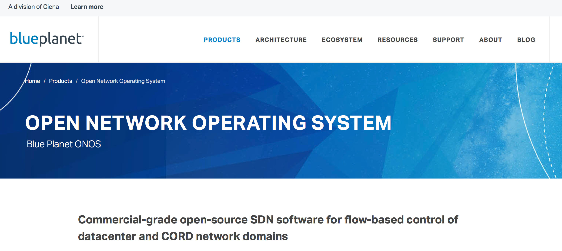
And, Huawei is doing ONOS field trials with several service providers

Slide 12
Takeaways
Community growing rapidly: 50+ members
Good diversity of contributions
Global deployment accelerating
Multiple vendors building commercial products based on ONOS
ONOS is production ready
Increasing impact on “standard” SDN, NFV distributions
ONOS enabled solutions gaining lot of traction/momentum
Especially CORD
ONOS capabilities strong at all levels - Apps, UI, NB, CORE, SB

