Slide 1
ONOS® Goldeneye Release
Bill Snow
bill@onlab.us

Slide 2

Our Mission
ONOS is building a better network
We are pursuing our vision of what networking could be for the public good
We want to fix closed, proprietary, complex, expensive and inflexible networks
We want networks that are enabling innovation rather than impeding innovation
Join us on our mission!
Notes:
Before getting to the community details, it’s important to step back and talk about the community’s mission. This is why the community exists and why people should care.

Slide 3
Takeaways
Community
Growth and diversity continue to accelerate
Excellent retention
Release and innovation momentum
Platform
Continuing to focus on core value proposition (Scale, Performance, HA) maintaining our undisputed leadership
Adding to strong capabilities at all levels - Apps, UI, NB, CORE, SB
Only platform to support incremental as well as disruptive SDN
Use cases and solutions
ONOS enabled solutions gaining lot of traction and momentum
Comprehensive set of Service Provider use cases and solutions: NREN deployments, Packet-Optical convergence, CORD

Slide 4
Takeaways
Community
Growth and diversity continue to accelerate
Excellent retention
Release and innovation momentum
Platform
Continuing to focus on core value proposition (Scale, Performance, HA) maintaining our undisputed leadership
Adding to strong capabilities at all levels - Apps, UI, NB, CORE, SB
Only platform to support incremental as well as disruptive SDN
Use cases and solutions
ONOS enabled solutions gaining lot of traction and momentum
Comprehensive set of Service Provider use cases and solutions: NREN deployments, Packet-Optical convergence, CORD

Slide 5















ONOS Community Members
ON.LAB
SERVICE PROVIDER
PARTNERS
VENDOR
PARTNERS
COLLABORATORS
VOLUNTEERS
50+ Companies
Notes:
Today our partnership and community looks like this.
We have 5 leading service providers from almost all important geographies: US, China, Japan, and Korea. All these service providers have a shared vision, they are actively engaged, providing and building SDN and NFV use cases, and looking to do field trials and deployments based on ONOS.
We have 8 vendors who represent almost all major vendors that provide products and solutions to service providers around the globe. At least some of the vendors are starting to build commercial products and solutions based on ONOS.
I want to also mention we have more than 20 collaborating organizations that are actively contributing to our mission in some significant way. Many of these are R&E network operators who are already deploying ONOS in their production networks. And others are contributing to ONOS, use cases, and other aspects.
I should mention there are another ten organizations that are already contributing and waiting to be “approved” as a collaborator.
I hope you agree we have created a very strong partnership in a year.
With this partnership and community we are in a strong position to realize our vision and achieve our mission.

Slide 6
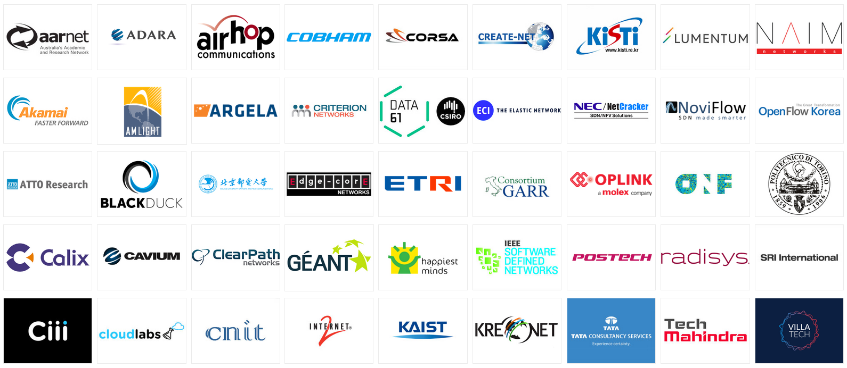
ONOS Collaborators
Collaborating organizations help grow the community and grow the impact
Notes:
This list of collaborators is current as of May 16, 2016

Slide 7
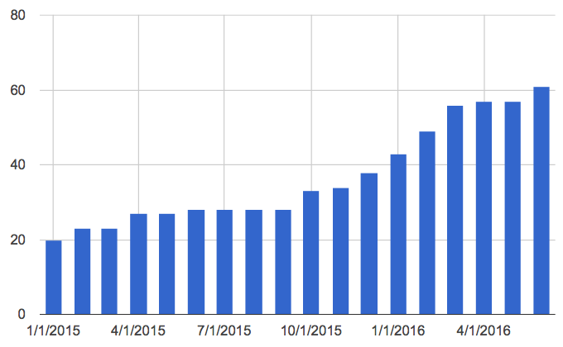
Member Growth Since Launch
Notes:
This chart is current as of May 16, 2016

Slide 8







Welcome Goldeneye Release
Q4/14 Avocet
Base Architecture
Q3/15 Drake
ONF ATRIUM
Secure Mode ONOS
VXLAN
Device Config
Q1/15 Blackbird
Performance
Q4/15 Emu
OPNFV
SONA
AARNET
KREONET-S
Q2/16 Goldeneye
CPMAN monitoring apps
Intents using Flow Objectives
AFS subsystem performance
P4 demo support
NETCONF device support
YANG tool chain
Q2/15 Cardinal
ONS Use Cases
SDN-IP
Packet Optical
R-CORD
Q1/16 Falcon
ONS Use Cases
{A, E, M, R} CORD
Disaggregated ROADM
DC Fabric Control
Global R&E Deployment
Every release: ++ Deployments, Applications, NB, CORE, SB, Test, Community, Performance….

Slide 9
Takeaways
Community
Growth and diversity continue to accelerate
Excellent retention
Release and innovation momentum
Platform
Continuing to focus on core value proposition (Scale, Performance, HA) maintaining our undisputed leadership
Only platform to support incremental as well as disruptive SDN
Use cases and solutions
ONOS enabled solutions gaining lot of traction and momentum
Comprehensive set of Service Provider use cases and solutions: NREN deployments, Packet-Optical convergence, CORD

Slide 10
ONOS’ Unique Value Proposition:
Scale, Performance, and HA
You need a car for commuting, and a car for racing. But you can only have 1 car.
Would you buy a prius and hope to turn it into a race car?
Would you buy a race car and also use it to commute in?

Slide 11

Scale-Out Design w/ Multiple ONOS Instances
Each instance is identical
One can add and remove instances seamlessly
Each instance is a master for a sub-set of switches
It works like a single system for apps and network devices
Apps
Apps
ONOS
Global Network View / State
Global Network View / State
ONOS Instance 1
ONOS Instance 2
ONOS Instance 3

Slide 12
ONOS Architecture Tiers
Northbound Abstractions:
network graph
application intents
flow objectives
virtualization & slicing
Core:
distributed
protocol independent
Southbound Abstractions:
“provider” model
pluggable & extensible
Apps
Apps
Northbound - Application Intent Framework
(policy enforcement, conflict resolution, virtualization, slicing)
Distributed Core
(scalability, availability, performance, persistence)
Southbound
(discover, observe, program, configure)
OpenFlow
NetConf
. . .

Slide 13
ONOS Performance Industry leading framework and results
A. Device and Link Sensing
< 100ms
ONOS part <10ms
Apps
C
Northbound - Application Intent Framework
(policy enforcement, conflict resolution)
B
B. Intent throughput
200k ops/sec
Flow rule subsystem
Distributed Core
(scalability, availability, performance, persistence)
A
D
C. Intent latency
< 50ms
Southbound
(discover, observe, program, configure)
D. Flow throughput
500K to 3M ops/sec
Improves with number of instances
Adapter
Adapter
. . .
OpenFlow
NetConf
. . .
Notes:
Cbench rudimentary - doesn’t cut it

Slide 14
ONOS Scalability & Performance Leadership
Performance
No regressions
6+ times performance improvement in distributed ops
Adaptive Flow Monitoring and selective DPI
Scale
A telecom provider testing 10s of thousands of switches, per instance!
HA
Chaos Monkey* added to extensive automated test env
Accumulating months of production run time
Developer experience: 10x build performance
ONOS continues to have undisputed leadership in scale, performance & HA
(No other controller even comes close to these results)
*Netflix/AWS: https://github.com/Netflix/SimianArmy/wiki/Chaos-Monkey

Slide 15
For additional information
Original Whitepaper
http://onosproject.org/wp-content/uploads/2014/11/Whitepaper-ONOSBlackbirdperformance-generalaudience-Apr-7.pdf
Blog correcting ODL claims
http://onosproject.org/2016/05/20/opendaylight-onos-performance-white-paper/

Slide 16
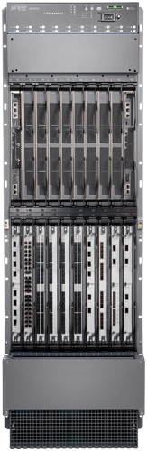
Incremental and Disruptive SDN
Config/Management: Yang
Apps: Network Control
Controller
SDN OS: ONOS
NetConf/Yang
OpenFlow/P4
Distributed Control
Vendor Dominated
ON.Lab, Service Providers & Partners
Incremental SDN
Good for short term Automation of legacy device config
Disruptive SDN
Offers disruptive value prop for the longer term

Slide 17
ONOS Milestones & Evolution: Quarterly Releases
Architecture Scale, Performance, HA
North & South-Bound Abstractions
OpenFlow & P4* On Many Hardware & Software Switches
Disruptive SDN
South-Bound Protocols NetConf/Yang, BGP-LS, PCEP, TL-1...
On Legacy Devices
Dynamic Configuration* NetConf/Yang, OVSDB
Incremental SDN
North-Bound Interfaces Intent Framework, REST
Model Based Services*
Yang based service definition
Micro-Services
* In progress
ONOS the only SDN control plane that can support all these scenarios

Slide 18
Takeaways
Community
Growth and diversity continue to accelerate
Excellent retention
Release and innovation momentum
Platform
Continuing to focus on core value proposition (Scale, Performance, HA) maintaining our undisputed leadership
Adding to strong capabilities at all levels - Apps, UI, NB, CORE, SB
Only platform to support incremental as well as disruptive SDN
Use cases and solutions
ONOS enabled solutions gaining lot of traction and momentum
Comprehensive set of Service Provider use cases and solutions: NREN deployments, Packet-Optical convergence, CORD

Slide 19
Platform and Solutions: The Virtuous Cycle
Enable
Platform
Solutions
Enrich
SDN OS: ONOS
CORD
R-CORD
E-CORD
M-CORD
Packet-Optical
SDN-IP Peering
Atrium
Multicast content dist
…
Gaining Traction and Momentum
Notes:
As we know any platform by itself is not useful and cannot succeed.
A platform has to enable many interesting and useful solutions.
ONOS is the SDN OS platform that enables many solutions and that is the value of ONOS or any platform for that matter.
We are in the process of creating the following solutions with ONOS.
And as we build these solutions and make them more and more real, we find new requirements and opportunities to make ONOS better.
This has been a very powerful cycle – it has been true for other platforms in the past.

Slide 20
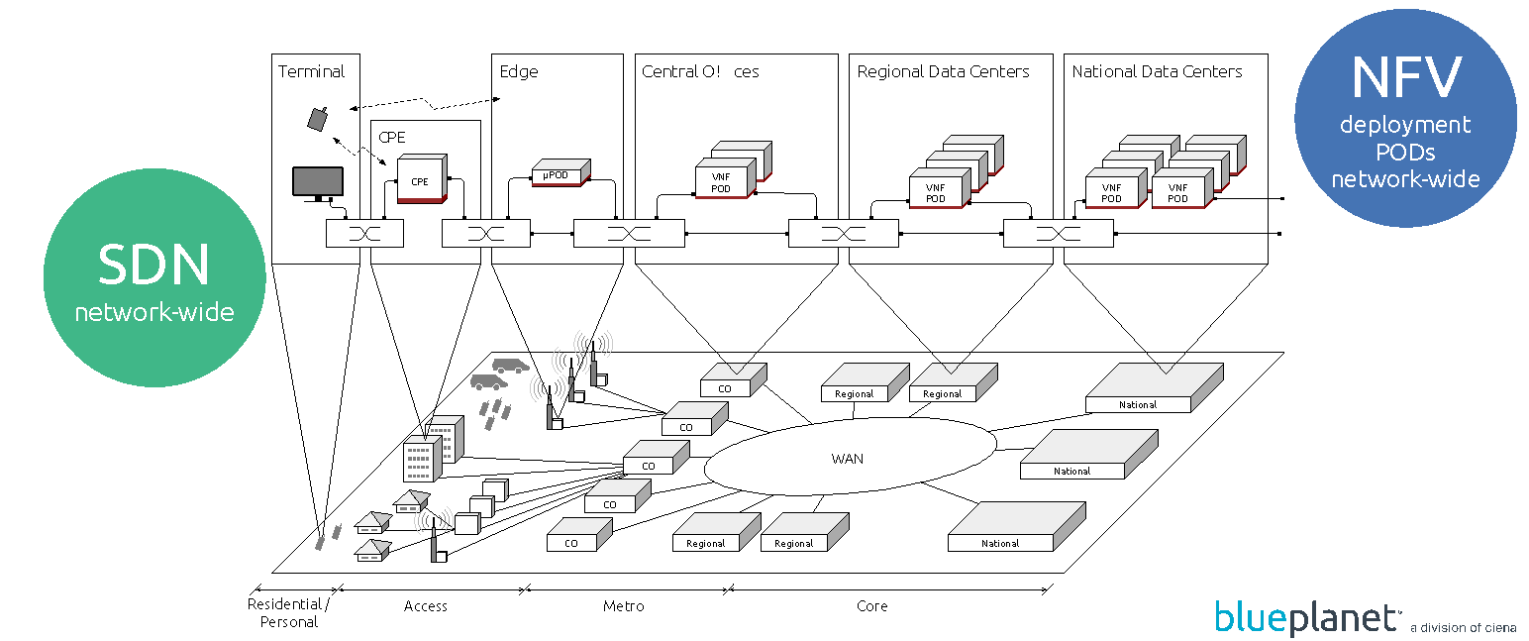
ONOS Use Cases in Service Provider Networks

Slide 21
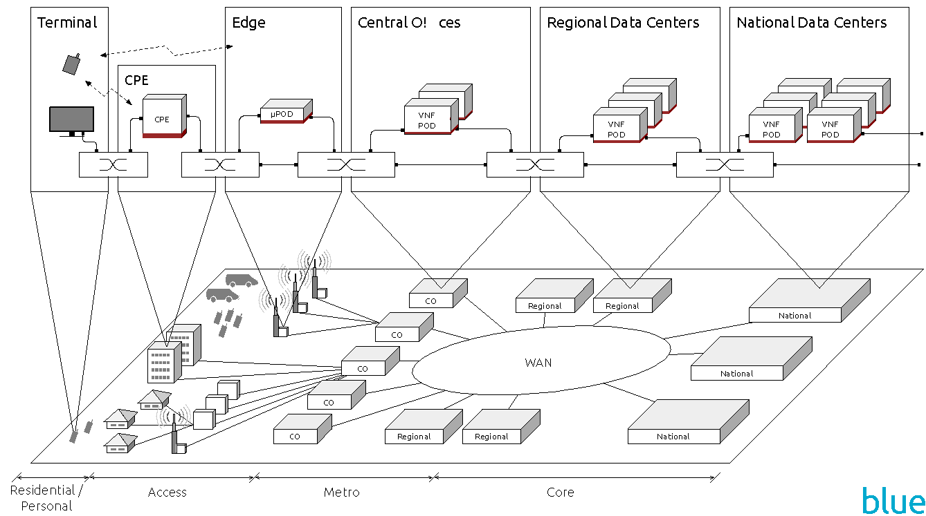
ONOS Use Cases in Service Provider Networks
Global deployment in R&E Networks
SDN/IP Peering
Dis aggregated ROADM
Traffic Engineering/PCE
Packet- Optical Use Case

Slide 22
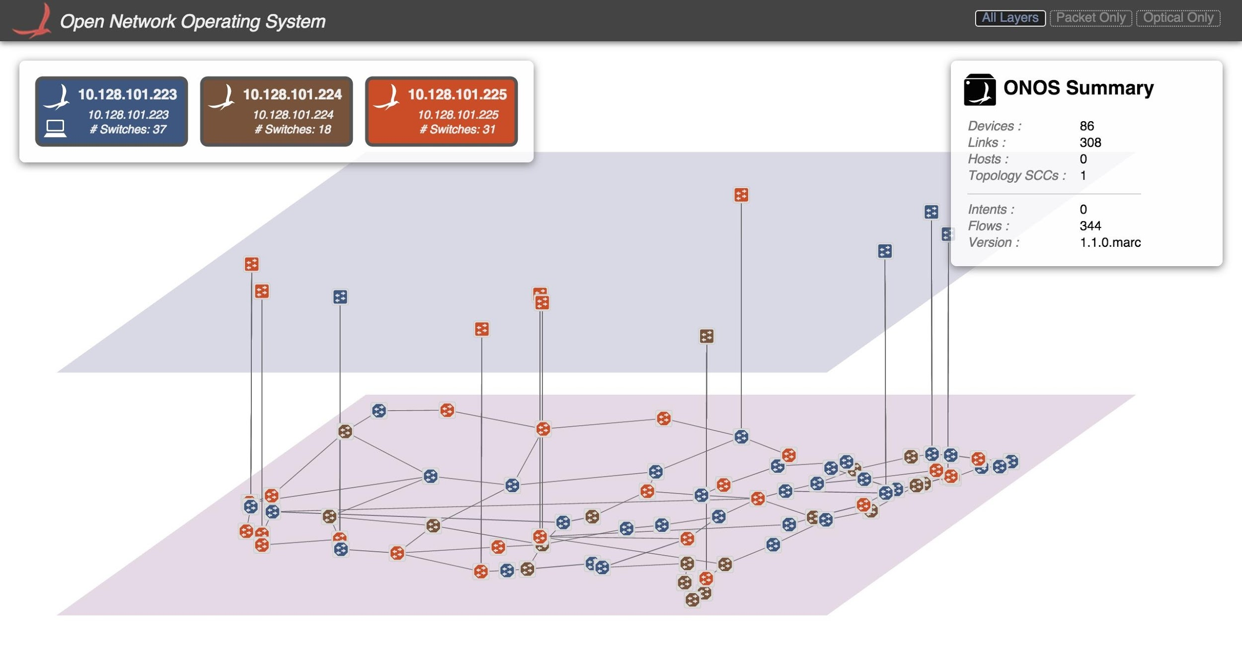
ONOS IP-Optical
Applications
Bandwidth on-demand, calendaring, optical restoration
Power balancing, fault management & correlation
Northbound Abstractions
Intent framework
ONOS Core: Scale & HA
Converged topology graph and modular PCE
Optical information model
Scalable resource manager (fixed & flex grid, OTN, …)
Southbound
Ciena TL1, Fujitsu TL1, OpenFlow, NETCONF, SNMP, REST
In progress: Infinera OTSv, Nokia (Alcatel-Lucent)
Notes:
Information model
1) devices, ports, links
2) flows, intents, config
3) faults

Slide 23
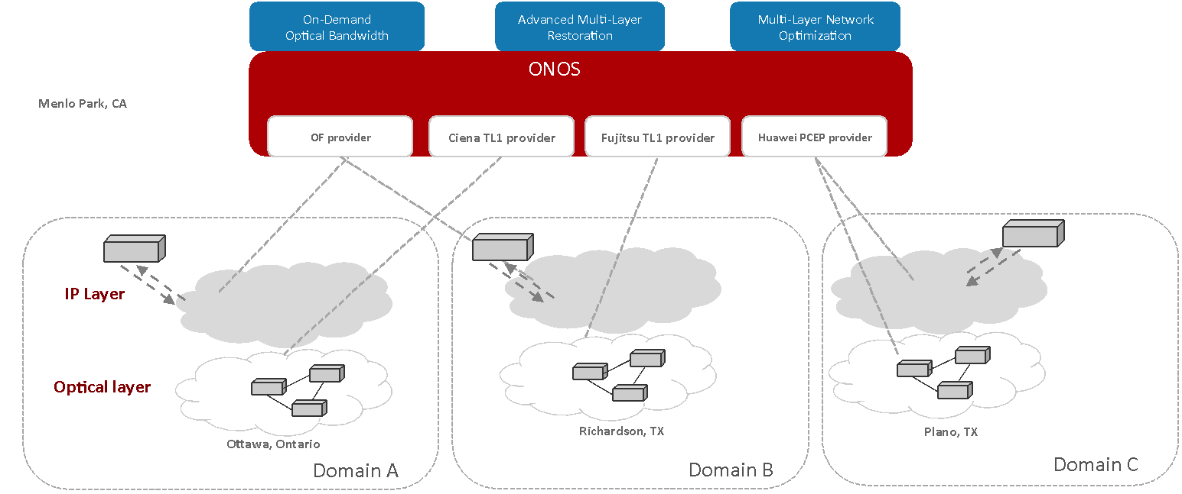
Multi-Layer, Multi-Vendor (June 2015)
https://youtu.be/gsfYwJyYfI4
Notes:
Demonstration with real hardware at both packet & optical layers
Single control plane supports multi-vendor, multi-protocol network
Any application can apply policies for multiple layers based on resource availability, economics and policies

Slide 24





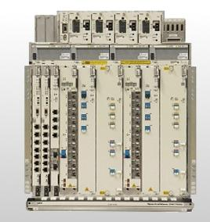
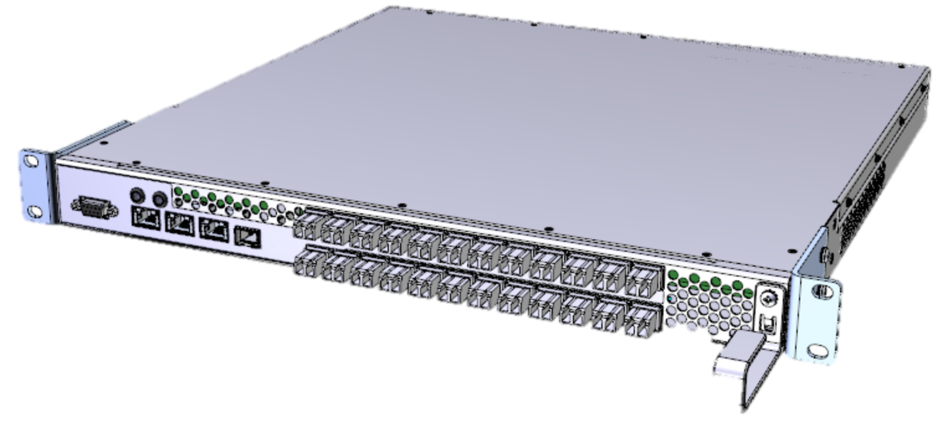
Disaggregated ROADM
Bandwidth On Demand
Alarm Handling
Power Management
Optical Restoration
ONOS
OpenFlow, SNMP, NETCONF, REST
X
WSS
To optical transport
WSS
Backplane
muxponder
To packet layer
transponder
1x20 WSS, 1U
8x2 transponder, 1U
160x160 backplane, 7U
Vertical integration | Disaggregated
Vendor lock-in | Multi vendor
One size fits all | Rightsize
Forklift upgrade | Piece-wise upgrade
System integration | Software-driven integration
Notes:
Eliminate vendor lock in
Innovation in terminal equipment is 2-3 years, ROADMs/amps live 5-7 years
Right-size your equipment, take advantage of best of breed (port density, power efficiency, capacity, programmability)
Opportunity for open interfaces

Slide 25



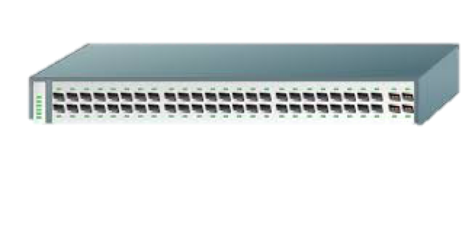


ONOS Global Deployment
Ability for both Users and Operators
to allocate end-to-end resources.
(E-)CORD / XOS
Orchestrator
SDN-IP / SDX-L3 / Castor
L3 intra-domain connectivity
Inter-domain BGP peering
OpenFlow switches
Layer 3
CORD / ONOS Applications
P2P Circuits
Broadcast multi-point Networks
VPLS / SDX-L2
Layer 2
Packet-Optical
Optical circuits
Layer 0 /1

Slide 26



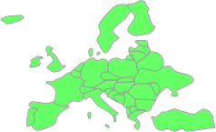



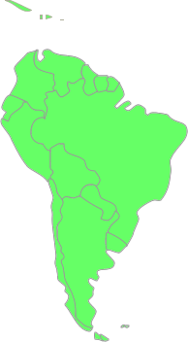






Global SDN Deployment Powered by ONOS
OF
Q3 2015
Korea announces the first
ONOS deployment
OpenFlow
Q1-Q2 2015
First ONOS Deployments
South America, US, EU
Q1 2016 – New connections
Miami - Korea
Miami - Taiwan
Korea - Taiwan
Q4 2015
ONOS deployed in Korea
Q1 2016
NCTU / Taiwan
deploys ONOS
Q4 2015 – New connections
Sidney – Seattle - Miami
Sao Paolo – Amsterdam
OpenFlow
Q4 2015
First ONOS
production deployment
in South America
OpenFlow
Q3 2015
ONOS Deployment in Australia

Slide 27
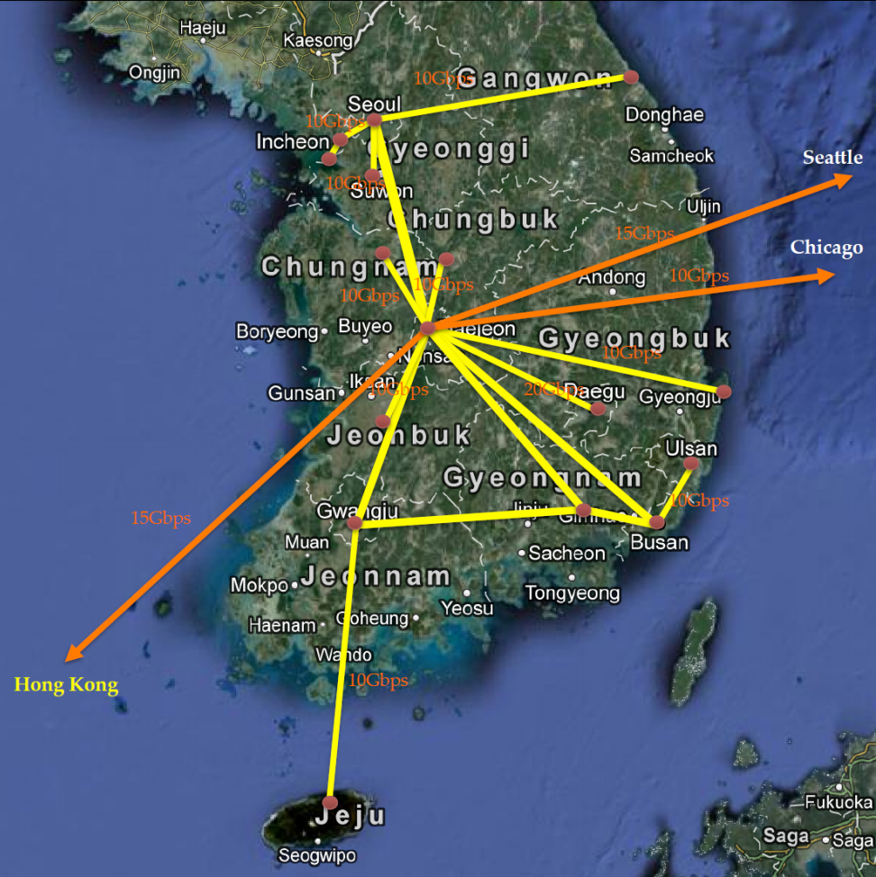
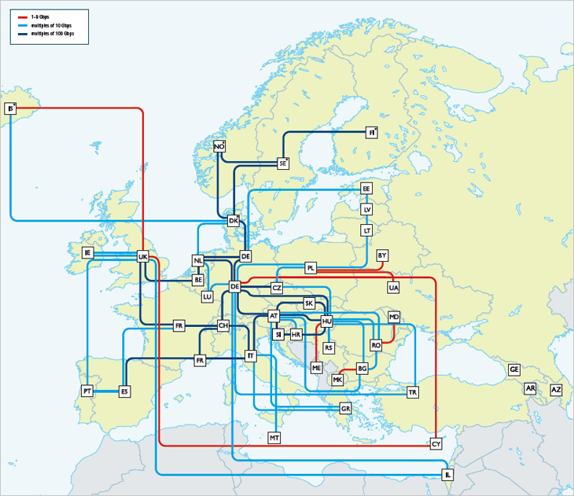
Additional Deployments (Q3/4 2016)
SDX-L2/L3
ONOS Bandwidth on Demand
Self serve portal
GEANT (Europe)
Infinera
Q4 2016
Kreonet (Korea)
Nokia
Q3 2016
Demonstrate ONF’s Transport API (T-API) and OpenConfig support

Slide 28
Goldeneye Highlights
Community | New Collaborators* Argela,Calix, IPT, SDNLAB, Villa-Tech
R&E Deployments | Castor contributed back to ONOS VPLS deployments continue Integration with International federated testbed | ON.Lab, AmLight, AARNET, Internet2, GEANT, IEEE
Build/Test Infra | Moved to Buck Added Chaos Monkey Dynamic clustering test suite | ON.Lab, Ciena, Huawei, Criterion
Apps | Control plane manager (metrics) SDN-IP multi VLAN support ICONA BGP interface | ON.Lab, POSTECH, CREATE-NET, Politecnico of Turin, Tata (TCS), BUPT
NB | Intent subsystem integrated with Flow objectives Beginnings of virtualization appearing Added concept of “regions” to UI for scaling | ON.Lab, Ciena, POSTECH, GEANT, CREATE-NET, Politecnico of Turin, Tata (TCS)
CORE | 6x improvement in throughput for distributed strongly consistent operations | ON.Lab, Fujitsu, ETRI, NEC
SB | Cisco IOS NETCONF improvements YANG toolchain | GEANT, Huawei
*Some not yet announced

Slide 29
Takeaways
Community
Growth and diversity continue to accelerate
Excellent retention
Platform
Continuing to focus on core value proposition (Scale, Performance, HA) maintaining our undisputed leadership
Adding to strong capabilities at all levels - Apps, UI, NB, CORE, SB
Only platform to support incremental as well as disruptive SDN
Use cases and solutions
ONOS enabled solutions gaining lot of traction and momentum
Comprehensive set of service provider use cases and solutions: NREN deployments, packet-optical convergence, CORD

Slide 30
ONOS Use Cases in Service Provider Networks
CORD

Slide 31
Backup

Slide 32
Community Metrics (Feb 2016)
13 partners
5 service providers (up from 1 a year ago)
8 vendors (up from 6 a year ago)
40+ collaborators (up from just a few a year ago)
950 ONOS registered
250+ code contributors
ON.Lab 44%, but declining rapidly with onboarding of community
Huawei 19%
Fujitsu, NEC, SK Telecom, ONF, Create-Net, Ericsson, BTI (1-5% ea)
15 others (.2-1% ea)
unknown org/independent 12%
Full blog post with more detail: http://onosproject.org/2016/02/19/how-has-the-onos-community-changed-in-its-first-year/

Slide 33
NREN development/deployment
Castor
• Provides L2/L3 connectivity for SDXs
• Developed and deployed in AARNET
SDN-IP
• Transforms a SDN into a transit IP network
• SDN AS uses BGP to communicate with neighbors
• L3 connectivity without legacy routers
• Deployed by AmLight, Internet2 (upgrading), KREONET, NCTU
SDX L2/L3
• Provides L2/L3 connectivity for SDXs
• Developed and deployed by GEANT
VPLS
• L2 broadcast overlay networks on demand
• Ready to be deployed at AmLight

