Slide 1
ONOS Hummingbird Release
®
Bill Snow
bill@onlab.us

Slide 2

Our Mission
ONOS is building a better network
We are pursuing our vision of what networking could be for the public good
We want to fix closed, proprietary, complex, expensive and inflexible networks through open source collaboration
We want networks that are enabling innovation rather than impeding innovation
Join us on our mission!
Notes:
Before getting to the community details, it’s important to step back and talk about the community’s mission. This is why the community exists and why people should care.

Slide 3









Welcome Hummingbird Release
Q4/14 Avocet
Base Architecture
Q3/15 Drake
ONF ATRIUM
Secure Mode ONOS
VXLAN
Device Config
Q2/16 Goldeneye
CPMAN monitoring apps
Intents using Flow Objectives
P4 demo support
YANG tool chain
Q4/15 Emu
OPNFV
SONA
AARNET
KREONET-S
Q1/15 Blackbird
Performance
Q3/16 Hummingbird
RabbitMQ, Kafka Message buses
YANG NBI, SBI CODECs
ACTN Traffic Engineering
Distributed system primitives
SB - OSPF, ISIS, REST Client...
Q2/15 Cardinal
ONS Use Cases
SDN-IP
Packet Optical
R-CORD
Q1/16 Falcon
ONS Use Cases
{A, E, M, R} CORD
Disaggregated ROADM
DC Fabric Control
Global R&E Deployment
Every release: ++ Deployments, Applications, NB, CORE, SB, Test, Community, Performance….

Slide 4
Hummingbird Release - Takeaways
ONOS Community is diverse and growing rapidly
ONOS is the only platform supporting both incremental and true SDN
ONOS is critical to operator PoCs, Field Trials, Deployments
Hummingbird: Automation, Integration and Legacy Enablement

Slide 5
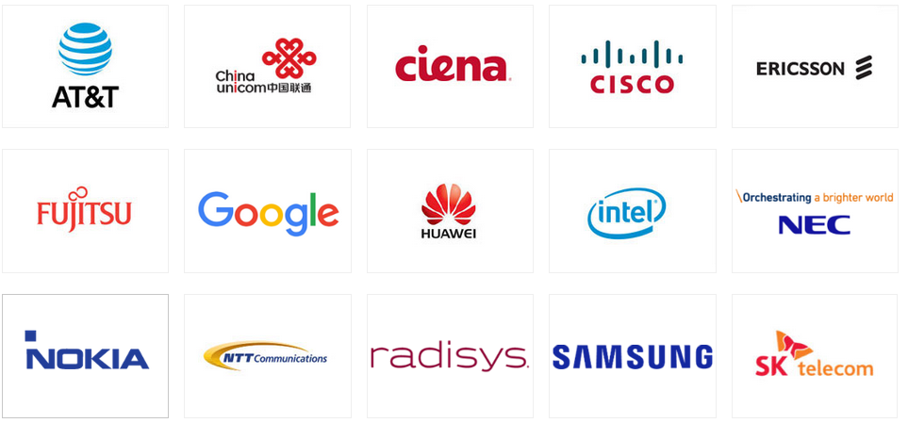

ONOS Partners
Key
Leading service providers make ONOS & SDN/NFV solutions relevant to them
Leading vendors help make ONOS and SDN/NFV solutions real & ready for deployment
Contributed SW
Newest
Notes:
This list of partners is current as of August 1, 2016

Slide 6
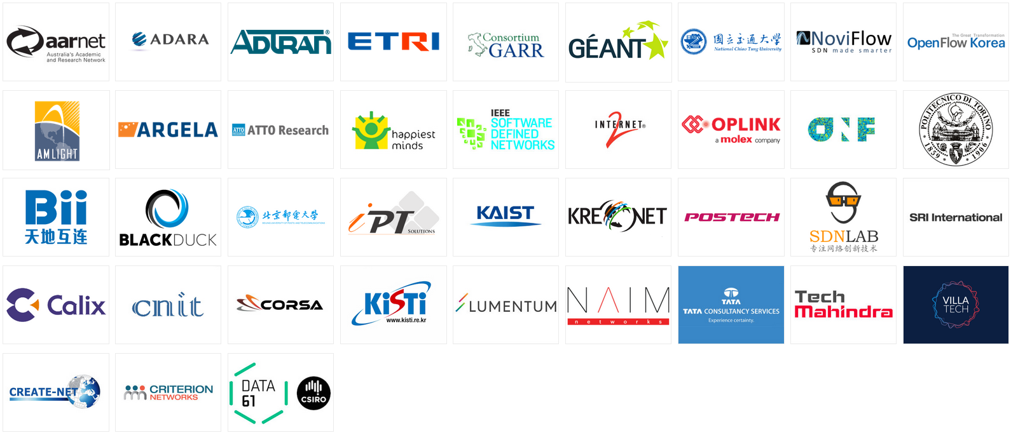



ONOS Collaborators
d
Key
Contributed SW
Newest
Collaborating organizations help grow the community and grow the impact

Slide 7
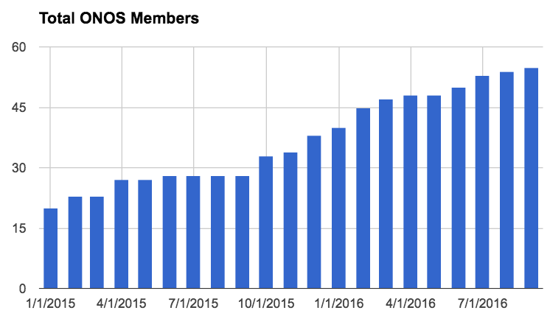
ONOS Member Growth
Notes:
This chart is current as of September 9, 2016

Slide 8
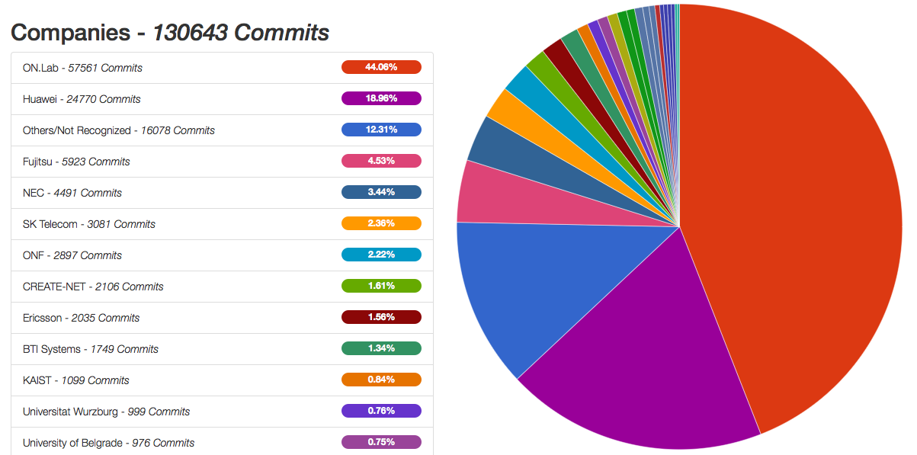
Diversity
Metrics: Percentage of contributions coming from across the whole community
Percentage of contributions from ON.Lab is decreasing and that’s good!
We can increase diversity more by recognizing contributions and distributing authority to people that get involved

Slide 9
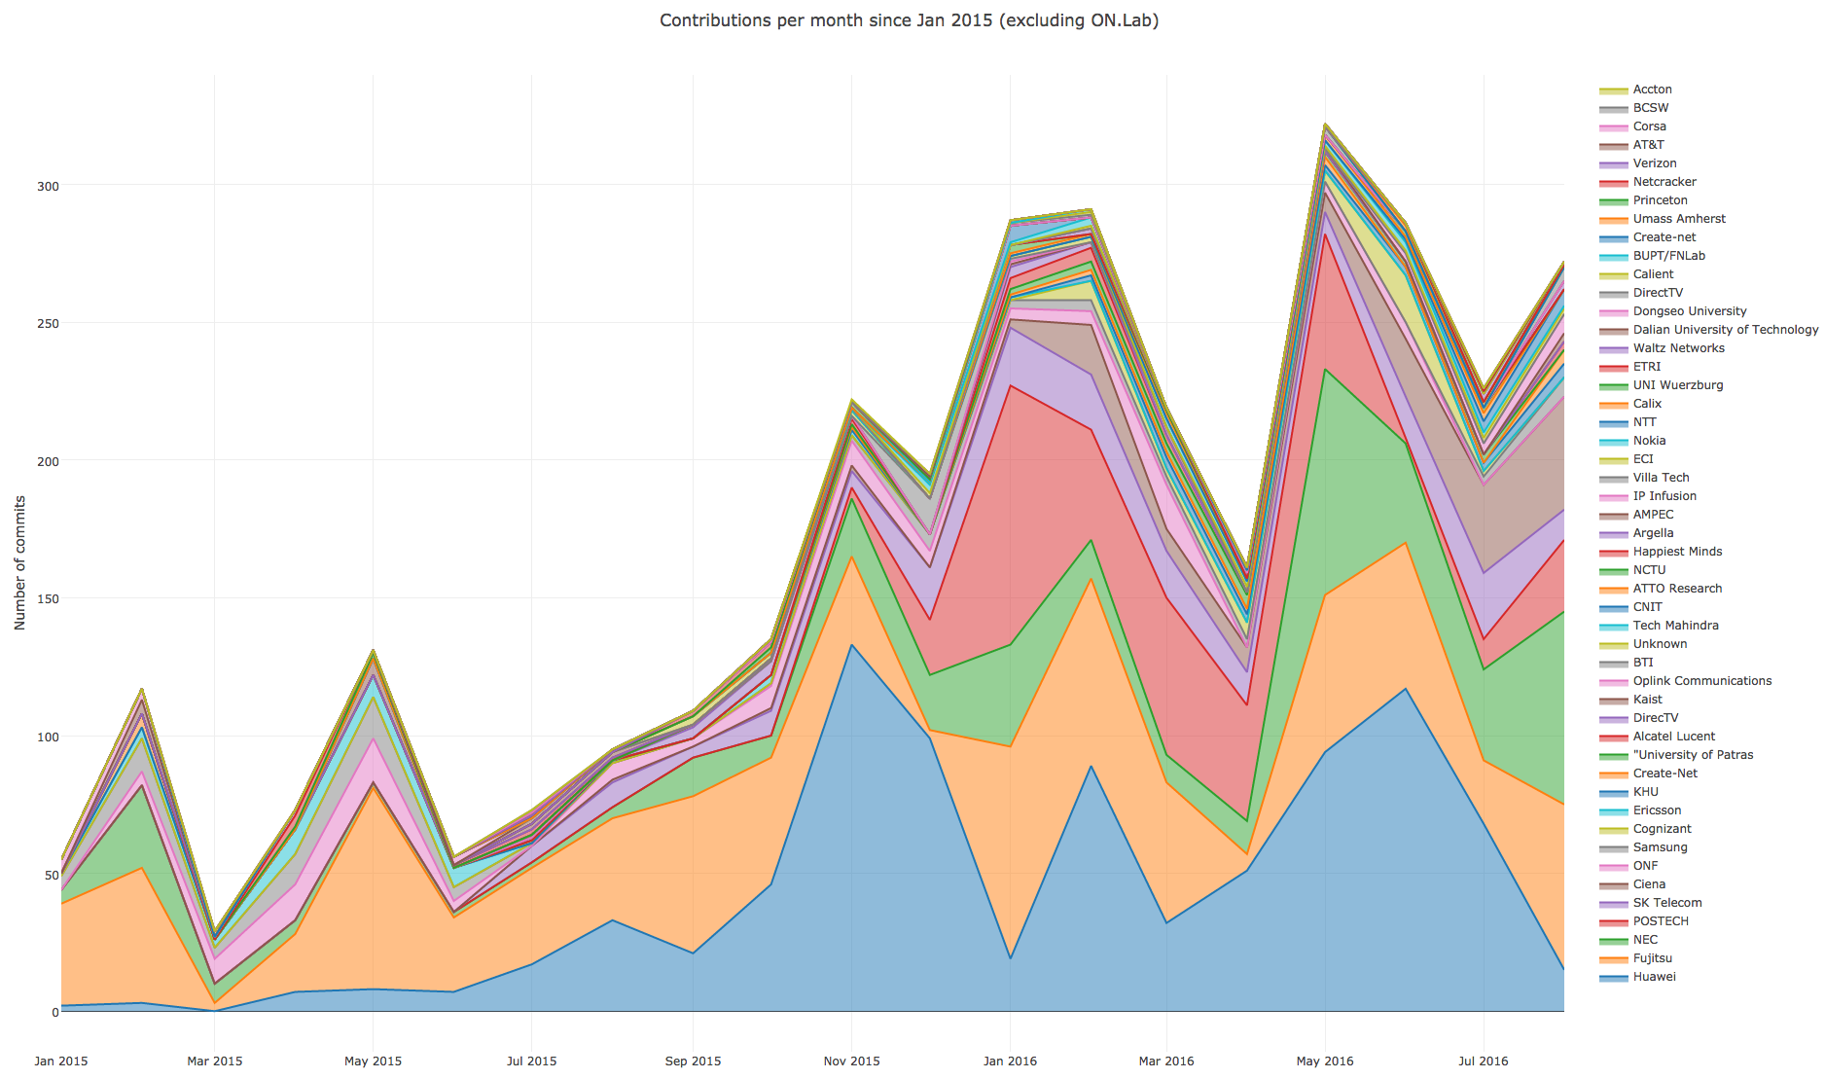
SW Commits per month
(excluding ON.Lab)

Slide 10
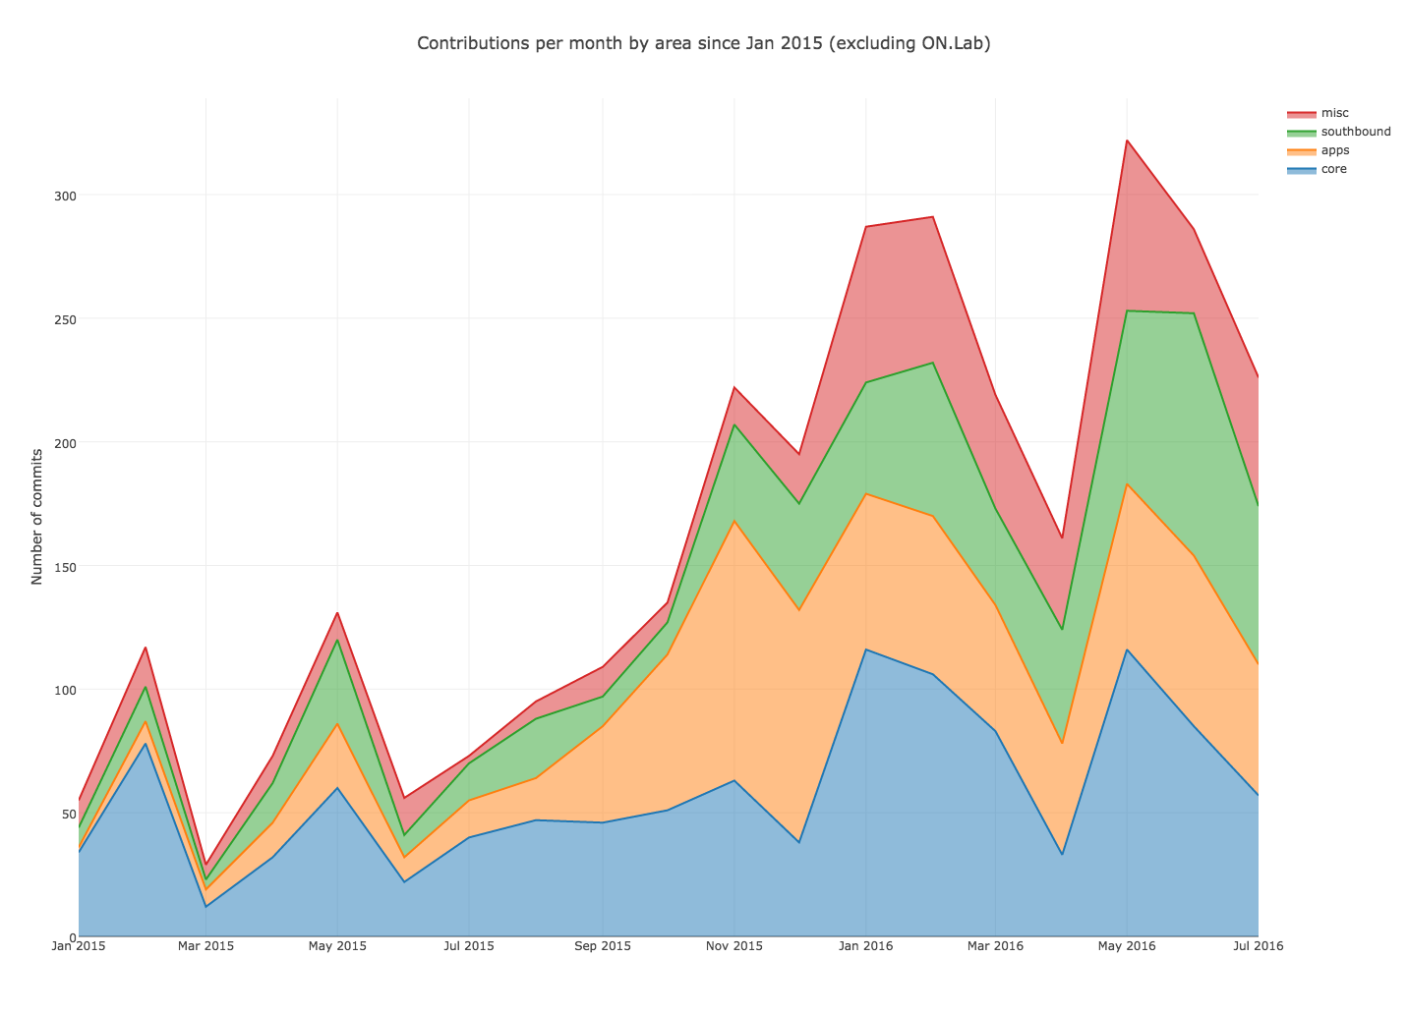
SW Commits per month by area
(excluding ON.Lab)

Slide 11


















ONOS Community
Healthy, Diverse, Growing
ON.LAB
SERVICE PROVIDER
PARTNERS
VENDOR
PARTNERS
COLLABORATORS
VOLUNTEERS
40+ Organizations
30 more in process

Slide 12
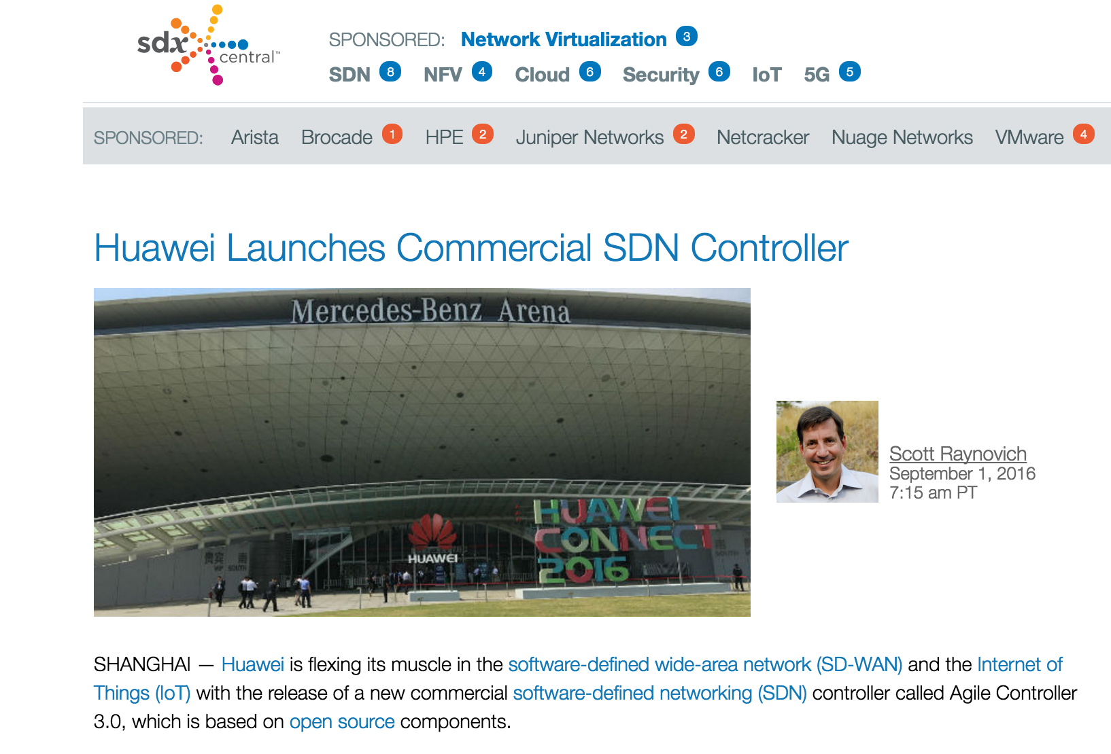
Huawei Launches Controller Based on ONOS

Slide 13
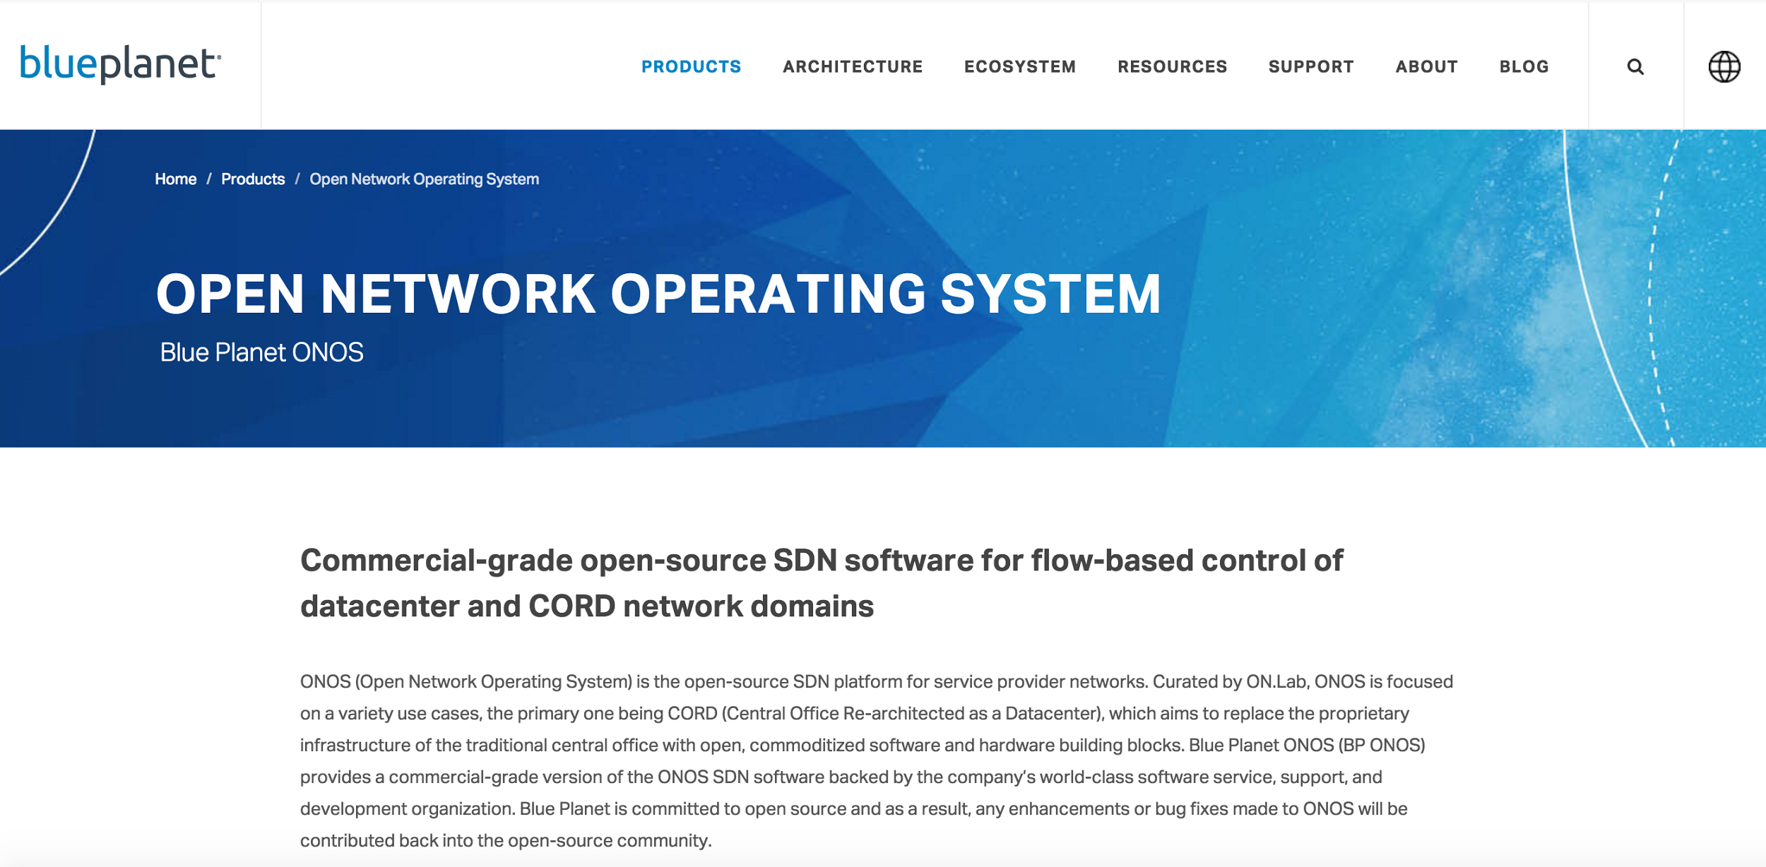
Ciena’s Commercial ONOS Offering

Slide 14
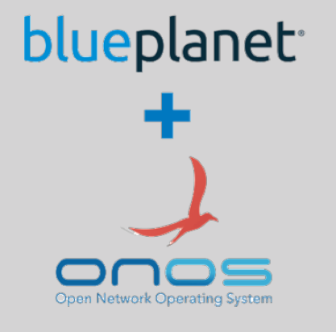

Ciena Blue Planet ONOS Controller
 | BP ONOS CONTROLLER SW | Jun 2016 GA | Dec CY16
TARGET CUSTOMERS | Network operators who want to create their own solution using BP ONOS controller
SUBSCRIPTIONS INCLUDE | Commercial hardened distribution of ONOS controller software
 | 24/7 Support
 | Bug fixes, and changes contributed back to open source (no forking!)
 | Product documentation
 | Integration with Blue Planet software (ONOS RA)
ADDITIONAL SERVICES | Web based, self-paced training on BP ONOS controller basics
 | Instructor-led training
 | Professional services for design and system integration
FUTURE OFFERINGS | Apps on ONOS controller.

Slide 15
Hummingbird Release - Takeaways
ONOS Community is Diverse and Growing Rapidly
ONOS is the only platform supporting both incremental and true SDN
ONOS is critical to operator PoCs, Field Trials, Deployments
Hummingbird
Automation, Integration and Legacy Enablement

Slide 16
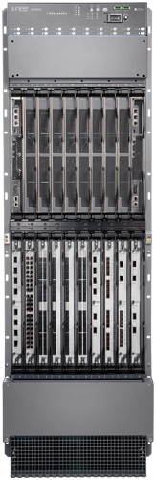
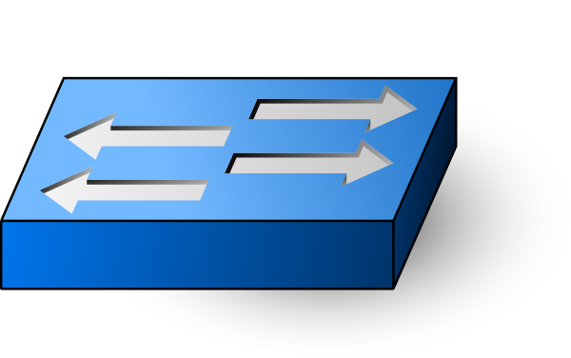
Incremental and Disruptive SDN
Config/Management: Yang
Controller Framework
Apps: Network Control
NetConf/Yang
SDN OS: ONOS
OpenFlow/P4
Distributed Control
Good for short term deployment with legacy devices
(vendor dominated)
Offers disruptive value prop for the longer term
(ONOS community)

Slide 17
Architectural Approach and Integrity Matter
If you needed a car to drive to work and a car to race, but could only have 1 car, would you buy a camry and hope you can alter it for racing? Or would you buy a car built for racing, and also drive it to work?
A: If you are serious about racing, you have to buy the race car. You will never be able to modify a camry to compete with cars built for racing.
ONOS is built BY Service Providers, FOR Service Providers, with the end goals and architecture in mind. It is simple to build apps on ONOS, and ONOS is streamlined, with form to fit function.

Slide 18
Race Car Question in Context...
HA, Scale and Performance of the control plane are fundamental architectural decisions - they are interrelated, and each affects the other. They are not “features” you add...they are the bones of what you create.
Configuration and automation can be added without affecting the control characteristics. It is not scale and latency sensitive like control.
Would you start with a base platform that was good at configuration and hope you can adapt it for HA, Scale, Performance? Systems design shows this won’t work.
ONOS is built first and foremost for HA, Scale, Performance of control - BUT - also has extensive and growing support for configuration and automation.

Slide 19
ONOS is the only SDN control plane supporting both Disruptive and Incremental SDN
Architecture Scale, Performance, HA
North & South-Bound Abstractions
OpenFlow & P4 On Many Hardware & Software Switches
Disruptive SDN
Southbound Protocols NetConf/Yang, BGP-LS, OSPF, ISIS, SNMP, PCEP, TL-1...
On Legacy Devices
Dynamic Configuration NetConf/Yang, OVSDB
Incremental SDN
Northbound Interfaces Intent Framework, REST, gRPC, Kafka, RabbitMQ
Model Based Services
Yang based service definition, container based deployments
Micro-Services

Slide 20
Hummingbird Sample Enhancements
Distributed primitives, Controller Peering, NEMO
Refactor of BMv2 protocol (P4)
Architecture Scale, Performance, HA
North & South-Bound Abstractions
OpenFlow & P4 On Many Hardware & Software Switches
Disruptive SDN
NETCONF, more devices, OSPF, ISIS, LISP, ACTN
Southbound Protocols NetConf/Yang, BGP-LS, PCEP, TL-1...
On Legacy Devices
Dynamic Configuration NetConf/Yang, OVSDB
YANG management system, toolchain, codecs
Incremental SDN
RabbitMQ,
KAFKA,
gRPC
Northbound Interfaces Intent Framework, REST
Model Based Services
Yang based service definition
Micro-Services
ONOS the only SDN control plane that can support all these scenarios

Slide 21


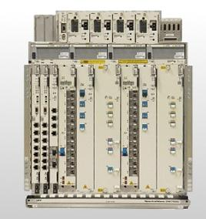
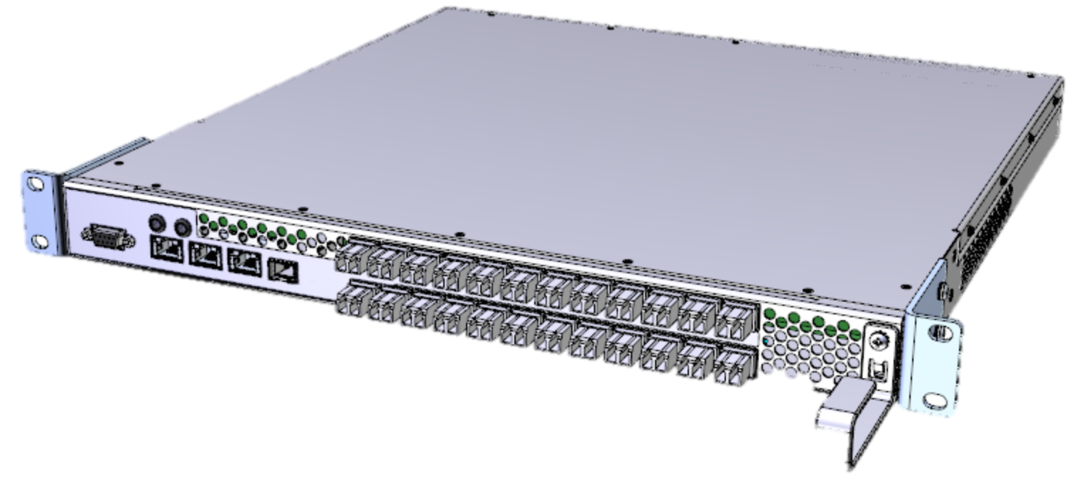
RabbitMQ
External Applications like ADARA PCE
Device Added
Device Removed
PORT Up
PORT Down
PKT_IN etc
Bandwidth On Demand
Alarm Handling
Power Management
ONOS
Supported Events
Device Event
Link Event
Topology Event
Packet Event

Slide 22

Abstraction and Control of Traffic Engineered Networks - ACTN
Customer Network Controller
Multi-vendor multi-domain IP/Transport Network TE SDN Control
Hierarchical network resource abstraction and control
Standard IETF Model-based Northbound Interface
Hybrid legacy and green-field network deployment
CNC
CNC
CNC
CMI
Multi-domain Service
Coordinator
Physical Network Controller
MDSC
MPI: RestConf/YANG
PNC
PNC
PNC
PNC
PNC
SBI: OpenFlow, PCEP, BGP, Proprietary
https://datatracker.ietf.org/doc/draft-ietf-teas-actn-framework/ (ACTN architecture)
https://datatracker.ietf.org/doc/draft-ietf-teas-yang-te-topo/ (TE topology YANG model)
https://datatracker.ietf.org/doc/draft-ietf-teas-yang-te/ (TE tunnel YANG models)
Notes:
ACTN provides a unified architecture to support traffic-engineered SDN control in multi-vendor, multi-domain network environment built of IP and transport networks. Through standard IETF-defined YANG model-based northbound and southbound interfaces and hierarchical network abstraction, ACTN provide means to control heterogeneous network domains for hybrid and green-field SDN network deployment.

Slide 23
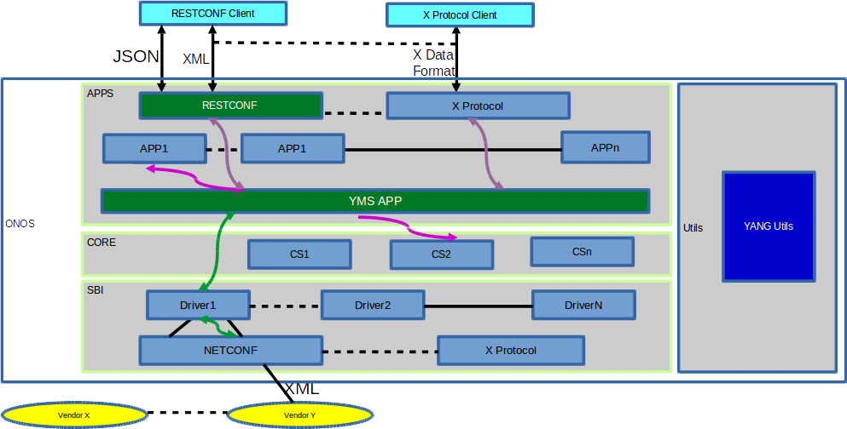
YANG Subsystem
Yang Utils: Automated creation of NB and SB interfaces - App only has to worry about implementing business logic
Yang Management System: Automated code generation for YANG model.
Automated CODEC based on YANG model.
Automated validation of data constraints.
Application development is abstract of protocol nuances.
Enhance ONOS NBI capability to support Notification.
Notes:
This list of partners is current as of August 1, 2016

Slide 24
Why are these examples so important?
RabbitMQ and Kafka make it easy to extend ONOS events to off-ONOS apps - no matter what language those apps are written in - in a performant and scaleable way.
ACTN brings a standard, model-based way to scale the configuration and control of traffic engineered networks and take advantage of ONOS’ extensive IP and Optical capabilities.
Yang
Different vendors can easily bring their devices+Yang models and quickly connect to ONOS to configure devices -- with minimal work by the provider or vendor.
Allows dynamic config and provisioning apps to work easily on top of ONOS to config and provision legacy and OF devices (OSS/BSS interface)
The config database will be built on ONOS distributed data store primitives for scalability and performance.

Slide 25
Disruptive + Incremental SDN -- Why it matters?
Disruptive SDN support in ONOS ensures a service provider can achieve the real infrastructure transformation it seeks
Incremental SDN support in ONOS ensures a service provider has a smooth transition to the final destination…
Most important, a platform that is only focused on incremental SDN cannot deliver disruptive SDN

Slide 26
Hummingbird Release - Takeaways
ONOS Community is Diverse and Growing Rapidly
ONOS is the only platform supporting both incremental and true SDN
ONOS is critical to operator PoCs, Field Trials, Deployments
Hummingbird
Automation, Integration and Legacy Enablement

Slide 27
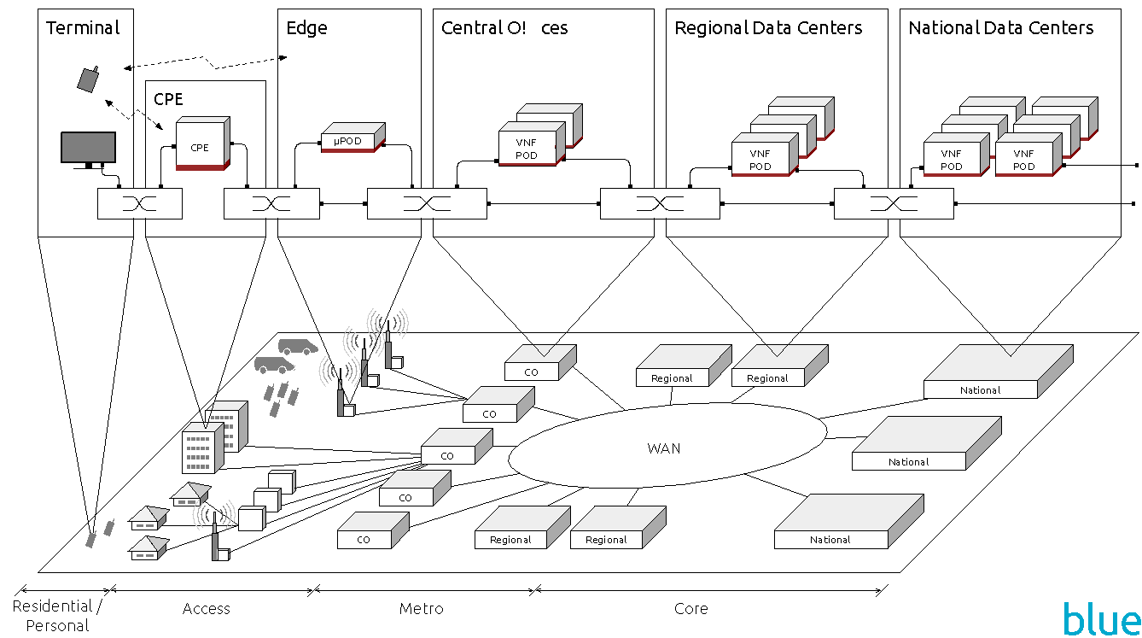
ONOS Use Cases in Service Provider Networks
SDN/IP Peering
Global deployment in R&E Networks
Dis aggregated ROADM
Traffic Engineering/PCE
CORD
Packet- Optical Use Case
Trellis

Slide 28



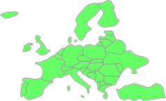



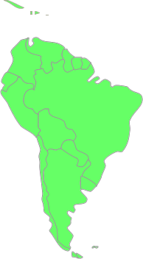






Global SDN Deployment Powered by ONOS
OF
Q3 2015
Korea announces the first
ONOS deployment
OpenFlow
Q1-Q2 2015
First ONOS Deployments
South America, US, EU
Q1 2016 – New connections
Miami - Korea
Miami - Taiwan
Korea - Taiwan
Q4 2015
ONOS deployed in Korea
Q1 2016
NCTU / Taiwan
deploys ONOS
Q4 2015 – New connections
Sidney – Seattle - Miami
Sao Paolo – Amsterdam
OpenFlow
Q4 2015
First ONOS
production deployment
in South America
OpenFlow
Q3 2015
ONOS Deployment in Australia
Global Production L3 Network, No Legacy Routers

Slide 29
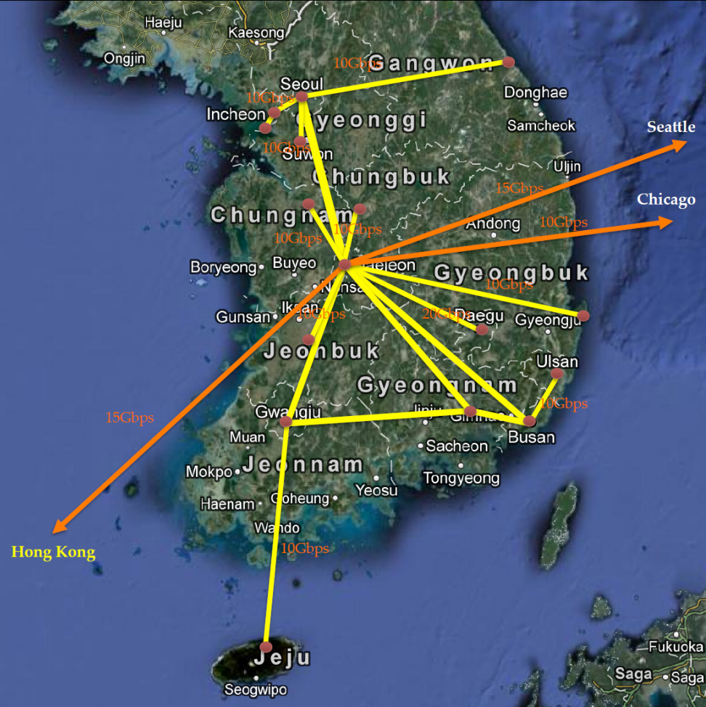
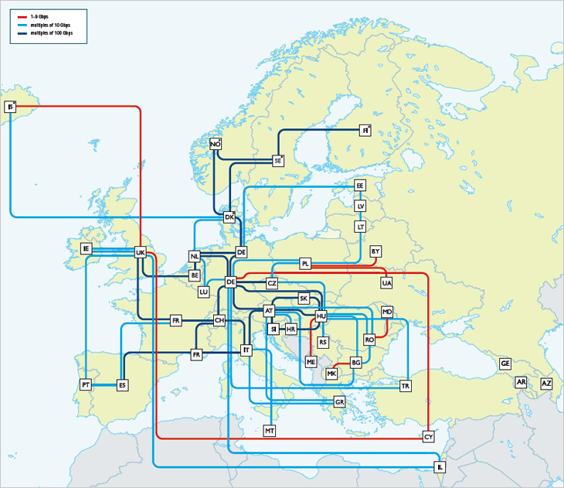
Additional Deployments (Q3/4 2016)
SDX-L2/L3
ONOS Bandwidth on Demand
Self serve portal
GEANT (Europe)
Infinera
Q4 2016
Kreonet (Korea)
Nokia
Q3 2016
Demonstrate ONF’s Transport API (T-API) and OpenConfig support

Slide 30
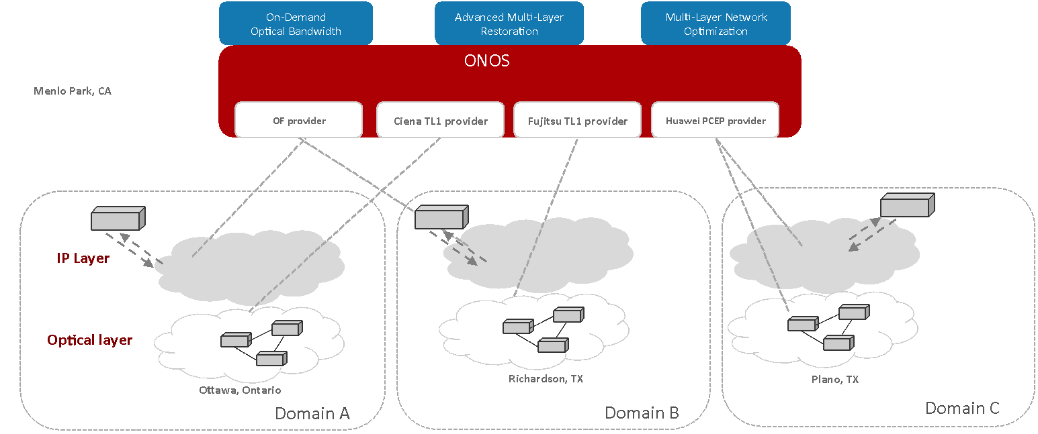
Multi-Layer, Multi-Vendor IP-Optical Demo
(June 2015)
https://youtu.be/gsfYwJyYfI4
Notes:
Demonstration with real hardware at both packet & optical layers
Single control plane supports multi-vendor, multi-protocol network
Any application can apply policies for multiple layers based on resource availability, economics and policies

Slide 31





Disaggregated ROADM
Bandwidth On Demand
Alarm Handling
Power Management
Optical Restoration
ONOS
OpenFlow, SNMP, NETCONF, REST
X
WSS
To optical transport
WSS
Backplane
muxponder
To packet layer
transponder
1x20 WSS, 1U
8x2 transponder, 1U
160x160 backplane, 7U
Vertical integration | Disaggregated
Vendor lock-in | Multi vendor
One size fits all | Rightsize
Forklift upgrade | Piece-wise upgrade
System integration | Software-driven integration
Notes:
Eliminate vendor lock in
Innovation in terminal equipment is 2-3 years, ROADMs/amps live 5-7 years
Right-size your equipment, take advantage of best of breed (port density, power efficiency, capacity, programmability)
Opportunity for open interfaces

Slide 32


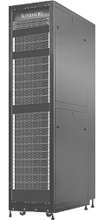

CORD: Central Office Re-architected as Datacenter
SDN Control Plane - ONOS
NFV Orchestration w/XOS
TRELLIS
Large number of COs
White Box
White Box
White Box
White Box
Leaf-Spine
Fabric
SDN Enabled CO Fabric
NFV
White Box
White Box
White Box
White Box
White Box
White Box
Cloud
SDN
White Box
White Box
White Box
White Box
White Box
White Box
Evolved over 40-50 years
Access
Core
300+ Types of equipment Huge source of CAPEX/OPEX
Commodity servers, switches and network access

Slide 33


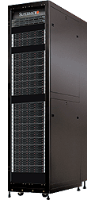
Enterprise Domains of Use:
Residential, Mobile, Enterprise
Field Trial
Residential vOLT, vSG, vRouter, vCDN
Mobile Enable 5G w/
Disaggregated/Virtualized RAN & EPC, Mobile Edge
Enterprise
SDN-WAN with programmability, packet-optical convergence
POC at ONS
POC at ONS
ONOS + OpenStack + XOS
Leaf-Spine
Fabric
ROADM
(Core)
Enterprise
Metro Ethernet
BBUs (Multi-RATs)
PON
OLT MACs
Commodity Servers, Storage, Switches, and I/O

Slide 34
Hummingbird Release - Takeaways
ONOS Community is Diverse and Growing Rapidly
ONOS is the only platform supporting both incremental and true SDN
ONOS is critical to operator PoCs, Field Trials, Deployments
Hummingbird
Automation, Integration and Legacy Enablement

Slide 35
Hummingbird focus
Automation
Automated generation of YANG model java code - NB and SB
Integration/Interoperability (with other system components)
YANG toolchain support to quickly integrate new service and device models
RabbitMQ (Adara) and Kafka (Calix) message bus support to quickly integrate new applications written in other languages
Controller peering support through ICONA project (Create-Net and TATA) and through Open Exchange Protocol (BUPT)
RestConf Client support in southbound (Huawei)
ACTN (Huawei)
Legacy Support
Additional NETCONF device support (Fujitsu)
BGP Route Policy Distribution (Huawei)
IETF TE Topology application, standard YANG models - ACTN (Huawei)
Additional optical support for devices (OPLink)
Arista switch support (SKT)
OSPF and ISIS southbound interfaces (Huawei, Cognizant)
Cisco IOS port discovery (University of Patras)
Initial implementation of LISP (POSTECH)

Slide 36
Hummingbird Release - Takeaways
ONOS Community is Diverse and Growing Rapidly
ONOS is the only platform supporting both incremental and true SDN
ONOS is critical to operator PoCs, Field Trials, Deployments
Hummingbird
Automation, Integration and Legacy Enablement

Slide 37
Detailed Contributions and Release Content
End of briefing, the rest of slides are for reference

Slide 38

















Hummingbird Primary Contributors*
*Software contributors - there are other contributions not shown here (deployments, documentation)

Slide 39
Sample Hummingbird Contributions
Community | New Collaborators: Adtran, BII, NCTU
Build/Test Infra | ONOS Swagger Plugin Stabilized STC, greatly improved coverage Mininet scripts for testing ONOS network partitions and dynamic scaling | Ciena, ON.Lab
Apps | Enhancements to ICONA (controller peering) SONA and Scalable gateway improvements ACTN - Abstraction and Control of Traffic Engineered Networks | Adara, ATTO Research, BUPT, Create-Net, Huawei, NEC, ON.Lab, SK Telecom, SRI, Tata, Tech-Mahindra
NB | Implement PowerConfig for Oplink Devices RabbitMQ, Kafka message bus integration Add basic error handling to gRPC Device SB service NeMo Intent based abstraction language | Calix, Ciena, Fujitsu, Huawei, NEC, ON.Lab, OpLink, Samsung, SK Telecom, Verizon
CORE | Refactoring of optical information model Initial work on virtualization New distributed system primitives | Ciena, Fujitsu, NEC, ON.Lab
SB | LOXI enhancements for optical extensions New provider for link discovery NETCONF enhancements | Cognizant, Create-Net, Fujitsu, GEANT, Huawei, NEC, ON.Lab, OpLink, POSTECH, SK Telecom, Tata, University of Patras

Slide 40
Release Features
Automated testing, Build environment
Contributions from ON.Lab and Ciena
Built new ONOS tutorial VM (ON.Lab)
ONOS Swagger Plugin (ON.Lab)
Finished moving to BUCK (ON.Lab)
Stabilized STC, greatly improved coverage (config subsystem, distributed primitives, applications, drivers), added capability to run tests multiple times while unattended (ON.Lab)
Mininet scripts for testing ONOS network partitions and dynamic scaling (Ciena)

Slide 41
Release Features
Applications
Contributions from Adara, ATTO Research, BUPT, Create-Net, Huawei, NEC, ON.Lab, SK Telecom, SRI, Tata, Tech-Mahindra
Enhancements to ICONA (controller peering) (Create-Net, Tata)
SONA and Scalable gateway improvements (SK Telecom, ATTO Research)
External event dispatching, standard JSON format for events, event registration, integration of events with packet, link, topology events, integration of RabbitMQ (Adara)
New subsystem for anomaly detection (ATHENA) (SRI)
Open Exchange Protocol for inter-controller communication (BUPT)
Added YANG Management System (YMS) application. (Huawei)
YANG Tools enhancements to support complete YANG 1.0 (Huawei)
Added DHCP Relay (Tech-Mahindra)
Improvements to FIB installer (Tech-Mahindra)
Dynamic XConnect support (ON.Lab)
BGP Route policy distribution and flow spec (Huawei)
Added BMv2 demo apps (P4 support) (ON.Lab)
VPLS code refactoring (NCTU)
UI - Separating theme from layout for CSS files, continued work on theming UI (ON.Lab)
IETF TE Topology Application under ACTN (Huawei)
Carrier Ethernet application for installing EPL/EP-LAN/EP-Tree and EVPL/EVP-LAN/EVP-Tree services (Huawei)

Slide 42
Release Features
Northbound
Contributions from Calix, Ciena, Fujitsu, Huawei, NEC, ON.Lab, OpLink, Samsung, SK Telecom, Verizon
Implement PowerConfig for Oplink Devices, Use LambdaQuery in OpenFlowDeviceProvider to get details for optical ports (OpLink)
Kafka message bus integration (Calix)
decouple optical-model from CLI (NEC)
Add basic error handling to gRPC Device SB service, Add link eviction to gRPC Link SB (NEC)
Initial implementation of Virtual network Intent service (Ciena)
Improve performance of Resource Reservation Service (Fujitsu)
YMS to provide automated CODEC for NBI. (Huawei)
Abstraction and Control of TE Networks (ACTN) implementation (Huawei)
Refactored tunnel and interface config behavior (SK Telecom)
sp2mp intents now modify packets at the egress switch (Verizon)
mp2sp intents now modify packets at the ingress switch (Verizon)
sp2mp intents support multiple treatments (Università Roma Tor Vergata / ON.Lab)
mp2sp intents support multiple selectors (Università Roma Tor Vergata / ON.Lab)
Added back-off mechanism for intent clean-up (ON.Lab)
Added ARP command (ON.Lab)
Support for standard IETF TE YANG models under ACTN (Huawei)
New neighbour message subsystem for handling ARP and NDP (ON.Lab)

Slide 43
Release Features
Core
Contributions from Ciena, Fujitsu, NCTU, NEC, ON.Lab
Refactoring of optical information model - Move optical Intent compilers out to optical-model (NEC)
Initial work on virtualization - Virtual Network DeviceService and LinkService to use VirtualNetwork service, virtual network topology provider (Ciena)
New distributed system primitives (AsyncConsistentTreeMap, DistributedTreeMap) (Fujitsu)
Distributed work queue primitive (ON.Lab)
New ApplicationStore that uses a single ConsistentMap to track all app related state (ON.Lab)
NetconfAlarmProvider alerts core about notifications given subscription (ON.Lab)
Implementation of Hybrid Logical Clock Service (ON.Lab)
New ComponentConfigStore that uses a ConsistentMap configured with sequential consistency (ON.Lab)
Support Cluster restart via stc (NCTU)

Slide 44
Release Features
Southbound
Contributions from Cognizant, Create-Net, Fujitsu, GEANT, Huawei, NEC, ON.Lab, OpLink, POSTECH, SK Telecom, Tata, University of Patras
LOXI enhancements for optical extensions (OpLink)
New provider for link discovery
NETCONF enhancements (Fujitsu)
YMS to provide automated CODEC for SBI (Huawei)
YANG Tools enhancements to support auto code generation for drivers/providers. (Huawei)
Implement the Driver for handling Arista switch (SK Telecom)
Updated NETCONF for Fujitsu OLT devices, Separate optical driver from "default" driver bundle (NEC)
Rate limit on port via NetConf (GEANT)
Cisco IOS Port Discovery (University of Patras)
Initial implementation of LISP control message objects (POSTECH)
OSPF refactoring to align with ISIS design, ISIS updates (Cognizant)
Major refactoring of the BMv2 protocol module (P4 support) (ON.Lab)
Add support for vlan based intents in the Corsa driver (ON.Lab)
Building alarms from NETCONF notifications (ON.Lab)
RestConf Client Implementation (Huawei)

Slide 45
ADARA’s contribution to Hummingbird Release
The ONOS and Service Provider Developer Community need to be able to develop and deploy non-JAVA Networking Applications -- - Development in a multitude of languages enables innovative, higher-performing and more flexible networking applications to be created with greater speed to market - Support of legacy applications with fewer changes would become possible ADARA’s contribution for the Hummingbird Software release was developed to give ONOS the ability to support external applications through the Rabbit MQ Framework, rounding out the Software with new and different ways for networking applications to interact with the Northbound protocol through message busses The ADARA contribution extends ONOS’ ability to support Asynchronous notifications of the following events from ONOS to external applications: 1. Device Event 2. Link Event 3. Topology Event 4. Packet Event

Slide 46
Backup

Slide 47
Scale-Out Design w/ Multiple ONOS Instances
Each instance is identical
One can add and remove instances seamlessly
Each instance is a master for a sub-set of switches
It works like a single system for apps and network devices
Apps
Apps
ONOS
Global Network View / State
Global Network View / State
ONOS Instance 1
ONOS Instance 2
ONOS Instance 3

Slide 48
ONOS Architecture Tiers
Apps
Apps
Northbound Abstraction:
- network graph
- application intents
- virtualization & slicing
Core:
- distributed
- protocol independent
Southbound Abstraction:
- generalized OpenFlow
- pluggable & extensible
Northbound - Application Intent Framework
(policy enforcement, conflict resolution, virtualization, slicing)
Distributed Core
(scalability, availability, performance, persistence)
Southbound
(discover, observe, program, configure)
OpenFlow
NetConf
. . .

Slide 49
ONOS Performance Industry leading framework and results
A. Device and Link Sensing
< 100ms
ONOS part <10ms
Apps
C
Northbound - Application Intent Framework
(policy enforcement, conflict resolution)
B
B. Intent throughput
200k ops/sec
Flow rule subsystem
Distributed Core
(scalability, availability, performance, persistence)
A
D
C. Intent latency
< 50ms
Southbound
(discover, observe, program, configure)
D. Flow throughput
500K to 3M ops/sec
Improves with number of instances
Adapter
Adapter
. . .
OpenFlow
NetConf
. . .
Notes:
Cbench rudimentary - doesn’t cut it

Slide 50
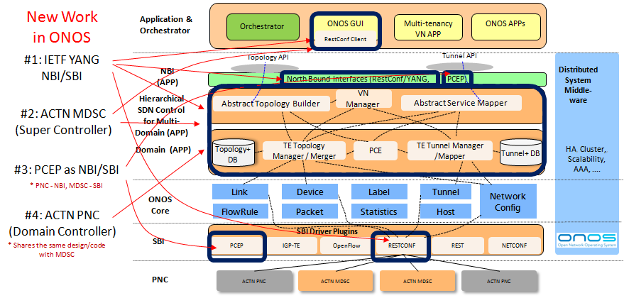
ACTN ONOS Architecture

Slide 51
ACTN ONOS H Release Features
IETF Topology YANG Model Support
Topology NB YANG APP and SB TE Provider
MDSC Application - TE Topology Core APP
RestConf/YANG Client (SB) and Server (NB), Integrated with YANG Utils and YMS

Slide 52
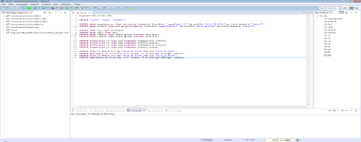
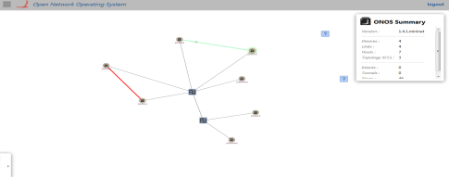
NEMO Overall Architecture
Main Components:
Editor:
An edit tool for users to compile users’ intent request into NEMO language
GUI:
A intuitive interface to present intent request and handling result
NEMO model:
All defined models to composite intent
Language Compiler:
Compile intent request described with NEMO language into models
Tenant Space Management:
Maintain each isolated tenant space, including authentication and CRUD of intent
NEMO Intent Resolver:
Intent/service resolution, decomposition and deployment
Drivers:
Delegate specific request into other apps
Storage:
Store all information involved in NEMO
Presentation
Eclipse NEMO Editor
ONOS GUI
NEMO Language-style API
NEMO Structure-style API
NEMO
NEMO Storage
NEMO Language Compiler
NEMO Model
Tenant Space Management
Implementation
NEMO Intent Resolver
VTN Driver
SFC Driver
Other Drivers
VTN
SFC
APPs
Dependency
ONOS Core

Slide 53
NEMO ONOS H Release Features
NEMO expression models and API
NEMO language compiler
Tenant Space Management
NEMO language editor

