Slide 1
Orchestration Brigade

Slide 2
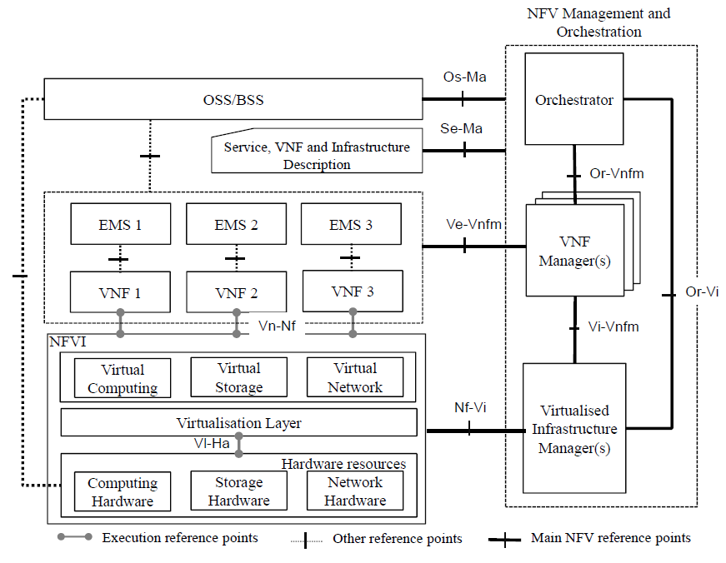

What we are doing ?
Since different opensource orchestration implementation are released ,
Sdn controller integration to these are getting more important .
With different orchestrator integrations , we can learn their requirements .
And , extend community

Slide 3
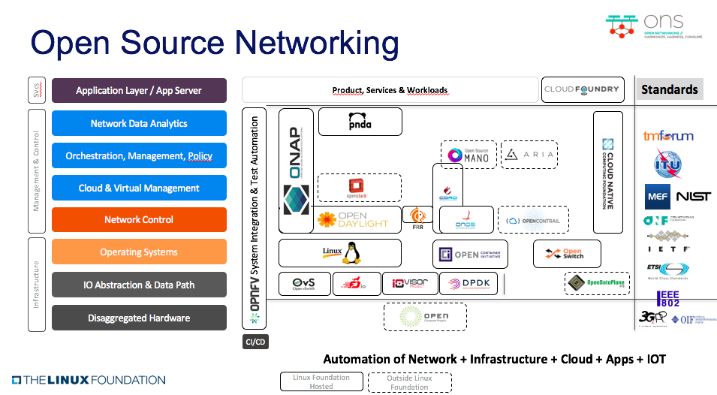

Slide 4
Open Source Orchestrators
OPNFV
MANO
OpenBaton
Onap

Slide 5
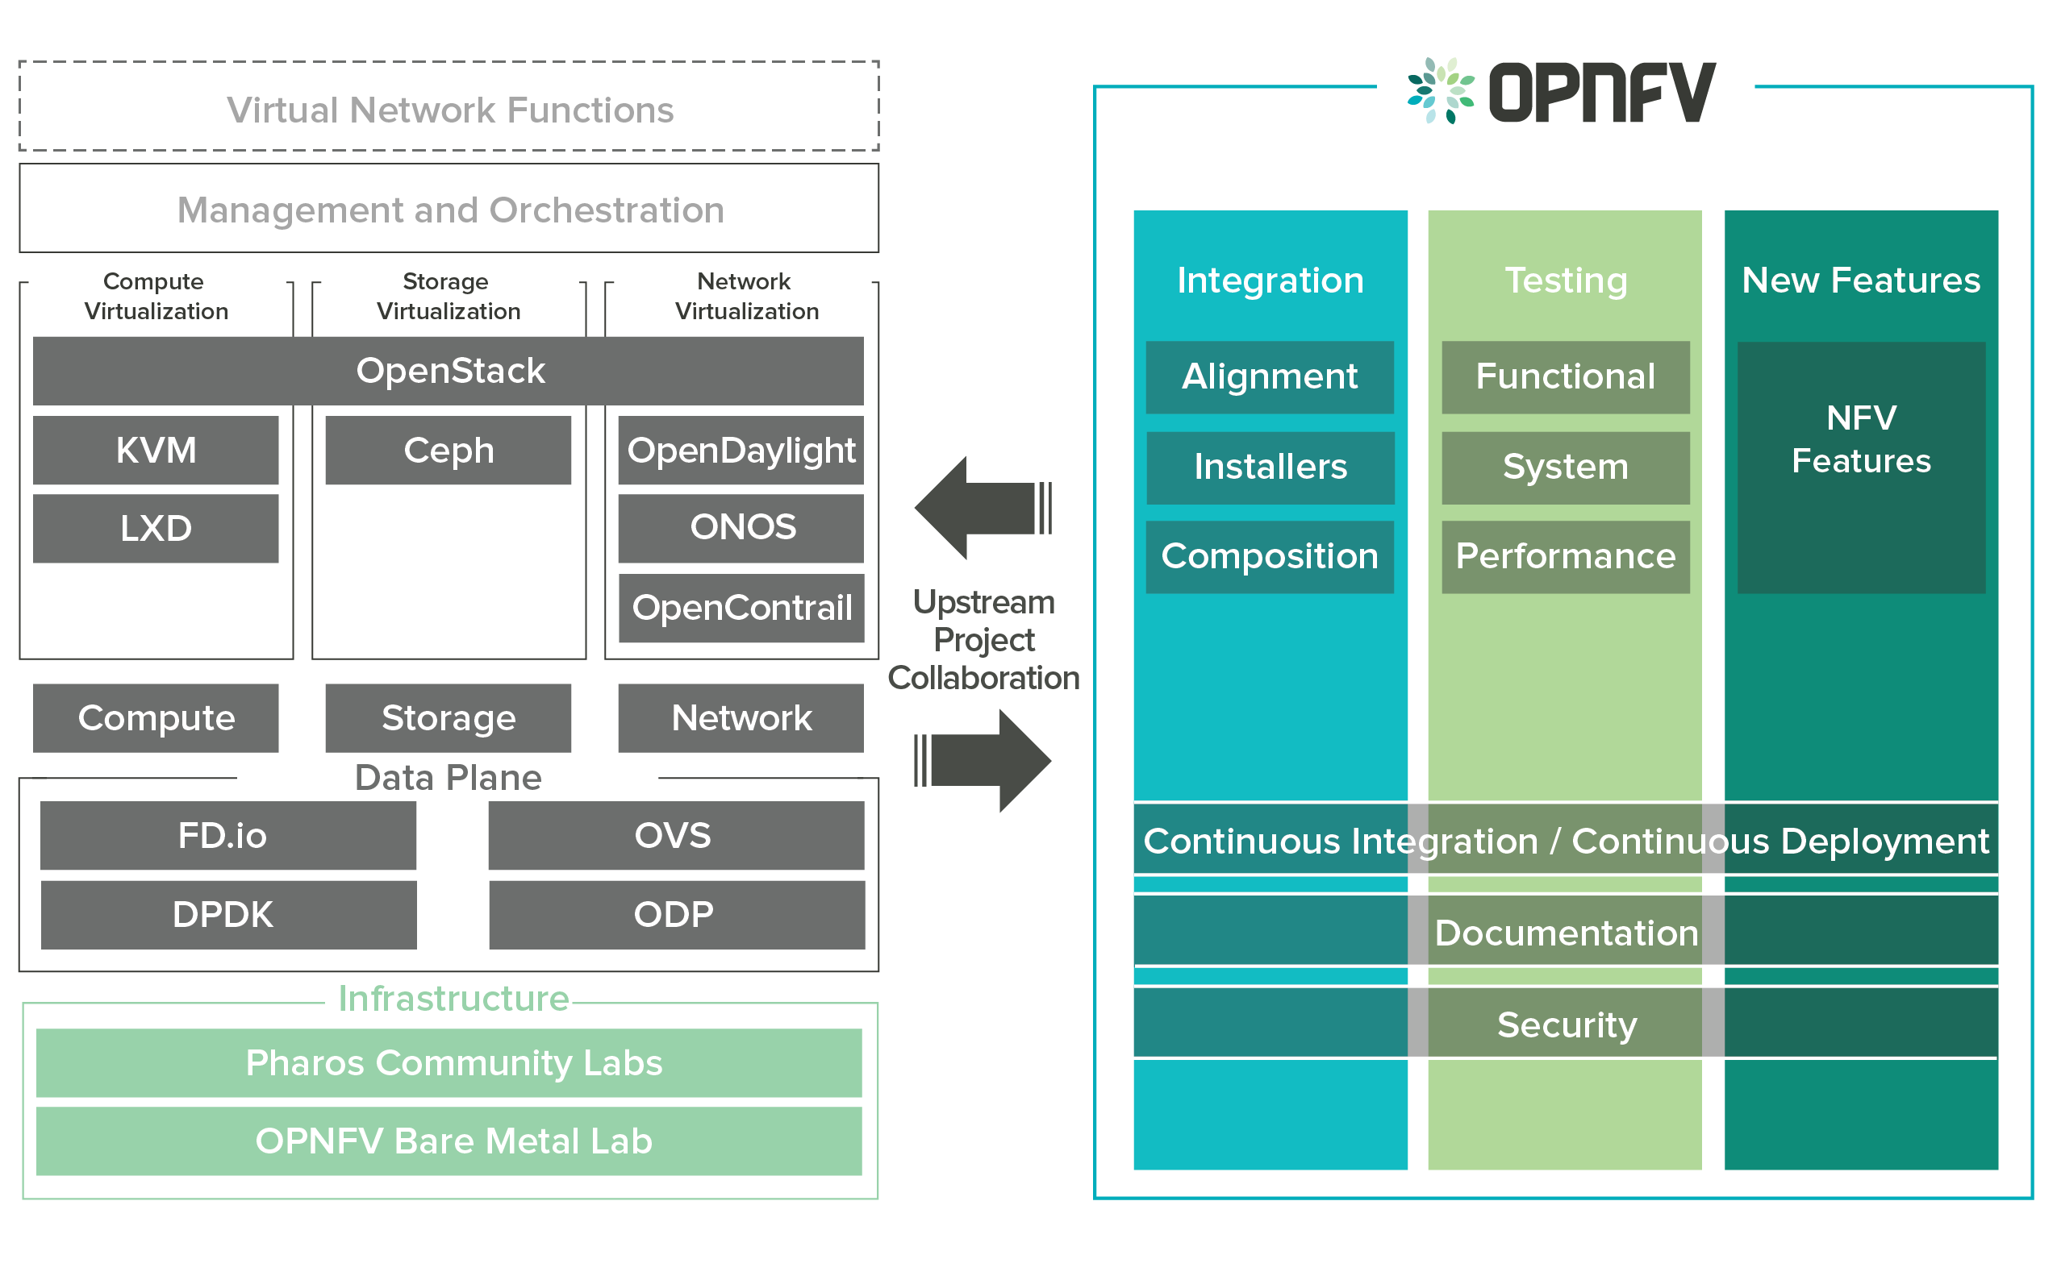
Opnfv

Slide 6
Onos status -OPNFV
Onos has been integrated in OPNFV B,C,D releases. Because of lack of engineer resource , Onos will not be integrated in OPNFV E release

Slide 7
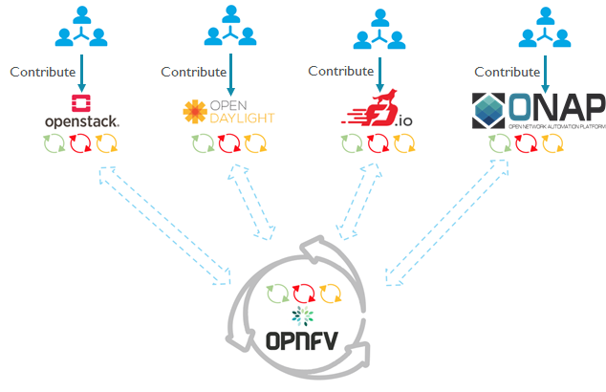
OPNFV-XCI

Slide 8
Opnvf–onos needs
Implementing ansible roles for onos integration to xci integration
Finding requirements to integrate use cases to opnfv

Slide 9
OSM
Open Source MANO is an ETSI-hosted project to develop an Open Source NFV Management and Orchestration (MANO) software stack aligned with ETSI NFV.

Slide 10
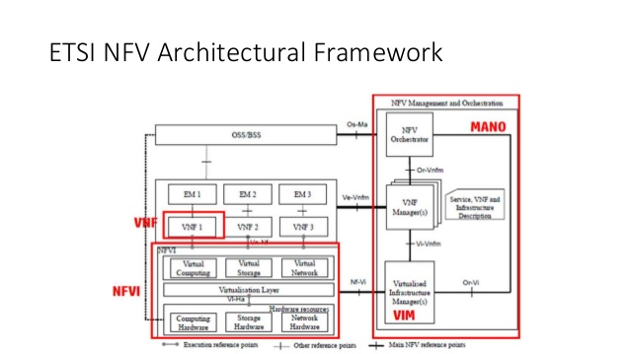
OSM

Slide 11
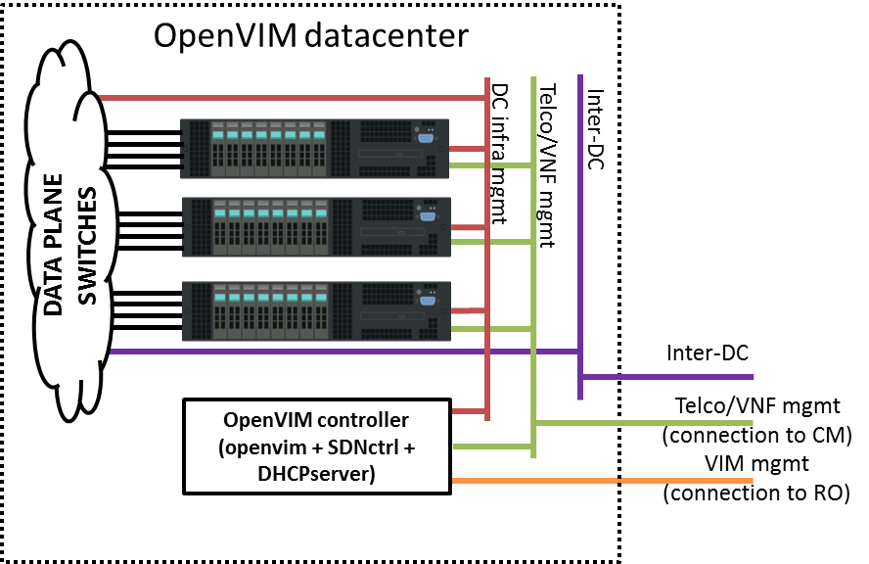
Osm OpenVIM

Slide 12
Osm–onos status
Osm is also contributing onos . They are using onos in openvim installation . Documentation should be revised .
Status will be updated .
https://osm.etsi.org/wikipub/index.php/OSM_Release_TWO
https://osm.etsi.org/wikipub/index.php/OpenVIM_installation_(Release_THREE)

Slide 13
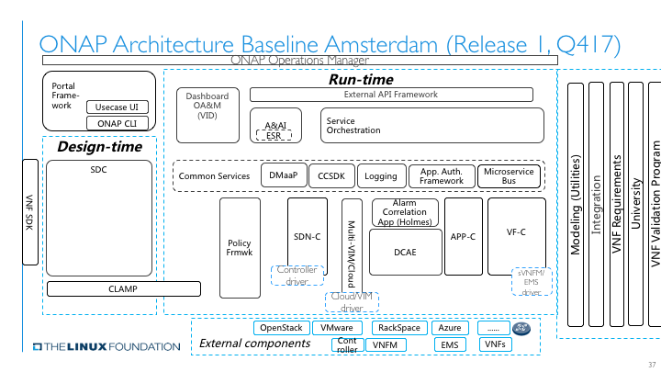
Onap

Slide 14
Onap-status
Amsterdam release will be on mid- November
Onos can be deployed into two place
Replicate SDN-C
Adding as 3rd party controller to ONAP

Slide 15
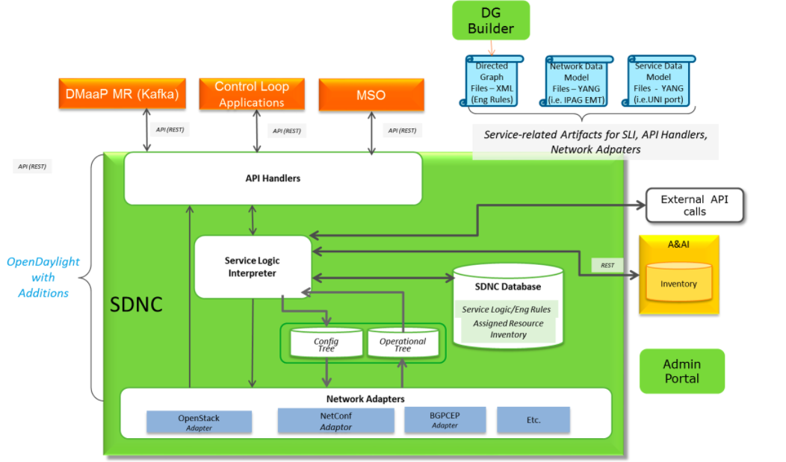
Replicate SDN-C

Slide 16
Onap-onos needs
Sdn-c replication should be out of focus . Too much dependencies .
3rd party controller integration to A&AI .
Flow diagrams .
Requirements
Documentation
No implementation (First phase)

Slide 17
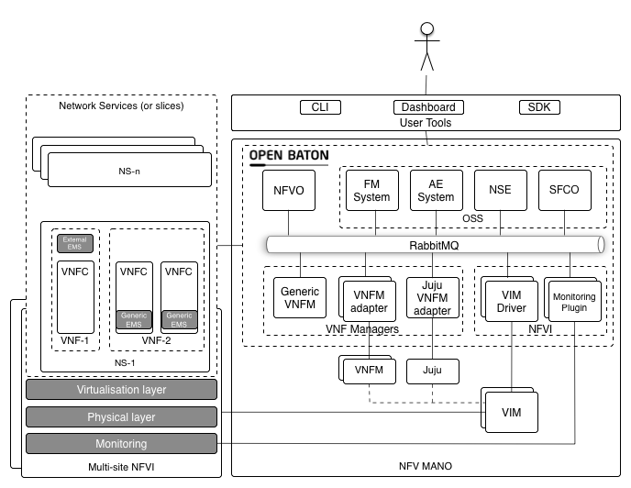
OpenBaton

Slide 18
OpenBaton-Onos needs
How to use onos in openbaton documentation

Slide 19
Contribution Time …
Project | Contributors
OPNFV | Murat Parlakisik
Mano
ONAP
OpenBaton

