Slide 1
XMPP as SBI implementation
Tomek Osiński: Orange Labs, Warsaw, Poland
Abdulhalim Dandoush: ESME Sudria engineering school, France
Project wiki: https://wiki.onosproject.org/display/ONOS/XMPP+as+SBI

Slide 2
Agenda
Introduction
BGP VPN architecture
XMPP protocol
Design & implementation
Demo
Evaluation
Conclusions

Slide 3
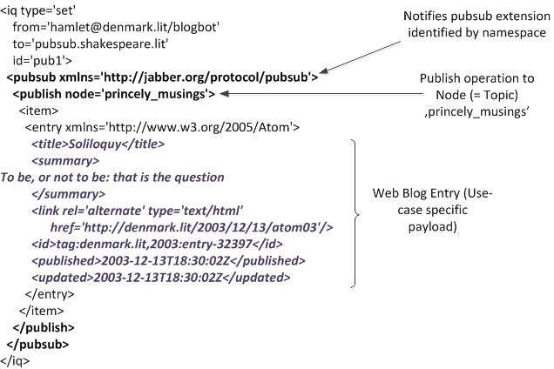
XMPP protocol
Features:
XML-based
Highly extensible
Core XMPP (RFC 6120):
XMPP Stream
XMPP Stanzas (IQ, Message, Presence)
TLS/SASL
XMPP Extension Protocols (XEPs)
https://xmpp.org/extensions/
XMPP Publish/Subscribe extension:
Publish/Subscribe paradigm
payload-agnostic
XMPP in the SDN area:
OpenContrail

Slide 4









Overview of MPLS/L3VPN-XMPP solution
https://tools.ietf.org/html/draft-ietf-l3vpn-end-system-06
L3 VPNs for Inter-Site Connectivity Traffic segmentation in the WAN MPLS over MPLS label encapsulation tunnels BGP route signaling
Contrail Virtual Networks in Datacenters Traffic segmentation in the LAN MPLS over GRE or VXLAN label encapsulation tunnels XMPP (with BGP payload) route signaling
OpenStack Cloud Manager
Route Reflector
Contrail Controller
BGP
XMPP (BGP)
Customer Site
CE Router
PE Router
Customer VRF
Encapsulation Tunnel
Protocols, Architecture
VM
Hypervisor with vRouter
Server or Compute Node
Tenant VRF, Policies, etc
Encapsulation Tunnel
(MPLSoGRE, or VXLAN)
Provider Network
SOURCE OPNFV/OpenContrail
Datacenter

Slide 5

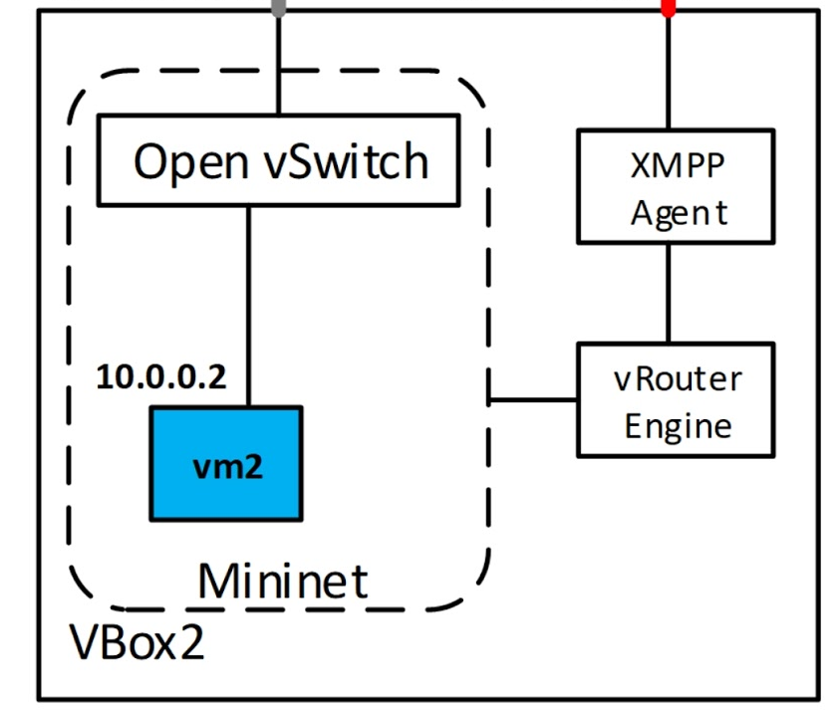

Proposed solution for ONOS
ONOS
XMPP SBI
BGP
Interacts with network elements for VM network provisioning and ensures uptime
Emulated vRouter for testing objective
VM
VM
VM
VM
vRouter
Nova Agent
Physical Host
with Hypervisor
Physical Network (no changes)
Juniper vRouter: Virtualized routing element handles localized control plane and forwarding plane work on the compute node
Gateway
Gateway: MX Series (or other router) or EX9200 serve as gateway eliminating need for SW gateway & improving scale & performance
WAN, Internet

Slide 6
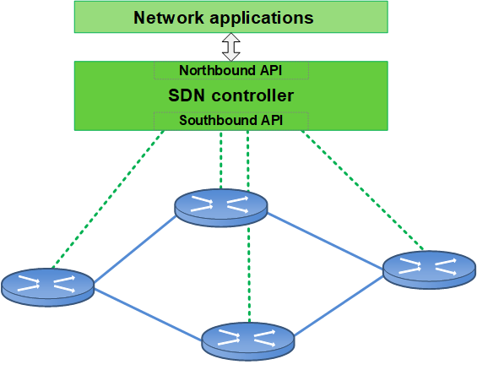


The concept of XMPP as SBI
We use XMPP Publish/Subscribe extension
XMPP PubSub introduces new communication model between devices and SDN controller
SDN controller as a communication bus
XMPP is a „container protocol”
How it differs from OpenFlow?

Slide 7
Design & Implementation
XMPP as SBI for ONOS

Slide 8
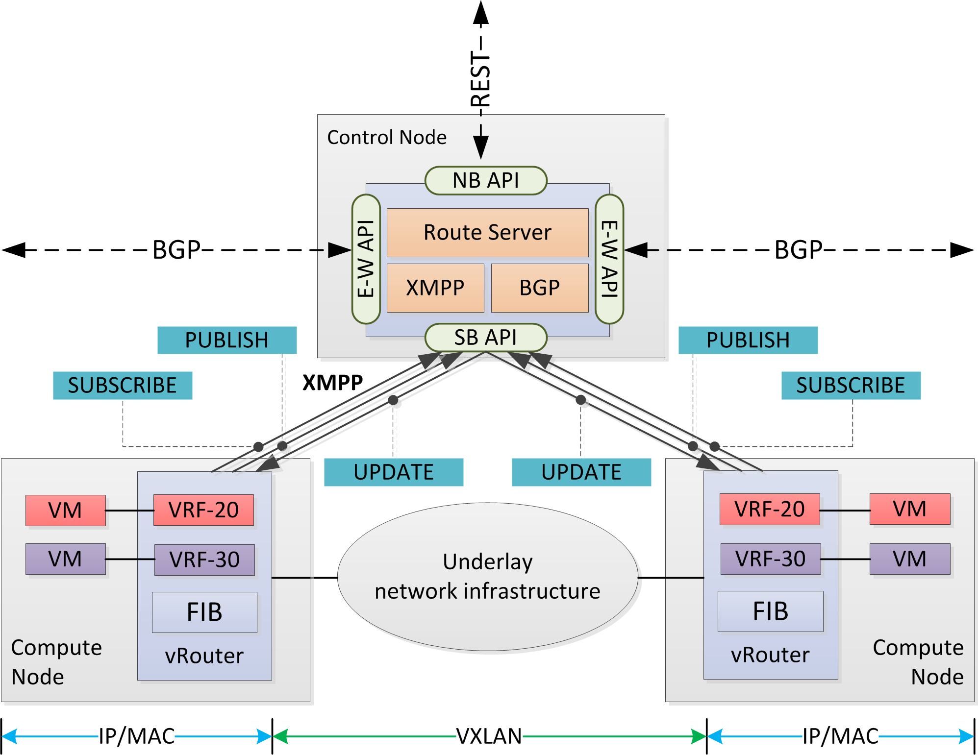
Solution design
ONOS with XMPP SBI and Route Server
Virtual routers in the data plane
BGP over XMPP
vRouters subscribes to ONOS for a VPN topic (SUBSCRIBE)
vRouter publishes BGP NLRI associated with VPN (PUBLISH)
Peer vRouters are notified about new virtual interface (UPDATE)

Slide 9
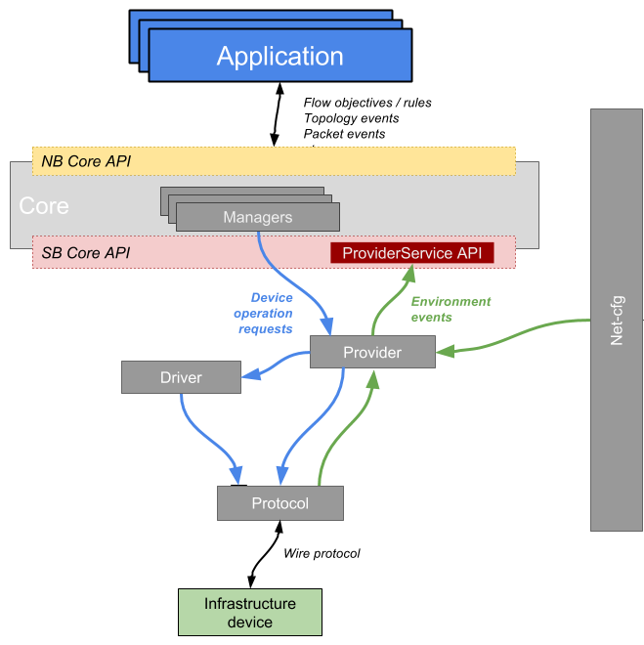
XMPP as SBI implementation
XMPP as SBI implementation is main contribution of the project
Main functionalities of XMPP SBI:
Asynchronous, non-blocking XML parsing
Decoding/encoding XMPP messages
Abstracting underlaying devices
Maintaining the state of connected devices
XMPP events distribution to Providers
Device Provider
Extensible implementation to add new XMPP extensions (e.g. Publish/Subscribe)

Slide 10
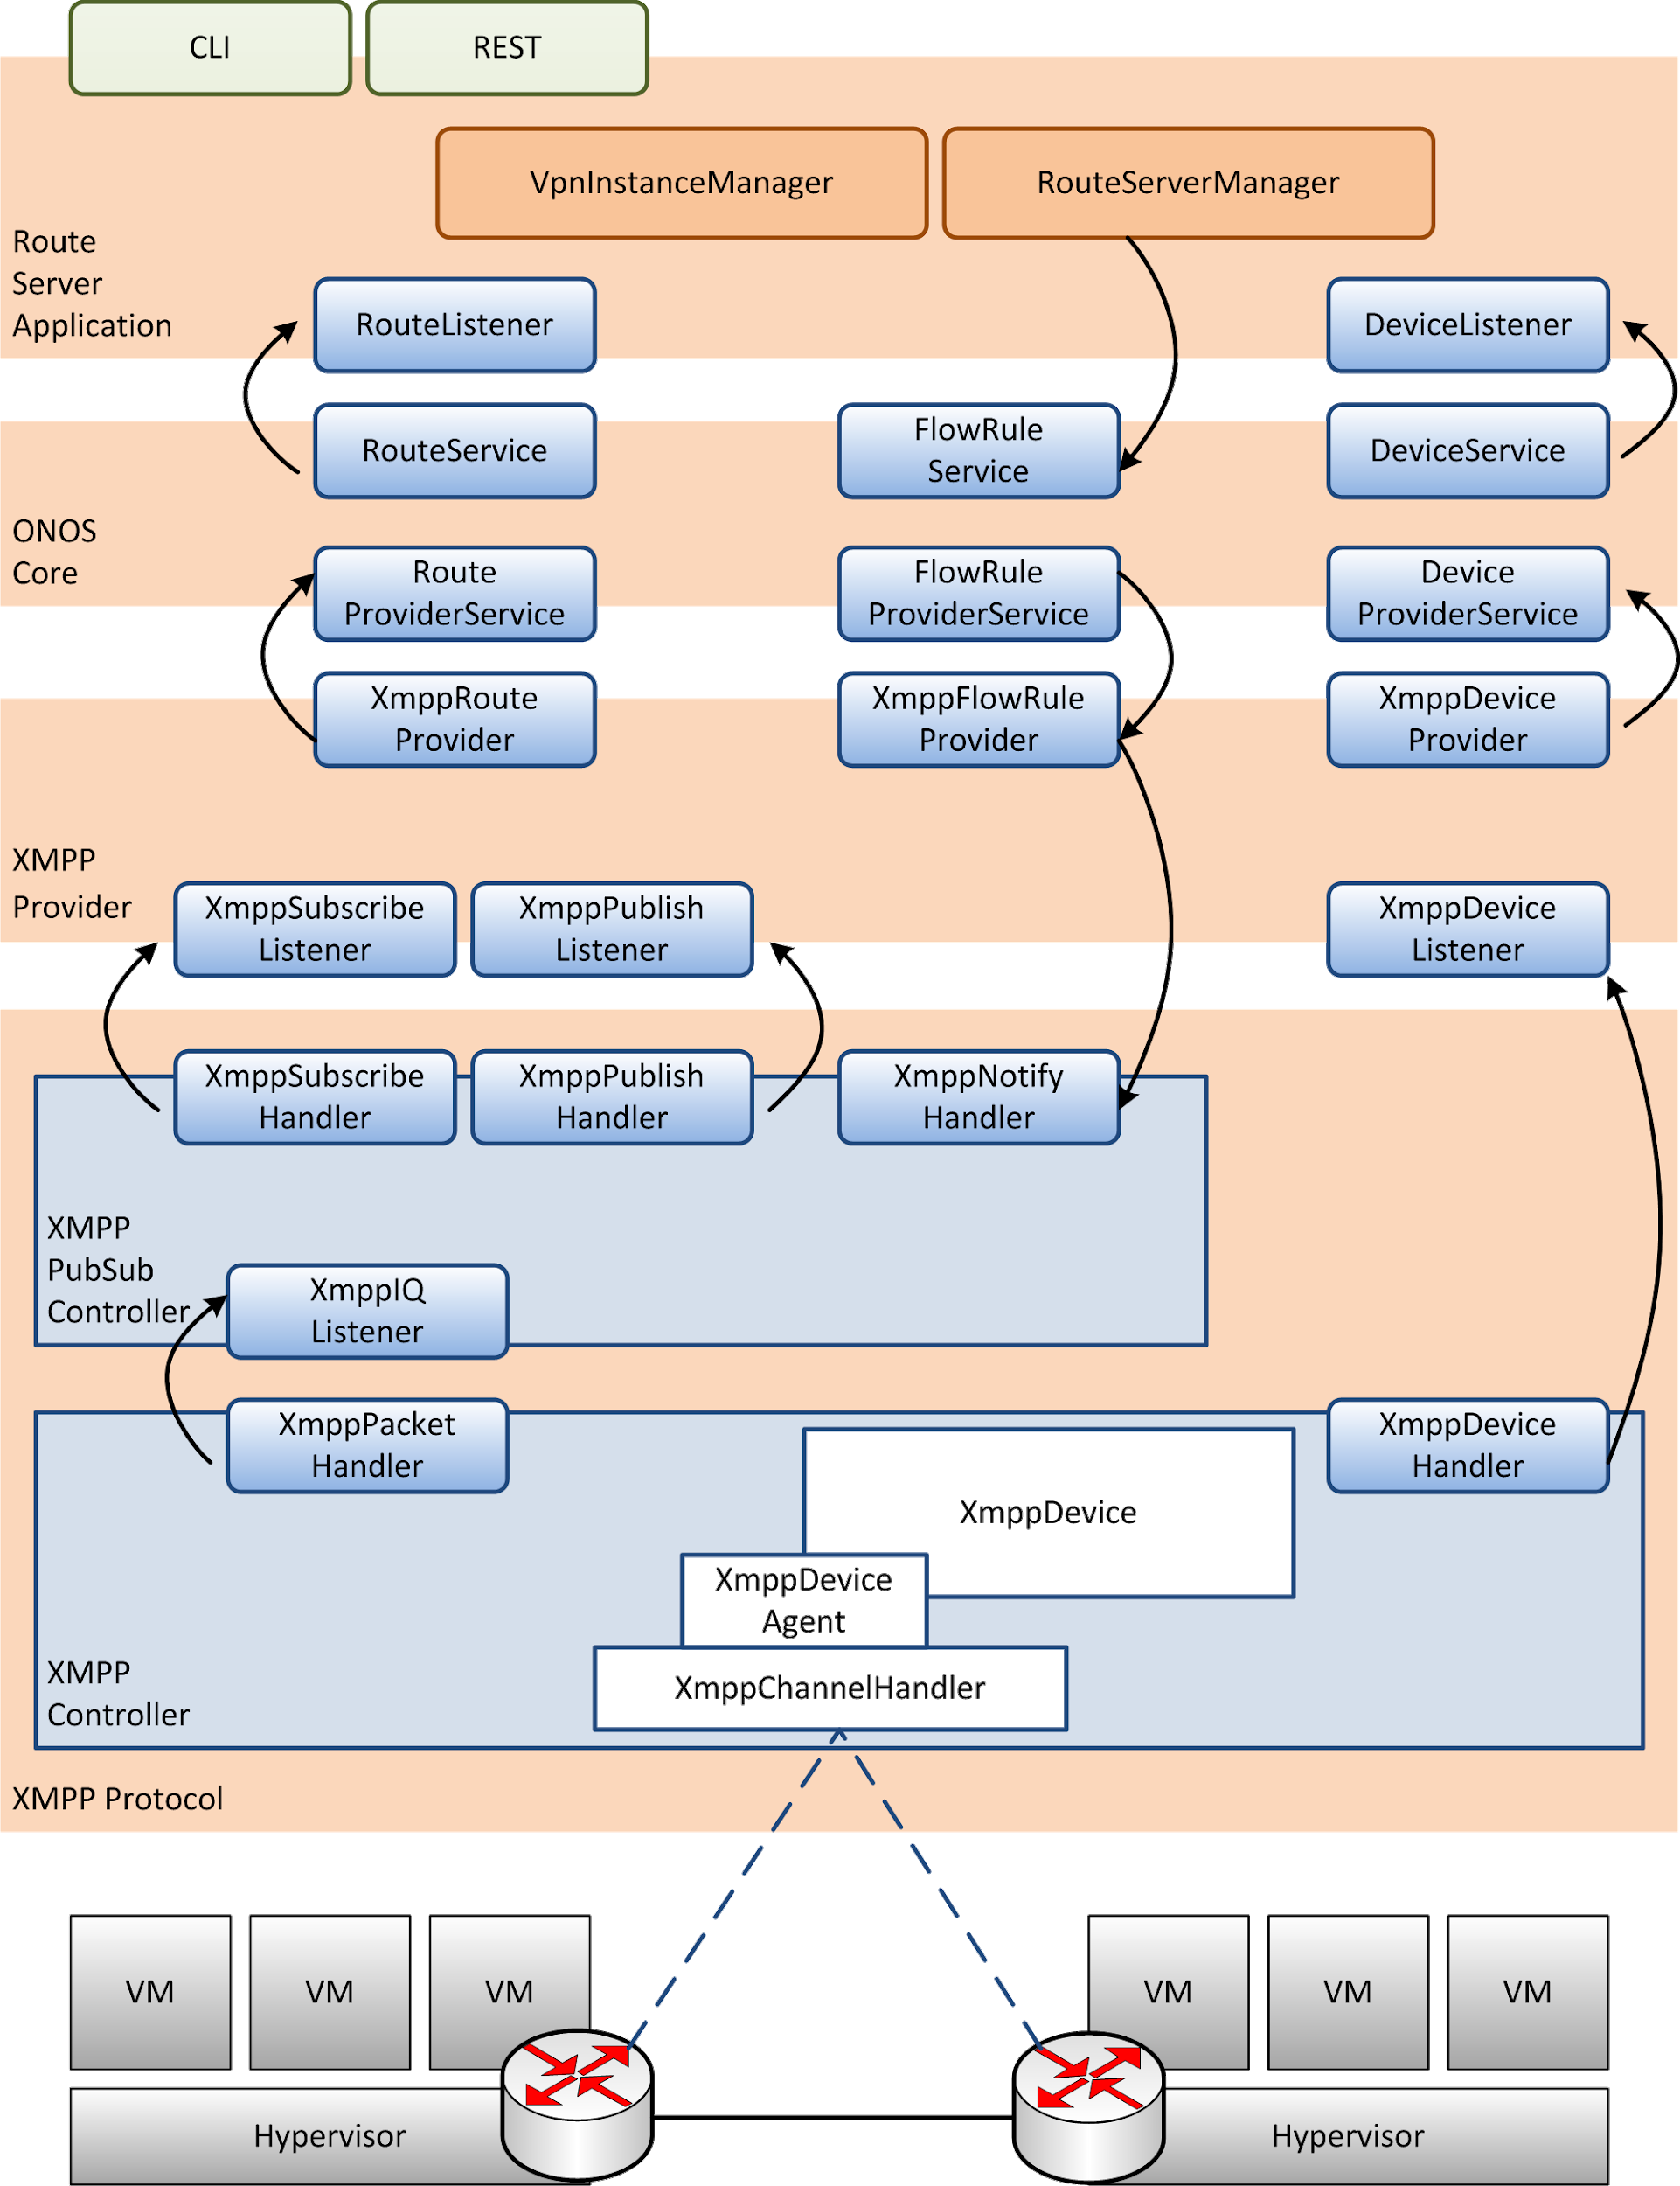
Implementation architecture
Principles:
extensibility
re-use of ONOS abstractions and subsystems
Protocols layer
decomposed into core XMPP and XEP implementation
Providers layer
Route provider (RouteService subsystem)
Flow provider (FlowRuleService subsystem)
Route Server application
make use of RouteService, FlowRuleService
VpnInstanceService

Slide 11

Tests of XMPP SBI
Unit tests coverage
Merged with master branch
Functional tests using Python sleekxmpp library:
Establishing XMPP stream
Closing XMPP stream
XMPP SUBSCRIBE / UNSUBSCRIBE test cases
XMPP PUBLISH / RETRACT test cases
Validation based on:
RFC 6120 - XMPP Core specification
XEP-0060 - XMPP Publish/Subscribe extension
IETF draft - BGP-signaled IP/VPNs system

Slide 12
Evaluation
XMPP as SBI for ONOS

Slide 13
SBI’s functionality
XMPP is a general-purpose protocol!
BGPoXMPP is Virtual interface-oriented (VRF tables)
“container protocol”, it’s all about data model design
OpenFlow is flow-oriented (multiple-flow-tables)
PCEP is used to compute the paths and requires IGP and TE protocols
Our BGP over XMPP is positioned between OpenFlow and PCE …
NETCONF, SNMP | OpenFlow | BGP over XMPP | LISP | PCEP | BGP, OSPF, IS-IS
Device management | Flow-oriented traffic engineering | Routing (L3VPN), Bridging (EVPN) | Tunneling | Traffic engineering mainly with legacy devices | East-west communication with legacy systems

Slide 14
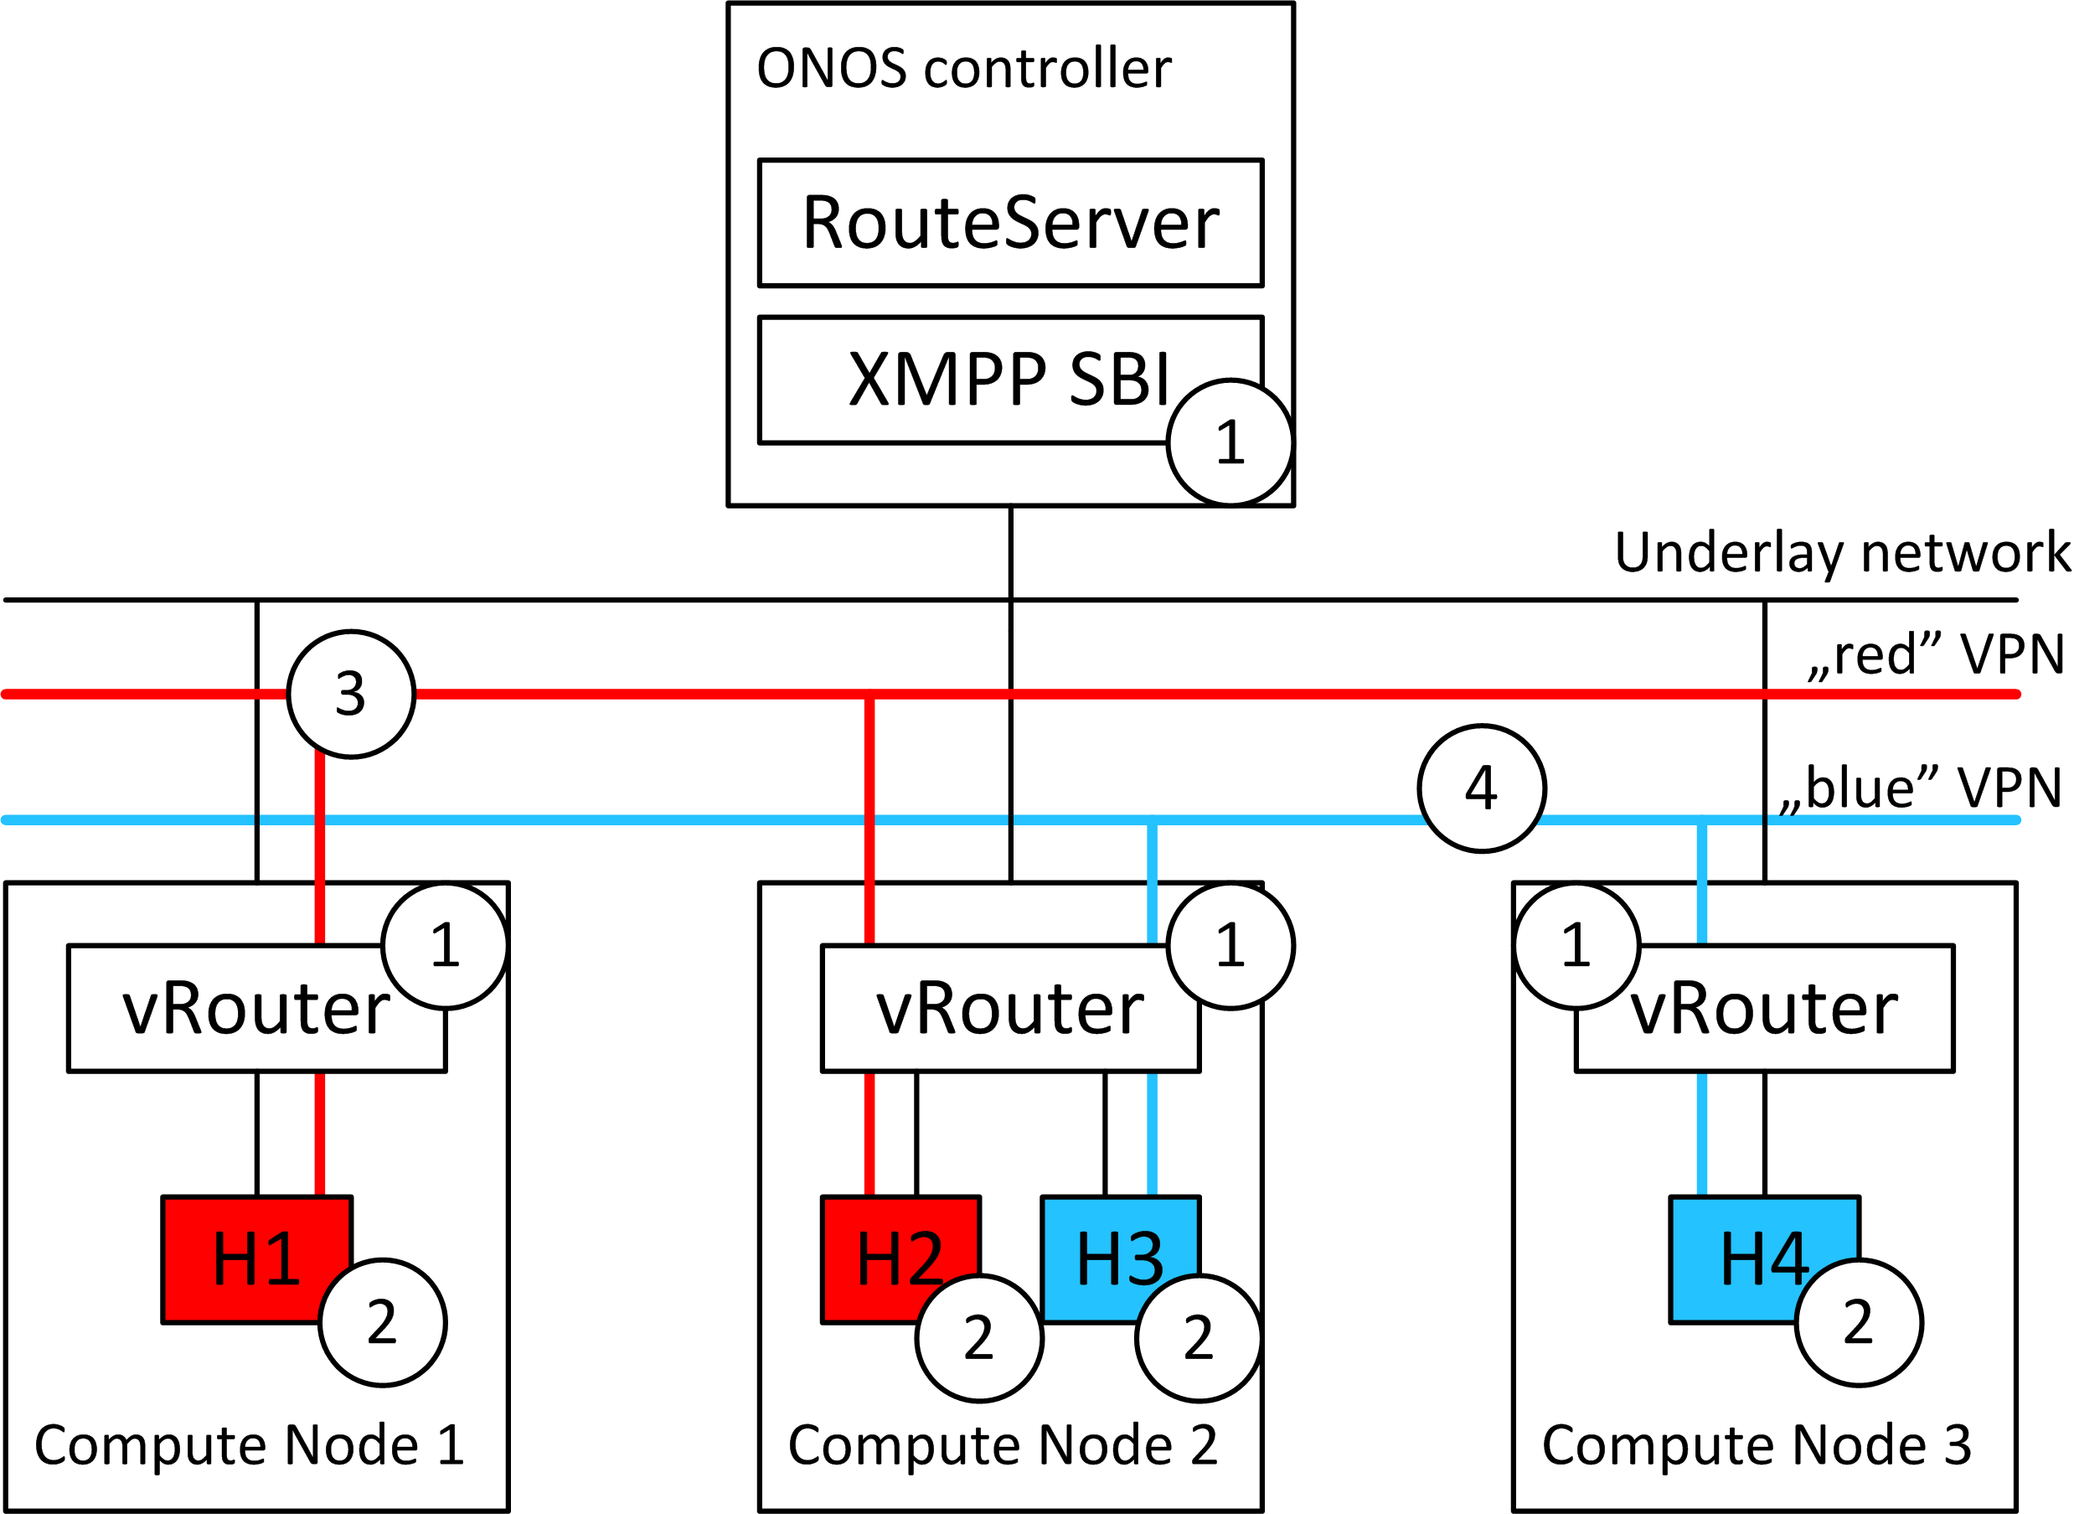
Performance of OpenFlow vs XMPP
Experiment setup:
Single ONOS instance - control plane performance
up to 5 vRouters (compute nodes)
Scenario 1:
1 VM per compute node
Increasing number of compute nodes (1..5)
ICMP ping between each unique pair of VMs
Scenario 2:
2 compute nodes
Increasing number of VMs (1..5)
ICMP ping between each unique pair of VMs

Slide 15
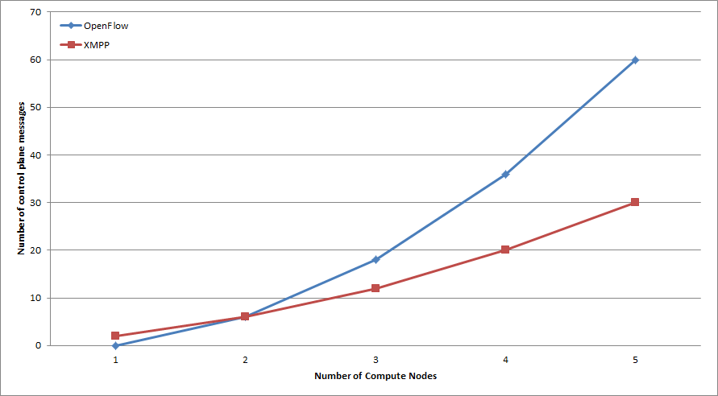
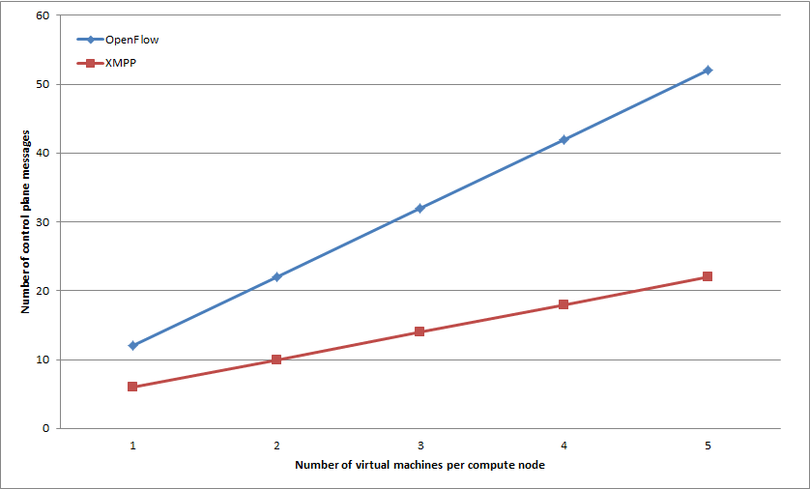
Performance of OpenFlow vs XMPP
Experiments:
Single instance - control plane performance (done)
ONOS cluster - control plane performance (to be done)
Data plane performance (to be done)
Control plane delay (to be done)

Slide 16
Use case
We propose BGP over XMPP, but XMPP is agnostic to use case!
 | Main use case | Area of usage | Approach | Scalability
BGP over XMPP | L3VPN, EVPN | Intra-DC, Inter-DC (with BGP) | Evolutionary | Good
OpenFlow | Traffic engineering, NAT, ACL, etc., multi | Intra-DC, Inter-DC | Revolutionary | Limited
PCEP | TE, path compute and tunnels | Inter-DC (with IS-IS or OSPF) | Evolutionary | very Good

Slide 17
Conclusions
XMPP as SBI for ONOS

Slide 18
Summary
XMPP SBI for ONOS is ready!
BGP over XMPP as a new control plane solution
extensible architecture
XMPP as “container protocol”
Evaluation:
BGP over XMPP positioned between OpenFlow and PCEP
In case of intra-DC connectivity BGP over XMPP performs much better than OpenFlow!
Further work:
Complete performance analysis
Research paper publication
Integration with OpenContrail vRouter
Integration with OpenStack

Slide 19
Demo
XMPP as SBI for ONOS

Slide 20
Demo scenario
Instantiate ONOS controller and 3 vRouters
Run Mininet hosts and attach them to vRouter (with overlapping IP addresses)
Test connectivity between “red” hosts
Test connectivity between “blue” hosts

Slide 21
Demo recording

Slide 22
Q&A
Thank you!

Slide 23
Functionality (2/2)
BGP over XMPP vs. OpenFlow
Both are used to exchange routing information inside DC
OpenFlow is flow-oriented (multiple-flow-tables), while BGPoXMPP is Virtual interface-oriented (VRF tables)
BGP over XMPP vs. PCEP
Both are used at the edge of network
PCEP cannot be applied inside DC, but few devices need to communicate with the controllers
BGP over XMPP allows to span VPN across multiple DC

