Slide 1
ONOS YANG Utils Demo

Slide 2
Contents
Overview YANG project status and roadmap YANG Utils user guide Demo application

Slide 3
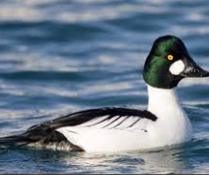
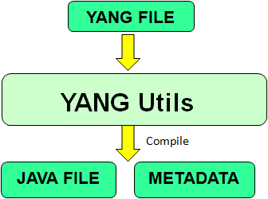
Overview
What is YANG Utils?
Utility to auto-generate Java interfaces corresponding to a YANG.
Generates the metadata information (i.e. YANG schema representation in Java)
Usage of YANG Utils.
By Applications: Models it’s NBI interfaces in YANG and use Utils to auto-generate Java for external interaction.
By Driver: Models device schema in YANG and use Utils to auto-generate Java for interaction with device.
By YANG Management System (YANG Shell):
For translation between Java & other language (using utils generated Metadata)
For information exchange with Application
(using utils generated Java interfaces)
Goldeneye
Notes:
Example for Translation includes - Example: JSON to JAVA, XML to JAVA etc.
Example of Generators includes –
- REST Generator (mapping JSON to JAVA and vice versa)
- NETCONF Generator (mapping XML to JAVA and vice versa)
Etc.
Generated JAVA file has java interface + builder.
Some technical details: for the query why metadata is generated separately?
Generated JAVA interfaces will be simple and will not have information which it doens'not have all the information present in YANG file (example: Range/Restrictions in YANG will not be present). But this information is required by Generators, thereby Metadata is used.

Slide 4
YANG status and roadmap
YANG Utils java code auto-generation for NBI Schema (Used by Apps/Core) – Available in Golden Eye (Enhancements in Hummingbird).
YANG Utils java code auto-generation for Device Schema (Used by Driver Impl) – Planned for Sprint 1 of Hummingbird.
YMS (YANG Shell) for NBI – Planned for Hummingbird.
YMS (YANG Shell) for SBI – Planned for Hummingbird.

Slide 5
YANG Utils status and roadmap
YANG construct | Supported/Planned version
config | Falcon
container | Falcon
key | Falcon
leaf | Falcon
leaf-list | Falcon
list | Falcon
mandatory | Falcon
module | Falcon
presence | Falcon
units | Falcon
String | Falcon
YANG construct | Supported/Planned version
augment | Goldeneye
belongs-to | Goldeneye
bit | Goldeneye
case | Goldeneye
choice | Goldeneye
enum | Goldeneye
grouping | Goldeneye
input | Goldeneye
length | Goldeneye
max-elements | Goldeneye
min-elements | Goldeneye
namespace | Goldeneye
notification | Goldeneye
output | Goldeneye
pattern | Goldeneye
position | Goldeneye
prefix | Goldeneye
range | Goldeneye
revision-date | Goldeneye
rpc | Goldeneye
submodule | Goldeneye
type | Goldeneye
typedef | Goldeneye
uses | Goldeneye
value | Goldeneye
yang-version | Goldeneye
Boolean/ empty | Goldeneye
Enumeration/union | Goldeneye
Interger types | Golden eye
YANG construct | Supported/Planned version
contact | Goldeneye Enhancement in Hummingbird
default | Goldeneye Enhancement in Hummingbird
description | Goldeneye Enhancement in Hummingbird
fraction-digits | Goldeneye Enhancement in Hummingbird
import | Goldeneye Enhancement in Hummingbird
include | Goldeneye Enhancement in Hummingbird
organization | Goldeneye Enhancement in Hummingbird
reference | Goldeneye Enhancement in Hummingbird
revision | Goldeneye Enhancement in Hummingbird
status | Goldeneye Enhancement in Hummingbird
Binary/bits/decimal64 | Goldeneye Enhancement in Hummingbird
YANG construct | Supported/Planned version
base | Hummingbird
feature | Hummingbird
identity | Hummingbird
if-feature | Hummingbird
must | Hummingbird
path | Hummingbird
when | Hummingbird
Identity-ref | Hummingbird
Instance -identifier | Hummingbird
leafref | Hummingbird
YANG construct | Supported/Planned version
anyxml | Not planned
argument | Not planned
deviate | Not planned
deviation | Not planned
error-app-tag | Not planned
error-message | Not planned
extension | Not planned
ordered-by | Not planned
refine | Not planned
require-instance | Not planned
unique | Not planned
yin-element | Not planned
https://wiki.onosproject.org/display/ONOS/YANG+utils
Notes:
Example for Translation includes - Example: JSON to JAVA, XML to JAVA etc.
Example of Generators includes –
- REST Generator (mapping JSON to JAVA and vice versa)
- NETCONF Generator (mapping XML to JAVA and vice versa)
Etc.
Generated JAVA file has java interface + builder.
Some technical details: for the query why metadata is generated separately?
Generated JAVA interfaces will be simple and will not have information which it doens'not have all the information present in YANG file (example: Range/Restrictions in YANG will not be present). But this information is required by Generators, thereby Metadata is used.

Slide 6
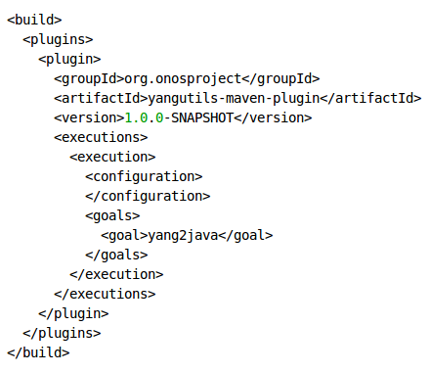
YANG utils user guide
Step1: Add YANG utils maven plugin to app's pom file build section
Notes:
Example for Translation includes - Example: JSON to JAVA, XML to JAVA etc.
Example of Generators includes –
- REST Generator (mapping JSON to JAVA and vice versa)
- NETCONF Generator (mapping XML to JAVA and vice versa)
Etc.
Generated JAVA file has java interface + builder.
Some technical details: for the query why metadata is generated separately?
Generated JAVA interfaces will be simple and will not have information which it doens'not have all the information present in YANG file (example: Range/Restrictions in YANG will not be present). But this information is required by Generators, thereby Metadata is used.

Slide 7
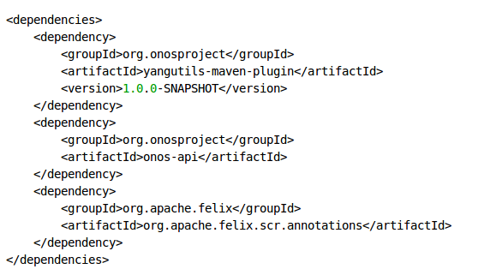
YANG utils user guide
Step2 : Add dependency required for yangutils to pom file’s dependency section
Notes:
Example for Translation includes - Example: JSON to JAVA, XML to JAVA etc.
Example of Generators includes –
- REST Generator (mapping JSON to JAVA and vice versa)
- NETCONF Generator (mapping XML to JAVA and vice versa)
Etc.
Generated JAVA file has java interface + builder.
Some technical details: for the query why metadata is generated separately?
Generated JAVA interfaces will be simple and will not have information which it doens'not have all the information present in YANG file (example: Range/Restrictions in YANG will not be present). But this information is required by Generators, thereby Metadata is used.

Slide 8
YANG utils user guide
Step3 : Plugin configuration supported in YANG utils
1. Input YANG Directory
Default: src/main/yang – User can create this folder and place it's YANG file in it
Configured: User can configure the desired Input directory using below maven configuration
<configuration>
<yangFilesDir>/opt/src/yang/</yangFilesDir>
</configuration>
2. Output JAVA Directory
Default: src/main/java
Configured: User can configure the desired Output directory using below maven configuration
<configuration>
<genFilesDir>/opt/src/java/</genFilesDir>
</configuration>
Notes:
Example for Translation includes - Example: JSON to JAVA, XML to JAVA etc.
Example of Generators includes –
- REST Generator (mapping JSON to JAVA and vice versa)
- NETCONF Generator (mapping XML to JAVA and vice versa)
Etc.
Generated JAVA file has java interface + builder.
Some technical details: for the query why metadata is generated separately?
Generated JAVA interfaces will be simple and will not have information which it doens'not have all the information present in YANG file (example: Range/Restrictions in YANG will not be present). But this information is required by Generators, thereby Metadata is used.

Slide 9
YANG utils user guide
Step4: Build using mvn clean install/ mvn install.
Generated java code will be placed in default directory or in desired destination folder configured by user.
Note : Code is generated as per ONOS coding guidelines.
Notes:
Example for Translation includes - Example: JSON to JAVA, XML to JAVA etc.
Example of Generators includes –
- REST Generator (mapping JSON to JAVA and vice versa)
- NETCONF Generator (mapping XML to JAVA and vice versa)
Etc.
Generated JAVA file has java interface + builder.
Some technical details: for the query why metadata is generated separately?
Generated JAVA interfaces will be simple and will not have information which it doens'not have all the information present in YANG file (example: Range/Restrictions in YANG will not be present). But this information is required by Generators, thereby Metadata is used.

Slide 10
YANG to JAVA mapping
https://wiki.onosproject.org/display/ONOS/YANG+utils
Notes:
Example for Translation includes - Example: JSON to JAVA, XML to JAVA etc.
Example of Generators includes –
- REST Generator (mapping JSON to JAVA and vice versa)
- NETCONF Generator (mapping XML to JAVA and vice versa)
Etc.
Generated JAVA file has java interface + builder.
Some technical details: for the query why metadata is generated separately?
Generated JAVA interfaces will be simple and will not have information which it doens'not have all the information present in YANG file (example: Range/Restrictions in YANG will not be present). But this information is required by Generators, thereby Metadata is used.

Slide 11
YANG Utils Demo App – Standard IETF L3VPN
Demo YANG File Details:
Pre-Setup: Demo Application created.
Step 1: YANG utils maven plugin added to test app POM File. Dependency required for YANG Utils is also updated in pom.xml
Step 2: Standard YANG files from https://datatracker.ietf.org/doc/draft-zha-l3sm-l3vpn-onos-deployment/ are placed in “src/main/yang” folder in test app.
Step 3: Run mvn clean install
Step 4: Verify the validated code
Notes:
Example for Translation includes - Example: JSON to JAVA, XML to JAVA etc.
Example of Generators includes –
- REST Generator (mapping JSON to JAVA and vice versa)
- NETCONF Generator (mapping XML to JAVA and vice versa)
Etc.
Generated JAVA file has java interface + builder.
Some technical details: for the query why metadata is generated separately?
Generated JAVA interfaces will be simple and will not have information which it doens'not have all the information present in YANG file (example: Range/Restrictions in YANG will not be present). But this information is required by Generators, thereby Metadata is used.

Slide 12
YANG Utils Demo App – SFC
Pre-Setup: YANG modelling of SFC app. Demo SFC's Application with these YANG files.
Step 1: YANG utils maven plugin added to test SFC's POM File. Dependency required for YANG Utils is also updated in pom.xml
Step 2: use default plugin configurations.
Step 3: SFC's NBI interfaces are modeled in YANG and placed in “src/main/yang” folder in SFC app.
Step 4: Run mvn clean install to generate the code.
Notes:
Example for Translation includes - Example: JSON to JAVA, XML to JAVA etc.
Example of Generators includes –
- REST Generator (mapping JSON to JAVA and vice versa)
- NETCONF Generator (mapping XML to JAVA and vice versa)
Etc.
Generated JAVA file has java interface + builder.
Some technical details: for the query why metadata is generated separately?
Generated JAVA interfaces will be simple and will not have information which it doens'not have all the information present in YANG file (example: Range/Restrictions in YANG will not be present). But this information is required by Generators, thereby Metadata is used.

Slide 13
YANG Utils Demo App – SFC
Sample Usage demo:
Copy the business logic of Manager from existing VTN app to the generated demo SFC app framework.
Modify the current WebResource to use the generated demo app.
Post the port pair and get the same.

Slide 14
Thank You

