Slide 1
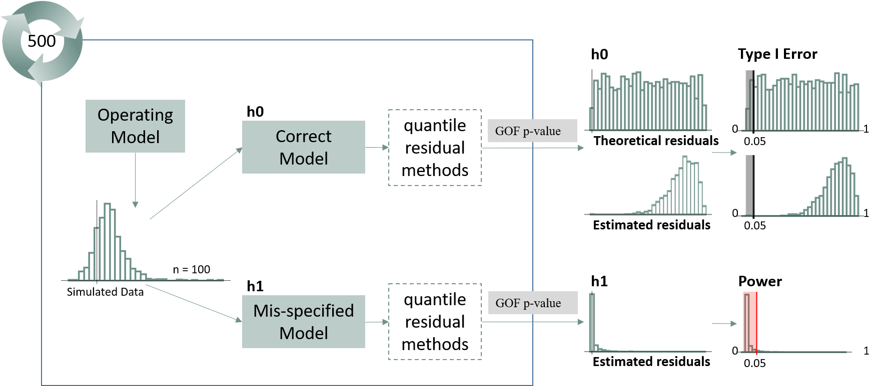
1000
residual methods
residual methods

