Slide 2
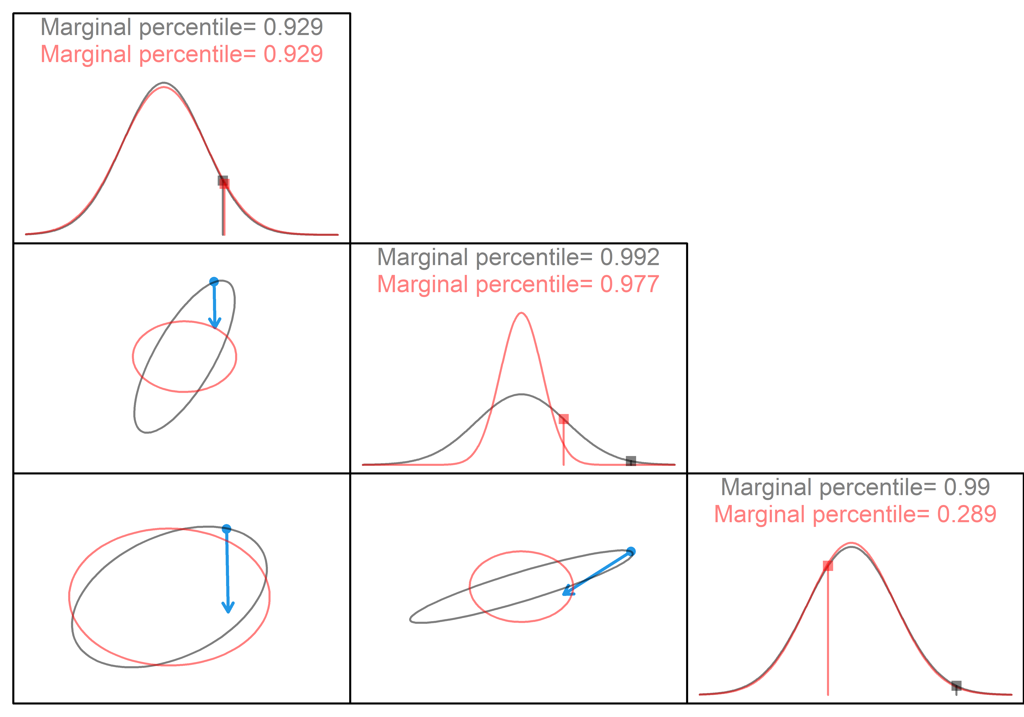
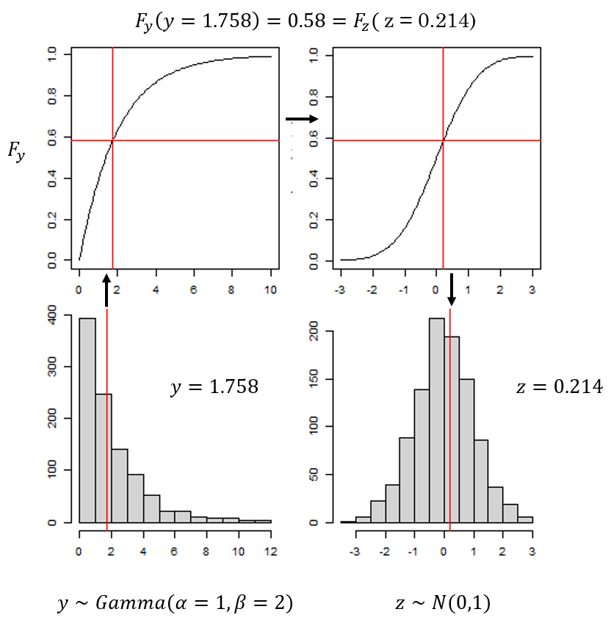
Pearson
LM
Non-spatial Poisson
LMs, some GLMs
Aprox Normal
Independent
No issues
LMMs, some GLMMs
Normal,
Dependent.
Cause: Random effects induce dependence
Issue: marginal quantiles != joint quantiles
Predicted data distribution from model
GLMs
Non-normal
Independent.
Issue: Non-symmetric
Solution: rotate analytically (OSA), simulation (rotated)
Random walk
GLMMs
Non-normal,
Dependent
Issue: Both
??
Delta-models, 0-inflated, Mixture distributions,
Non-existent quantile function
Issue: ?
Solution: OSA
Spatial LMM
Solution: quantile residuals
Analytical marginal quantiles
Repeated measures
Repeated measures Tweedie
Solution: Sequential conditioning (OSA CDF/Generic)
Conditional simulation
MCMC
Spatial Poisson
Non-linear normal/non-normal
? Repeated measures gamma
Delta spatial GLMM?

Slide 3
Pearson residuals assumption
Approximate Normality
Independence
X
X
X
X
Model class
GLM
GLMM
LMM
Quantile residuals
Non-linearly decorrelated quantile residuals
Linearly decorrelated Pearson residuals
Solution
Simulation or OSA CDF
Rotated simulation or OSA FG
Recommendation
OSA CDF

