Slide 1

Neural networks and deep learning
ICT FOR LIFE AND HEALTH - Department of Information Engineering
PHYSICS OF DATA - Department of Physics and Astronomy
COGNITIVE NEUROSCIENCE AND CLINICAL NEUROPSYCHOLOGY - Department of Psychology
A.A. 2019/20 (6 CFU)
Dr. Alberto Testolin,
Dr. Federico Chiariotti (chiariot@dei.unipd.it)
NEURAL NETWORKS AND DEEP LEARNING - Lab. 02

Slide 2
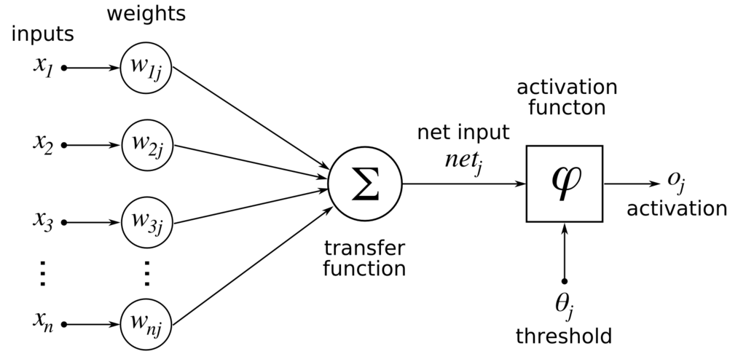
Artificial neuron

Slide 3
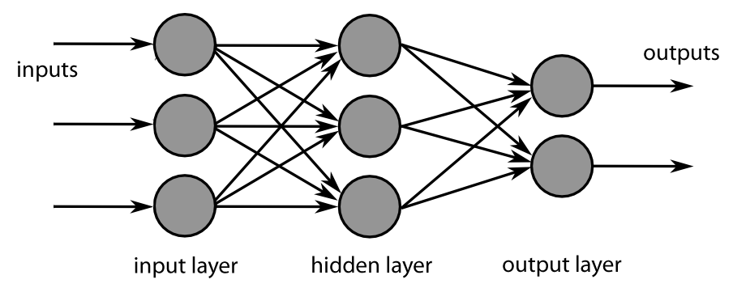
Fully connected feed-forward network

Slide 4
Fully connected feed-forward network

Slide 5
Fully connected feed-forward network
Activation function (e.g. sigmoid)
Network with 2 hidden layer (regression)
Activation function (e.g. sigmoid)

Slide 6
Gradient Descent
Loss function to minimize (MSE, like OLS)
Network output
True value
Learning rate
Chain rule refresh

Slide 7
Gradient Descent

Slide 8
Gradient Descent

Slide 9
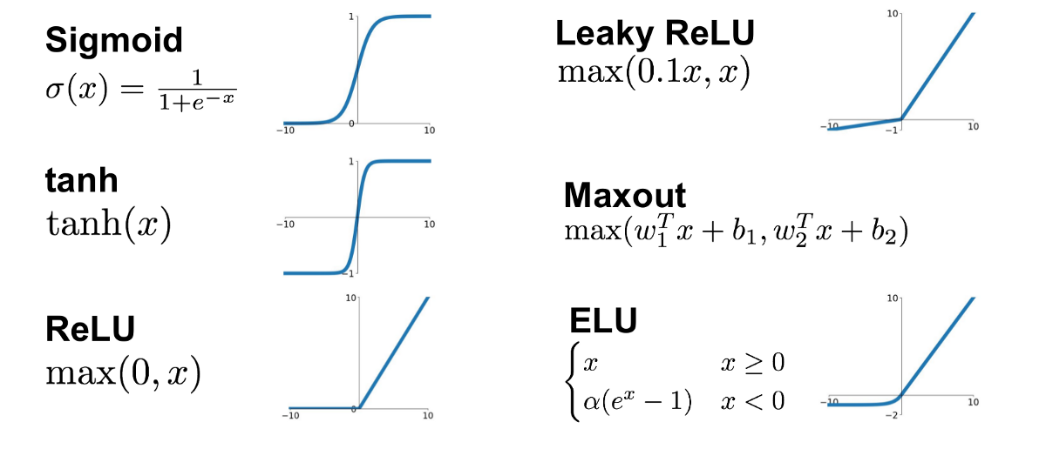
Activation Functions

Slide 10
Homework: function estimation contest
1. Download the dataset from the Elearning page
2. Train your neural network (no cheating → don’t use pre-built
frameworks)
3. Write the report
4. We will run a test on a hidden set of values to create the rankings
Don’t worry, the rankings are just for fun!

Slide 11
Report and homework
1. 3-page report
-Brief introduction
-Parameter search (parameters you tried, activation function…)
-Final model (network structure, activation function, loss, etc.)
-Plots and figures are appreciated
2. Code used to train the neural network
3. Testing script: you should provide a script with the trained
model, so that running python trained_model.py outputs the
MSE of the points in the file test_set.py)

