Slide 1
MLM – Alice project
November 17 meeting

Slide 2
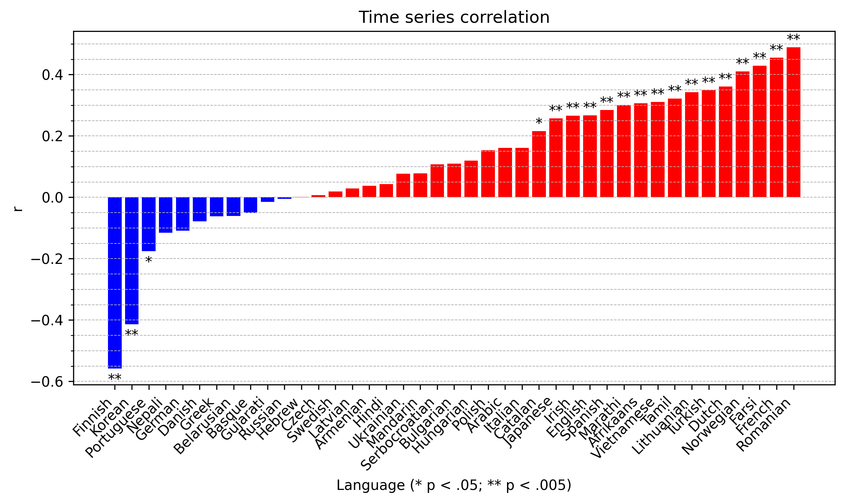
Time series correlation
Correlations are significant in 16 languages
Irish is not supported by whisper-timestamped
→ 15 languages

Slide 3
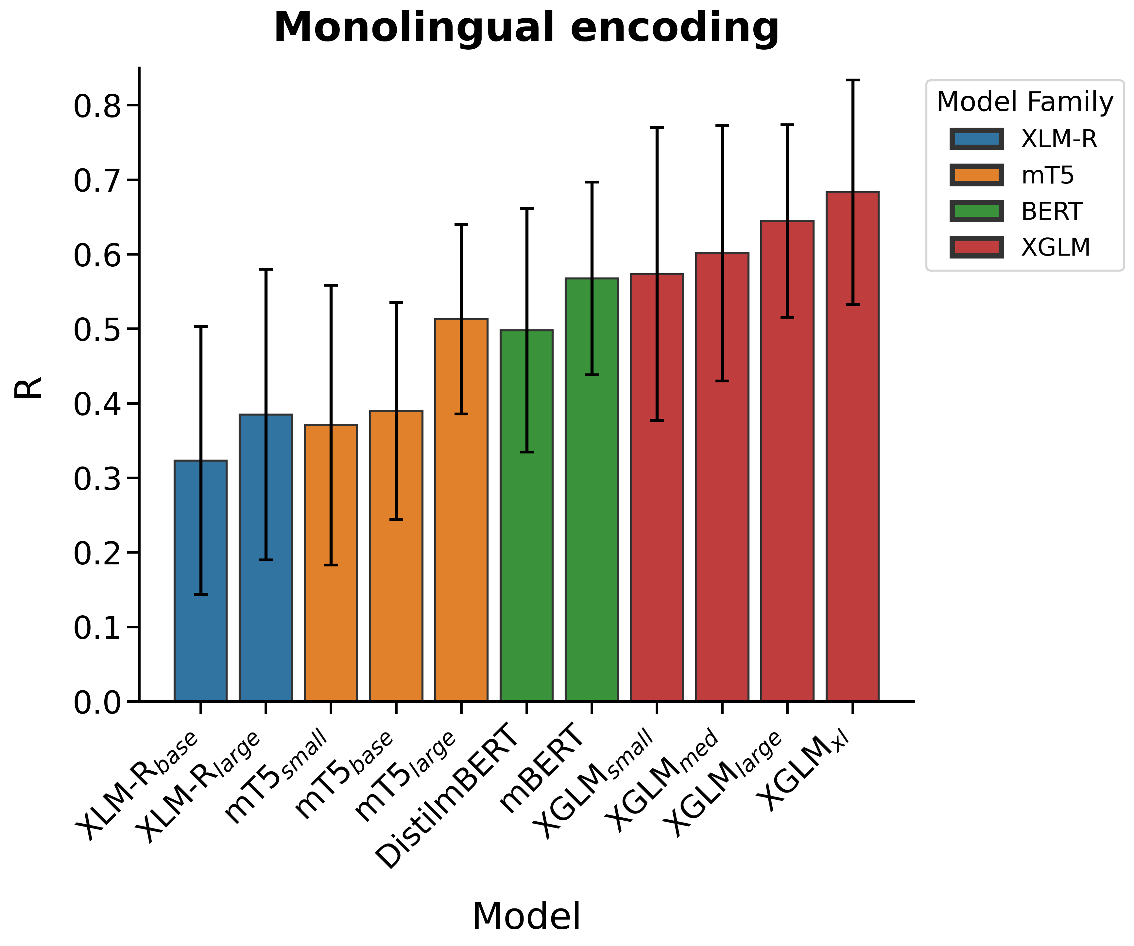
Encoding performance by model
Monolingual encoding
Best layer for each model
10-fold cross-validation (random split)
No “embedding lag”
R values averaged across folds and languages
Error bars: SD across languages

Slide 4
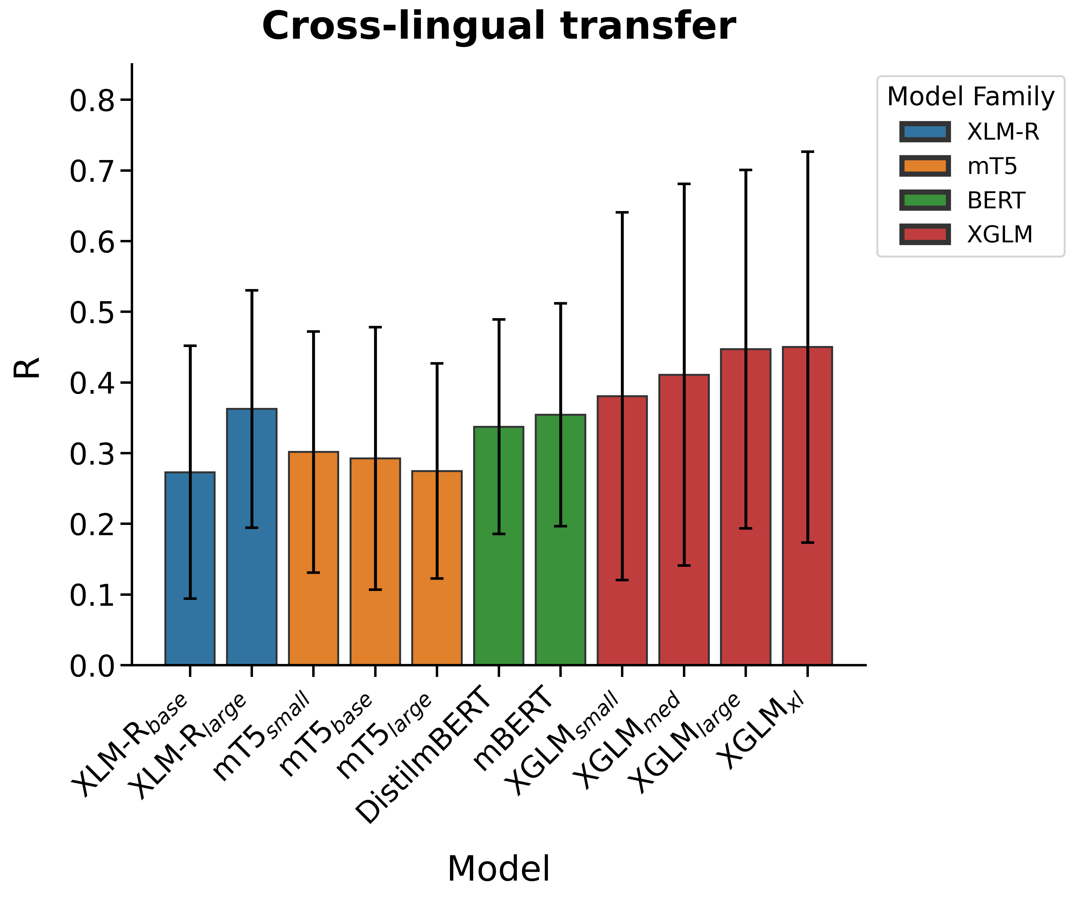
Encoding performance by model
Cross-lingual transfer
Best layer for each model
10-fold cross-validation (random split)
No “embedding lag”
R values averaged across languages (there are no folds)
Error bars: SD across languages

Slide 5
Model capacity
Larger-capacity models outperform smaller models (except for mT5 in cross-lingual transfer)
Cfr. Schrimpf et al. 2021

Slide 6
Auto-regressive vs. bidirectional
Auto-regressive language models outperform the bidirectional ones
Cfr. Schrimpf et al. 2021

Slide 7
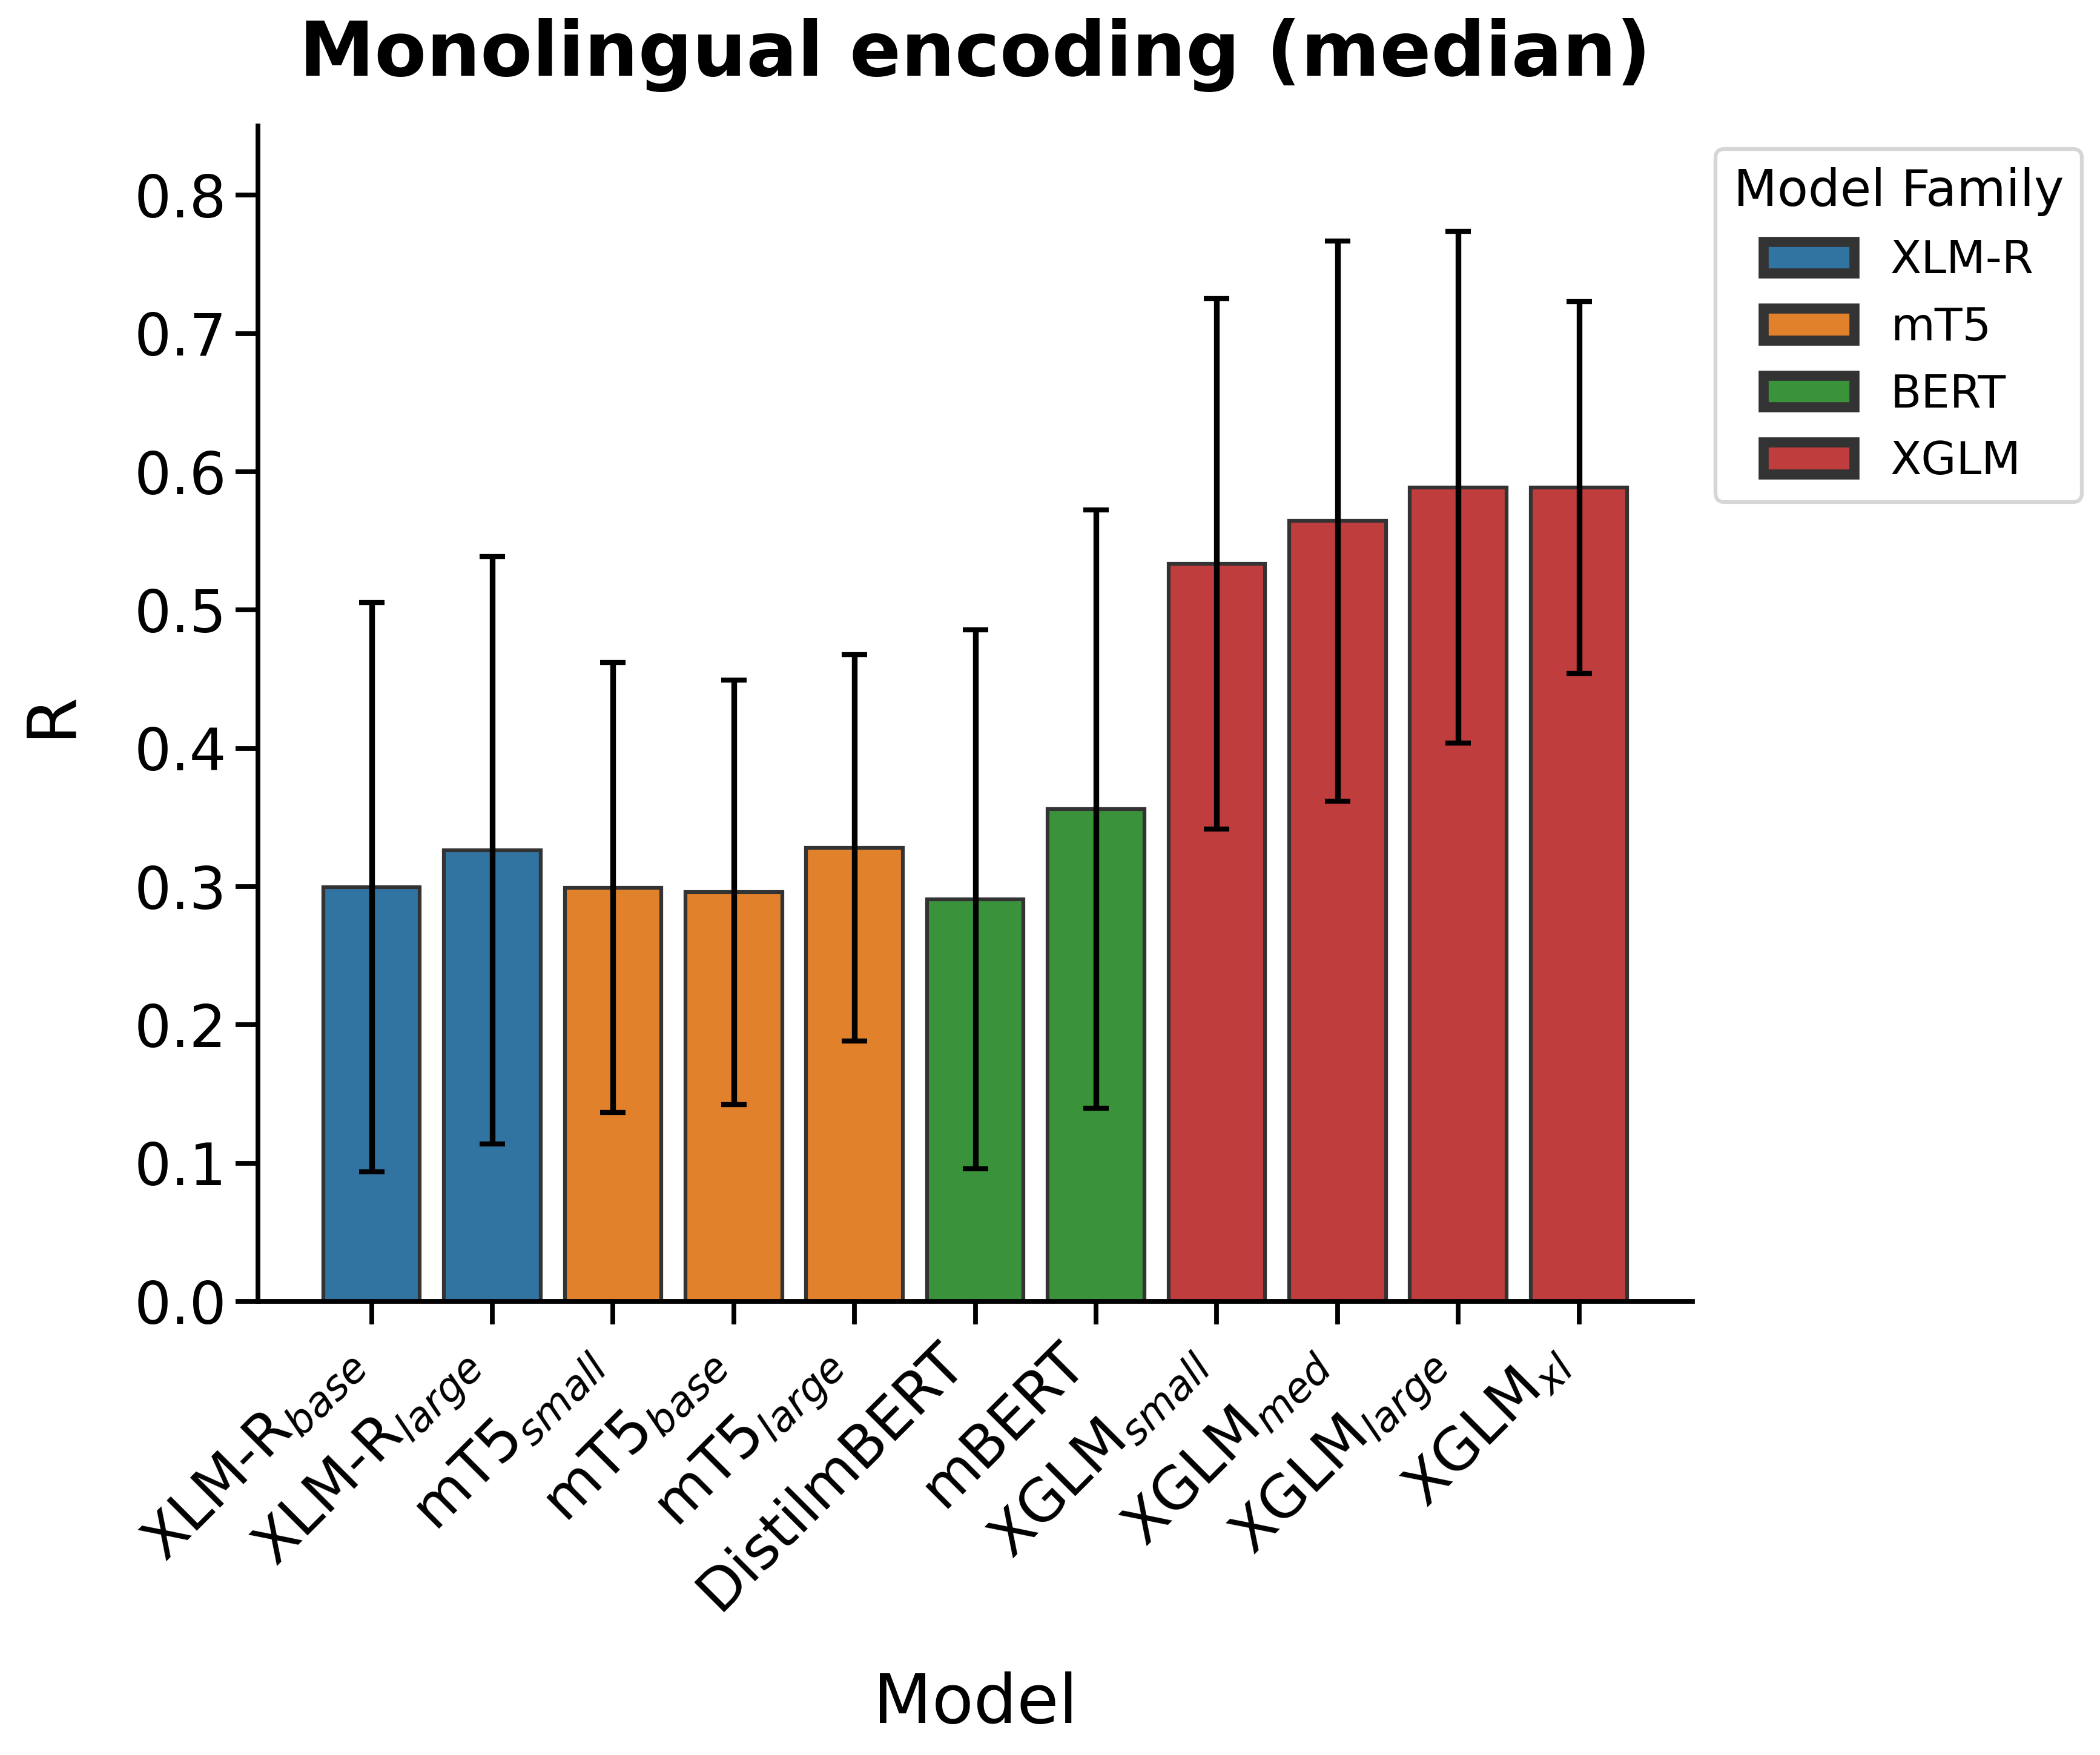
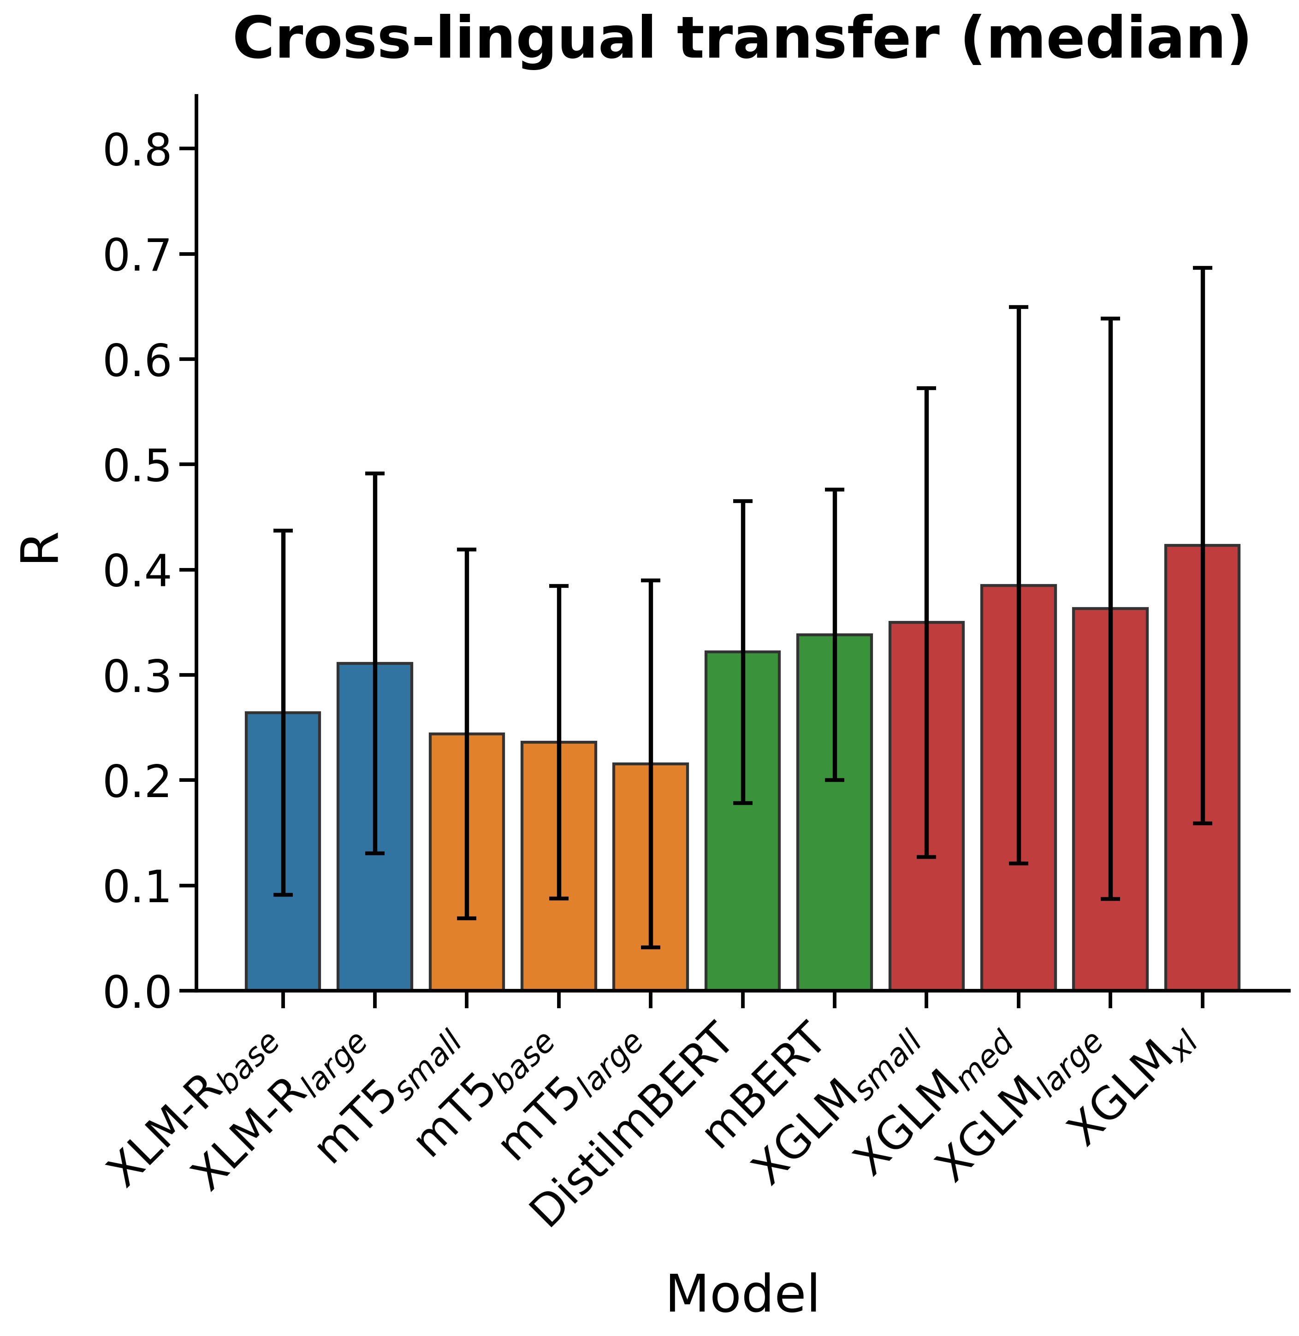
Median layer
The results are similar when considering the median (as opposed to best) layer
Bigger > smaller
Causal > bidirectional

Slide 8
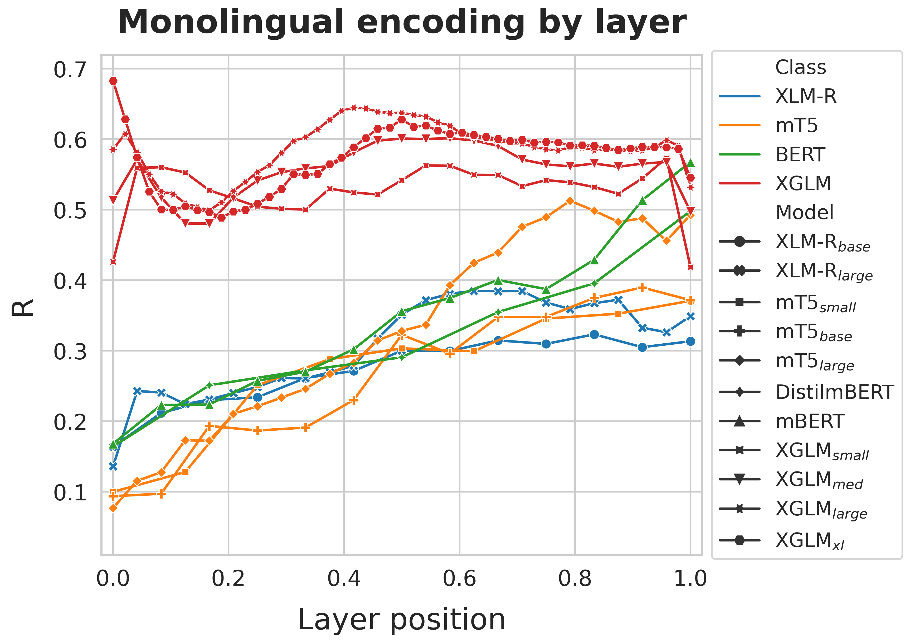
Encoding performance by layer
Monolingual encoding
Middle-to-deep layers achieve the strongest predictivity
  Intermediate layers work better for the auto-regressive models
  Deep layers work better for the bidirectional models

Slide 9
Encoding performance by layer
Monolingual encoding
Middle-to-deep layers achieve the strongest predictivity
  XGLMxl achieves the strongest predictivity in the embedding layer
  Deep layers work better for the bidirectional models

Slide 10
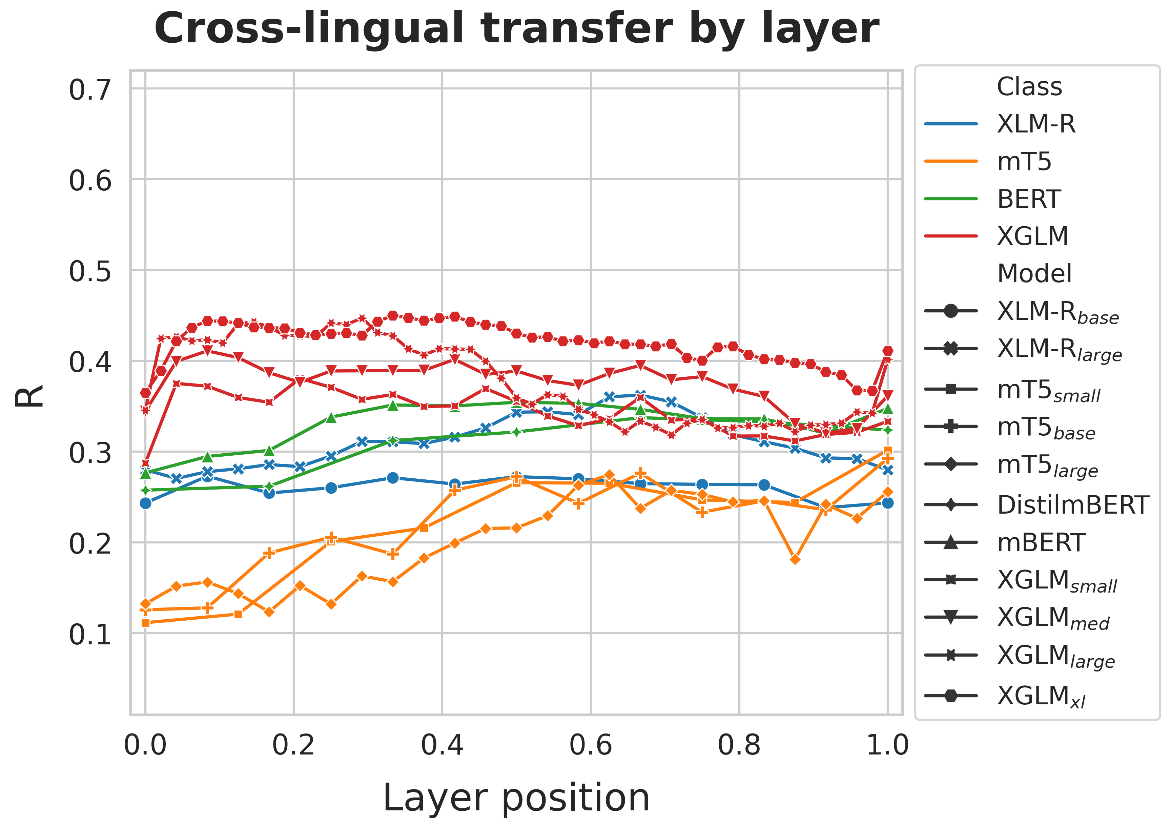
Encoding performance by layer
Multilingual encoding
Intermediate layers achieve the strongest predictivity
  Early-intermediate layers work better for the auto-regressive models
  Intermediate-deep layers work better for the bidirectional models

Slide 11
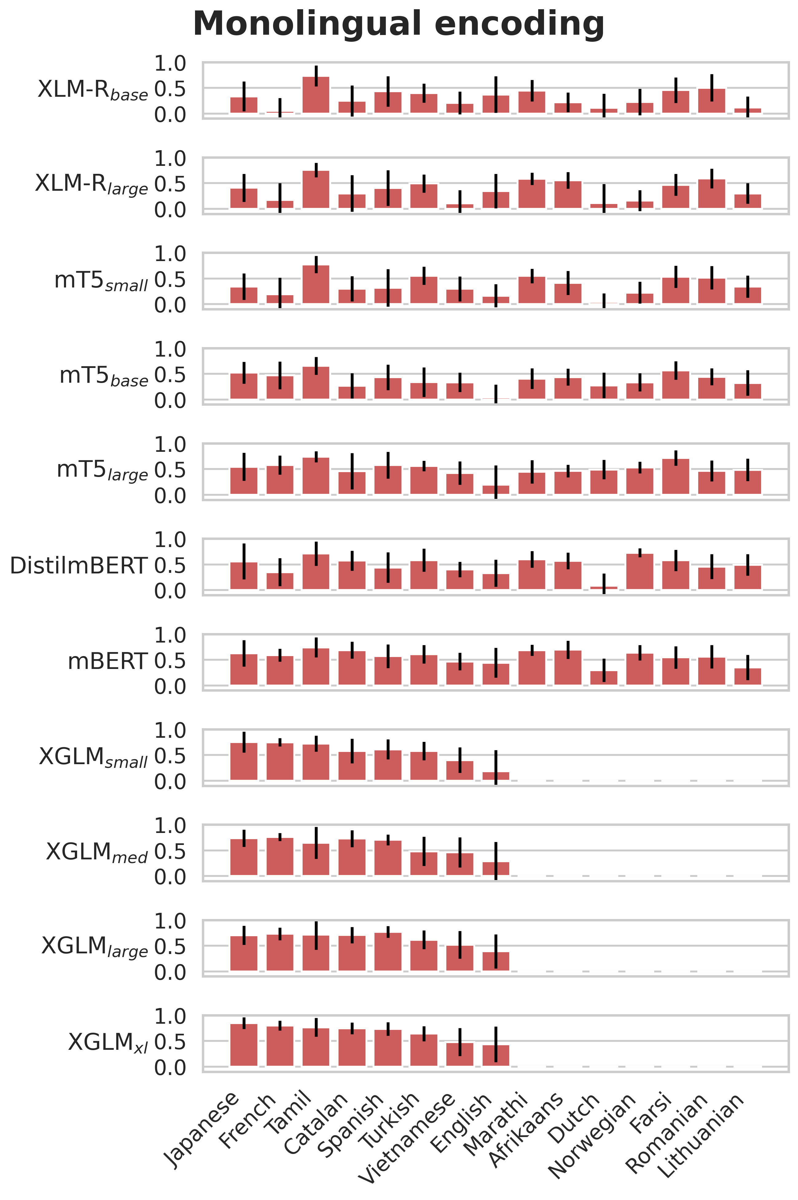
Performance by language
Monolingual encoding
Performance obtained with the best layer (overall)
Error bars indicate the SD across folds

Slide 12
Performance by language
Monolingual encoding
Performance obtained with the best layer (overall)
Error bars indicate the SD across folds
  Auto-regressive models obtain a relatively strong performance across all 8 languages

Slide 13
Performance by language
Monolingual encoding
Performance obtained with the best layer (overall)
Error bars indicate the SD across folds
  Auto-regressive models obtain a relatively strong performance across all 8 languages
  mBERT achieves relatively strong performance scores across all 15 languages

Slide 14
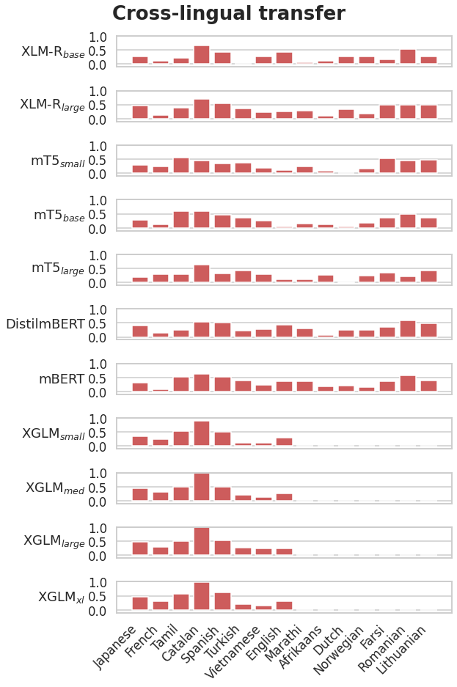
Performance by language
Multilingual encoding
For each language l∈ L, an encoding model is fitted in all languages m in L excluding l (m ∈ L∖ { l }), and tested on l.

Slide 15
Performance by language
Multilingual encoding
For each language l∈ L, an encoding model is fitted in all languages m in L excluding l (m ∈ L∖ { l }), and tested on l.
Alternative:
Fit an encoding model in each language
Transfer it zero-shot to all the other languages

Slide 16
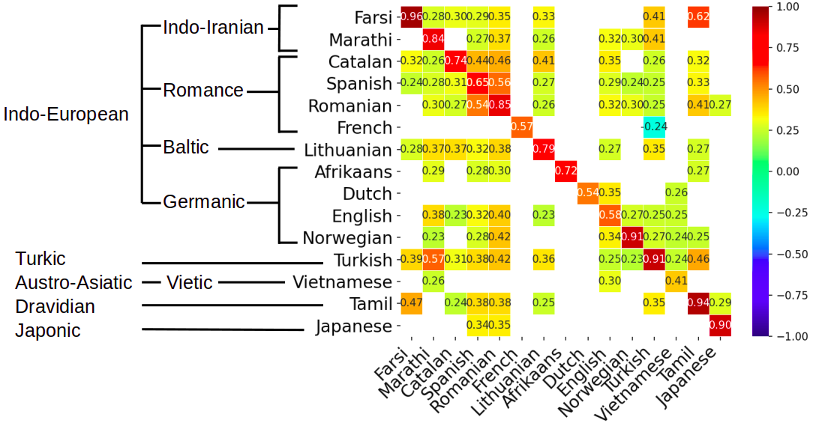
Single training language
Rows: how well a model trained in a language transfers to the other
No clear typological pattern

Slide 17
Single training language
Rows: how well a model trained in a language transfers to the other
No clear typological pattern
Some languages generally support well the transfer
  Turkish, Catalan, Spanish, Romanian

Slide 18
Single training language
Rows: how well a model trained in a language transfers to the other
No clear typological pattern
Some languages generally support well the transfer
  Turkish, Catalan, Spanish, Romanian
Other languages don’t
  French, Dutch, Vietnamese

Slide 19
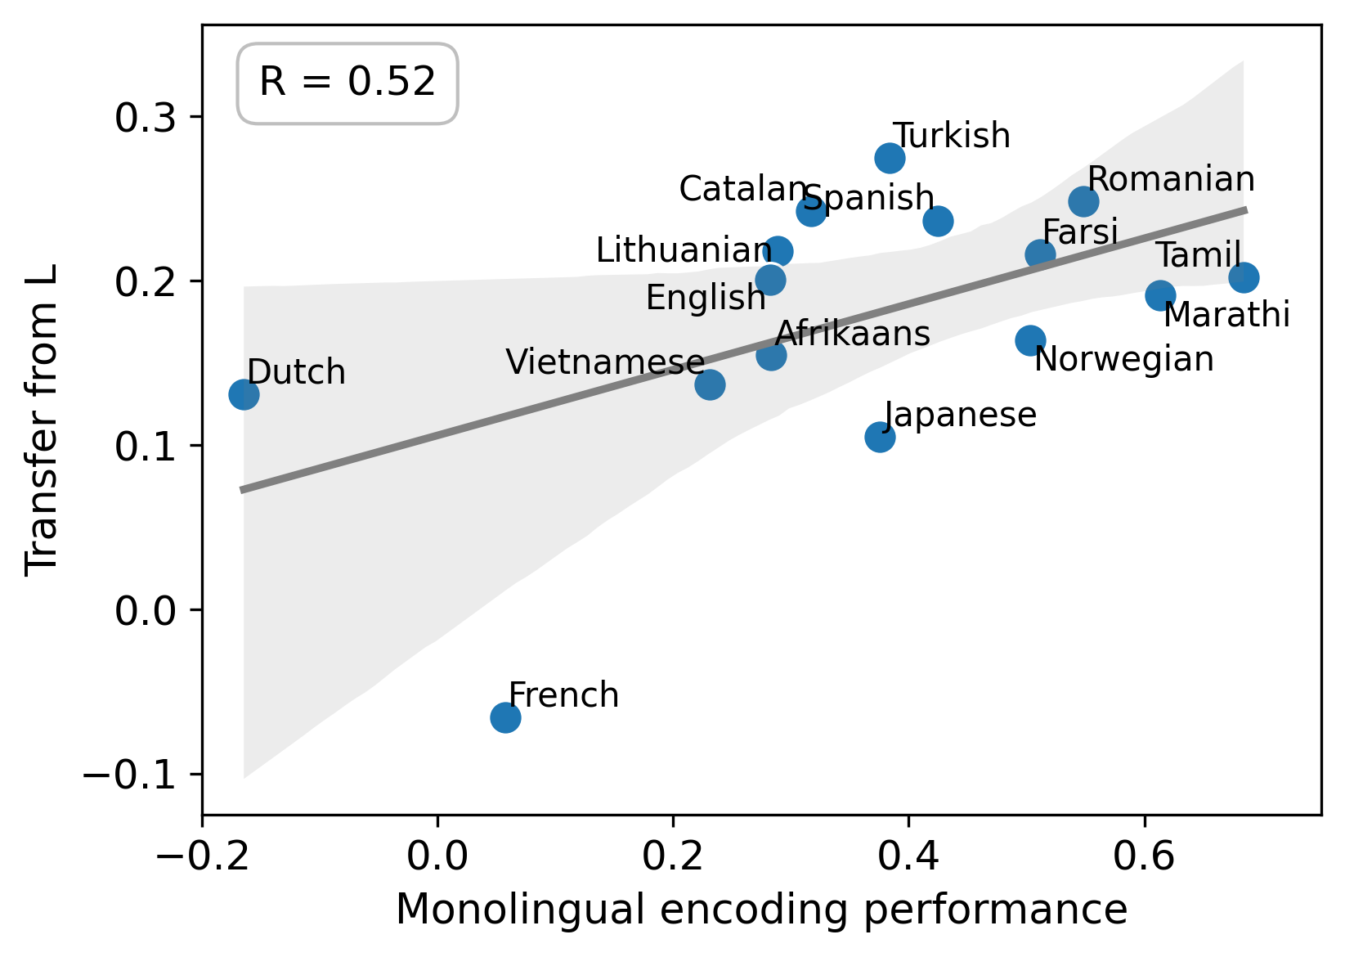
Encoding and transfer performance
Transfer is generally better for some languages than for others.
  Relationship between monolingual encoding score in a given language l and:
    How well the models trained on l transfers to other languages
    How well the models trained on other languages transfer to l

Slide 20
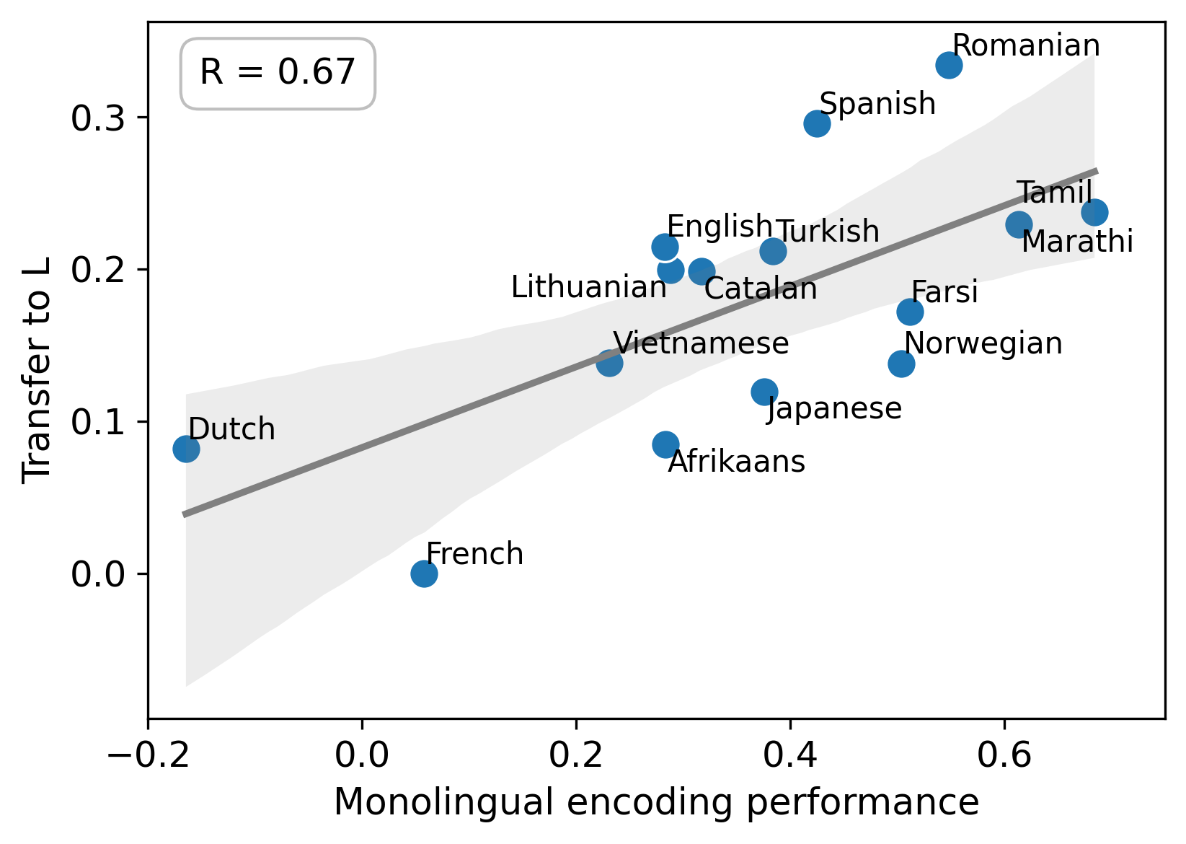
Encoding and transfer performance
Transfer is generally better for some languages than for others.
  Relationship between monolingual encoding score in a given language l and:
    How well the models trained on l transfers to other languages
    How well the models trained on other languages transfer to l

Slide 21
Encoding and transfer performance
Transfer is generally better for some languages than for others
Quality of the embeddings
Quality of the fMRI signal

Slide 22
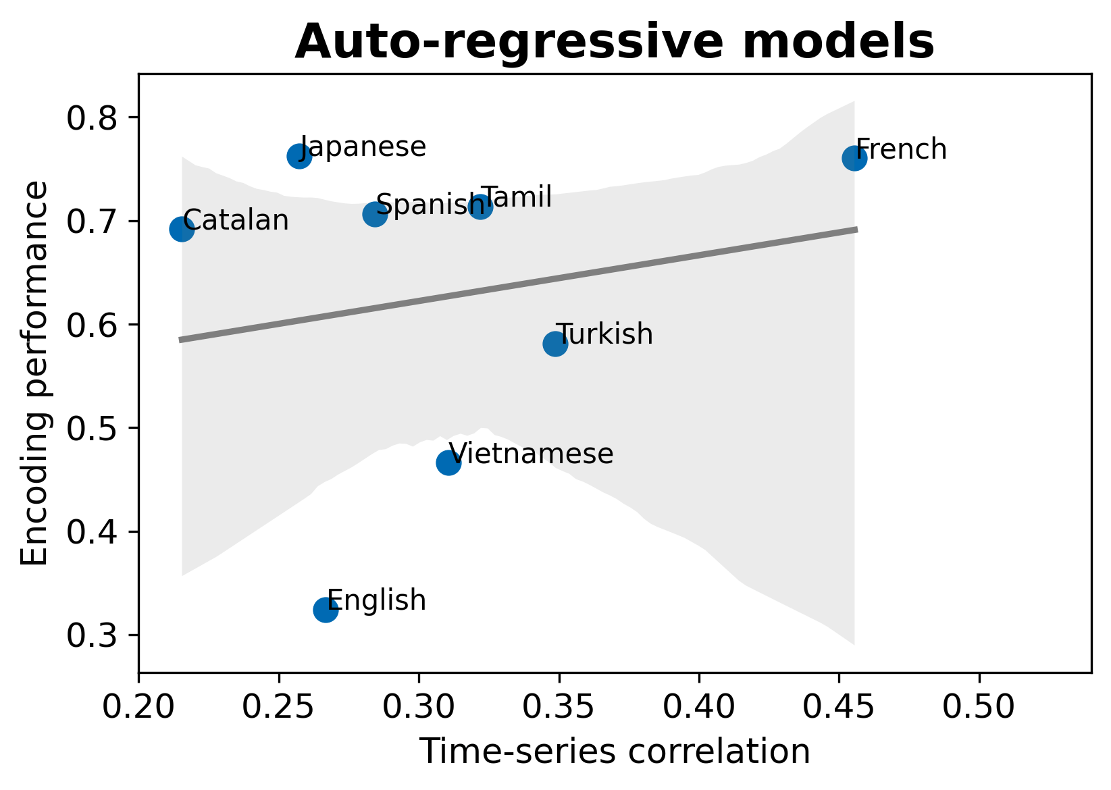
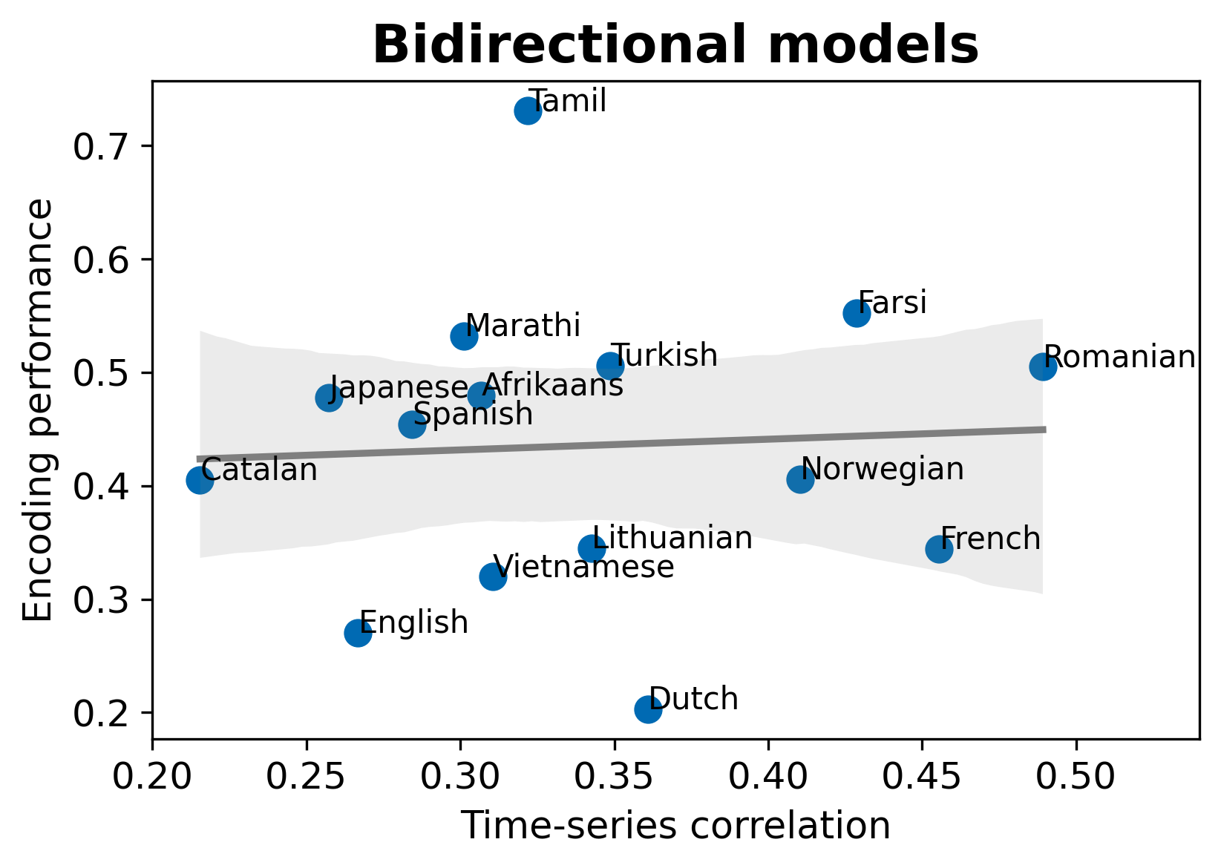
Encoding and transfer performance
Transfer is generally better for some languages than for others
Quality of the embeddings
Quality of the fMRI signal

Slide 23
Encoding and transfer performance
Transfer is generally better for some languages than for others
Quality of the embeddings
Quality of the fMRI signal
P1
P1
“true” TS value
“true” TS value
P2
P2

Slide 24
Encoding and transfer performance
Transfer is generally better for some languages than for others
Quality of the embeddings
Quality of the fMRI signal
P1
P1
“true” TS value
“true” TS value
P2
P2

Slide 25
Open questions
Model
Shuffled
Fold 1
0.46
0.10
How to evaluate statistical significance
  Paired samples permutation test?
    Baseline where the dependent variable is randomly shuffled
    Compare the encoding performance between target and randomized model by doing fold-wise permutation
Fold 2
0.31
0.02
Fold 3
0.28
0.04
Fold 4
0.40
0.01
Fold 5
0.63
0.15
Fold 6
0.11
0.12
Fold 7
0.55
0.03
Fold 8
0.42
0.19
Fold 9
0.64
0.00
Fold 10
0.08
0.07

Slide 26
Open questions
Model
Shuffled
Fold 1
0.46
0.10
How to evaluate statistical significance
  Paired samples permutation test?
    Baseline where the dependent variable is randomly shuffled
    Compare the encoding performance between target and randomized model by doing fold-wise permutation
Fold 2
0.31
0.02
Fold 3
0.28
0.04
Fold 4
0.40
0.01
Fold 5
0.63
0.15
Fold 6
0.11
0.12
Fold 7
0.55
0.03
Fold 8
0.42
0.19
Fold 9
0.64
0.00
Fold 10
0.08
0.07
Δ0

Slide 27
Open questions
Model
Shuffled
Fold 1
0.10
0.46
How to evaluate statistical significance
  Paired samples permutation test?
    Baseline where the dependent variable is randomly shuffled
    Compare the encoding performance between target and randomized model by doing fold-wise permutation
Fold 2
0.31
0.02
Fold 3
0.28
0.04
Fold 4
0.01
0.40
Fold 5
0.63
0.15
Fold 6
0.11
0.12
Fold 7
0.55
0.03
Fold 8
0.19
0.42
Fold 9
0.64
0.00
Fold 10
0.08
0.07
Δ

Slide 28
Open questions
Model
Shuffled
0.46
0.10
0.46
0.10
0.10
0.46
0.10
Fold 1
0.46
How to evaluate statistical significance
  Paired samples permutation test?
    Baseline where the dependent variable is randomly shuffled
    Compare the encoding performance between target and randomized model by doing fold-wise permutation
Fold 2
0.31
0.46
0.02
0.02
0.10
0.31
Fold 3
0.28
0.04
Fold 4
0.40
0.01
Fold 5
0.46
0.63
0.63
0.10
0.15
0.15
Fold 6
0.11
0.12
Fold 7
0.55
0.03
Fold 8
0.42
0.19
Fold 9
0.64
0.00
Fold 10
0.08
0.07
Δ

Slide 29
Open questions
Model
Shuffled
0.46
0.46
0.10
0.10
0.10
Fold 1
0.46
How to evaluate statistical significance
  Paired samples permutation test?
    Baseline where the dependent variable is randomly shuffled
    Compare the encoding performance between target and randomized model by doing fold-wise permutation
Fold 2
0.31
0.02
Fold 3
0.28
0.04
Fold 4
0.46
0.46
0.01
0.40
0.10
0.10
0.40
0.01
Fold 5
0.63
0.15
Fold 6
0.11
0.12
Fold 7
0.55
0.03
Fold 8
0.42
0.19
Fold 9
0.46
0.46
0.00
0.64
0.10
0.10
0.64
0.00
Fold 10
0.08
0.07
Δ

Slide 30
Open questions
Model
Shuffled
0.46
0.46
0.10
0.10
0.10
Fold 1
0.46
How to evaluate statistical significance
  Paired samples permutation test?
    Baseline where the dependent variable is randomly shuffled
    Compare the encoding performance between target and randomized model by doing fold-wise permutation
p = | Δ > Δ0 | / Nperm
Fold 2
0.31
0.02
Fold 3
0.28
0.04
Fold 4
0.46
0.46
0.01
0.40
0.10
0.10
0.40
0.01
Fold 5
0.63
0.15
Fold 6
0.11
0.12
Fold 7
0.55
0.03
Fold 8
0.42
0.19
Fold 9
0.46
0.46
0.00
0.64
0.10
0.10
0.64
0.00
Fold 10
0.08
0.07
Δ

Slide 31
Open questions
Extending the drive/suppress framework
  Do we still want to do it?
    The models are already transferred to new languages, stimuli, and participants
  If we want to do it, what do we want to test?
    Surprisal, grammaticality, plausibility, mental state, valence, etc?

Slide 32
Open questions
Relating the language models’ performance (BERT, XGLMxl?) with the prediction of fMRI activity
  (Pseudo)perplexity
    Cfr. Schrimpf et al. 2021
  Semantic similarity
    Existing similarity datasets (e.g., MultiSimLex) have limited coverage
    We could use a multilingual lexicon (e.g., word2word), and see how a model can retrieve translations from and to each language
  XTREME
  Unsupervised evaluation
    Closeness of embeddings in language l to the global centroid of the multilingual space

