Slide 1
Camera

Slide 2
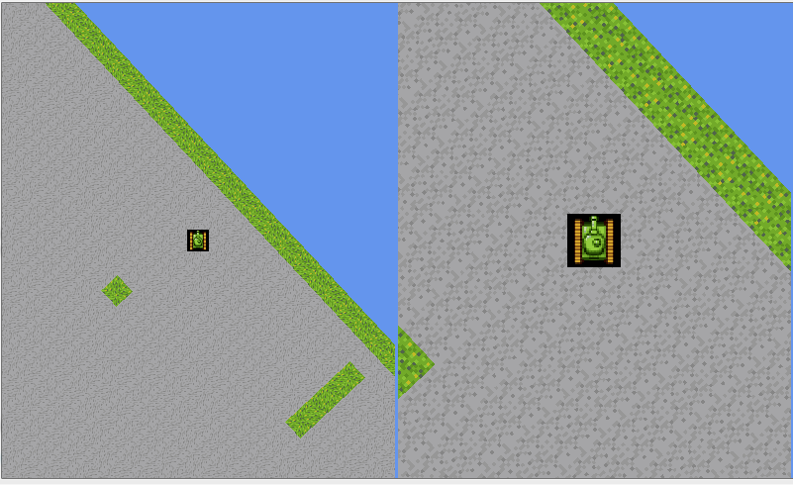
We want to do this

Slide 3
Start in the game class

