Slide 1
Camera
2D on XNA

Slide 2
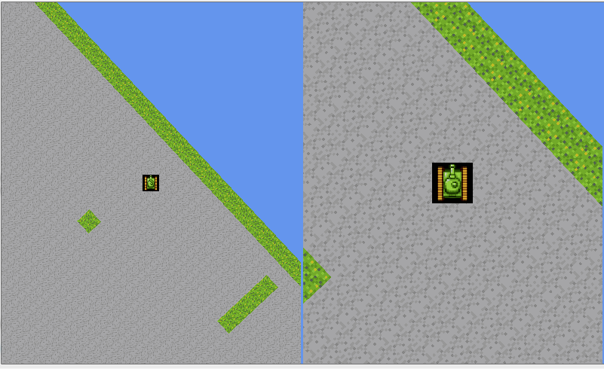
We want to do this

Slide 3
Start in the game class

Slide 4
World
(0,0)
(0,0)
Screen

Slide 5
1st Translation
World
(0,0)
(0,0)
Screen

Slide 6
2nd Rotation
(0,0)
World
(0,0)
Screen

Slide 7
3rd Scaling
(0,0)
World
(0,0)
Screen

Slide 8
4th Translation
(0,0)
World
(0,0)
Screen

