Slide 1
Conditional Diffusion for EEG Data Synthesis
Semester Project for Advanced Machine Learning 2024
by
Group 18

Slide 2
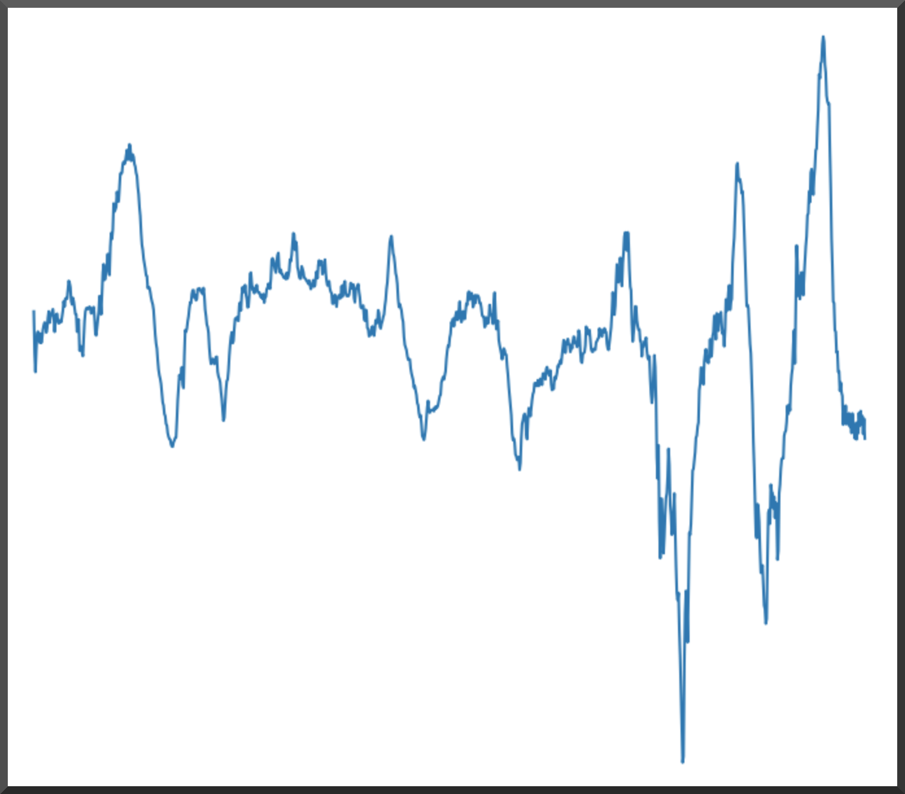
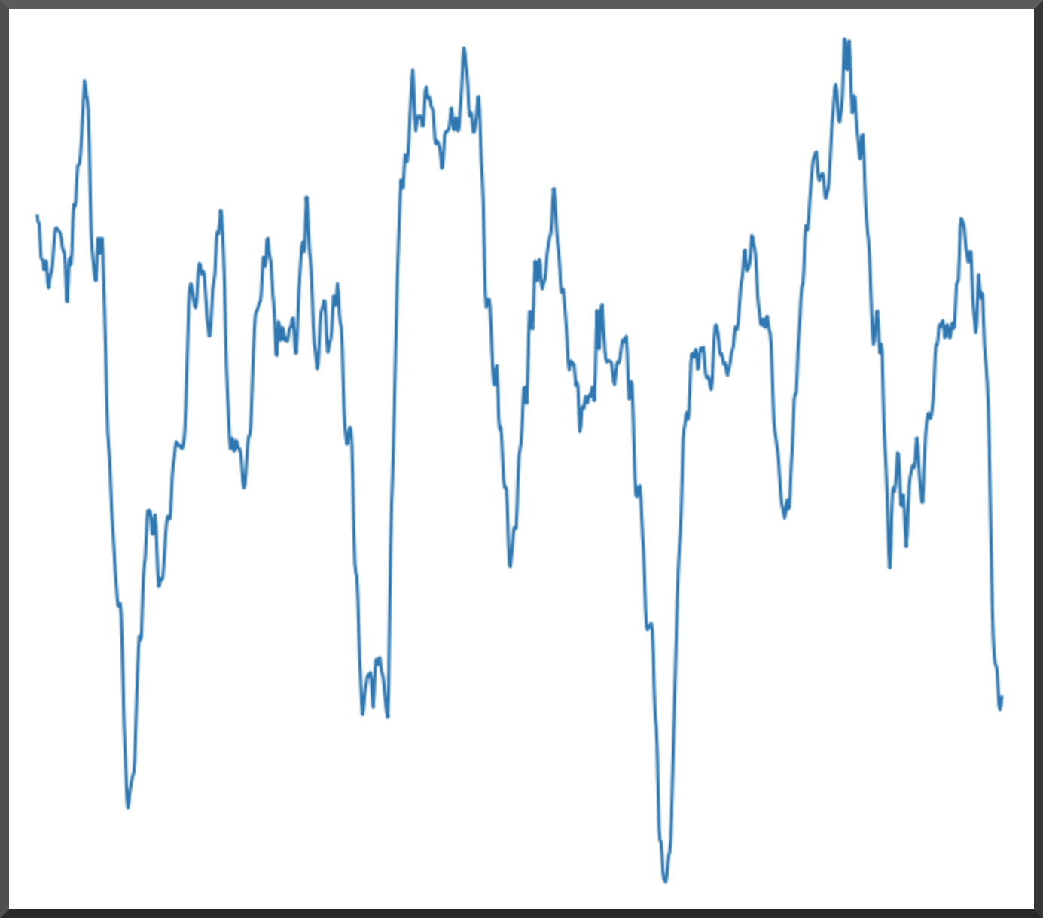
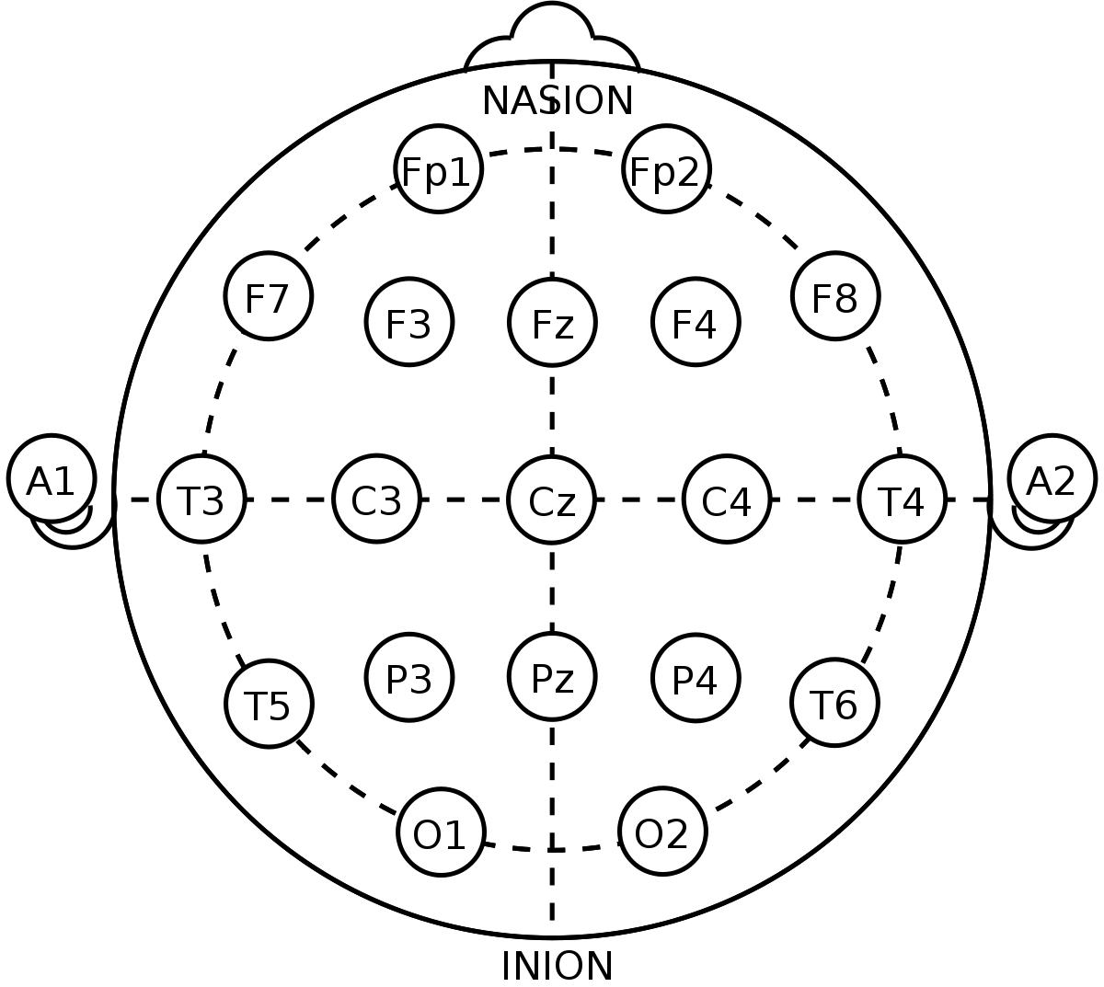
Introduction
EEG: the brain activity of different areas of the cerebral outer cortices
Dataset (TUH EEG) with labels for different kinds of seizure activity
Generally, seizures are slow waves between 2 - 10 Hz, hyper-synchronous in time
Idea: Generate synthetic EEG with seizure and non-seizure activity
Healthy EEG
Seizure EEG
Notes:
Say: EEG is Micro-potential differences are measured between electrodes placed on the scalp, data is scarce, etc.

Slide 3
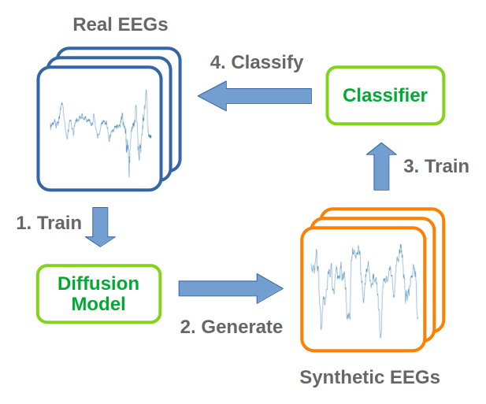
Overview
Train a diffusion model using real EEGs with two targets (seizure, non-seizure)
Use diffusion model to sample synthetic EEGs (conditioned by target)
Use synthetic EEGs to train a (simple) classifier model
Evaluate classifier model on real EEGs

Slide 4
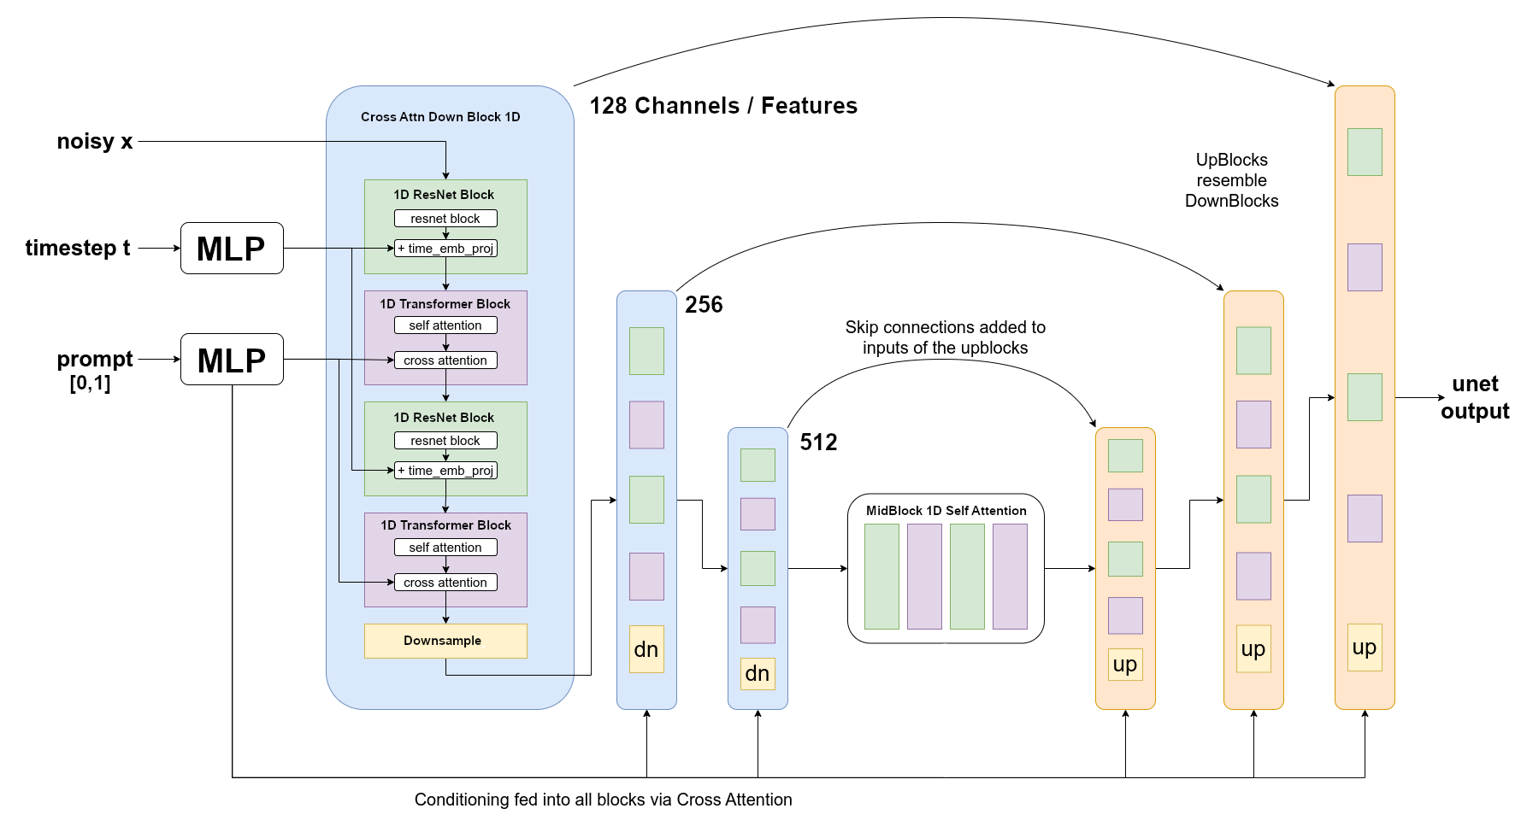
Model
U-Net with Attention
(1,64)
[0,1]
nn.Linear

Slide 5
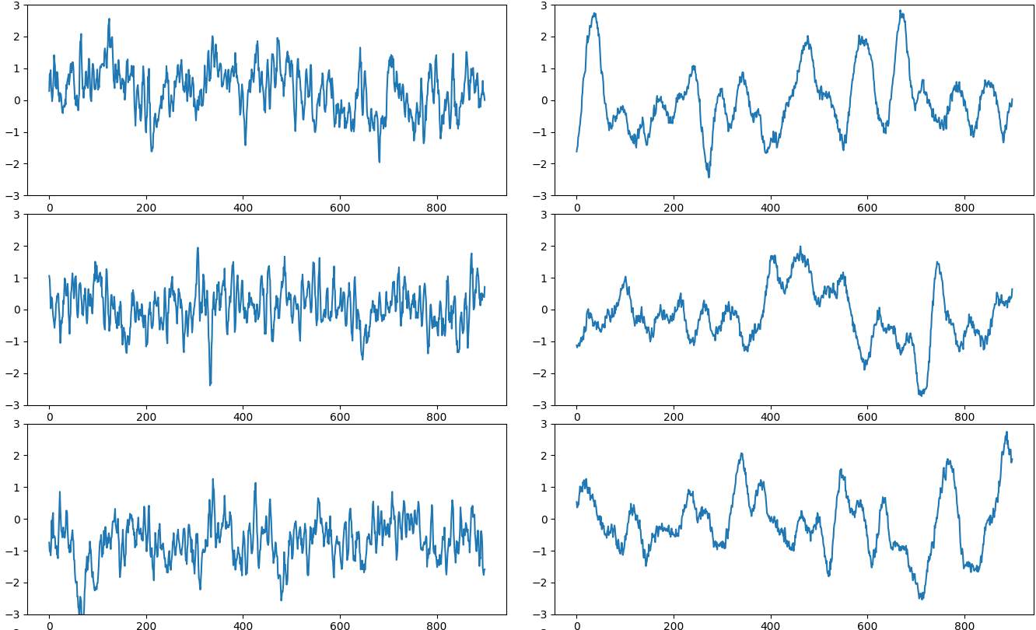
Results
non seizure
(0)
fnsz
(1)

Slide 6
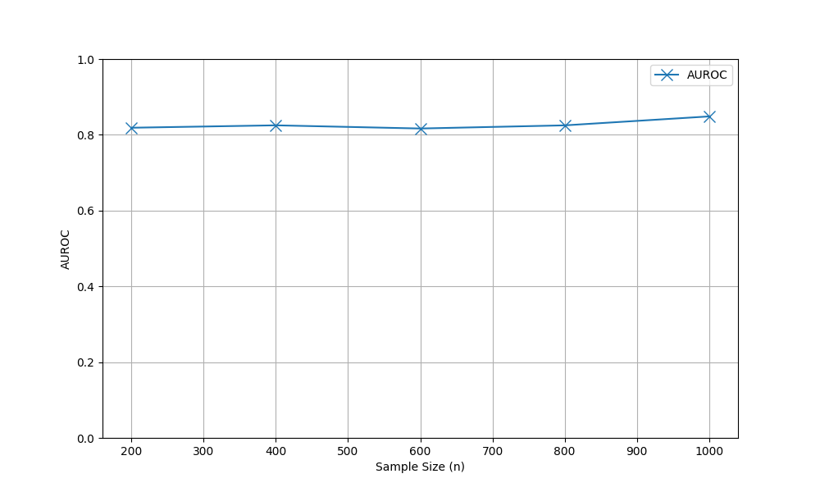
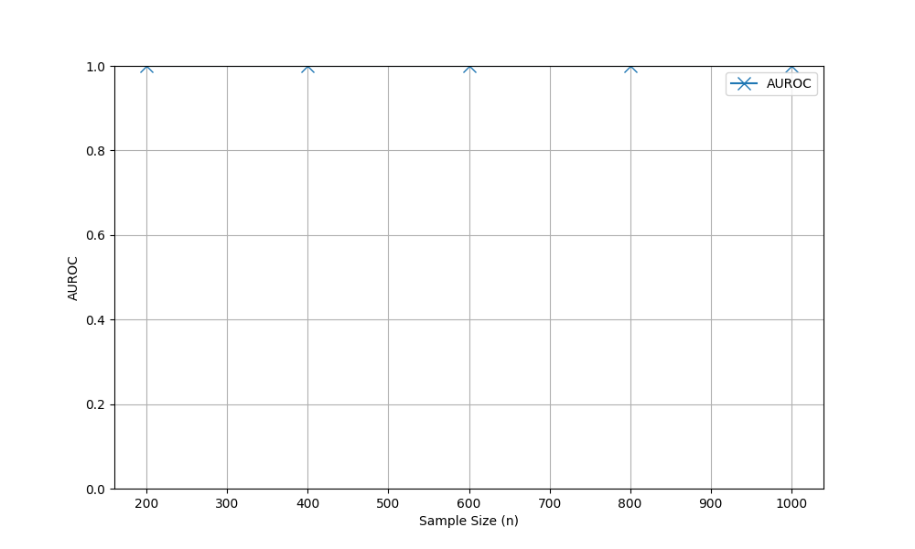
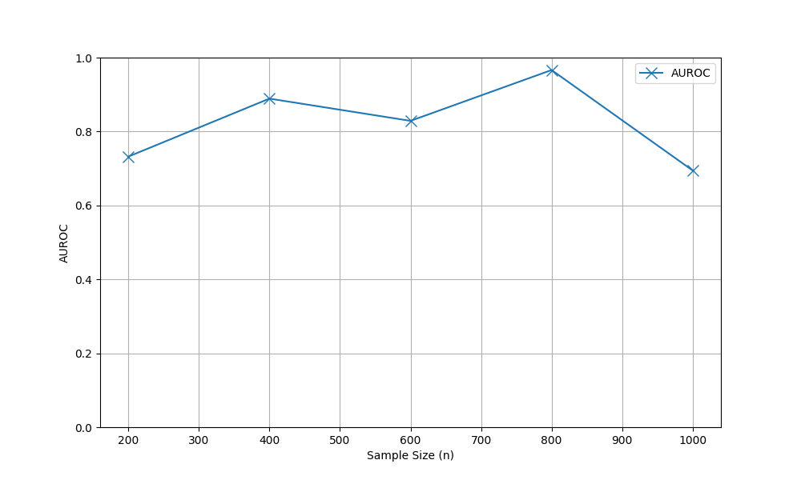
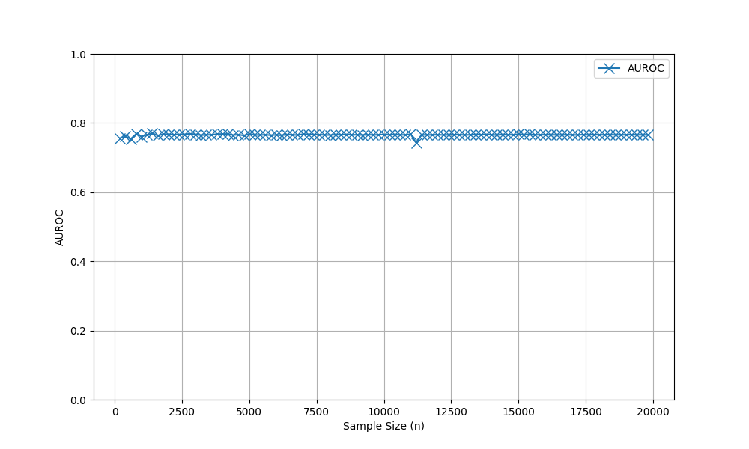
Validation
(w/ perfect class balance)
(w/ perfect class balance)
Accuracy: 0.80
TPR: 0.89
TNR: 0.71
F1 score: 0.81
AUROC: 0.85
Accuracy: 1.0
TPR: 1.0
TNR: 1.0
F1 score: 1.0
AUROC: 1.0 😎
Train: Real - Test: Real
b) Train: Synth - Test: Synth
Accuracy: 0.5
TPR: 1.0
TNR: 0.0
F1 score: 0.66
AUROC: 0.70
Accuracy: 0.57
TPR: 0.30
TNR: 0.84
F1 score: 0.41
AUROC: 0.77
c) Train: Real - Test: Synth
c) Train: Synth - Test: Real

Slide 7
Thank you for your attention
Questions?

Slide 8
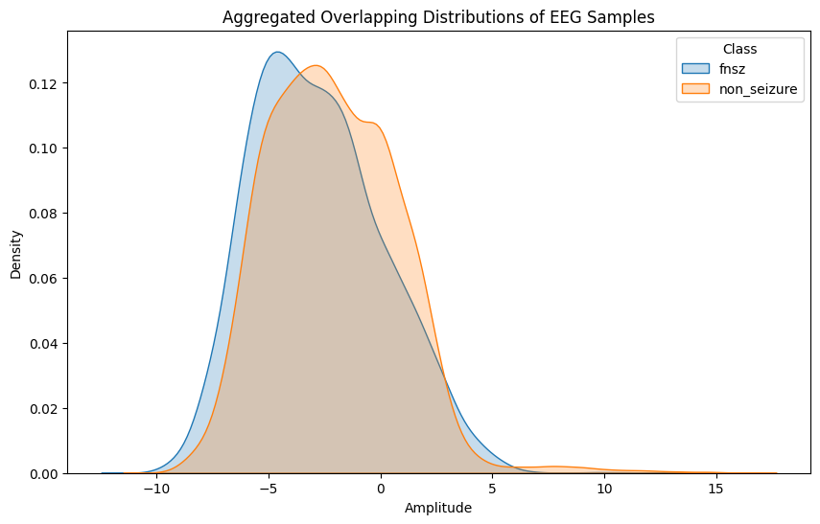
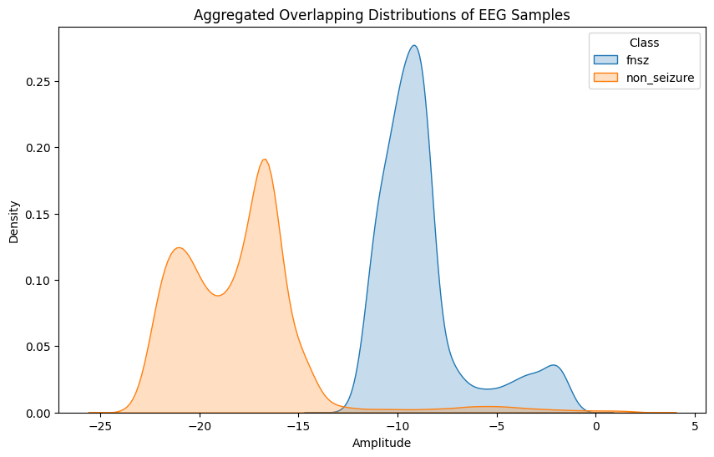
Appendix A
a) Real samples b) Synthetic samples
Frequency features

Slide 9
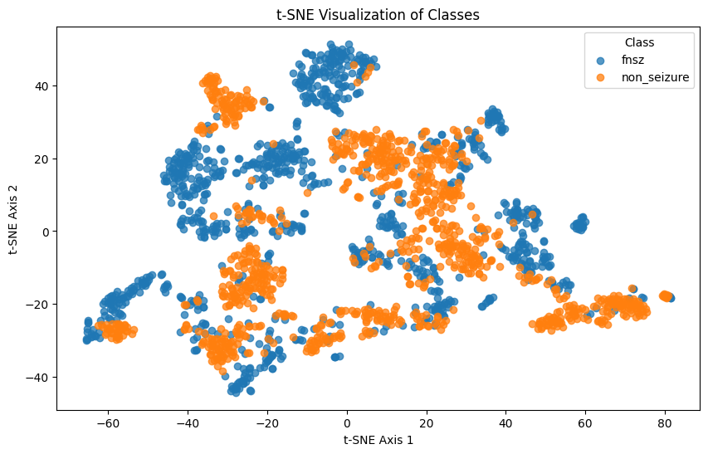
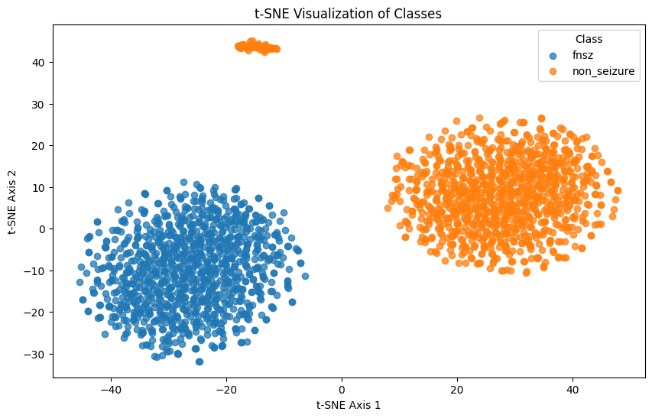
Appendix B
a) Real samples b) Synthetic samples
Frequency features

Slide 10
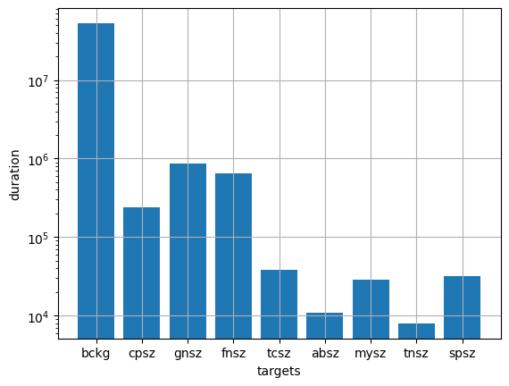
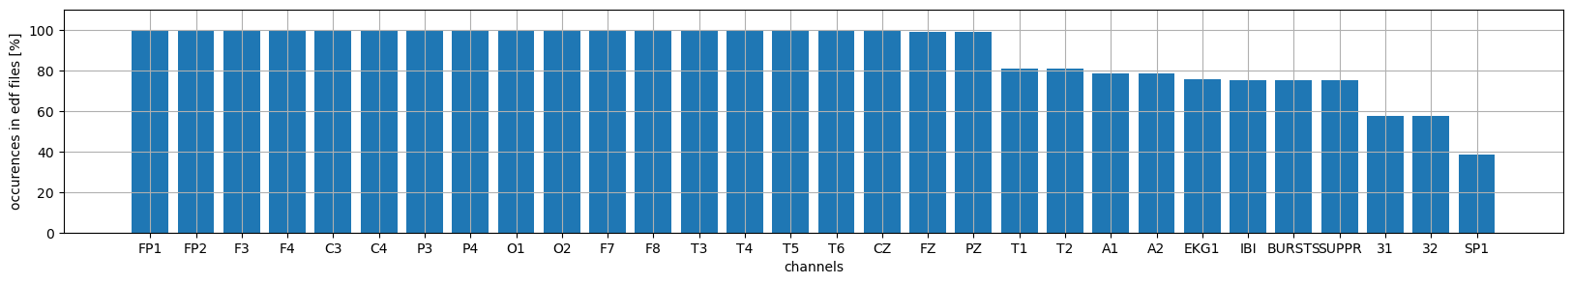
Appendix C: Channels and classes

Slide 11
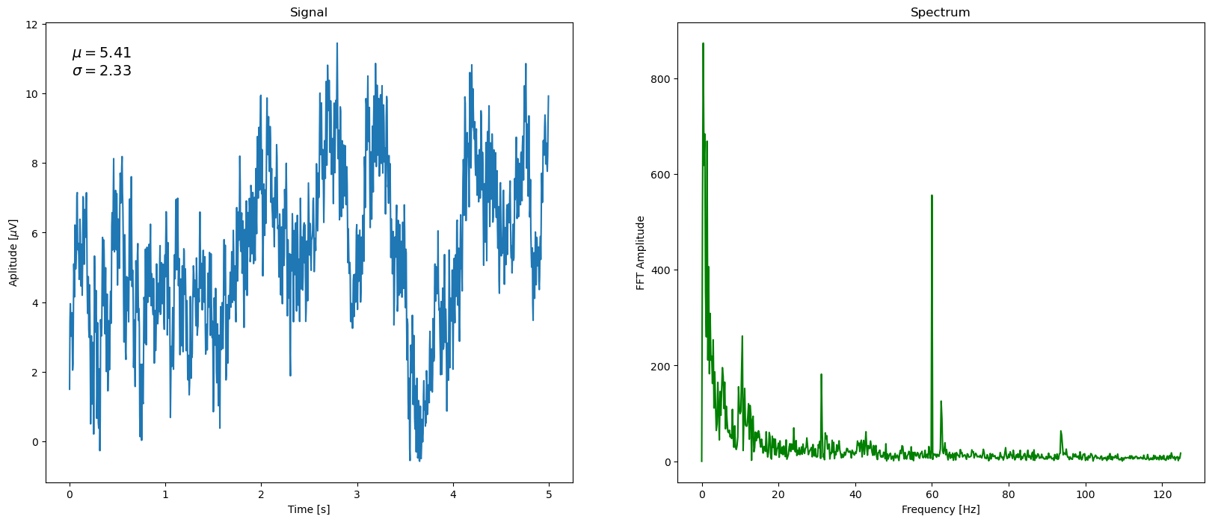
Appendix D: Original signal and spectrum

Slide 12
Appendix E: Choice of classifier
Try out different classifier models
Train on real data, test on real data
Features:
FFT
Discrete wavelet transform
Mean, Standard deviations, Percentiles
Welch’s PSD
Models:
Gradient boosting
SVC
Multilayer perceptron
Model chosen: FFT + SVC

Slide 13
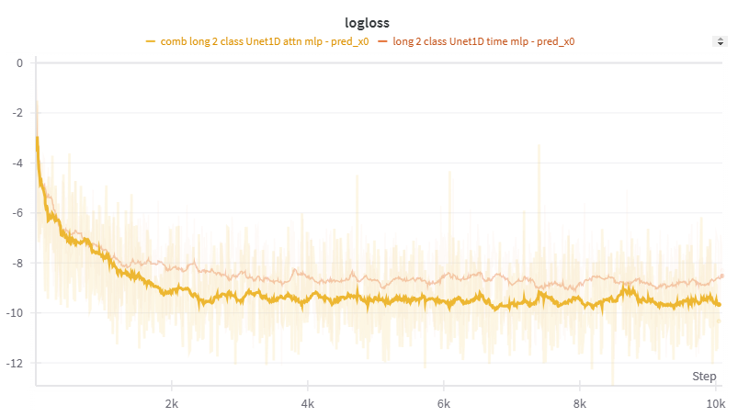
Appendix F

Slide 14
Appendix G: Dataset
https://isip.piconepress.com/projects/tuh_eeg/html/downloads.shtml
Access on request
26 846 clinical EEG recordings collected at Temple University Hospital (TUH) from 2002 - 2017
EEGs stored as EDF files (EDF = European Data Format)
Annotations stored as CSV (channels, start, stop, class [e.g. fnsz])

