Slide 1
TELETUBBIES X SAN MARTINO
FriEndship day

Slide 2








TECHNOLOGIES
CSS
JAVA
MYSQL
GIT
HTML
JAVASCRIPT
MAVEN
NODE.JS

Slide 3
THE CONTEST
Goal: to promote the San Martino brand through an online prize competition that encourages user registration and engagement, rewarding the fastest participants with a Rush&Win mechanism.
Contest Period: from July 1st to 8th at 9 AM, 2025.
Target: adults residing in Italy and San Marino.
Prize: a Lambrusco KIT for the first 499 users who complete the registration process correctly.
Additional Prizes: there will also be a consolation draw and a recovery draw for unassigned prizes.
Security: everything is managed securely, in compliance with D.P.R. 430/2001 and GDPR.
Server and Data: managed in Italy; verifications and certifications conducted in the presence of a notary.

Slide 4
WEBSITE WORK FLOW DIAGRAM

Slide 5
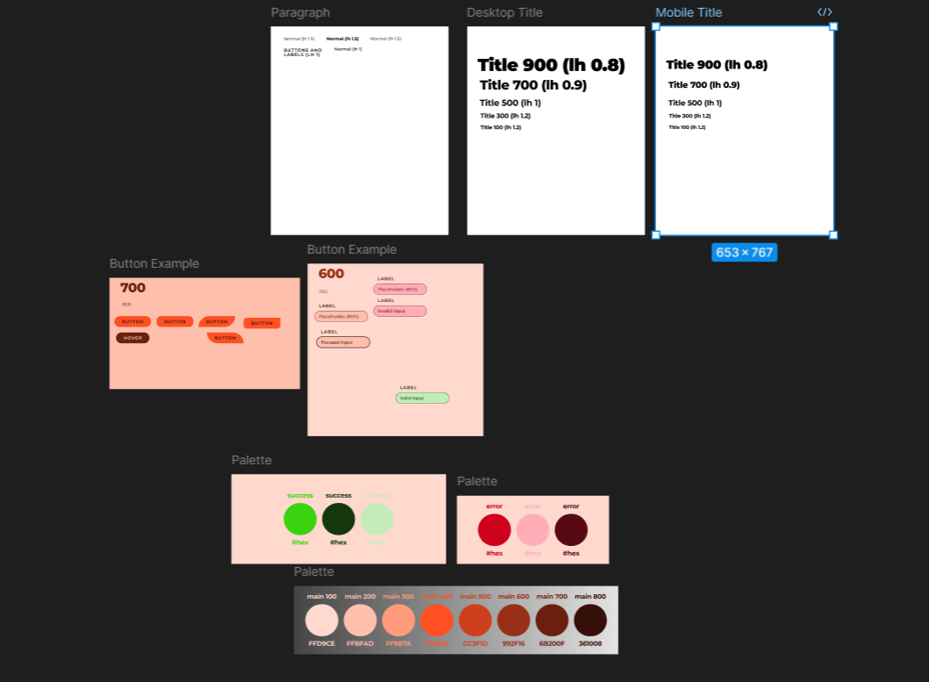
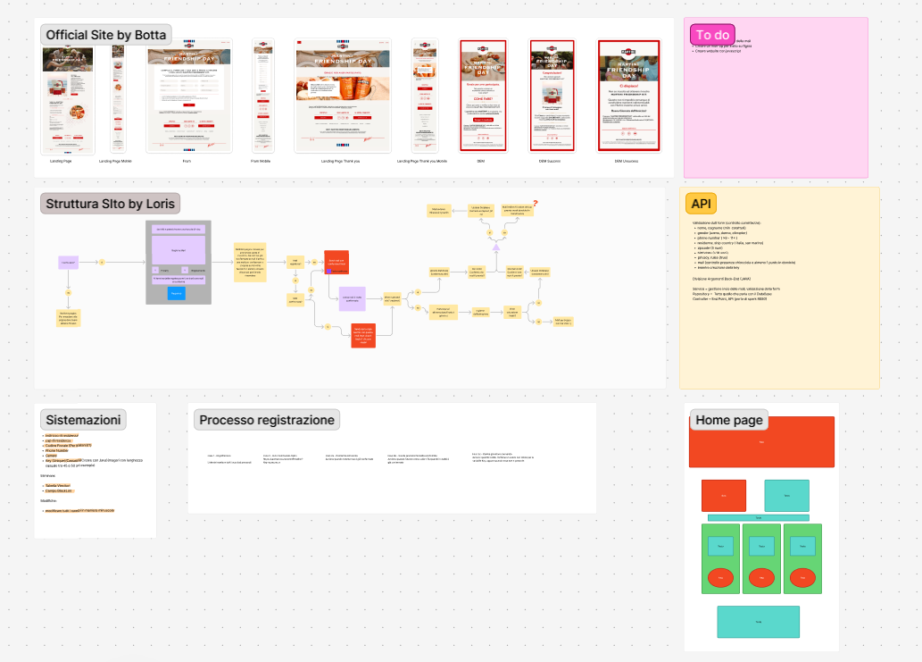
UI/UX DESIGN

Slide 6
FUTURE IMPROVEMENTS
In a real-world scenario, users might make mistakes during registration. For example, a typo in their address or email.
In future updates, we are considering the option to allow users to edit their submitted data before the contest ends.
This would involve:
Verifying the identity of the user (e.g., via token or email link)
Unlocking their data for changes
Updating the database while maintaining validation and uniqueness constraints
This feature would improve user experience, reduce support requests, and ensure accurate data collection for prize delivery.

Slide 7
CONCLUSION
This project helped us apply concepts from databases, web development, backend programming, and security.
We learned to work as a team and to follow a real-world specification.
Main challenges:
Managing concurrency and email sending
Overall, it was a rewarding and realistic experience.

Slide 8
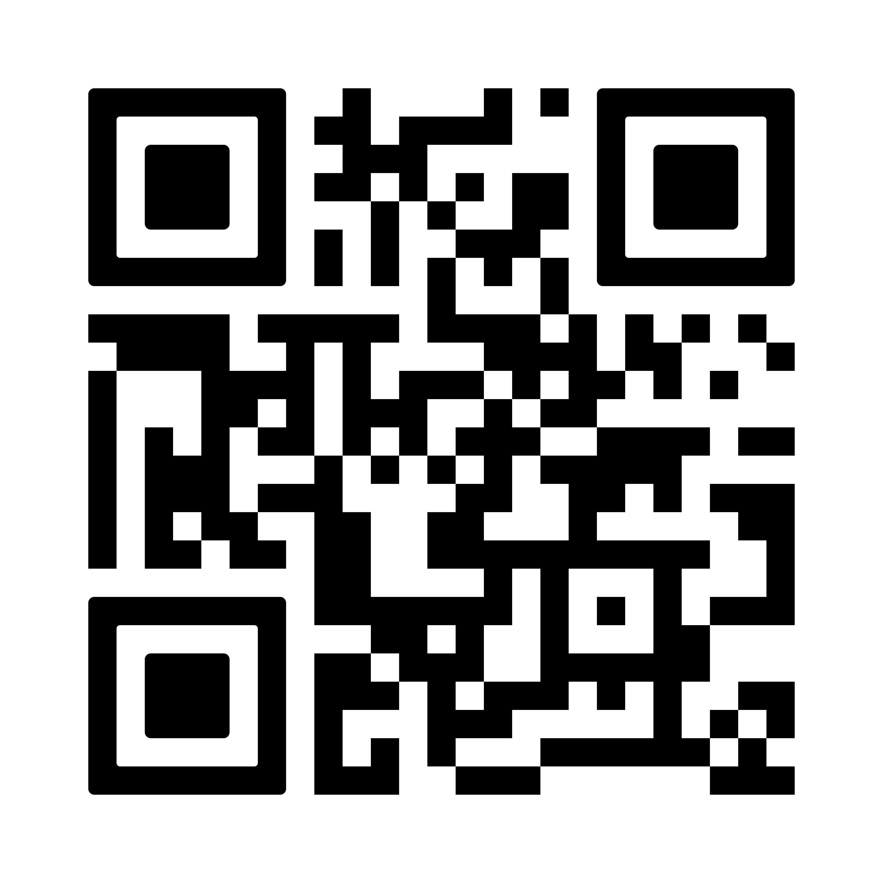
DEMO TIME
ARE YOU FAST ENOUGH?

Slide 9
THANKS TO ALL OF YOU
Andrea Fabio Grossi, Loris Catizzone, Tiberiu Stefan Melinescu, Vincenzo Vitale

