Slide 1
Bitcoin price forecasting
Author: andrea palermo

Slide 2
Introduction
(BTC) price time series forecast
Existing techniques:
Statistical models
Expomeantial smoothing
ARIMA
ML/DL models
Linear models (linear regression, svr…)
Ensembles (bagging/boosting)
MLP
RNN (LSTM, GRU…)

Slide 3

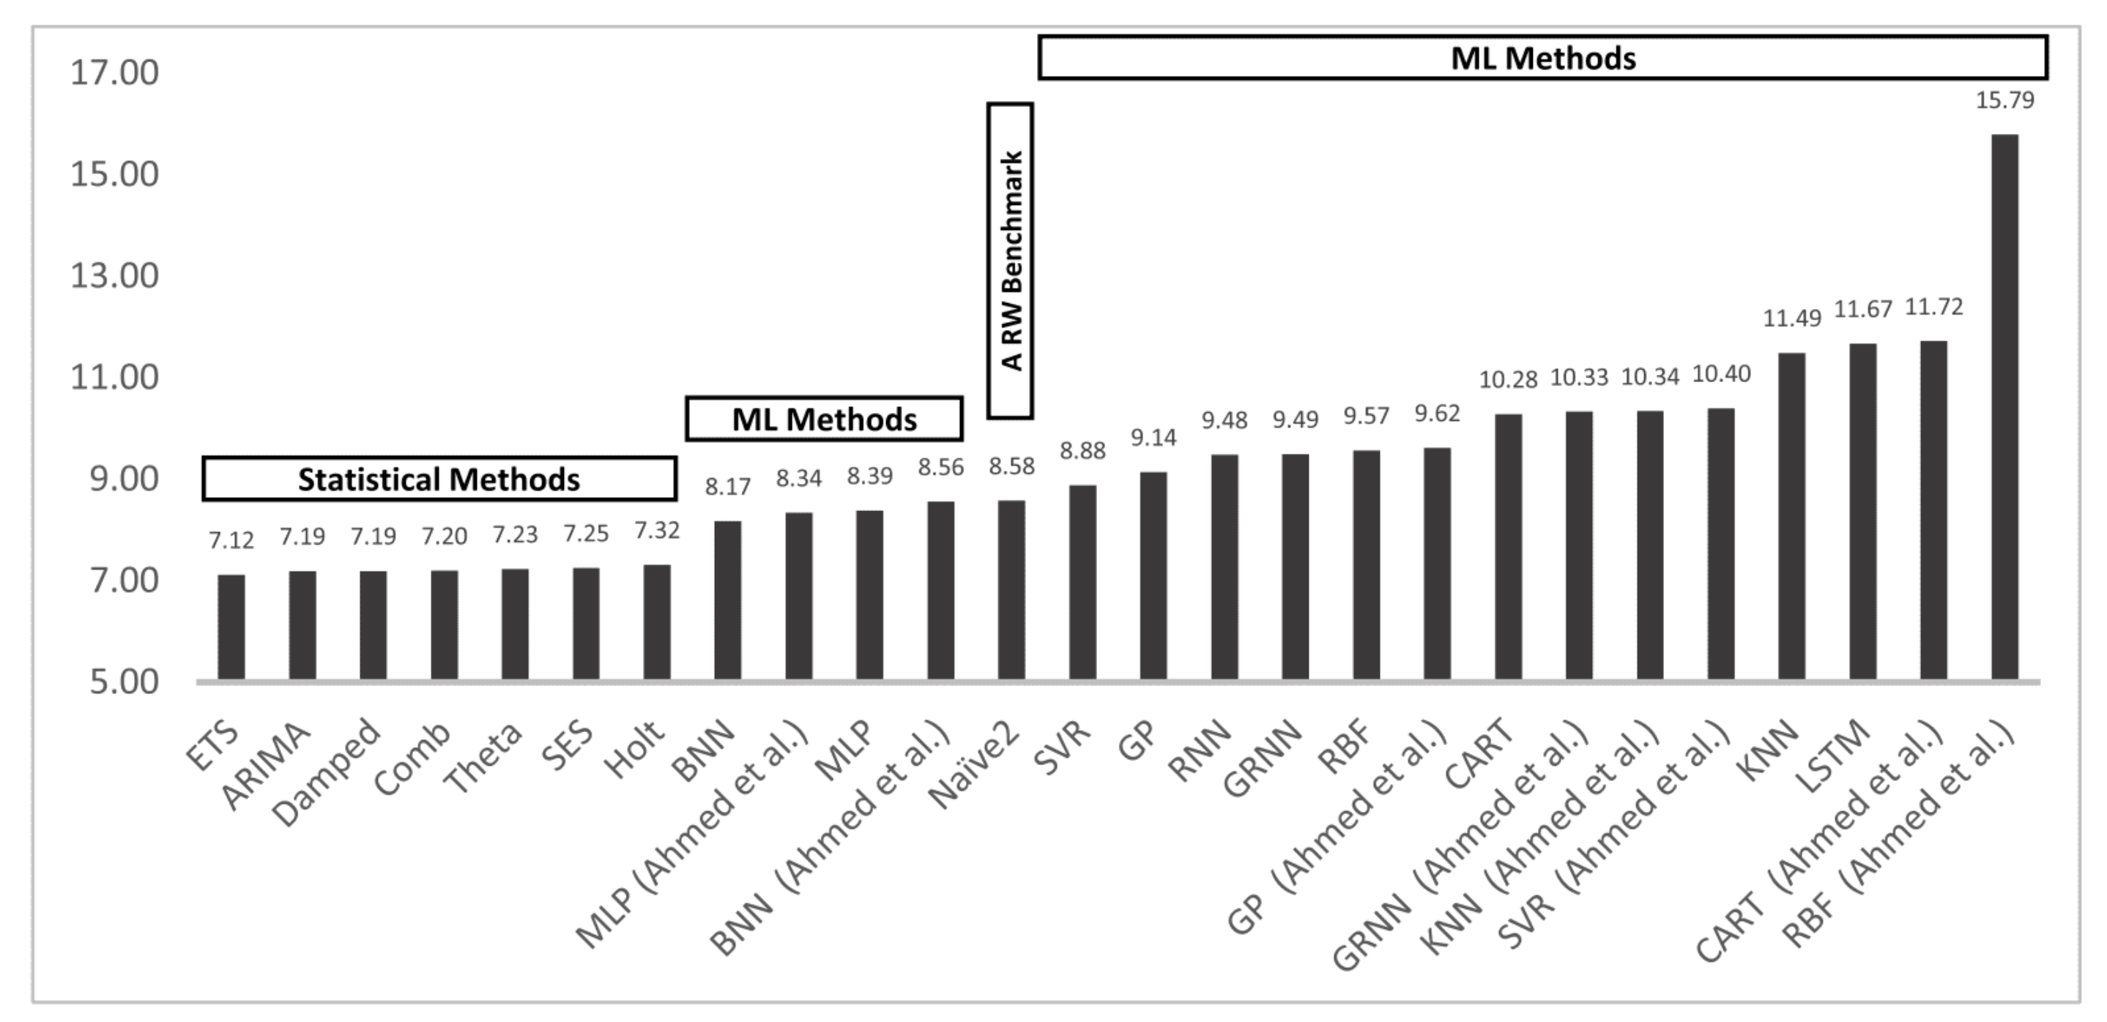
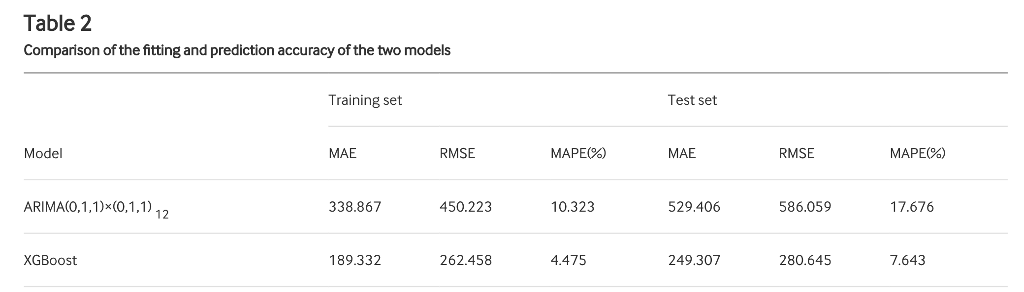
Analysis of existing techniques
References:
Spyros Makridakis, et al → https://machinelearningmastery.com/findings-comparing-classical-and-machine-learning-methods-for-time-series-forecasting
Alim M, Ye G, Guan P, et al → Comparison of ARIMA model and XGBoost model for prediction of human brucellosis in mainland China: a time-series study
Findings → simple methods > complex and specifically designed ones
In practice:
ARIMA, ETS > ”simple” ML/DL (LINEAR, MLP…) >> LSTM, GRU
Gradient Boosting > ARIMA in some specific settings

Slide 4
Chosen approach
Try to improve ML/DL techniques
LSTM/GRU/MLP
Elephas, SparkFlow, SparkTorch → poor docs, compatibility problems, batch not supported (LSTM)
Linear Regression (elasticnet→ ridge + lasso)
Pyspark
Ensembles→ GBT
Pyspark
Development environment: Pyspark + Databricks Community Edition

Slide 5
Architecture – Data Processing/Feature engineering
CORR. (PEARSON/ SPEARMAN) | Open | Close | High | Low | Volume
Open | 1/1 | 0.99/0.99 | 0.99/0.99 | 0.99/0.99 | 0.73/0.93
Close | 0.99/0.99 | 1/1 | 0.99/0.99 | 0.99/0.99 | 0.73/0.93
High | 0.99/0.99 | 0.99/0.99 | 1/1 | 0.99/0.99 | 0.73/0.93
Low | 0.99/0.99 | 0.99/0.99 | 0.99/0.99 | 1/1 | 0.72/0.93
Volume | 0.73/0.93 | 0.73/0.93 | 0.73/0.93 | 0.72/0.93 | 1/1
Dataset→ Yahoo Finance
BTC daily (2014 <–> now)
Open, Close, High, Low, Volume
Train/validation: 2014 <-> 2019
Test: 2019 <-> now
No missing values → no preprocessing
No categorical features → no encoding
Feature engineering -> 30 days sliding window on prices
Example: x = <Day_1, … , Day_30> ; y = <Day_31>
Feature selection for day_n representation:
Correlation matrix (Pearson/Spearman)
Only close selected (maximize window)

Slide 6
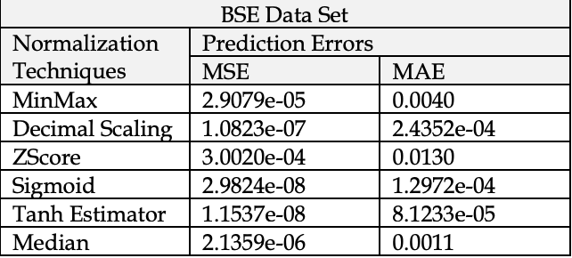

Architecture – Feature normalization
Before sliding window
Scaling Close column values (train + test)
Problem→ no range of possible values [0; inf]
Observed min and max not reliable
Solution→ Tanh estimator
Impact of Data Normalization on Deep Neural Network for Time Series Forecasting by Samit Bhanja and Abhishek Das
$0.5\left(tanh\left(\frac{0.01\left(x−μ\right)}{σ}\right)+1\right)$

Slide 7
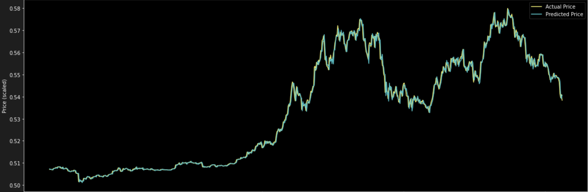

Architecture – Linear regression
Pyspark CrossValidator + LinearRegression
Validated params(train/validation set):
elasticNet: $LOSS+ λ\left(α\left|θ\right|+\left(1−α\right){\left\|θ\right\|}^{2}\right)$
Grid search:
regParam(0.33, 0.66) → $λ$
elasticNetParam (0.33, 0.5, 0.66) → $α$
Best model found
regParam = 0.66
elasticNetParam = 0.33
Tested on test set (unseen)
Pyspark Evaluator → RMSE = 0.0018142377818714116 → $\sim 2.25\%$of y’s range
Predicted/Actual price graph produced

Slide 8

Architecture – GBT
GRADIENT BOOSTING
BOOSTING → simple models (trees) added in steps to correct mistakes of previous ones
$o_{k+1}={(h}_{1}+…+h_{k})+ h_{k+1}$ → $h_{k+1}=o_{k+1}−(h_{1}+…+h_{k})$
$h_{k+1}$ fitted to residuals of ${(h}_{1}+…+h_{k})$
Pyspark CrossValidator + GBTRegressor
Validated params (train/validation set):
maxDepth (4, 8, 12)
featureSubsetStrategy (0.33, 0.66)
Best model found
maxDepth = 8
featureSubsetStrategy = 0.66
Tested on test set (unseen)
Pyspark Evaluator → RMSE = 0.001124827640277391 → $\sim 1.375\%$of y’s range
Predicted/Actual price graph produced

Slide 9
Conclusions
Hard to compare RMSE with other solutions
Depends on range of y
1.375% and 2.25%
Need to consider y = 1 day
Also naive method performs quite well
High precision needed
In this setting:
GBT > Linear regression
Confirms idea of Alim M, Ye G, Guan P, et al
Gradient boosting suitable for time series forecasting
THANK YOU FOR YOUR ATTENTION!

