Slide 1
Java Swing
Università di Modena e Reggio Emilia
Prof. Nicola Bicocchi (nicola.bicocchi@unimore.it)

Slide 2
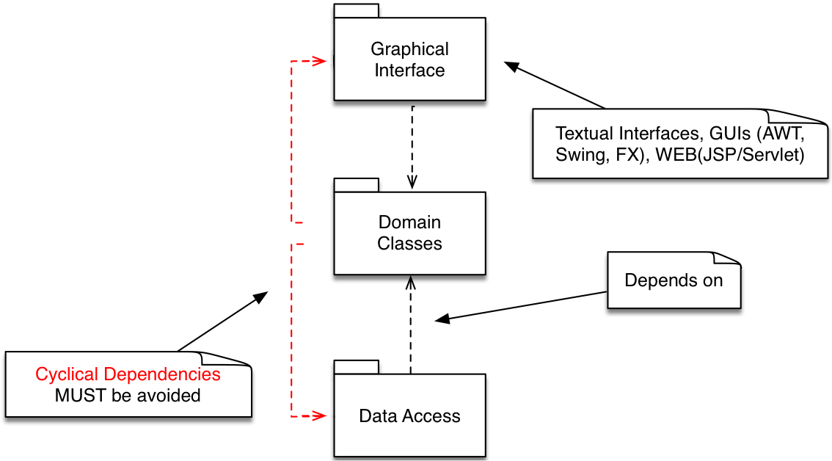
Software Design

Slide 3
Package java.awt.*
Provides:
Components (button, checkbox, scrollbar, etc.)
Containers (they are still components)
Event management:
System-generated events
UI-generated events
Layout management

Slide 4
Package javax.swing.*
Contains the same components of java.awt, but with different names (JButton, JFrame, etc.)
All these components derive from JComponent
Advantages:
provides a series of components with the same appearance and behavior on all platforms
look and feel changeable at runtime
Swing is an extension of AWT

Slide 5
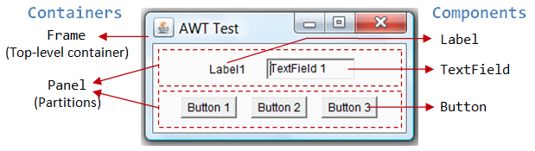
Containers and components

Slide 6
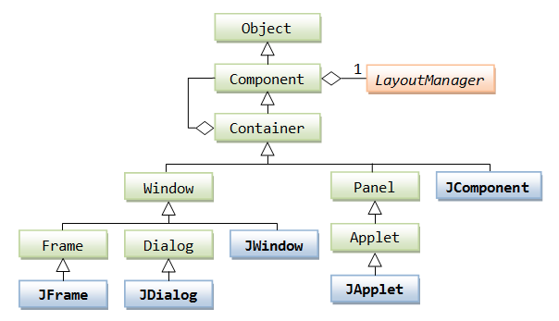
Class hierarchy (Containers)

Slide 7
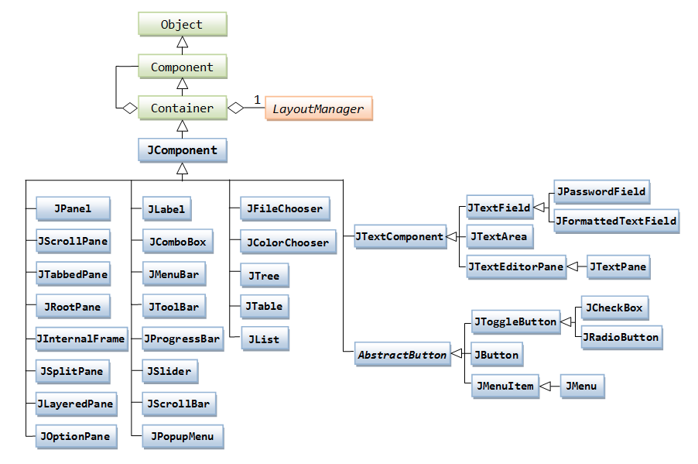
Class hierarchy (Components)

Slide 8
Graphical Programming
Set a Look & Feel (= Style)
Microsoft Windows, Mac, Java Metal
Define one (or more) top-level container
JFrame, JDialog, JApplet
Add components to the containers
JButton, JComboBox, JSlider, …
Add secondary containers
Set Look & Feel
Define top-level container
Add component
Add secondary container

Slide 9
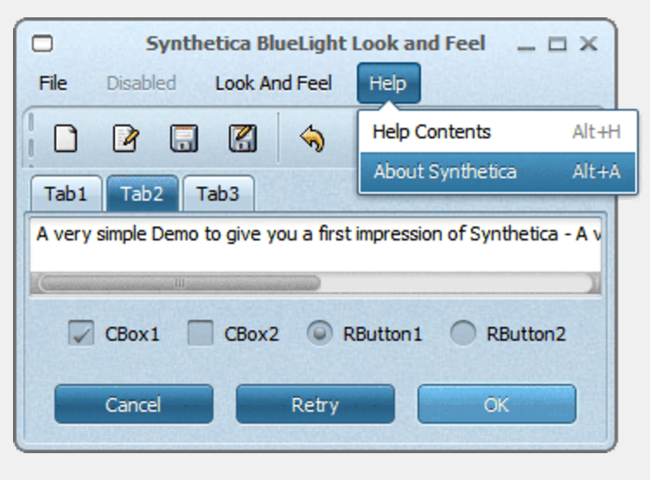
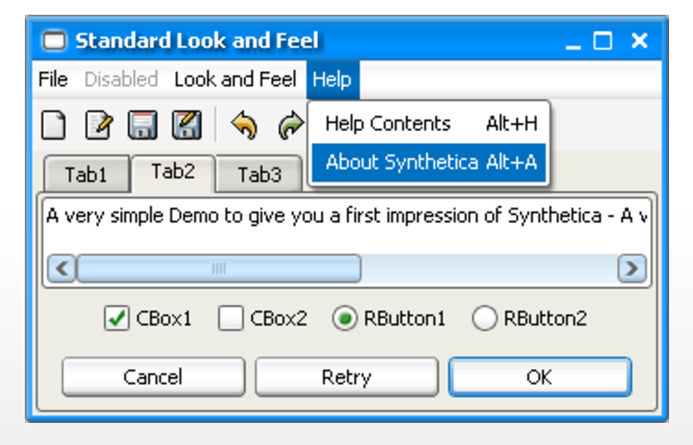
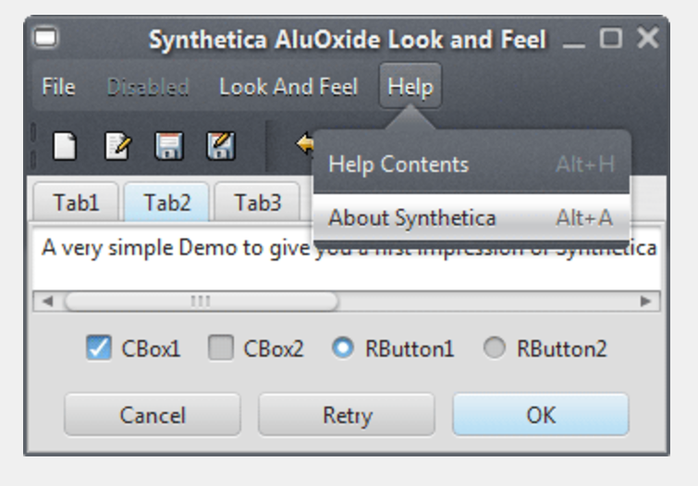
Look & Feel

Slide 10
Look & Feel
UIManager manages the current look and feel. For examples, look at http://www.jyloo.com/synthetica/themes/
// Set Metal Look and Feel
UIManager.setLookAndFeel("javax.swing.plaf.metal.MetalLookAndFeel");
// Set Motif Look and Feel
UIManager.setLookAndFeel("com.sun.java.swing.plaf.motif.MotifLookAndFeel");
// Set Windows Look and Feel
UIManager.setLookAndFeel("com.sun.java.swing.plaf.windows.WIndowsLookAndFeel");

Slide 11

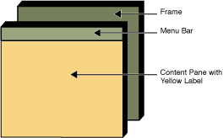
Top-level container: JFrame

Slide 12
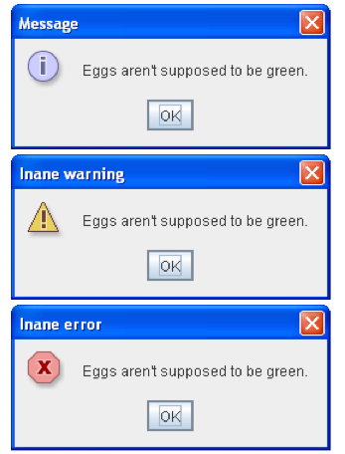
Top-level container: JDialog

Slide 13
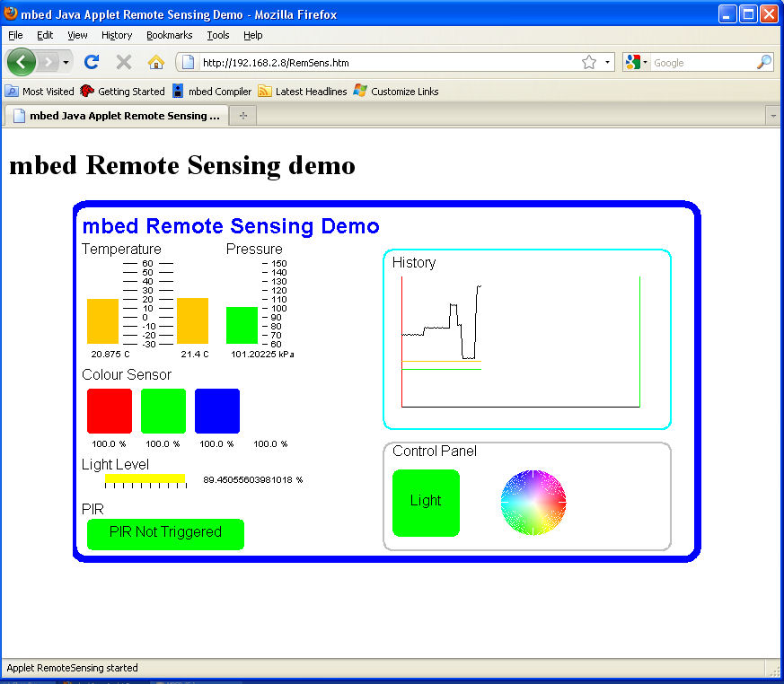
Top-level container: JApplet (deprecated)

Slide 14
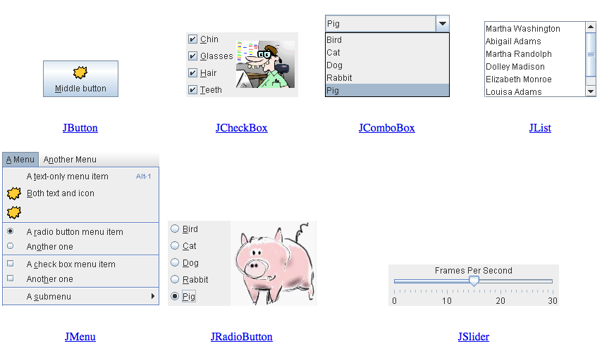
Components, a visual guide
http://web.mit.edu/6.005/www/sp14/psets/ps4/java-6-tutorial/components.html

Slide 15
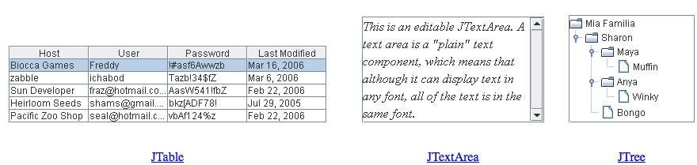

Components, a visual guide
http://web.mit.edu/6.005/www/sp14/psets/ps4/java-6-tutorial/components.html

Slide 16
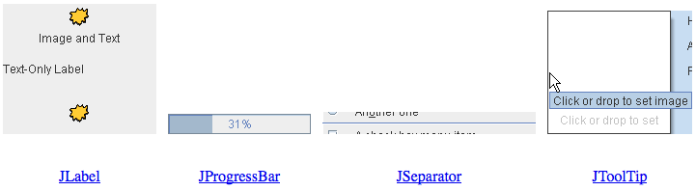
Components, a visual guide
http://web.mit.edu/6.005/www/sp14/psets/ps4/java-6-tutorial/components.html

Slide 17
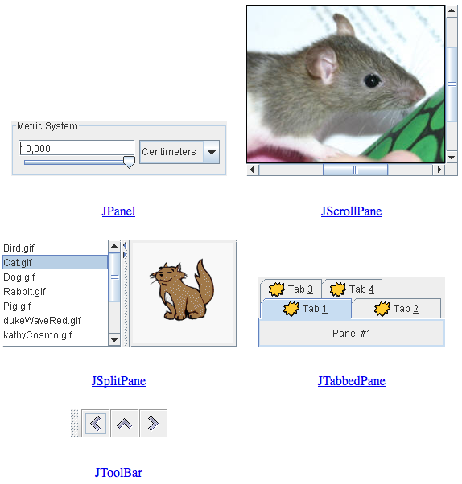
Components, a visual guide
http://web.mit.edu/6.005/www/sp14/psets/ps4/java-6-tutorial/components.html

Slide 18
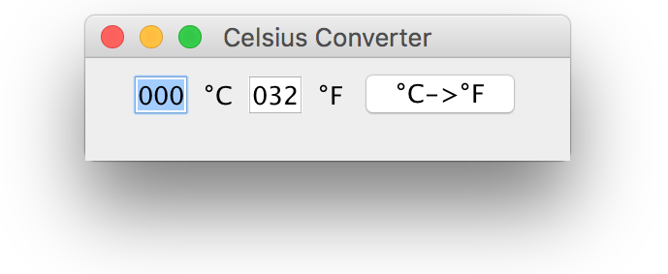
A complete example
public class CelsiusConverterBasic extends JFrame {
private static final long serialVersionUID = 1L;
private JButton CFButton;
private JTextField fahrenheitTF, celsiusTF;
public CelsiusConverterBasic() {
super("Celsius Converter");
celsiusTF = new JTextField("000");
fahrenheitTF = new JTextField("032");
CFButton = new JButton("°C->°F");
JPanel p1 = new JPanel();
p1.add(celsiusTF);
p1.add(new JLabel("°C"));
p1.add(fahrenheitTF);
p1.add(new JLabel("°F"));
p1.add(CFButton);
add(p1);
setDefaultCloseOperation(WindowConstants.EXIT_ON_CLOSE);
setSize(250, 75);
setVisible(true);
}
}

Slide 19
JFrame basic methods
setcontentpane(Container c)
sets the ContentPane. It is a a secondary container, usually a JPanel
add(Component c)
add a component to ContentPane
setDefaultCloseOperation(WindowConstants)
EXIT_ON_CLOSE
DO_NOTHING_ON_CLOSE
DISPOSE_ON_CLOSE
HIDE_ON_CLOSE
setSize(int base, int height)
defines the dimensions of the component
setVisible(boolean visibility)
defines the visibility status of the component

Slide 20
Running it!
// Ok
public static void main(String[] args) {
new CelsiusConverter();
}
// Better
public static void main(String[] args) {
EventQueue.invokeLater(new Runnable() {
@Override
public void run() {
new CelsiusConverter();
}
});
}

Slide 21
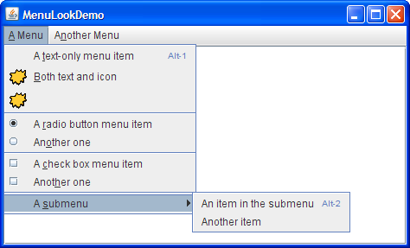
JFrame MenuBar

Slide 22
JFrame MenuBar
Three components are involved in a hierarchical fashion:
JMenuBar, JMenu, JMenuItem
JMenuItem openFile = new JMenuItem("Open");
JMenuItem closeFile = new JMenuItem("Close");
JMenu file = new JMenu("File");
file.add(openFile);
file.add(closeFile);
JMenuBar menuBar = new JMenuBar();
menuBar.add(file)
setJMenuBar(menuBar);

Slide 23
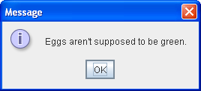
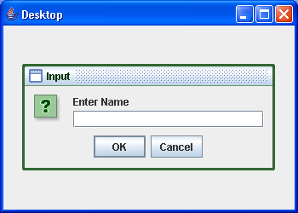
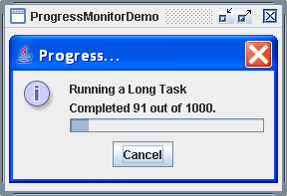
JDialog
Applications need to provide information, advise the user, etc.

Slide 24
JDialog
Dialogs are a better choice than instantiating other JFrames!
Every dialog is dependent on a top-level container.
Dialogs are all instances of JDialog, even though the majority is done using helper classes (e.g., JOptionPane).

Slide 25
How to make Dialogs
Specializing JDialog (top-level container) and defining your own layouts. Same principle as specializing JFrame.
Using JOptionPane. JOptionPane provides support for laying out standard dialogs, providing icons, specifying the dialog title and text, and customizing the button text.

Slide 26
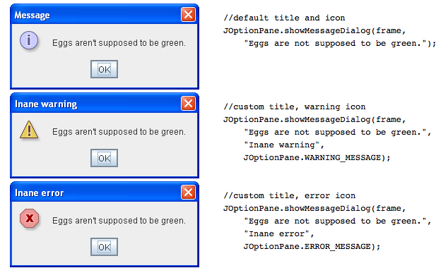
JOptionPane.showMessageDialog()

Slide 27
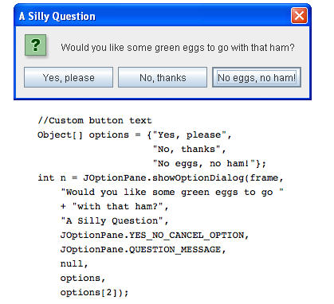
JOptionPane.showOptionDialog()
Displays a modal dialog with the specified buttons, icons, message, title, and so on. With this method, you can change the text that appears on the buttons of standard dialogs. You can also perform many other kinds
of customization.

Slide 28
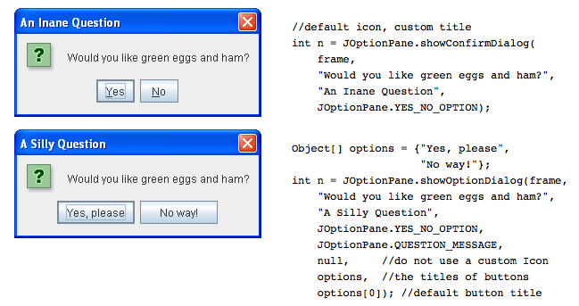
JOptionPane.showConfirmationDialog()

Slide 29
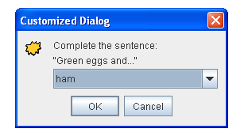
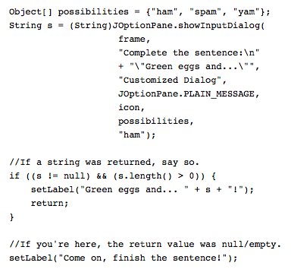
JOptionPane.showInputDialog()

Slide 30
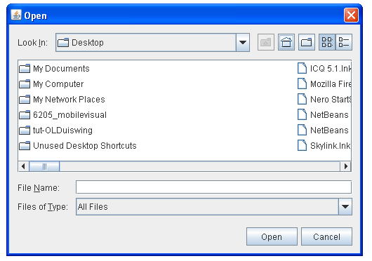
JFileChooser
Provides a GUI for navigating the file system
int result = fileChooser.showOpenDialog(Component parent);

Slide 31
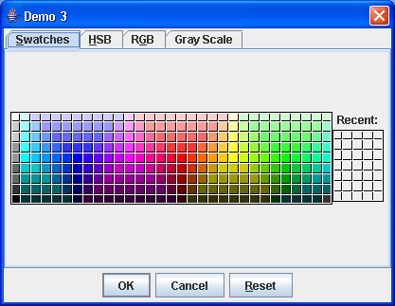
JColorChooser
Provides a GUI for navigating color spaces
Color c = JColorChooser.showDialog(Component parent, String title, Color initialColor)

Slide 32
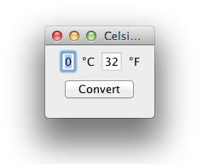
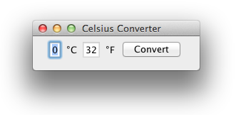
What is a layout?
Default GUIs, when resized, allow the automatic relocation of components:
this is a necessity: Java runs to many different platforms. Android, for example, runs on either 65” TVs or 6” smartphones (very different screen size!)

Slide 33
Layout Manager
A layout manager determines the disposal of the components in a container
Flow, Border, Grid, GridBag, Card Layouts
JPanels are containers supporting layouts
Different panels can have different layout managers
Layout managers are passed to JPanel constructor
Methodology:
JPanel p = new JPanel(new GridLayout(2,2));
p.add(JButton);

Slide 34
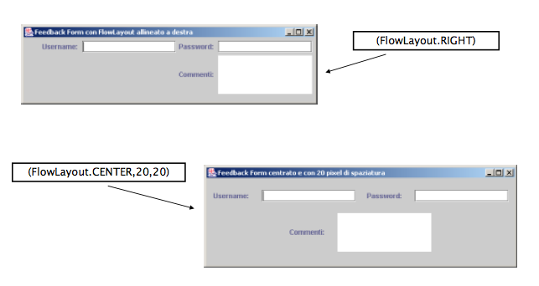
Layout Manager - FlowLayout

Slide 35
Layout Manager - FlowLayout
Default layout (i.e., new JPanel())
Disposes components from left to right
Constructors:
FlowLayout f = new FlowLayout();
FlowLayout f = new FlowLayout(int align);
FlowLayout f = new FlowLayout(int align, int hgap, int vgap);
Constructors parameters:
align: Alignment of basis (FlowLayout.LEFT, FlowLayout.RIGHT, FlowLayout.CENTER)
hgap: Horizontal space between components (default: 3 pixel)
vgap: Vertical space between components (default: 3 pixel)

Slide 36
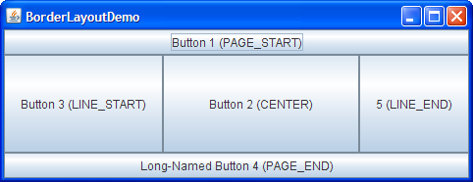
Layout Manager - BorderLayout

Slide 37
Layout Manager - BorderLayout
Splits into five areas (PAGE_START, PAGE_END, LINE_START, LINE_END, CENTER).
Constructors:
BorderLayout b = new BorderLayout();
BorderLayout b = new BorderLayout(int1, int2);
int1, int2 are the spaces between the components related horizontal and vertical
The filling is “targeted”:
JPanel p = new JPanel(new BorderLayout()); p.add(BorderLayout.PAGE_START, new JButton());
p.add(BoarderLayout.PAGE_END, new JButton());

Slide 38
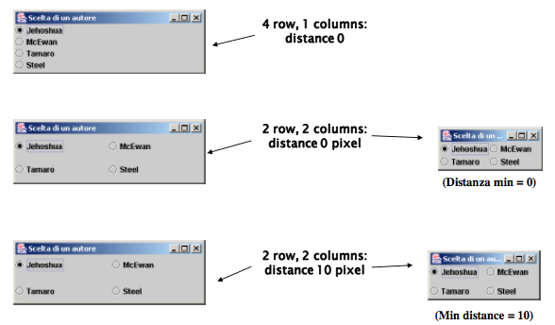
Layout Manager - GridLayout

Slide 39
Layout Manager - GridLayout
Splits the visual area in a grid of rows and columns
Starts from the box in the top left
Constructors:
GridLayout g = new GridLayout(int rows, int cols);
GridLayout g = new GridLayout(rows, cols, hgap, vgap);
Constructors parameters:
rows: number of row; cols: number of columns;
hgap: Spacing (in pixels) between two horizontal boxes (default: 0 pixel)
vgap: spacing (in pixel) between two vertical boxes (default: 0 pixel)

Slide 40
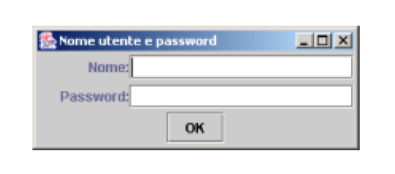
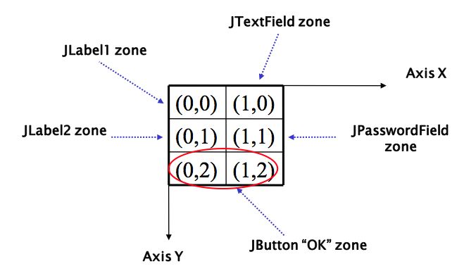
Layout Manager - GridBagLayout

Slide 41
Layout Manager - GridBagLayout
Extension of GridLayout. Makes it possible to adjust the elements of the grid
Methodology:
JPanel pane = new JPanel(new GridBagLayout());
GridBagConstraints c = new GridBagConstraints();
//For each component to be added to this container:
//...Create the component...
//...Set instance variables in the GridBagConstraints instance...
pane.add(theComponent, c);

Slide 42
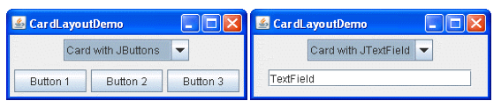
Layout Manager - CardLayout
CardLayout allows to have different panels in the frame, but only one showed at time
￼￼￼￼￼the panels are called cards
Methodology:
JPanel p = new JPanel(new CardLayout());
p.add(“Panel1”, new JPanel());
p.add(“Panel2”, new JPanel());

Slide 43
Java Swing Events
Università di Modena e Reggio Emilia
Prof. Nicola Bicocchi (nicola.bicocchi@unimore.it)

Slide 44
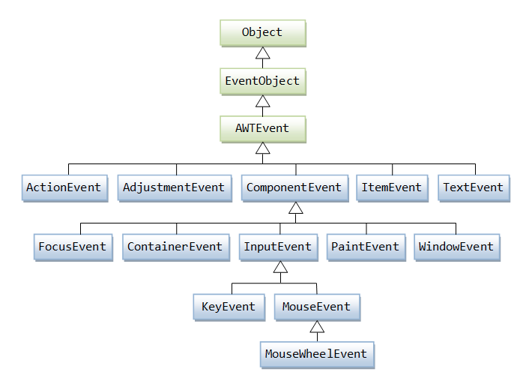
EventObject

Slide 45
Event Delegation Model
Events are classified by type
MouseEvent, KeyEvent, ActionEvent
Events are generated in components (source)
Listeners (target) can be registered to components
Whenever an event occurs, the event thread send a message to all the registered listeners (the event is passed as a parameter)
Listeners must implement appropriate interfaces to make the callback mechanism possible

Slide 46
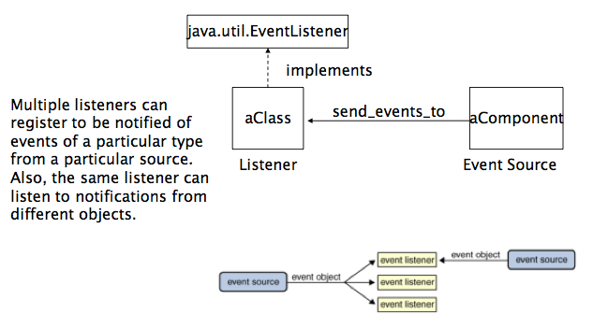
Event Delegation Model

Slide 47
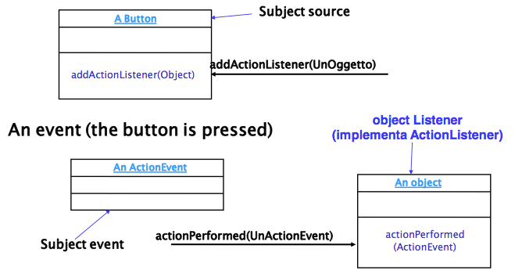
Example

Slide 48
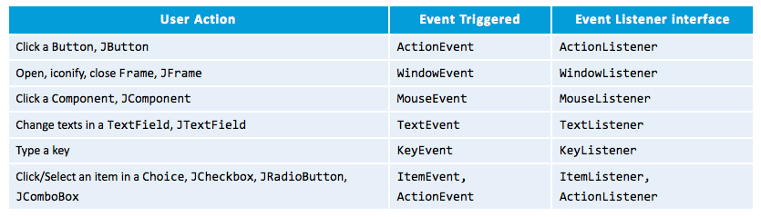
Event Delegation Model
Events are organized by type and need specific listeners

Slide 49
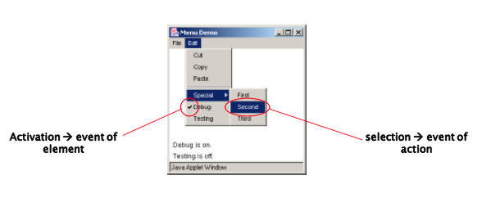
“selection” and “activation”

Slide 50
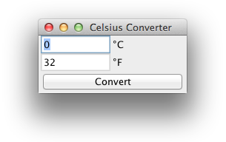
A complete example
import java.awt.*;
import java.awt.event.*;
import javax.swing.*;
public class CelsiusConverter extends JFrame implements ActionListener {
private JButton convertButton;
private JTextField fahrenheitLabel;
private JTextField tempTextField;
public CelsiusConverter() {
super("Celsius Converter");
tempTextField = new JTextField("0");
fahrenheitLabel = new JTextField("32");
fahrenheitLabel.setEditable(false);
convertButton = new JButton("Convert");
convertButton.addActionListener(this);
JPanel p = new JPanel();
p.setLayout(new GridLayout(2, 2));
p.add(tempTextField); p.add(new JLabel("°C"));
p.add(fahrenheitLabel); p.add(new JLabel("°F"));

Slide 51
A complete example
setLayout(new BorderLayout());
add(p, BorderLayout.CENTER);
add(convertButton, BorderLayout.SOUTH);
setDefaultCloseOperation(WindowConstants.EXIT_ON_CLOSE);
setSize(200, 100);
setVisible(true);
}
public void actionPerformed(ActionEvent e) {
int tempFahr = (int)
((Double.parseDouble(tempTextField.getText())) * 1.8 + 32);
fahrenheitLabel.setText(Integer.toString(tempFahr));
}
public static void main(String[] args) {
new CelsiusConverter();
}
}

Slide 52
How to manage events in Java
The principle underlying the events is quite similar to the exceptions :
the receivers declare which event are able to deal with (one or more) by implementing the needed interfaces
the components that are source of events (JButton, JTextField, etc..) select their receivers
button.addActionListener(receiver)
Pay attention! You're implementing interfaces, so you must implement all methods of those interfaces!

Slide 53
How to manage events in Java
Components can:
Handle events on their own
In case of large number of components
Delegate events to their container
In case of small/medium number of components
Delegate events to external classes
Rarely used (produces unneeded classes)

Slide 54
Handle events on their own
JButton btn = new Jbutton();
btn.addActionListener(new ActionListener() {
@Override
public void actionPerformed(ActionEvent e) {
// do something
}});

Slide 55
Delegate events to their container
class FrameWithEvents extends JFrame implements InterfaceWithEvents {
JComponent componentSourceofEvents = new JComponent();
componentSourceOfEvents.addListener(this);
void methodOfTheInterfaceWithEvents() {...}
void anotehrMethodOfTheInterfaceWithEvents() {...}
}

Slide 56
Delegate events to external classes
class MyListener implements InterfaceWithEvents {
void methodOfTheInterfaceWithEvents() {...}
void anotehrMethodOfTheInterfaceWithEvents() {...}
} //end class
class Frame extends JFrame {
MyListener listener = new MyListener();
JComponent componentSourceofEvents = new JComponent();
componentSourceOfEvents.addListener(listener);
} //end class

Slide 57
Dealing with multiple sources
getSource() and object references
if (e.getSource() == buttonSelfDestruction ) {}
getActionCommand() and custom strings
If (e.getActionCommand() == “destroy”) {}
Event classes
If (e instanceof(KeyEvent)) {}

Slide 58
Event Interfaces
ActionListener
void actionPerformed (ActionEvent evt)
FocusListener
void focusGained (FocusEvent evt)
void focusLost (FocusEvent evt)
ItemListener
void itemStateChanged (ItemEvent evt)

Slide 59
Event Interfaces
MouseListener
void mouseClicked (MouseEvent evt)
void mouseEntered (MouseEvent evt)
void mouseExited (MouseEvent evt)
void mousePressed (MouseEvent evt)
void mouseReleased (MouseEvent evt)
MouseMotionListener
void mouseDragged (MouseEvent evt)
void mouseMoved (MouseEvent evt)

Slide 60
Event Interfaces
KeyListener
void keyPressed (KeyEvent evt)
void keyReleased(KeyEvent evt)
void keyTyped(KeyEvent evt)
WindowListener
void windowActivated(WindowEvent evt)
void windowClosed (WindowEvent evt)
void windowClosing (WindowEvent evt)
void windowDeactivated (WindowEvent evt)
void windowDeiconified (WindowEvent evt)
void windowIconified (WindowEvent evt)
void windowOpened (WindowEvent evt)

