Slide 1

GENERIC QUEUE IN C++
September 27th
Embedded and Real Time Systems
Project by: Diego Mercoliano & Andrea Aguzzoli

Slide 2
SUMMARY
Class Queue
Synchronization strategy
C++ main function
PyBind11
Python Wrapper
Python main function

Slide 3
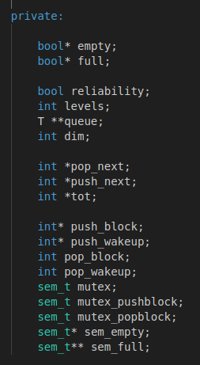

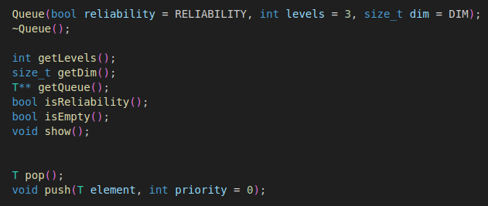



CLASS QUEUE
}
Array for check if a priority level is empty/full or not
Constructor and Destructor
}
{
Variabiles with queue’s informations:
QoS type (reliability or not), priority levels, the queue and the size of each priority level.
{
}
The index of the next item (or space) to be taken (or filled) for each priority level. In addition, the item count for each priority level.
Getters
}
Methods for interacting with queue
{
AND SO ON...
Variabiles for synchronization stuffs

Slide 4
SYNCHRONIZATION STRATEGY
If we need to guarantee the insertion/picking on the queue (which means to satisfy the reliability QoS) is necessary to be able to manage synchronization problems.
In this case we are faced with an example of Producer/Consumer paradigm.

