Slide 1
Analyzing Amazon Books Reviews
University of Pavia
Data Science and Big data Analytics
course
Davide Ligari
Andrea Alberti
Cristian Andreoli

Slide 2
Dataset
Kaggle dataset
Two tables: Books data and Ratings
Size: 3.86 GB
Around 3 millions of reviews
Ethical considerations
Data Table Schema:
Title
Description
Authors
Image
previewLink
Publisher
publishedDate
infoLink
categories
ratingsCount
Ratings Table Schema:
Id
Title
Price
User_id
profileName
review/helpfulness
review/score
review/time
review/summary
review/text

Slide 3
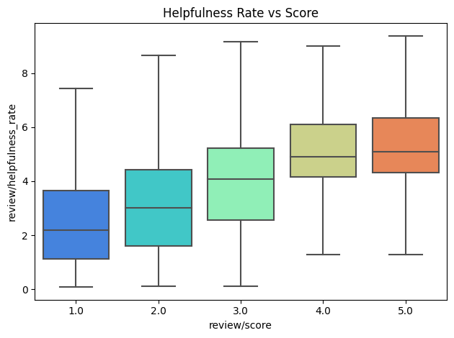
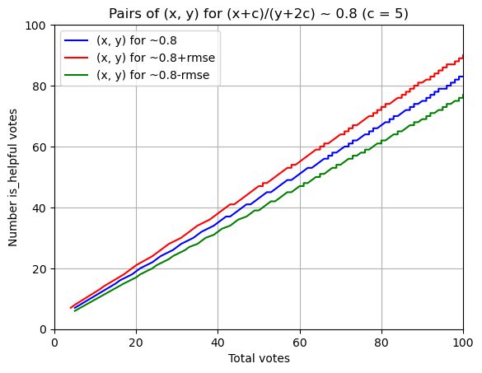
Framing: Our Objectives
Providing a scalable solution to the dataset exploration and analysis
Developing a machine learning model able to predict the helpfulness of a review looking at its content

Slide 4

Workflow
Load to HDFS
Prior Analysis
Data Cleaning
SandBox Creation
MapReduce

Slide 5
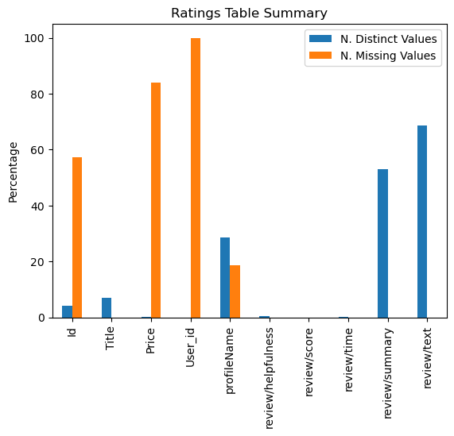
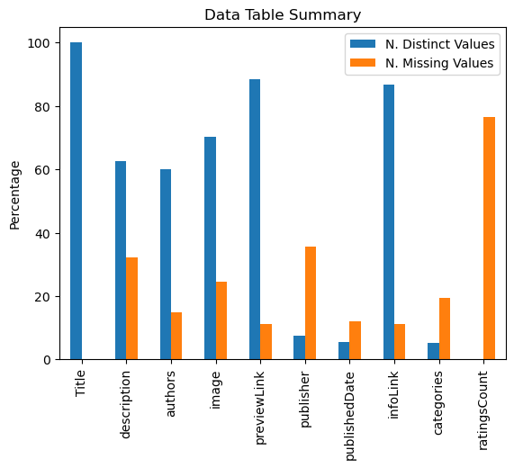
Prior Analysis

Slide 6
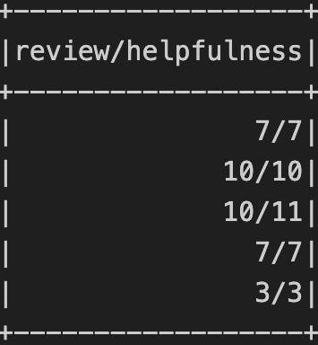
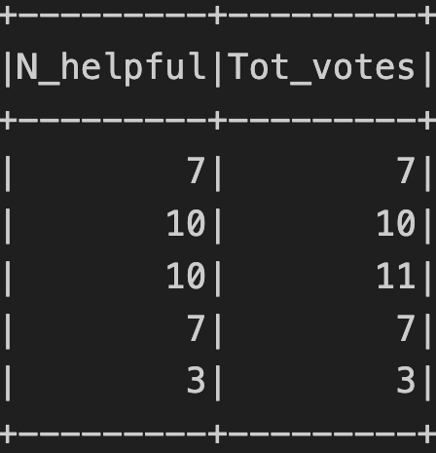
Data Cleaning
Methodology
Duplicates deletion
Unuseful columns deletion (those containing links)
‘Dangerous’ symbols deletion
‘Helpfulness’ columns splitting

Slide 7
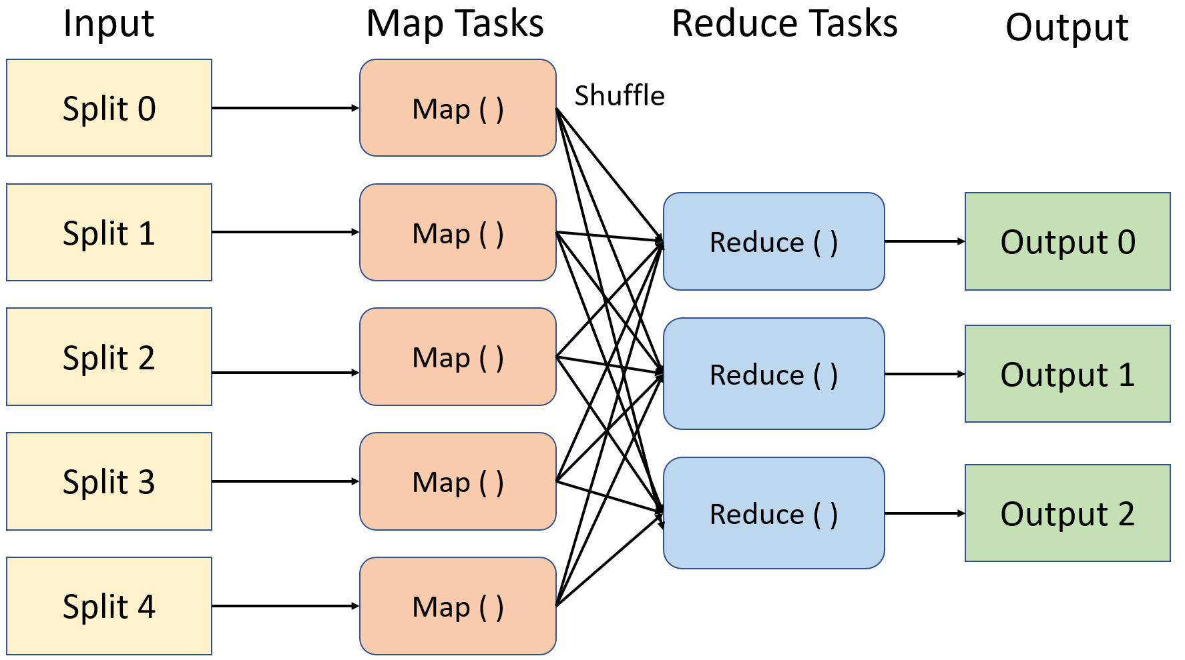
MapReduce Job
Join the two tables
Mapper creates a key-value structure
Double key sorting (Title, second field)
Reducer performs the join
The table is stored in Hadoop

Slide 8
SandBox Creation
# Connect to MongoDB
import pymongo
client = pymongo.MongoClient('mongodb://localhost:27017/')
database = client['spark_db']
books = database['books_joined']
reviews = database['book_reviews’]
# Load the data
df_joined = spark.read.csv("hdfs://localhost:9900/user/book_reviews/joined_tables",
header=True, schema=joined_schema, sep='\t’)
# Select a random subset of the big data to import
N_to_sample = 300000
df_sample = df_joined.sample(withReplacement = False, fraction = N_to_sample/df_joined.count(), seed = 42)
# Convert to a dictionary
df_sample_dict = df_sample.toPandas().to_dict(orient='records')
# Insert into MongoDB
books.insert_many(df_sample_dict)
Methodology
MongoDB query to get data ready for analysis
SciPy to compute metrics
Pandas data manipulation
Seaborn and Matplotlib for graphs

Slide 9
Hypothesis Testing
# Remove the samples which have no score or helpfulness data
pipeline_remove =
{'$match’:{
'review/score':{'$exists':True},
'N_helpful' :{'$exists':True, '$ne':0},
'Tot_votes' :{'$exists':True, '$ne':0}
}
}
# Retain only the required fields
pipeline_project =
{'$project’:{
'review/score':1,
'review/helpfulness_rate’:{
'$multiply’:[
{'$divide':['$N_helpful','$Tot_votes']},
{'$sqrt':'$Tot_votes’}
]
},
'_id':0,
'Tot_votes':1,
'N_helpful’:1
}
}
books_data = books.aggregate([pipeline_remove,pipeline_project])
Methodology
MongoDB query to get data ready for analysis
SciPy to compute metrics
Pandas data manipulation
Seaborn and Matplotlib for graphs

Slide 10
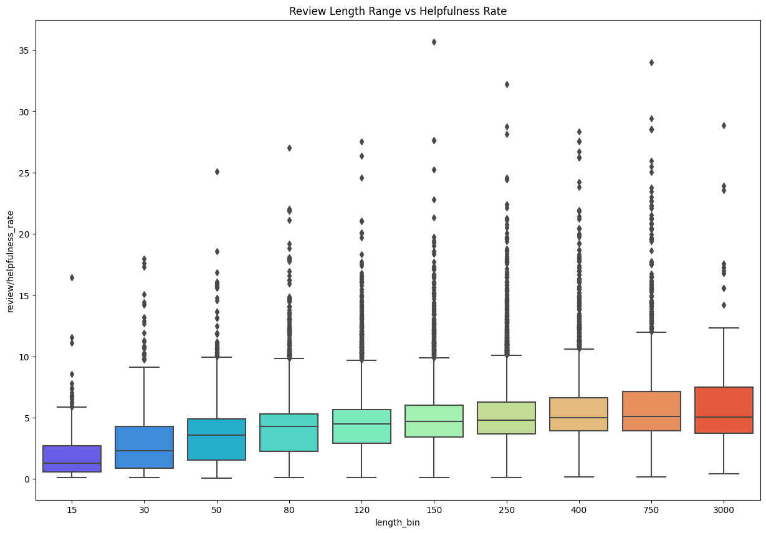

Hypothesis 1
Is the helpfulness correlated to the length of the review?
$$helpfulness score=\frac{x}{y}\sqrt{y}$$
Spearman's correlation value: 0.331
P-value < 0.05

Slide 11
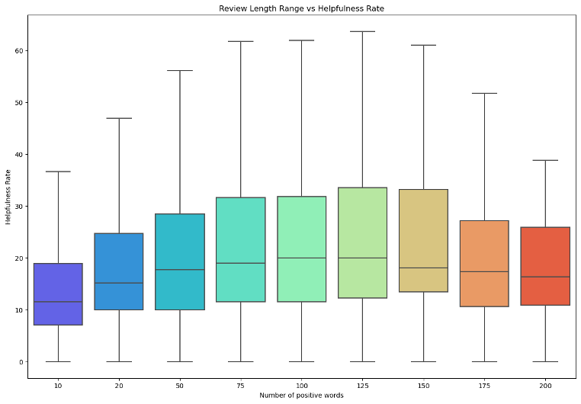

Hypothesis 2
Is the number of positive words correlated to helpfulness?
$$Multinomial NBC : →top 800 positive words$$
Spearman's correlation value: 0.318
P-value < 0.05

Slide 12

Hypothesis 3
Is there correlation between rating score and helpfulness?
$$Tot votes<20 →leads to bias$$
Spearman's correlation value: 0.525
P-value < 0.05

Slide 13
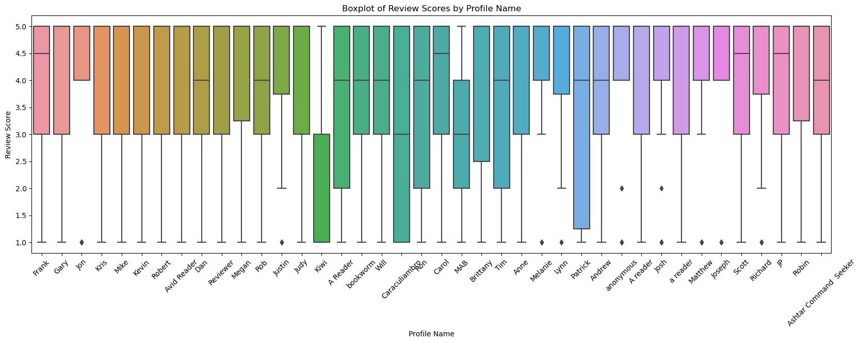


Hypothesis 4
$$ANOVA test$$
Is the rating score influenced by the user?
$$N. reviews<20 →leads to bias$$
F-statistic: 1.537
P-value: 0.067

Slide 14
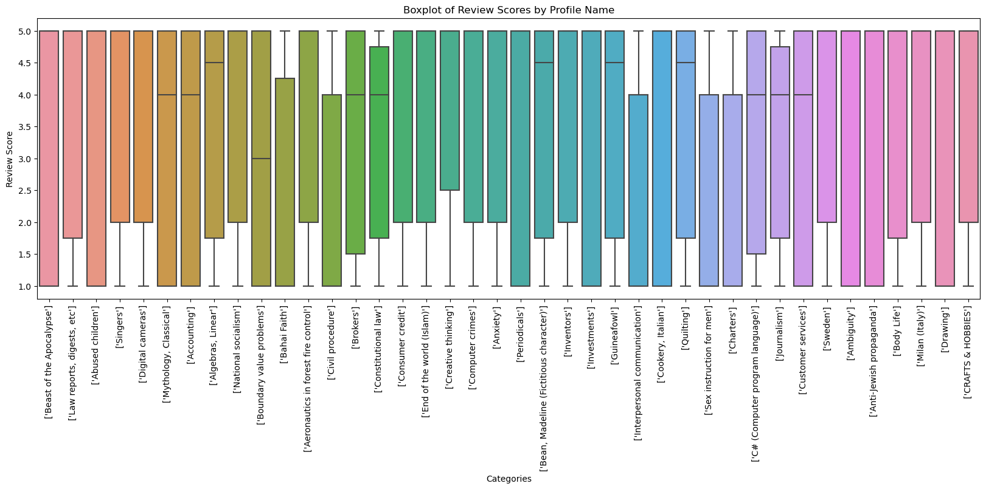


Hypothesis 5
$$ANOVA test$$
Is the rating score influenced by the category of a book?
$$N. reviews<20 →leads to bias$$
F-statistic: 0.177
P-value: 0.999

Slide 15
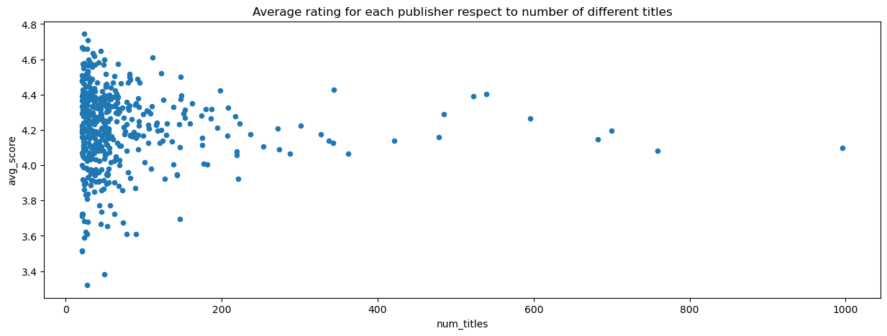

Hypothesis 6
Is there correlation between the number of books by a publisher and the review score?
$$N. books<20 →leads to bias$$
Spearman’s: -0.067
P-value: 0.151

Slide 16
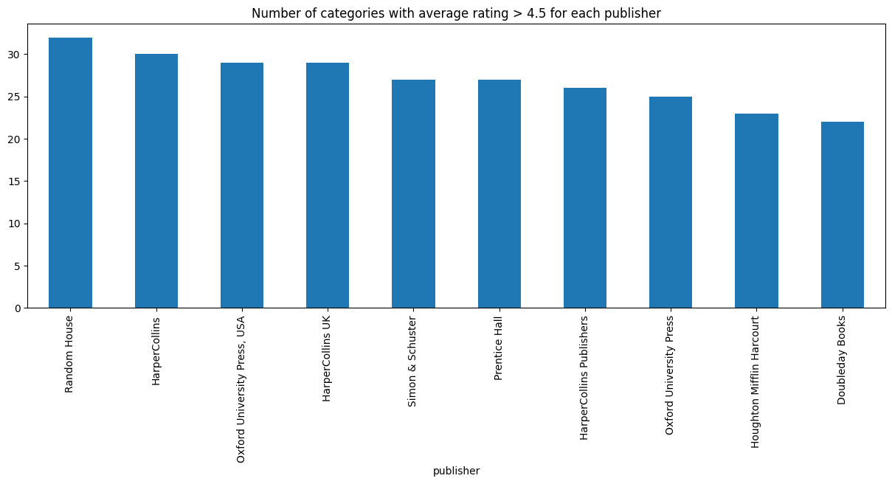

Curiosity
Which are the best publishers?
In which category are the best publishers focused?
$$Complex MongoDB query$$
Notes:
During the testing of hypothesis 6, two curiosities came to our mind:
- quest 1
- quest 2
To answer both question we used a mongo DB query based on double id grouping.
We defined the best publishers as those getting a score greater than 4.5 in a large number of categories and in the figure are depicted the top 10 publishers and almost all of them are American.

Slide 17
Real Scenario
Goals
Provide scalable solution
Prove results consistency
Tools
Spark DataFrame
Pyspark.ml
Hypothesis 1
Hypothesis 2
Hypothesis 3
 | Spearman Coeff
Hadoop | 0.361
Sandbox | 0.331
 | Spearman Coeff
Hadoop | 0.318
Sandbox | 0.318
 | Spearman Coeff
Hadoop | 0.527
Sandbox | 0.525
Notes:
Since our goal was that of providing a scalable solution for the dataset analysis and we wanted also to prove our results consistency, we implemented some hypothesis analysis also on spark, to make them suitable for a big data context.
We used the spark dataframe API in Python and the Machine Learning library.
In particular we focused on the implementation of the first three hypotheses and as the tables show the results are consistent with the one we got in the sandbox.

Slide 18
Helpfulness Prediction
Features Extraction
Model Selection
Best Model Analysis
Notes:
The second goal of our analysis was that of building a model able of predicting the helpfulness of a review, just by looking at its content.
To do that we performed the theee steps in figure, so feature extraction, model selection and best model analysis.

Slide 19
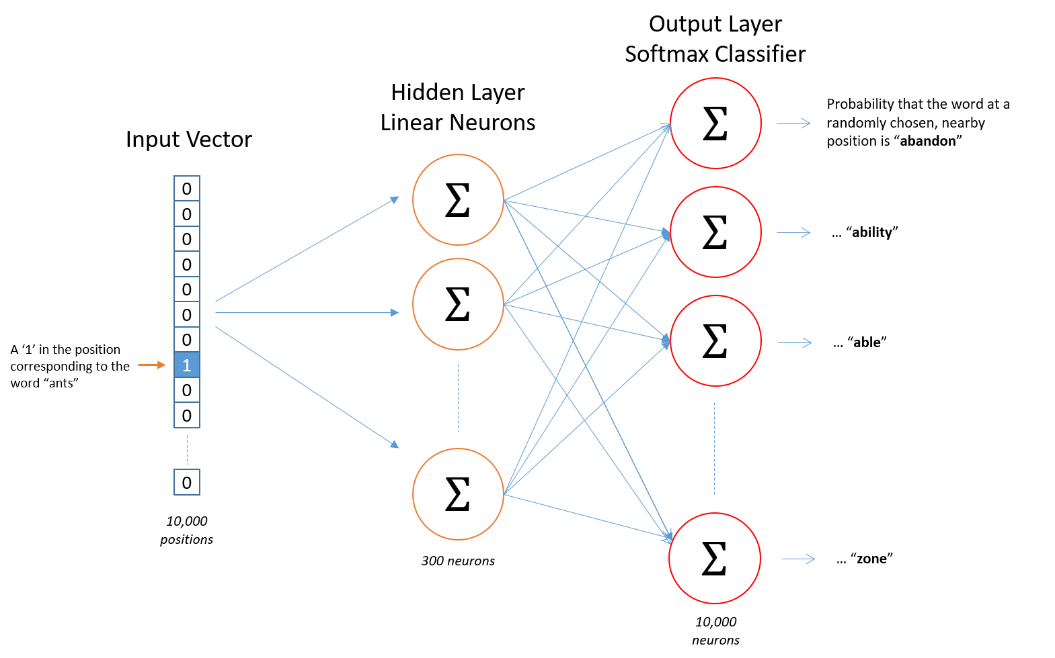
Features Extraction
Creation steps
Word2Vec from Gensim
Size = 30, Window = 5, Min count = 2
Size = 150, Window = 5, Min count = 2
Review = average of contained words
Notes:
Since the task is quite complex, we decided to discard a simple bow encoding in favor of a more sophisticated word embedding one with the goal of providing the model with information about context and relations between words.
We used the word2vec model from Gensim library and we created two embeddings with different feature size.
As a result each word is represented by a vector of 30 and 150 fratures and thereby the review is the average of all the contained words.

Slide 20
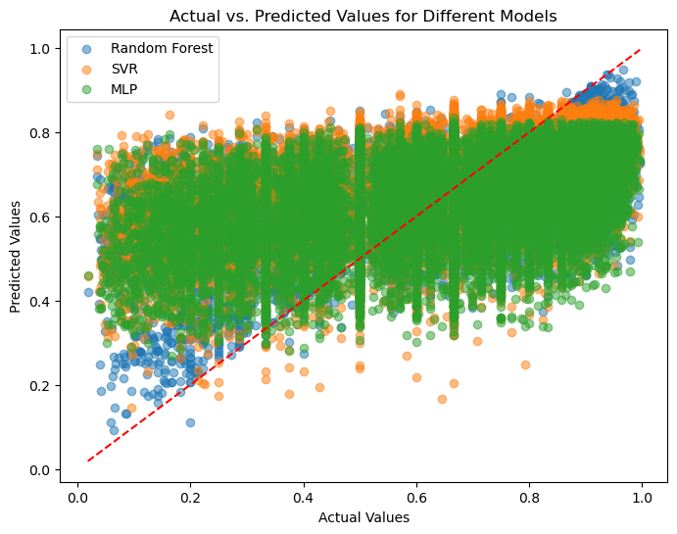
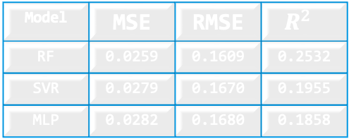
Model Selection
Trained Models
Random Forest Regressor
Support Vector Regressor
MLP Neural Network
GridSearchCV → Hyperparameters selection
Model | MSE | RMSE | $$R^{2}$$
RF | 0.0259 | 0.1609 | 0.2532
SVR | 0.0279 | 0.1670 | 0.1955
MLP | 0.0282 | 0.1680 | 0.1858
Notes:
Since the problem was a regression one we trained three models on a subset of 240000 samples due to time reasons, the models are:
- 1
- 2
- 3
To evaluate and compare them we used GridSearchCv that perform train a model trying all the combination of hyperparameters and eventually evaluate the best according to the results of cross validation.
As the figure shows, the best one was the random forest.

Slide 21
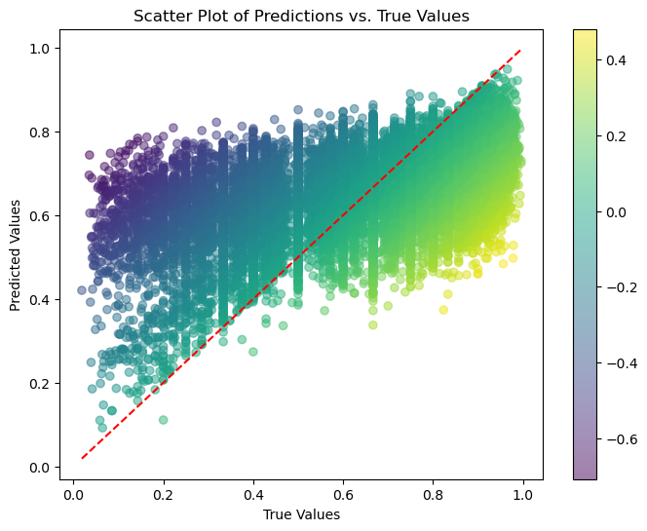
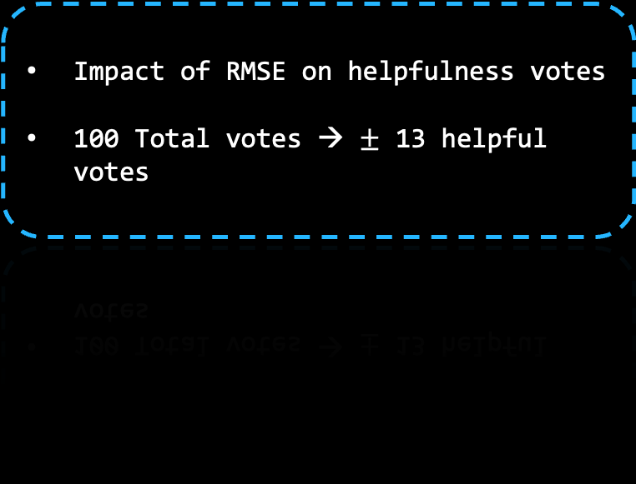
Best Model: Random Forest
Size = 150 small improvement
Underestimate when low and Overestimate when high
Impact of RMSE on helpfulness votes
100 Total votes → $±$ 13 helpful votes
Notes:
From the analysis of the best model we can see that it tends to overestimate the results when the score is high and underestimate when the score is low.
We individuated the feature engineering task, especially on the target variable, as a possible explanation but a deeper analysis of the causes is left as a future task.
On the right instead we can see a translation of the results in more understandable terms, showing the couple total votes, helpful votes associated to a given score. Our model on a base of 100 votes provides a results that can exceed or underestimate the real number of helpeful votes by 13.

Slide 22
Conclusions
Importance of Scalable Systems: Emphasizes the significance of scalable systems in data analysis.
Review Length and Sentiment: Longer reviews, especially the ones with positive words, tend to be more useful, but excessively long reviews can be tedious.
User Preference for Positive Reviews: Users find positive reviews more helpful.
Objective User Ratings: User ratings appear to be unbiased and reflect objective evaluations of books.
Experience vs. Appreciation: The experience of publishers does not necessarily correlate with higher appreciation from users.
Future Work: Indicates a focus on feature engineering to enhance the model's performance.

Slide 23
THANK YOU!

