Slide 1
Analyzing Amazon Books Reviews
University of Pavia
Data Science and Big data Analytics
course
Davide Ligari
Andrea Alberti
Cristian Andreoli

Slide 2
Dataset
Kaggle dataset
Two tables: Books data and Ratings
Size: 3.86 GB
Around 3 millions of reviews
Ethical considerations
Data Table Schema:
Title
Description
Authors
Image
previewLink
Publisher
publishedDate
infoLink
categories
ratingsCount
Ratings Table Schema:
Id
Title
Price
User_id
profileName
review/helpfulness
review/score
review/time
review/summary
review/text

Slide 3
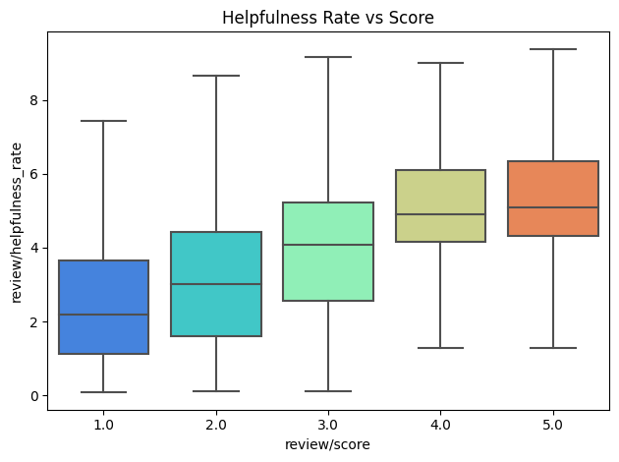
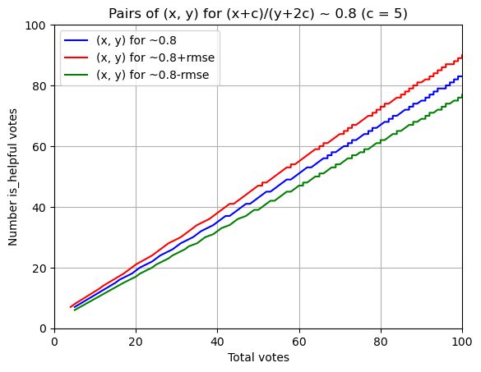
Framing: Our Objectives
Providing a scalable solution to the dataset exploration and analysis
Developing a machine learning model able to predict the helpfulness of a review looking at its content

Slide 4

Workflow
Load to HDFS
Prior Analysis
Data Cleaning
SandBox Creation
MapReduce

Slide 5
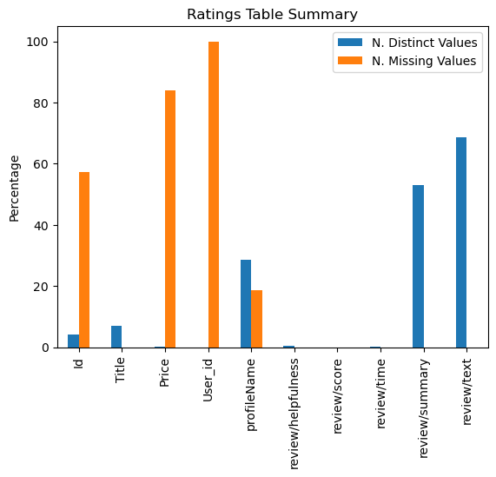
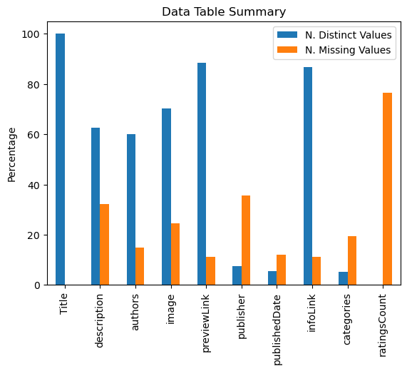
Prior Analysis

Slide 6
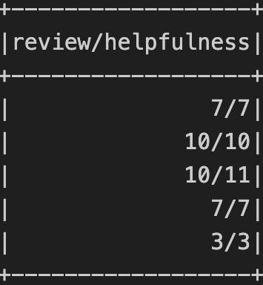
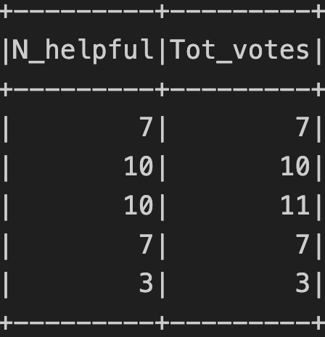
Data Cleaning
Methodology
Duplicates deletion
Unuseful columns deletion (those containing links)
‘Dangerous’ symbols deletion
‘Helpfulness’ columns splitting

Slide 7
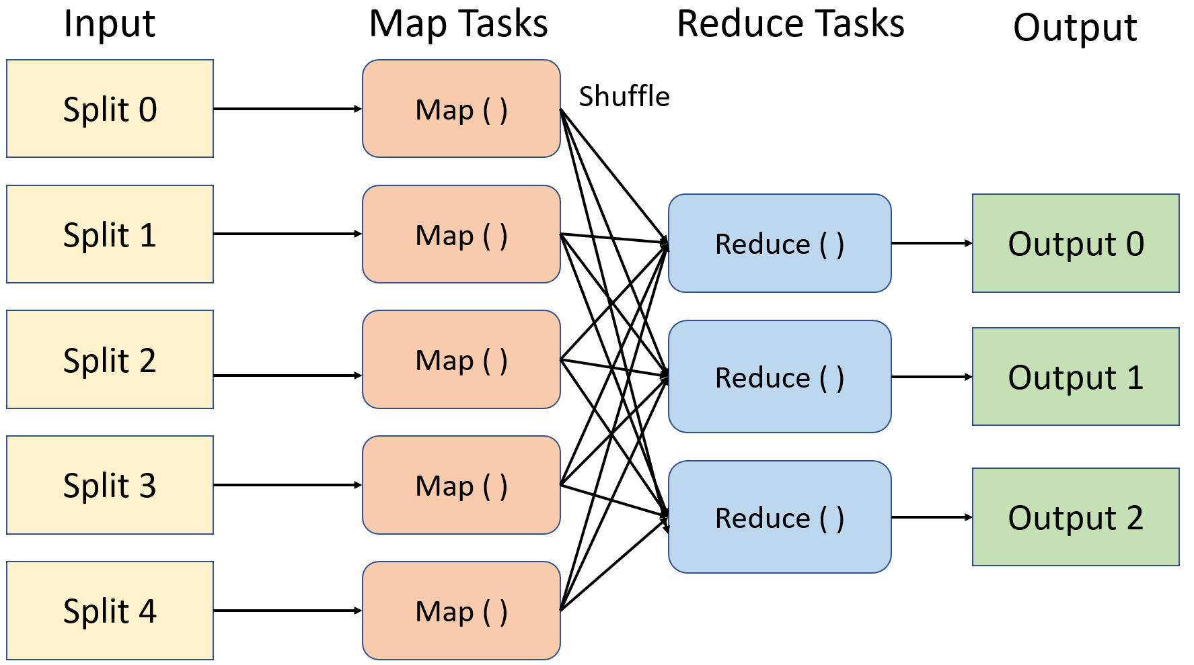
MapReduce Job
Join the two tables
Mapper creates a key-value structure
Double key sorting (Title, second field)
Reducer performs the join
The table is stored in Hadoop

Slide 8
SandBox Creation
# Connect to MongoDB
import pymongo
client = pymongo.MongoClient('mongodb://localhost:27017/')
database = client['spark_db']
books = database['books_joined']
reviews = database['book_reviews’]
# Load the data
df_joined = spark.read.csv("hdfs://localhost:9900/user/book_reviews/joined_tables",
header=True, schema=joined_schema, sep='\t’)
# Select a random subset of the big data to import
N_to_sample = 300000
df_sample = df_joined.sample(withReplacement = False, fraction = N_to_sample/df_joined.count(), seed = 42)
# Convert to a dictionary
df_sample_dict = df_sample.toPandas().to_dict(orient='records')
# Insert into MongoDB
books.insert_many(df_sample_dict)
Methodology
MongoDB query to get data ready for analysis
SciPy to compute metrics
Pandas data manipulation
Seaborn and Matplotlib for graphs

Slide 9
Hypothesis Testing
# Remove the samples which have no score or helpfulness data
pipeline_remove =
{'$match’:{
'review/score':{'$exists':True},
'N_helpful' :{'$exists':True, '$ne':0},
'Tot_votes' :{'$exists':True, '$ne':0}
}
}
# Retain only the required fields
pipeline_project =
{'$project’:{
'review/score':1,
'review/helpfulness_rate’:{
'$multiply’:[
{'$divide':['$N_helpful','$Tot_votes']},
{'$sqrt':'$Tot_votes’}
]
},
'_id':0,
'Tot_votes':1,
'N_helpful’:1
}
}
books_data = books.aggregate([pipeline_remove,pipeline_project])
Methodology
MongoDB query to get data ready for analysis
SciPy to compute metrics
Pandas data manipulation
Seaborn and Matplotlib for graphs

Slide 10
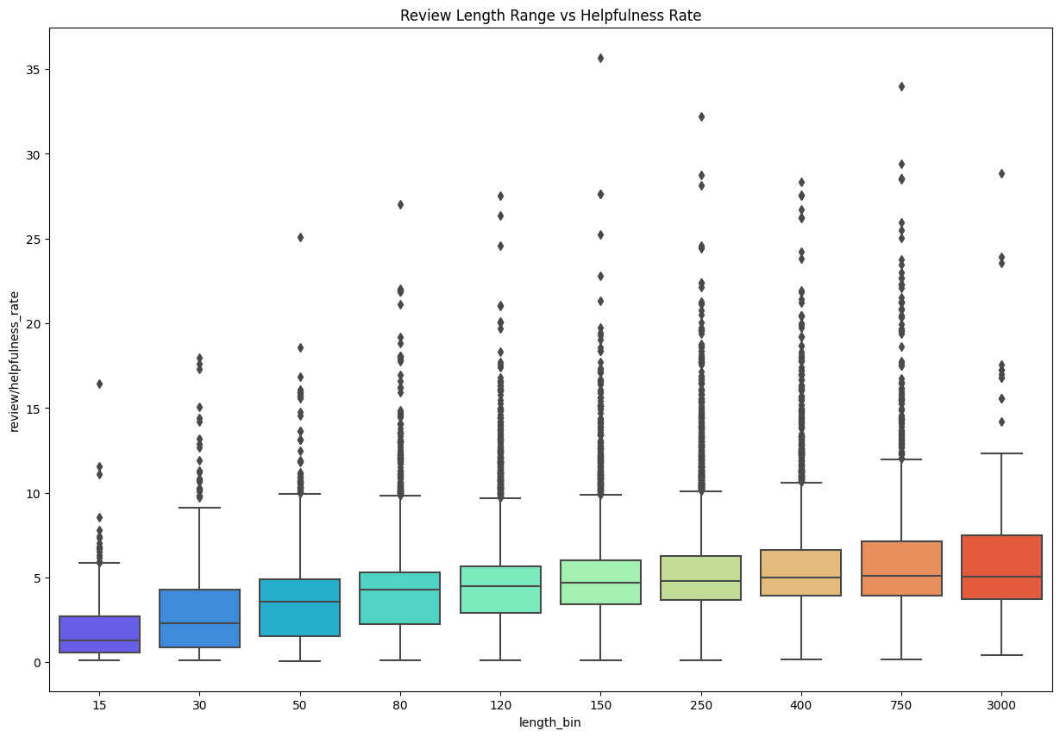

Hypothesis 1
Is the helpfulness correlated to the length of the review?
$$helpfulness score=\frac{x}{y}\sqrt{y}$$
Spearman's correlation value: 0.331
P-value < 0.05

Slide 11
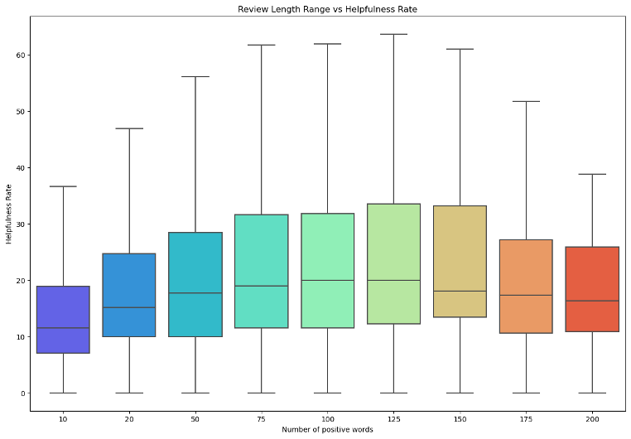

Hypothesis 2
Is the number of positive words correlated to helpfulness?
$$Multinomial NBC : →top 800 positive words$$
Spearman's correlation value: 0.318
P-value < 0.05

Slide 12

Hypothesis 3
Is there correlation between rating score and helpfulness?
$$Tot votes<20 →leads to bias$$
Spearman's correlation value: 0.525
P-value < 0.05

Slide 13
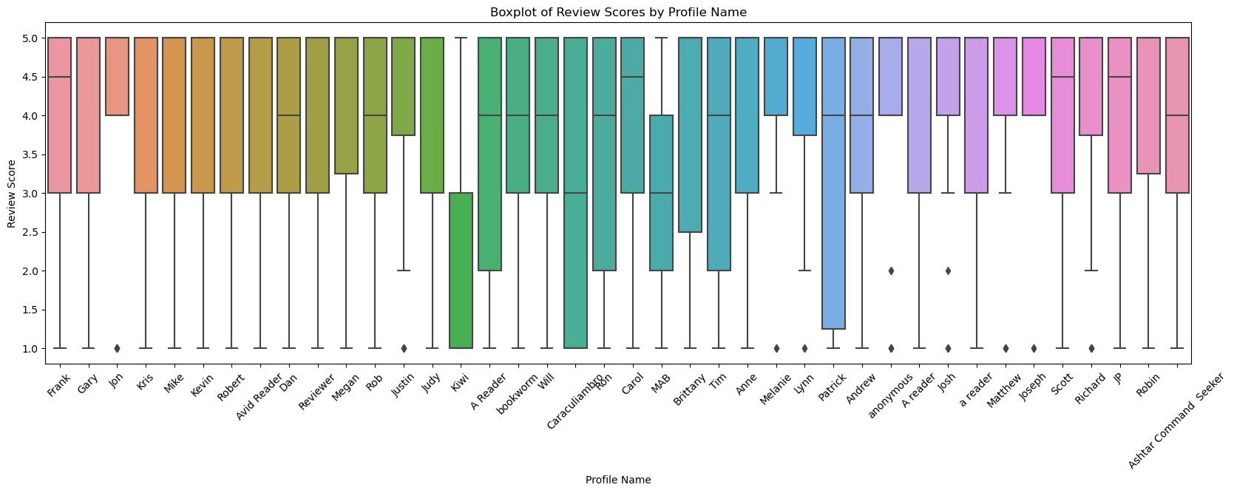


Hypothesis 4
$$ANOVA test$$
Is the rating score influenced by the user?
$$N. reviews<20 →leads to bias$$
F-statistic: 1.537
P-value: 0.067

Slide 14
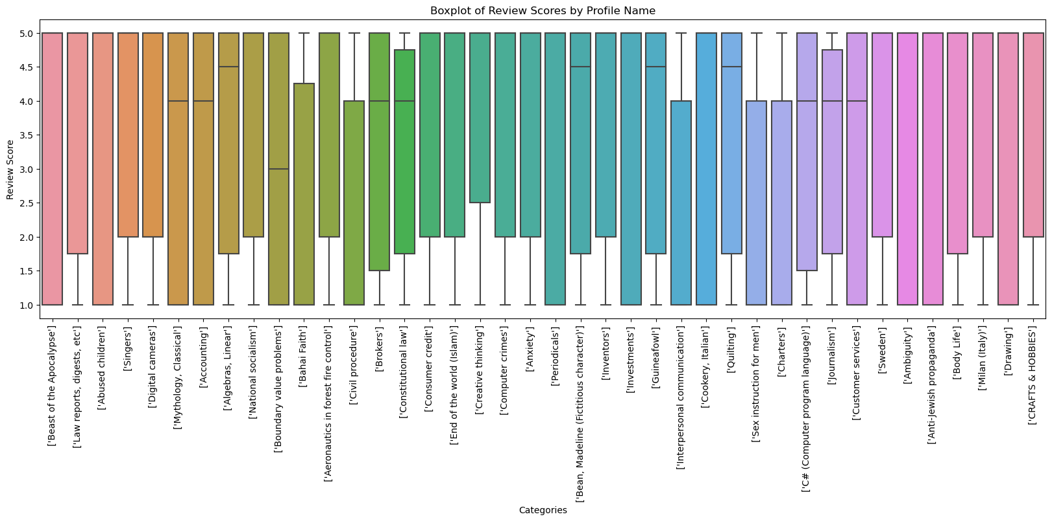


Hypothesis 5
$$ANOVA test$$
Is the rating score influenced by the category of a book?
$$N. reviews<20 →leads to bias$$
F-statistic: 0.177
P-value: 0.999

Slide 15
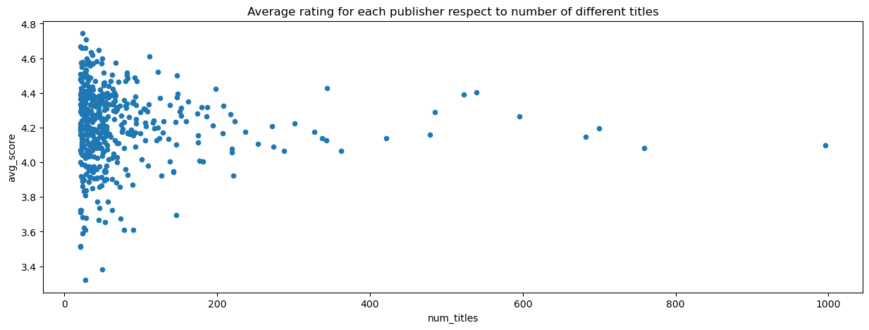

Hypothesis 6
Is there correlation between the number of books by a publisher and the review score?
$$N. books<20 →leads to bias$$
Spearman’s: -0.067
P-value: 0.151

Slide 16
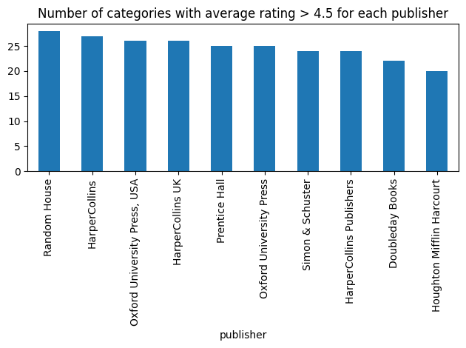

Curiosity
Which are the best publishers?
In which category are the best publishers focused?
$$Complex MongoDB query$$

Slide 17
Real Scenario
Goals
Provide scalable solution
Prove results consistency
Tools
Spark DataFrame
Pyspark.ml
Hypothesis 1
Hypothesis 2
Hypothesis 3
 | Spearman Coeff
Hadoop | 0.361
Sandbox | 0.331
 | Spearman Coeff
Hadoop | !!!!!!!!!!!
Sandbox | 0.318
 | Spearman Coeff
Hadoop | 0.527
Sandbox | 0.525

Slide 18
Helpfulness Prediction
Features Extraction
Model Selection
Best Model Analysis

Slide 19
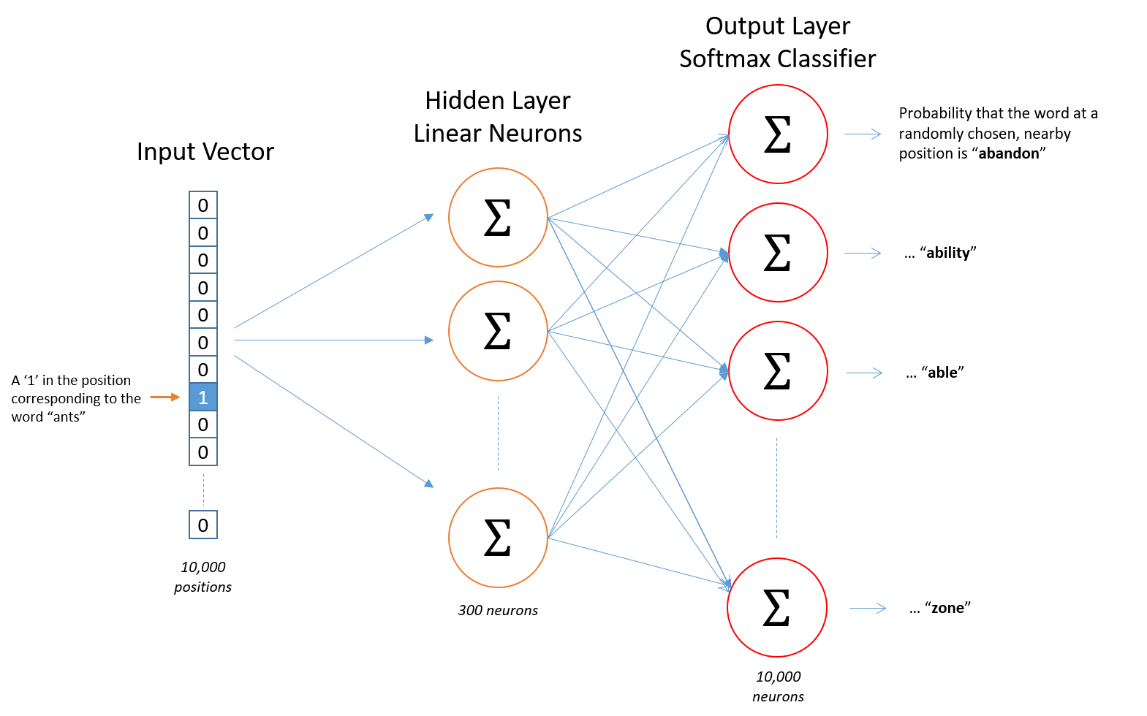
Features Extraction
Creation steps
Word2Vec from Gensim
Size = 30, Window = 5, Min count = 2
Size = 150, Window = 5, Min count = 2
Review = average of contained words

Slide 20
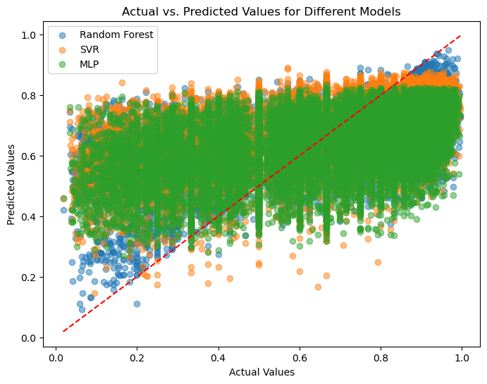
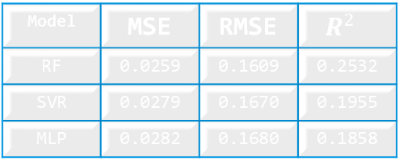
Model Selection
Trained Models
Random Forest Regressor
Support Vector Regressor
MLP Neural Network
GridSearchCV → Hyperparameters selection
Model | MSE | RMSE | $$R^{2}$$
RF | 0.0259 | 0.1609 | 0.2532
SVR | 0.0279 | 0.1670 | 0.1955
MLP | 0.0282 | 0.1680 | 0.1858

Slide 21
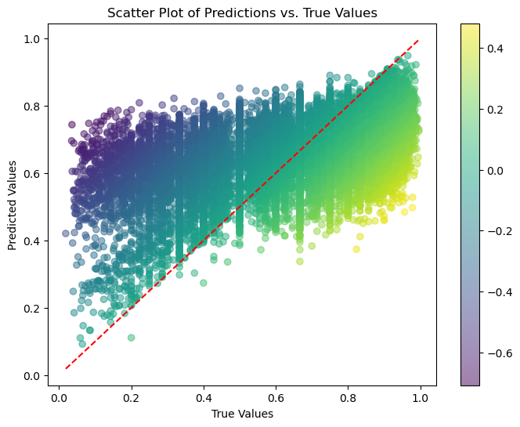

Best Model: Random Forest
Size = 150 small improvement
Overestimate when low and Underestimate when high
Impact of RMSE on helpfulness votes
100 Total votes → $±$ 13 helpful votes

Slide 22
Conclusions
Importance of Scalable Systems: Emphasizes the significance of scalable systems in data analysis.
Review Length and Sentiment: Longer reviews, especially the ones with positive words, tend to be more useful, but excessively long reviews can be tedious.
User Preference for Positive Reviews: Users find positive reviews more helpful.
Objective User Ratings: User ratings appear to be unbiased and reflect objective evaluations of books.
Experience vs. Appreciation: The experience of publishers does not necessarily correlate with higher appreciation from users.
Future Work: Indicates a focus on feature engineering to enhance the model's performance.

Slide 23
THANK YOU!

