Slide 1
Analyzing Amazon Books Reviews
University of Pavia
Data Science and Big data Analytics
course
Davide Ligari
Andrea Alberti
Cristian Andreoli

Slide 2
Dataset
Data Table Schema:
Title
Description
Authors
Image
previewLink
Publisher
publishedDate
infoLink
categories
ratingsCount
Ratings Table Schema:
Id
Title
Price
User_id
profileName
review/helpfulness
review/score
review/time
review/summary
review/text
Kaggle dataset
Two tables : Books data and Ratings
3.86 GB
Around 3 millions of reviews
Ethical considerations

Slide 3

Data ingestion
Load to HDFS
Data cleaning
MapReduce
Sandbox creation

Slide 4
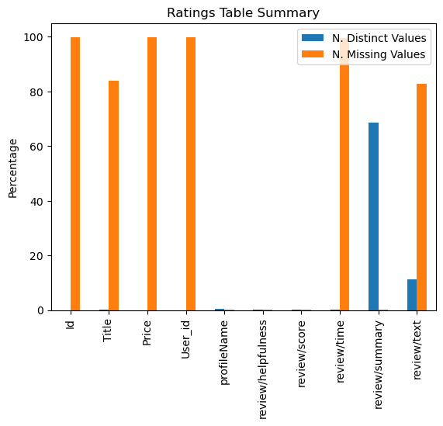
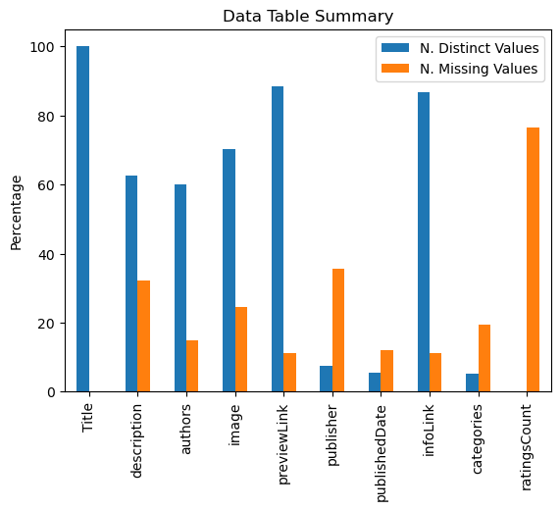
Prior analysis

Slide 5
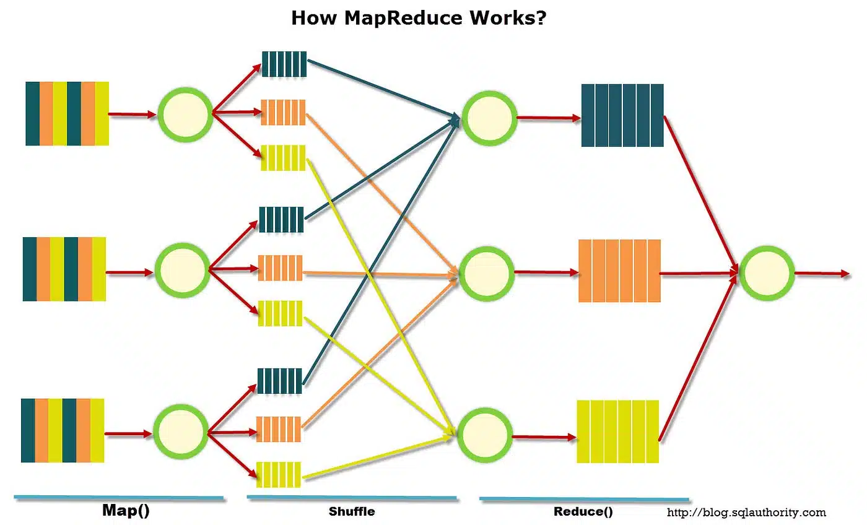
MapReduce Job
Join the two tables
Mapper creates a key-value structure
Double key sorting (Title, second field)
Reducer performs the join
The table is stored in Hadoop

Slide 6
Hypotheses Testing
MongoDB queries to get data ready for the analysis
Metrics computed with SciPy
Graphs generated with Matplotlib and Seaborn

Slide 7
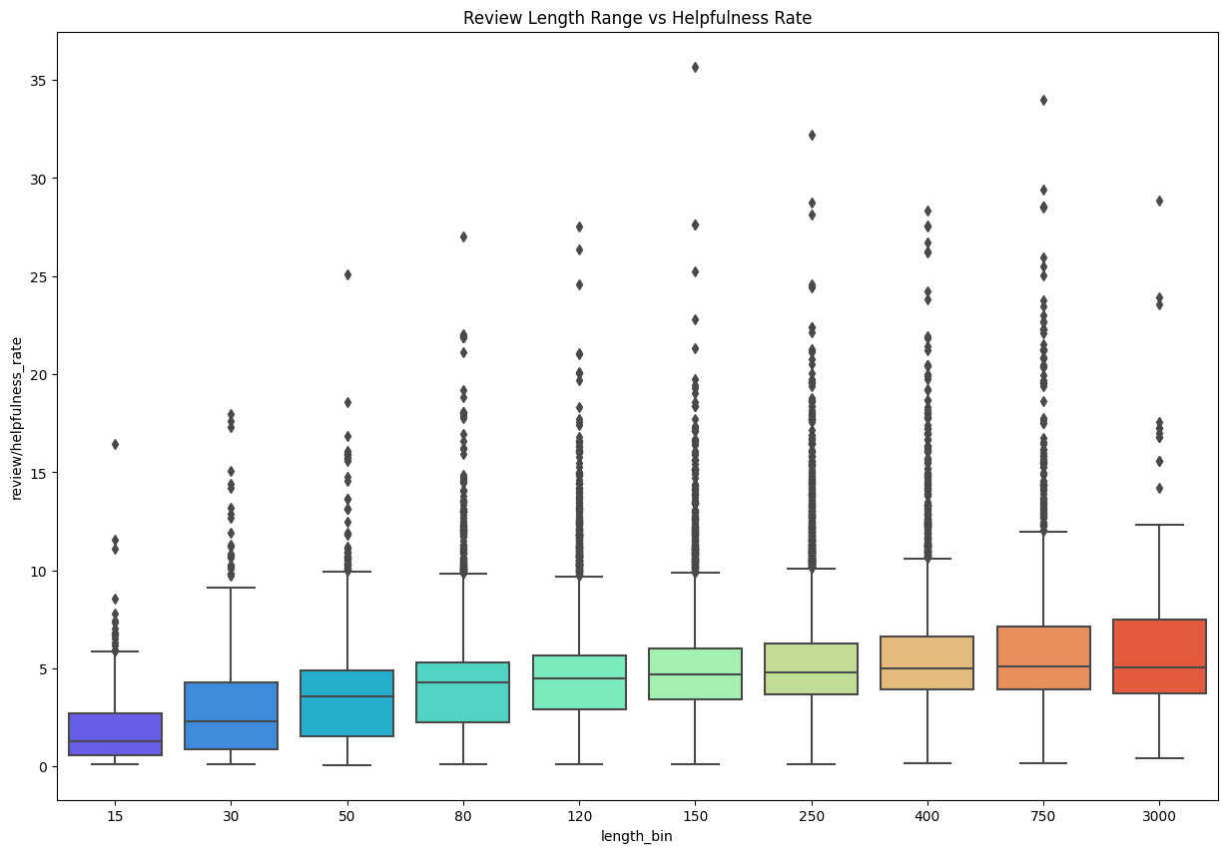
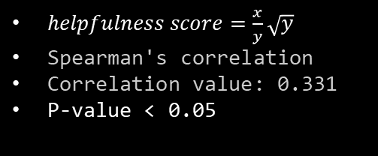
Does the helpfulness is correlated to the length of the review?
$helpfulness score=\frac{x}{y}\sqrt{y}$
Spearman's correlation
Correlation value: 0.331
P-value < 0.05

Slide 8
HYPOTHESIS 2 !!!!!!!!!!!!

Slide 9
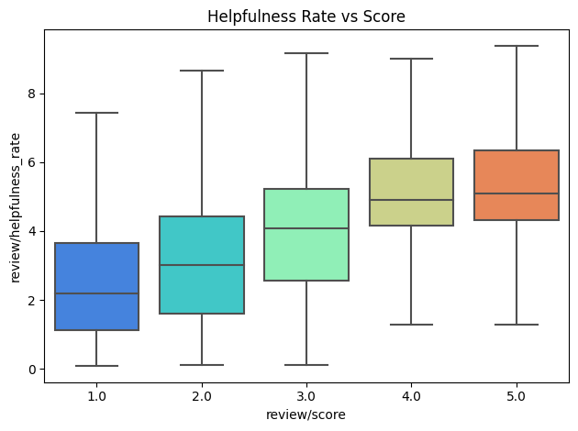

Is there correlation between rating score and helpfulness ?
$helpfulness score=\frac{x}{y}\sqrt{y}$
Removed samples below 20 helpfulness votes
Spearman's correlation value: 0.5247
P-value < 0.05

Slide 10
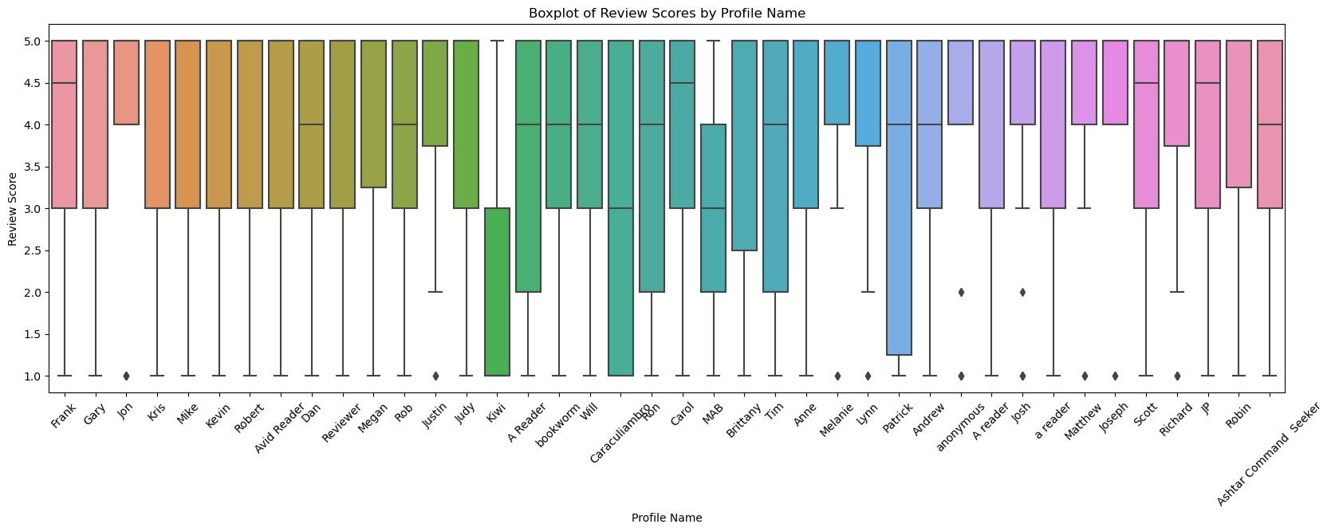
Is there correlation between rating score and helpfulness ?
Removed users below 20 reviews
ANOVA test
F-statistic:1.5374
P-value: 0.0670

Slide 11
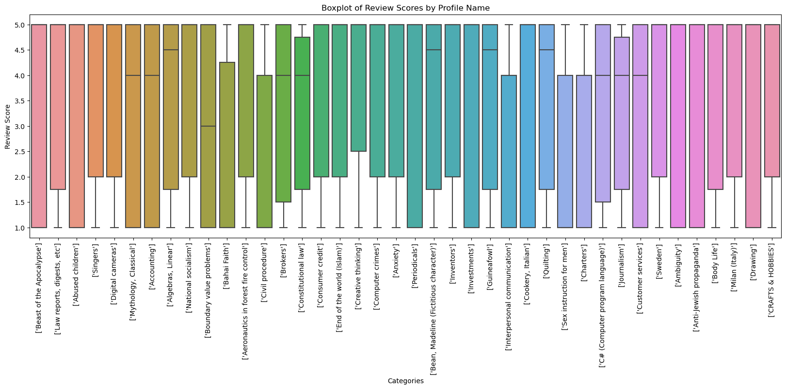
Is the review score influenced by the category of a book?
Removed categories below 20 reviews
ANOVA test
F-statistic: 0.177
P-value: 0.999

Slide 12
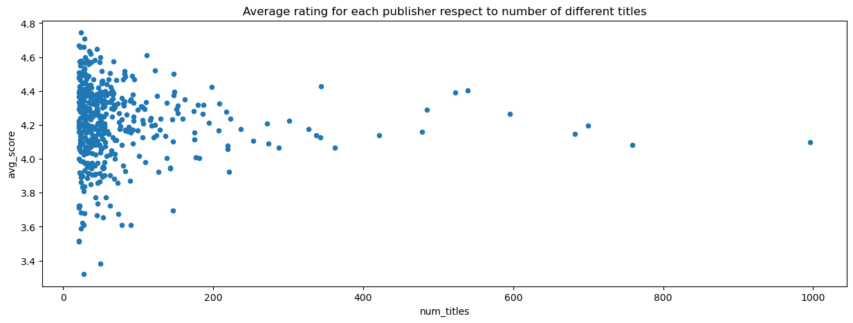
Is there correlation between the number of books published by publishers and the review score?
Removed publisher below 20 books
Spearman's correlation: -0.067
P-value: 0.151

Slide 13
Feature Extraction and Modeling
Discuss the process of feature extraction (e.g., Word2Vec for text)
Introduce the machine learning models used (e.g., Random Forest, SVR, MLP)
Share model evaluation metrics and comparisons

Slide 14
Results and Interpretation
Present the main findings and insights from the analysis
Use visual aids to illustrate important points (e.g., scatter plots, box plots)
Explain the significance of the results

Slide 15
Future Works
Outline potential areas for future research and improvement
Highlight opportunities for enhancing the analysis or addressing limitations

Slide 16
Conclusion
Summarize the project's key takeaways and achievements
Reinforce the project's significance and contributions
End with a closing statement

