Slide 1
DDoS Attack DNS reflection and amplification
University of Pavia, Italy

Slide 2
TABLE OF CONTENTS.
01
02
03
04
05
06
We will talk about this first.
We will talk about this second.
Then, we will talk about this.
After that we will talk about this.
We will also talk about this.
And we will talk about this last.

Slide 3
DDoS Attack Types
01
<p> Distributed Denial of Service (DDoS) is a cyber attack aimed at running out of service a given target. </p>

Slide 4
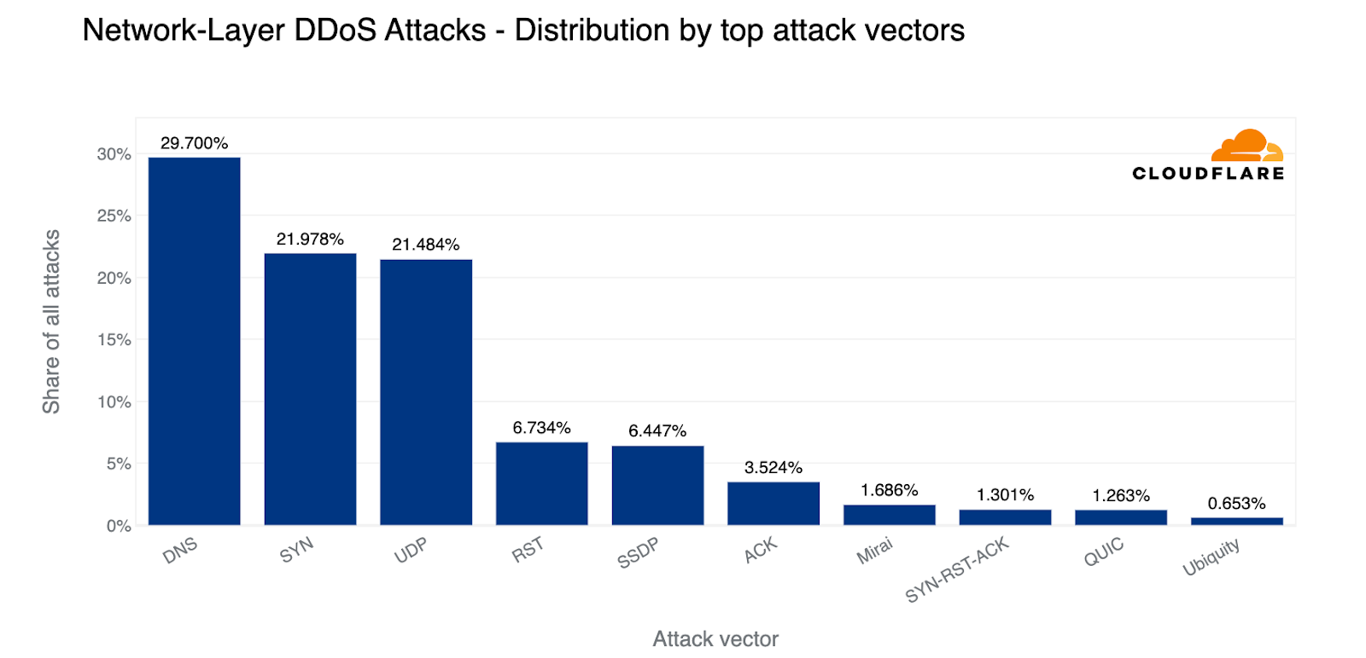
DID YOU KNOW?
<p> 1/3 of all DDoS attacks are DNS-based. <p>
DDoS involving DNS:
DNS Query Flood
TCP Flood
DNS Reflection and Amplification

Slide 5
DNS Query Flood
Specifics
Goal: Exhausting target’s resources
How: Sending DNS queries directly to target (botnet)
Target: Recursive server or Authoritative server
Trick: DNS queries not already cached

Slide 6
DNS Water Torture
Specifics
Goal: Exhausting authoritative target’s resources
How: Sending a huge amount of queries
Trick: Creating FQDN as ‘[random host] + [target domain]’

Slide 7
TCP Flood
Specifics
Goal: Exhausting target’s resources
How: Opening lots of TCP connections
Trick: Do not close TCP connections

Slide 8
DNS Reflection and Amplification
Specifics
Goal: Exhausting target’s bandwidth
How: Reflecting and Amplifying queries on DNS recursive NS
Trick: Spoofing IP (not difficult with UDP protocol)
It is the Most used DNS-based DDoS attack

Slide 9
Mechanisms for MITIGATION
06
<p> DNS is vital for the Internet, so protecting it from DDoS attacks is crucial. </p>

Slide 10
Proactive measures
Reactive measures
Routing hops detection
Machine learning
Anycast scheme
Caching behavior
Rate limiting
Trusted sources
Firewall

Slide 11
Proactive measures
Rate limiting
Trusted sources
Firewall
Limit N. responses to same I
Reducing amplification effect
Trusted whitelist
Reduce available IP to spoof
Risk trusted IP to be spoofed
Traffic control
Port Blocking

Slide 12
Reactive measures
Anycast scheme
Machine learning
Caching behavior
Server replication
Traffic distribution (routing)
Roots attack mitigated
Classification algorithms (SVM, NN, Trees)
Vulnerable to adversarial approach (EAD)
No TTL expired eviction if unavailability
Cached query served even during attack

