Slide 1
From Ripples to Waves DNS Reflection and Amplification Attack
University of Pavia, Italy

Slide 2
TABLE OF CONTENTS.
01
02
03
04
05
06
DDoS attack types and reasons behind the chosen method.
We will talk about this second.
Then, we will talk about this.
After that we will talk about this.
We will also talk about this.
And we will talk about this last.

Slide 3
DDoS Attack Types
01
<p> Distributed Denial of Service (DDoS) is a cyber attack aimed at running out of service a given target. </p>
Notes:
As you have seen from the first slide, our project is about the implmenetation of a DDoS attack, specifically a DNS reflection and amplification attack.
The choice was not made at random, instead it was the result of a selection and research process.
In the next slides i'm gonna introduce you to the reasons behind our choice and we are gonna see briefly some kinds of DDoS attacks.

Slide 4
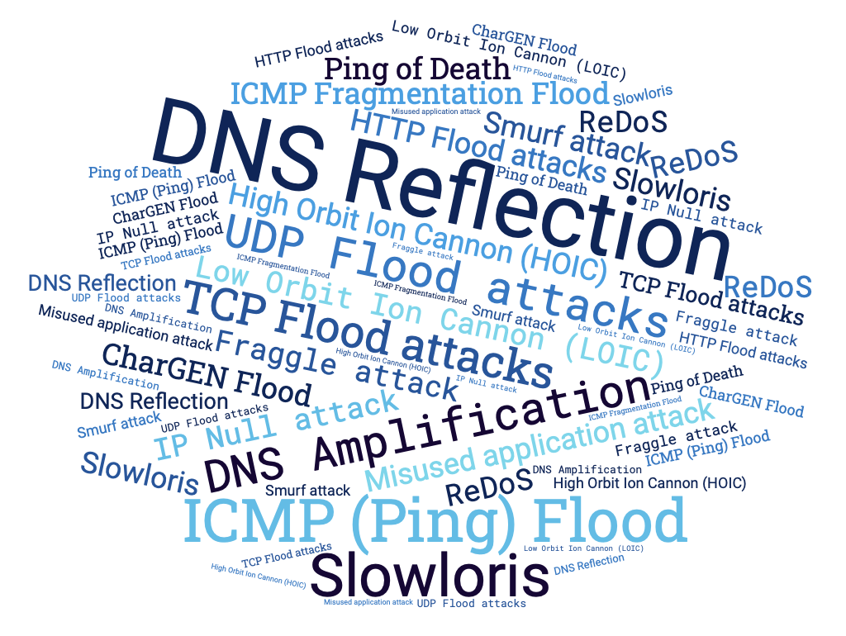
THERE IS PLENTY OF DDOS ATTACK TYPES
Our interest was in experimenting with a commonly employed approach in real-world scenarios, as opposed to sporadic cases.
Notes:
We started from the intention of simulating a DDoS attack, however as you can see from the figure, there many different ways in which this type of attack can be performed.
Our goal was that of experimenting something commonly used in real word situations and not just in sporadic cases.

Slide 5
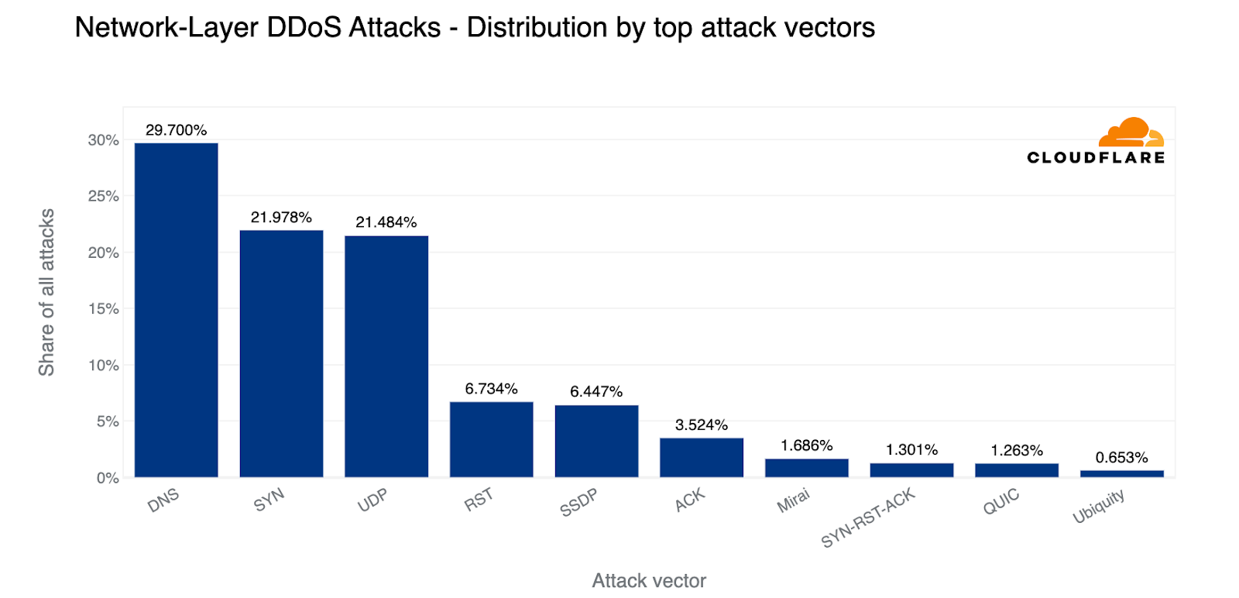
DID YOU KNOW?
<p> 1/3 of all DDoS attacks are DNS-based. <p>
DDoS involving DNS:
DNS Query Flood
TCP Flood
DNS Reflection and Amplification
Notes:
We discovered that according to a recent report by cloudflare, published in the first quarter of 2023, almost 1/3 of all the DDoS attacks are DNS based.
However also inside the sub-category of the dns-based attack there are several possibilites and here are listed the three most important.
DNS query flood, TCP flood and DNS reflection and amplification.

Slide 6
DNS Query Flood
Specifics
Goal: Exhausting target’s resources
How: Sending DNS queries directly to target (botnet)
Target: Recursive server or Authoritative server
Trick: DNS queries not already cached
Notes:
The DNS query flood is aimed at exahusting the target resources, by sending a huge amount of DNS queries.
The key point is sending lots of queries and this is achieved by the attackers using a botnet. A botnet is an army of compormised devices controlled by the attacker to send DNS queries.
This attack can mainly have two target, a recursive NS or an authoritative one.
In the case the target is the first one, there is a trick played by the attacker, that consists in crafting the queries in a such a way that they are not already cached in the server. That way the server is forced to query other NS until, eventually it gets the response and sends it back to the client.

Slide 7
DNS Water Torture
Specifics
Goal: Exhausting authoritative target’s resources
How: Sending a huge amount of queries
Trick: Creating FQDN as ‘[random host] + [target domain]’
Notes:
If the target is a specific authoritative NS, the attack takes the name of water torture.
The goal is the same as before, but on this case the trick played is that of crafting queries taking the domain of the target and adding a random string.
That way, we are sure the queries reach the target using its resources to answer to them NXDOMAIN.

Slide 8
TCP Flood
Specifics
Goal: Exhausting target’s resources
How: Opening lots of TCP connections
Trick: Do not close TCP connections
Notes:
TCP flood attack has still the goal of exhausting the target resources but instead of using UDP traffic it exploits the THREE-WAY handshaking of TCP.
The trick is to open a large number of TCP connections without closing them, therefore forcing the target to use its resources to handle it, until they are exhausted.

Slide 9
DNS Reflection and Amplification
Specifics
Goal: Exhausting target’s bandwidth
How: Reflecting and Amplifying queries on DNS recursive NS
Trick: Spoofing IP (not difficult with UDP protocol) + ANY
It is the Most used DNS-based DDoS attack
Notes:
The last type of attack is the DNS reflection and amplification.
The goal of this attack is to exhaust the target network bandwidth by exploiting the concepts of reflection and amplification.
It starts with the spoofing of the IP address of a victim by the attacker. Then the attacker sends lots of queries to a misconfigured DNS recursive server that will consequently respond to the victim IP.
So we have a kind of reflection on the name server.
The amplification affect is obtained since usually the types of queries performed are of type ANY, therefore the response size is larger than the query, leading to an amplification effect.
The higher the amplification factor, the higher the impact of this attack.
According to the already cited report, DNS reflection is the most commonly used attack among the dns-based ddos, so we decided to simulate it.

Slide 10
Mechanisms for MITIGATION
06
<p> DNS is vital for the Internet, so protecting it from DDoS and any other type of attack is crucial. </p>
Notes:
The DNS is vital for the internet, so protecting it from DDoS and any other type of attack is crucial.
To achieve this many mitigations measures have been deployed across the years and we are gonna see some of them in this section.

Slide 11
Proactive measures
Reactive measures
Rate Limiting
Trusted Sources
Firewall
Machine Learning
Anycast Scheme
Caching Behavior
Notes:
They can be roughly classified in two categories.
Proactive measures that tries to prevent and avoid the attack.
Reactive measures aimed at identifying and stop as soon as possible the attack, while increasing the system resilience as well.
Read the measures.

Slide 12
Proactive measures
Rate Limiting
Trusted Sources
Firewall
Trusted whitelist
Reduce available IP to spoof
Risk trusted IP to be spoofed
Limit N. responses to same I
Reducing reflection effect
Traffic control
Traffic filtering
Notes:
The idea behind the rate limiting is to limit th enumber of response a server can provide to a given IP. That way the server can stop providing answer to the spoofed IP and the reflection effect is mitigated.
As regard the trusted sources the idea is to create a whitelist of IP that are legitimated to send queries to the DNS server.
Thereby, the number of IP that can be spoofed to perform attack is reduced and consequentely the probability of an attack.
However there is still the risk of the trusted IP to be spoofed, so it is not a foolproof measure.
Lastly it is possible to set firewall to control and filter traffic to block the queries and prevent the attack.

Slide 13
Reactive measures
Anycast Scheme
Machine Learning
Caching Behavior
Server replication
Traffic distribution (routing)
Hard to push all servers down
Classification algorithms (SVM, Neural Networks, Trees)
Vulnerable to adversarial approach (EAD)
No TTL expired eviction if unavailability
Cached query served even during attack
Notes:
Here are some reactive measures.
The first is the anycast scheme. The idea here is to create replicas of the server all with the same logical IP and use the anycast scheme to choose at any time the best server according to some criteria (like availability and traffic).
Thereby, the attacker would have to run out of service all the server which becomes more diffucult the higher the number of servers.
With machine learning the idea is to train some classification algorithms like SVM, NN and trees (random forests) to discriminate between an attack situation and a legitimate one, according to some features extracted from the queries.
However has been recently shown that using an adversarial approach the classification algorithm can be fooled.
This apporach conists in taking a two netowrk, the classifier and another challenging it. This network can learn to slightly change the features to fool the classifier.
The idea of cahching behavior is to keep providing the cached entry when a relevant server is down, indipentely on the TTL. That way even during an attack the cached entries can be served, increasing the resilience of the system.

