Slide 1
From Ripples to Waves DNS Reflection and Amplification Attack
University of Pavia, Italy

Slide 2
TABLE OF CONTENTS.
01
02
03
04
05
06
DDoS attack types and reasons behind the chosen method.
We will talk about this second.
Then, we will talk about this.
After that we will talk about this.
We will also talk about this.
And we will talk about this last.

Slide 3
DDoS Attack Types
01
<p> Distributed Denial of Service (DDoS) is a cyber attack aimed at running out of service a given target. </p>
Notes:
As you have seen from the first slide, our project is about the implmenetation of a DDoS attack, specifically a DNS reflection and amplification attack.
The choice was not made at random, instead it was the result of a selection and research process.
In the next slides i'm gonna introduce you to the reasons behind our choice and we are gonna see briefly some kinds of DDoS attacks.

Slide 4
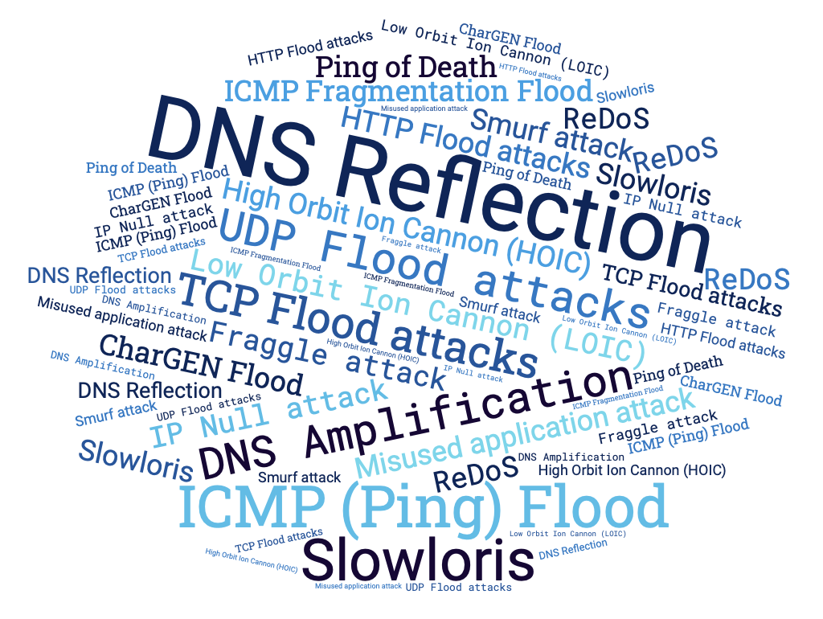
THERE IS PLENTY OF DDOS ATTACK TYPES
Our interest was in experimenting with a commonly employed approach in real-world scenarios, as opposed to sporadic cases.
Notes:
We started from the intention of simulating a DDoS attack, however as you can see from the figure, there many different ways in which this type of attack can be performed.
Our goal was that of experimenting something commonly used in real word situations and not just in sporadic cases.

Slide 5
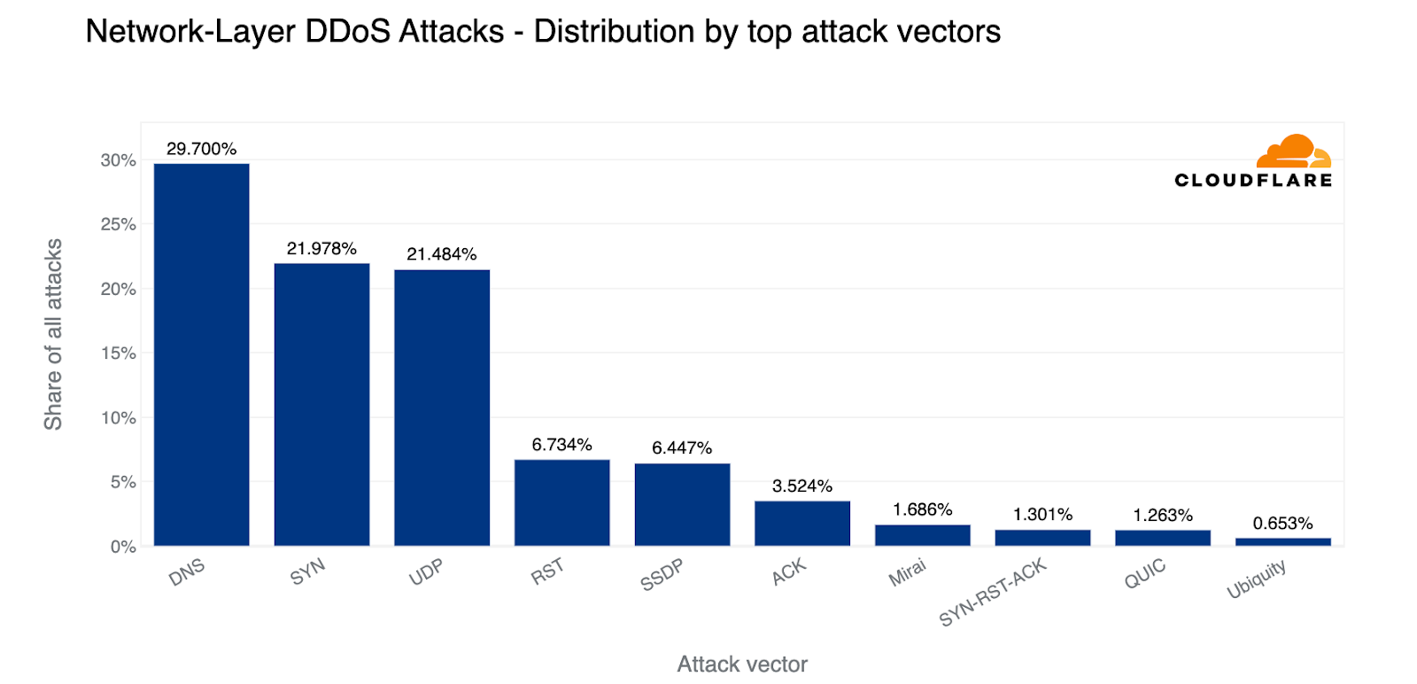
DID YOU KNOW?
<p> 1/3 of all DDoS attacks are DNS-based. <p>
DDoS involving DNS:
DNS Query Flood
TCP Flood
DNS Reflection and Amplification
Notes:
We discovered that according to a recent report by cloudflare, published in the first quarter of 2023, almost 1/3 of all the DDoS attacks are DNS based.
However also inside the sub-category of the dns-based attack there are several possibilites and here are listed the three most important.
DNS query flood, TCP flood and DNS reflection and amplification.

Slide 6
DNS Query Flood
Specifics
Goal: Exhausting target’s resources
How: Sending DNS queries directly to target (botnet)
Target: Recursive server or Authoritative server
Trick: DNS queries not already cached
Notes:
The DNS query flood is aimed at exahusting the target resources, by sending a huge amount of DNS queries.
The key point is sending lots of queries and this is achieved by the attackers using a botnet. A botnet is an army of compormised devices controlled by the attacker to send DNS queries.
This attack can mainly have two target, a recursive NS or an authoritative one.
In the case the target is the first one, there is a trick played by the attacker, that consists in crafting the queries in a such a way that they are not already cached in the server. That way the server is forced to query other NS until, eventually it gets the response and sends it back to the client.

Slide 7
DNS Water Torture
Specifics
Goal: Exhausting authoritative target’s resources
How: Sending a huge amount of queries
Trick: Creating FQDN as ‘[random host] + [target domain]’
Notes:
If the target is a specific authoritative NS, the attack takes the name of water torture.
The goal is the same as before, but on this case the trick played is that of crafting queries taking the domain of the target and adding a random string.
That way, we are sure the queries reach the target using its resources to answer to them NXDOMAIN.

Slide 8
TCP Flood
Specifics
Goal: Exhausting target’s resources
How: Opening lots of TCP connections
Trick: Do not close TCP connections
Notes:
TCP flood attack has still the goal of exhausting the target resources but instead of using UDP traffic it exploits the THREE-WAY handshaking of TCP.
The trick is to open a large number of TCP connections without closing them, therefore forcing the target to use its resources to handle it, until they are exhausted.

Slide 9
DNS Reflection and Amplification
Specifics
Goal: Exhausting target’s bandwidth
How: Reflecting and Amplifying queries on DNS recursive NS
Trick: Spoofing IP (not difficult with UDP protocol) + ANY
It is the Most used DNS-based DDoS attack
Notes:
The last type of attack is the DNS reflection and amplification.
The goal of this attack is to exhaust the target network bandwidth by exploiting the concepts of reflection and amplification.
It starts with the spoofing of the IP address of a victim by the attacker. Then the attacker sends lots of queries to a misconfigured DNS recursive server that will consequently respond to the victim IP.
So we have a kind of reflection on the name server.
The amplification affect is obtained since usually the types of queries performed are of type ANY, therefore the response size is larger than the query, leading to an amplification effect.
The higher the amplification factor, the higher the impact of this attack.
According to the already cited report, DNS reflection is the most commonly used attack among the dns-based ddos, so we decided to simulate it.

Slide 10
Mechanisms for MITIGATION
06
<p> DNS is vital for the Internet, so protecting it from DDoS attacks is crucial. </p>

Slide 11
Proactive measures
Reactive measures
Routing hops detection
Machine learning
Anycast scheme
Caching behavior
Rate limiting
Trusted sources
Firewall

Slide 12
Proactive measures
Rate limiting
Trusted sources
Firewall
Limit N. responses to same I
Reducing amplification effect
Trusted whitelist
Reduce available IP to spoof
Risk trusted IP to be spoofed
Traffic control
Port Blocking

Slide 13
Reactive measures
Anycast scheme
Machine learning
Caching behavior
Server replication
Traffic distribution (routing)
Roots attack mitigated
Classification algorithms (SVM, NN, Trees)
Vulnerable to adversarial approach (EAD)
No TTL expired eviction if unavailability
Cached query served even during attack

