Slide 1
From Ripples to Waves DNS Reflection and Amplification Attack
University of Pavia, Italy
Notes:
Good Morning !
In this presentation, we will talk about DDoS attacks and how they affect the DNS .
We'll explore the important connection between cybersecurity and network systems.

Slide 2
TABLE OF CONTENTS.
01
02
03
04
Why a DDoS attack
DNS overview
DNS-based DDoS Attacks
Experimental Setup
05
06
07
08
DNS Server configuration
Attack Scripts
Experimental results
Mitigation Mechanisms
Notes:
Firstly, we’ll start by understanding why attackers carry out DDoS attacks and the motivation behind them.
Next, we'll provide an overview of the DNS, which is a crucial part of the internet infrastructure that translates human-friendly domain names into computer-readable IP addresses.
We'll then explore how DDoS attacks and the DNS are connected. We'll look at the methods attackers use to exploit vulnerabilities in the DNS.
To provide you with practical observations, we'll present a setup that simulates real-world scenarios, allowing us to analyze and understand how DNS-based DDoS attacks work.
Following that, we will explore our DNS server configuration.
Next, we will focus on the main part of our presentation: the attack scripts. These scripts were created to target our DNS servers, and we will discuss their technical aspects.
We'll share the results of our experiments and explain how effective the attacks were in our controlled environment.
Lastly, we'll talk about mitigation techniques. We'll explore different strategies and methods that organizations can use to defend against DDoS attacks.

Slide 3
DDoS Attack
01
Distributed Denial of Service (DDoS) is a cyber attack aimed at running out of service a given target.
Notes:
As you have seen from the first slide, our project is about the implementation of a DDoS attack, specifically a DNS reflection and amplification attack.
The choice was not made at random, instead it was the result of a selection and research process.
In the next slides I will introduce you to the reasons behind our choice and I will provide you a brief overview of various types of DDoS attacks.

Slide 4
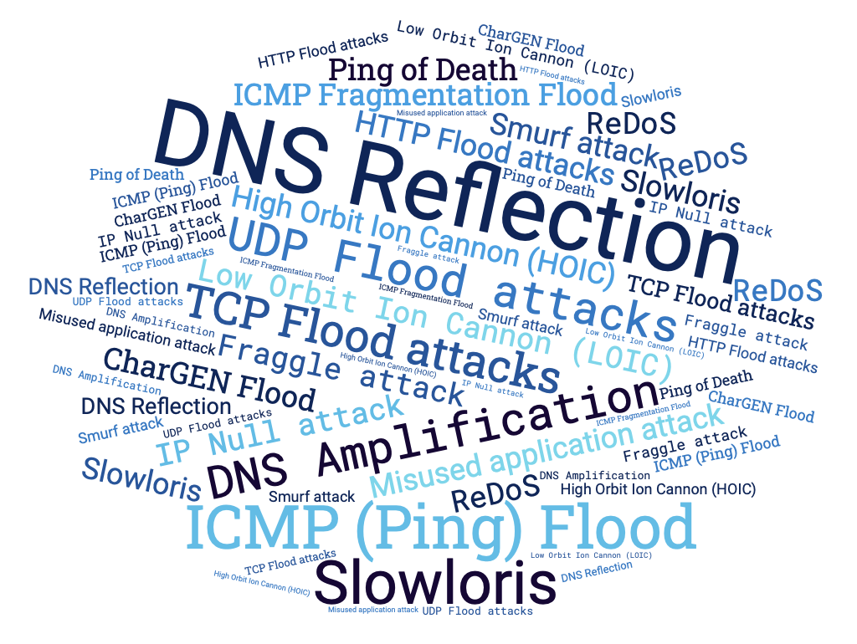
THERE IS PLENTY OF DDOS ATTACK TYPES
Our interest was in experimenting with a commonly employed approach in real-world scenarios, as opposed to sporadic cases.
Notes:
We started from the intention of simulating a DDoS attack, however as you can see from the figure, there are many different ways in which this type of attack can be performed.
Our goal was that of experimenting something commonly used in real word situations and not just in sporadic cases.

Slide 5
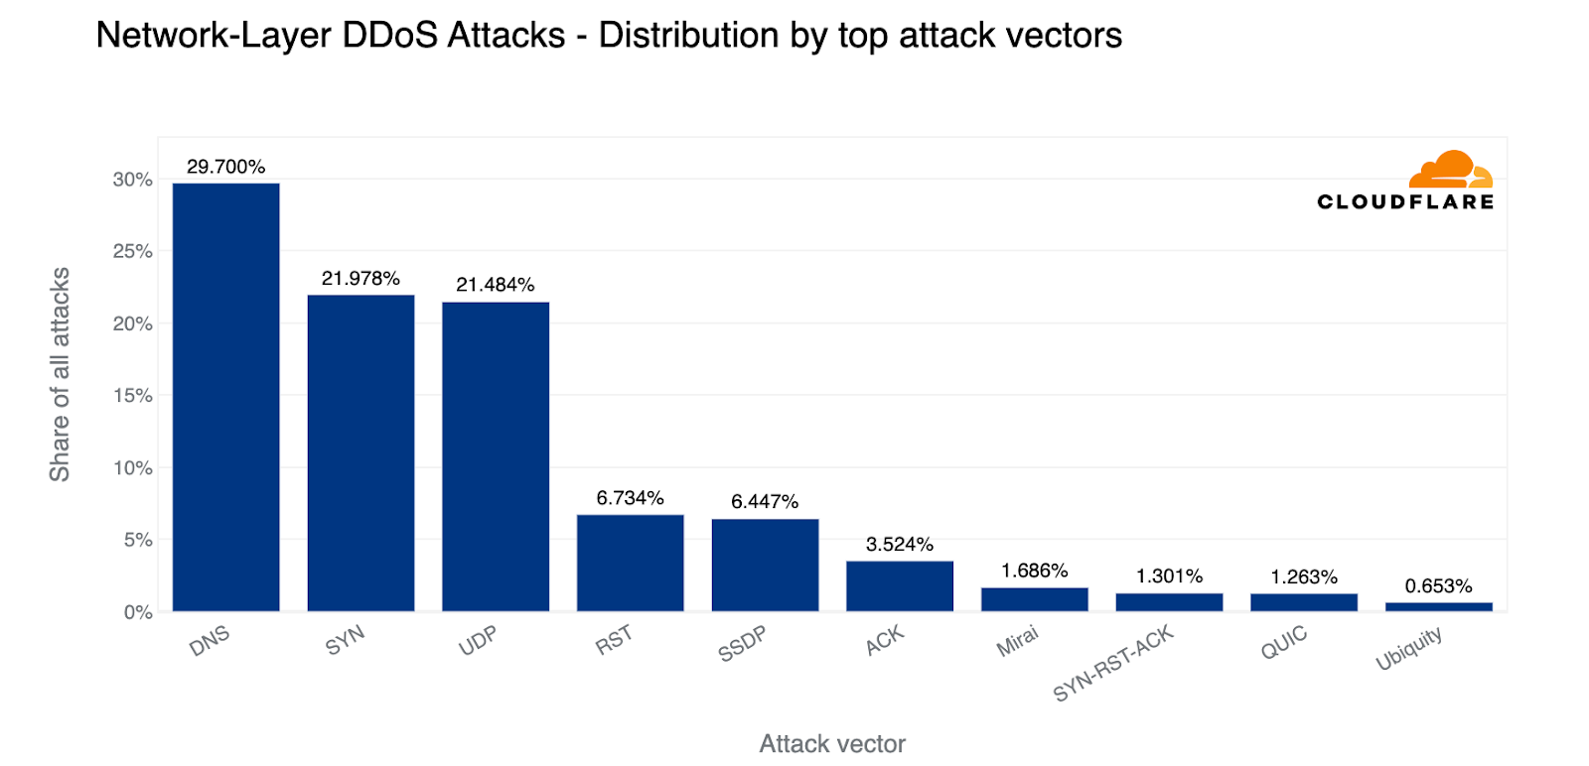
DID YOU KNOW?
1/3 of all DDoS attacks are DNS-based.
Notes:
We discovered that according to a recent report by Cloudflare, published in the first quarter of 2023, almost 1/3 of all the DDoS attacks are DNS based.
So we decide next to simulate a DNS based attack !

Slide 6
DNS Service
02
DNS (Domain Name System) is a crucial part of the internet infrastructure that translates human-friendly domain names into machine-readable IP addresses.
Notes:
As I mentioned before, the DNS plays a vital role in ensuring that websites, applications, and online resources are easily accessible and can communicate with each other.
However, the very nature of the DNS also makes it an attractive target for malicious actors seeking to disrupt the normal functioning of online services. DDoS attacks, in particular, pose a significant threat to the availability and stability of the DNS infrastructure.
However, because the DNS is essential for online communication, it becomes a prime target for malicious actors trying to disrupt the normal functioning of online services.

Slide 7
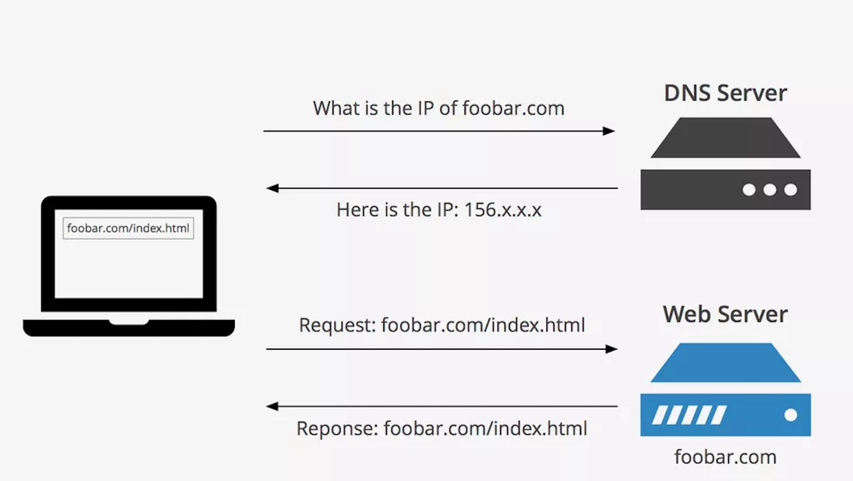
WHAT IS DNS?
DNS is a distributed hierarchical system that translates human-readable domain names into their corresponding IP addresses.
Notes:
DNS, or the Domain Name System, is a distributed hierarchical system that translates human-readable domain names into their corresponding IP addresses.
When you enter a domain name in your web browser, your device sends a DNS query to a recursive resolver (typically provided by your ISP or a public DNS service). The resolver starts by checking its cache to see if it already has the IP address for the requested domain. If the resolver doesn't have the information, it acts as a middleman, forwarding the query to other DNS servers in a recursive manner until it obtains the IP address or determines that it doesn't exist.
The DNS hierarchy consists of different types of servers. At the top are the root servers, which maintain a list of authoritative servers for each top-level domain (TLD) such as .com, .org, or country-specific TLDs like .uk or .jp. These authoritative servers are responsible for storing the DNS records that map domain names to IP addresses.

Slide 8
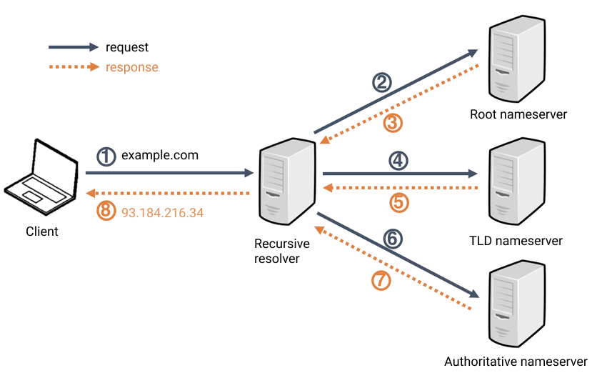
DNS COMPONENTS
DNS Resolver
Recursive DNS Server
Authoritative DNS Server
Notes:
The main components of DNS are the DNS resolver, authoritative DNS server, and recursive DNS server. These components work together to translate domain names into IP addresses.
DNS Resolver: The resolver is a software or service on your device, ISP, or network that handles DNS queries. When you enter a domain name in your web browser, the resolver receives the request and starts the process of finding the IP address associated with that domain. It may have a cache to store previously resolved information, which helps improve response times and reduce network traffic.
Recursive DNS Server: If the resolver doesn't have the requested information, it contacts a recursive DNS server. This server takes on the task of resolving the query by reaching out to different DNS servers. It starts with the root DNS servers to find the authoritative DNS server for the top-level domain (TLD) of the domain name. Then it queries the authoritative server for the specific domain to get the IP address. This process continues until the recursive server obtains the IP address or determines it doesn't exist, and then it sends the result back to the resolver.
Authoritative DNS Server: The authoritative server holds the DNS records for a specific domain. It stores information such as the IP addresses associated with the domain name and other related records. When queried by a recursive server, the authoritative server provides the requested DNS records. There are different levels of authoritative servers, including those for TLDs, second-level domains, and subdomains.

Slide 9

DNS VULNERABILITIES
DNS Cache Poisoning
DNS Spoofing
DNS Hijacking
DNS Tunnelling
Zone Transfer Exploitation
DDoS Attacks
Notes:
DNS is vulnerable to different types of attacks that attackers can exploit. Here are some key vulnerabilities:
1. DNS Cache Poisoning: Attackers can manipulate the DNS cache to misdirect users to malicious websites or intercept their communication.
2. DNS Spoofing: Attackers can trick users by sending fake DNS responses, leading them to connect to malicious servers. This can result in phishing, man-in-the-middle, or session hijacking attacks.
3. DNS Hijacking: Attackers can compromise DNS settings on routers, servers, or user devices, redirecting DNS queries to malicious servers. This allows them to gain unauthorized access or steal data.
4. DNS Tunneling: Attackers can use DNS to bypass network security measures, hiding unauthorized data within DNS queries or responses. This lets them bypass firewalls and steal sensitive information.
5. Zone Transfer Exploitation: Misconfigured DNS servers can allow unauthorized zone transfers, enabling attackers to gather valuable information about a targeted domain.
6. DDoS Attacks: DNS infrastructure can be overwhelmed by massive traffic in Distributed Denial of Service (DDoS) attacks, causing service disruptions.

Slide 10
DNS-based DDoS Attacks
03
There are many types of DNS-based DDoS attacks
DNS Query Flood
TCP Flood
DNS Reflection and Amplification
Notes:
As karim said we opted for a DNS based attack, however even inside the subcategory of dns based there are many types of attacks. We are gonna see briefly some kinds and in particular the reflection and amplification attack.

Slide 11
DNS Query Flood
Specifics
Goal: Exhausting target’s resources
How: Sending DNS queries directly to target (botnet)
Target: Recursive server or Authoritative server
Trick: DNS queries not already cached
Notes:
The DNS query flood is aimed at exahusting the target resources, by sending a huge amount of DNS queries.
The key point is sending lots of queries and this is achieved by the attackers using a botnet. A botnet is an army of compormised devices controlled by the attacker to send DNS queries.
This attack can mainly have two target, a recursive NS or an authoritative one.
In the case the target is the first one, there is a trick played by the attacker, that consists in crafting the queries in a such a way that they are not already cached in the server. That way the server is forced to query other NS until, eventually it gets the response and sends it back to the client.

Slide 12
DNS Water Torture
Specifics
Goal: Exhausting authoritative target’s resources
How: Sending a huge amount of queries
Trick: Creating FQDN as ‘[random host] + [target domain]’
Notes:
If the target is a specific authoritative NS, the attack takes the name of water torture.
The goal is the same as before, but on this case the trick played is that of crafting queries taking the domain of the target and adding a random string.
That way, we are sure the queries reach the target using its resources to answer to them NXDOMAIN.

Slide 13
TCP Flood
Specifics
Goal: Exhausting target’s resources
How: Opening lots of TCP connections
Trick: Do not close TCP connections
Notes:
TCP flood attack has still the goal of exhausting the target resources but instead of using UDP traffic it exploits the THREE-WAY handshaking of TCP.
The trick is to open a large number of TCP connections without closing them, therefore forcing the target to use its resources to handle it, until they are exhausted.

Slide 14
DNS Reflection and Amplification
Specifics
Goal: Exhausting target’s bandwidth
How: Reflecting and Amplifying queries on DNS recursive NS
Trick: Spoofing IP (not difficult with UDP protocol) + ANY
It is the Most used DNS-based DDoS attack
Notes:
The last type of attack is the DNS reflection and amplification.
The goal of this attack is to exhaust the target network bandwidth by exploiting the concepts of reflection and amplification.
It starts with the spoofing of the IP address of a victim by the attacker. Then the attacker sends lots of queries to a misconfigured DNS recursive server that will consequently respond to the victim IP.
So we have a kind of reflection on the name server.
The amplification affect is obtained since usually the types of queries performed are of type ANY, therefore the response size is larger than the query, leading to an amplification effect.
The higher the amplification factor, the higher the impact of this attack.
According to the already cited report, DNS reflection is the most commonly used attack among the dns-based ddos, so we decided to simulate it.

Slide 15
Experimental SETUP
04
To ensure the success of the project, it is essential to establish a clear methodology
Notes:
To ensure the success of the project, it is essential to establish a clear methodology that consists in a systematic approach that allows for the accurate replication of a DDoS attack while maintaining ethical considerations and minimizing the potential impact on public network.

Slide 16
Why
Which/Who
Identify DNS vulnerabilities
Evaluate Network resiliance
identify potential countermeasures
1 laptop hosts DNS server
4 laptops perform the attack
1 laptop act as victim of spoofing
Notes:
The objective is to asses Dos attck by expoiting the DNS protocol and monitoring the reachability of the targeted device and the nodes available on the network. Our study aims to identify the vulnerabilities within the DNS protocol, evaluate the network resiliance and finally identify potential countermeasures that could be applied to limit the impact of the attack.
In the simulation 6 laptops has been used:
1 hosts the dns server
4 perform the attack
1 is the victim of spoofing, since the attackers does not send dns queries using their actual ip, but they use the ip of the spoofed laptop

Slide 17
What
Where
RTT before and during the attack
Response time of DNS query
Resources used by the DNS server
1 laptop monitors the status of the network
LAN isolated from internet
Notes:
The choosen metrics encompass the the evaluation of the rtts of icmp packets and response time of the dns queries, considering also possible timeouts. In addition, the resources allocate by the server were monitored ,
All these measurments wer taken before and during the attack.
For what concerns the vantage point of the monitoring phase, one laptop were dedicated for this task.
And the experiment were conducted inside a Local Area Network which were isolated form internet in order to avoid that the attack could impact the public network devices.

Slide 18
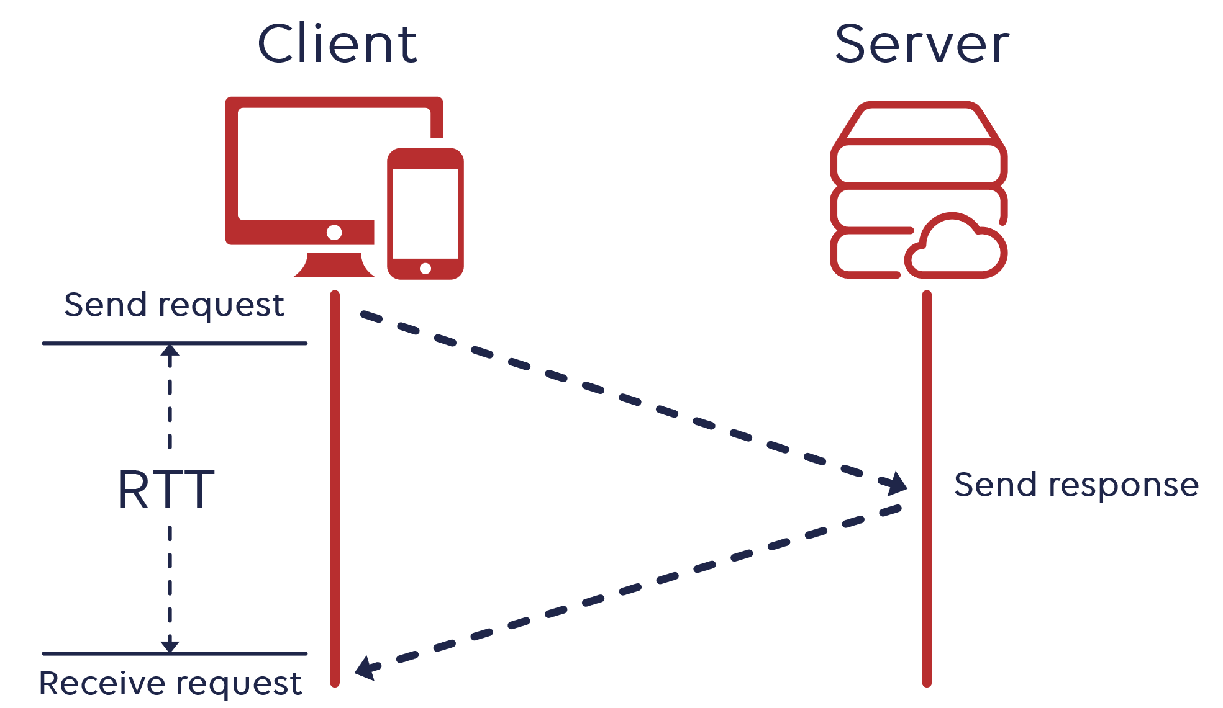
PING
Network utility tool
Sends small packets to a specific IP address
Measures the RTT
Notes:
The first tool we employed is Ping, a network utility tool used to test the connectivity between two networked devices. It essentially works by sending a sequence of icmp packets and measures the Round trip time, which is the time to send, receive and return.

Slide 19
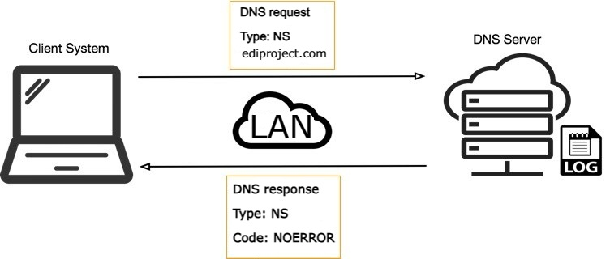
DIG
Domain Information Groper
Performs DNS queries
Measure query time
Used to check DNS records and the status of the server
Notes:
Another tool is DIG which stands for Domain Information Groper.
It allows users to perform DNS lookups to check DNS records and obtain information about DNS configurations. It were used to measure the response time of dns queries and also in the preliminary phase, to check if the dns server were reachable and properly configured.

Slide 20
TOP
Tool used to monitor the system resources, like memory and CPU usage.
Used to monitor the resources allocate by the server before and during the attack.
Notes:
a command that provides real-time monitoring of system resources such as CPU usage, memory utilization, running processes, and more. It displays an interactive, dynamic table that continually updates, enabling users to view the current state of their system.

Slide 21

Wireshark
Open-source network protocol analyser
Designed to capture, analyse, and display network traffic in real-time
Used to monitor the status of the attack, in terms of number of packets sent, and the behaviour of the DNS server
Notes:
an open-source network protocol analyser. Wireshark is designed to capture, analyse, and display network traffic in real-time. It were used to monitor the traffic of the network under attack

Slide 22
DNS server configuration
05
Notes:
Let’s go deeper in the dns server configuration

Slide 23
The configuration
Running on Ubuntu 20.4 LTS
BIND9 implementation
Authoritative server for the domain “ediproject.com”
No security measures. The devices on the LAN were able perform all queries
Notes:
The server were running on Ubuntu 20.4 OS.
BIND9 is the selected implementation of the DNS server, because it is open source.
And it can be easily customized by editing the configuration files.
The Server were configured as a local DNS with autority over the domain ‘ediproject.com’
We decided to not implement any security measure in order to facilitate the attack and make it more effective.
So all devices on the LAN were able to perform any kind of request

Slide 24
Resurce Records
1 record of type SOA
6 records of type NS
5 records of type MX
10 records of type A
Notes:
Since we would perform the attack using different amplification factors, the server was configured to have different number of records for each type. By doing that the amplification factor can be changed only by modifiyng the type of records in the queries sent by the attacckers.

Slide 25
Scripts
06
Combining the capabilities of multithreading, IP spoofing, and ping sweeping to unlock new horizons in cybersecurity attacks!
Notes:
SLIDE 25
To perform our DDOS attack, we created some scripts that implement functions such as multithreading, IP spoofing, and ping sweeping
that we will use combined together in order to perform our DDos attack.

Slide 26
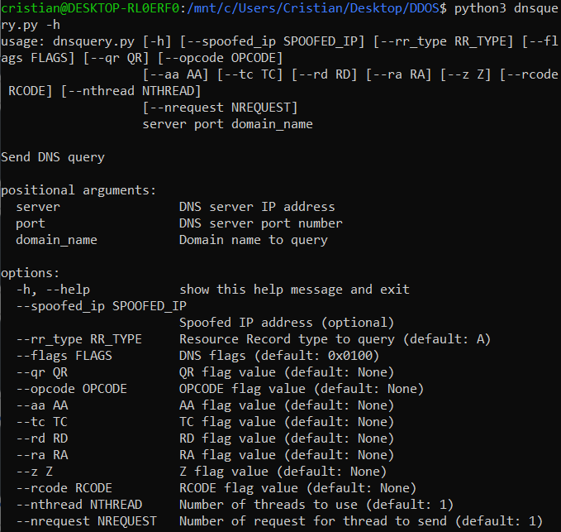
DNS query
A script was created to build and send a custom DNS query.
It allow us to:
Different DNS request type
Edit the flags
Specify spoofed IP
Use multithreading
Notes:
SLIDE 26
Let's begin by delving into our first script, which revolves around DNS queries. With this custom-built script,
we possess the power to construct and send personalized DNS queries, enabling us to navigate the intricate DNS landscape.
The script empowers us to tailor the DNS request type, edit the flags, specify a spoofed IP address,
and leverage the advantages of multithreading for enhanced efficiency.

Slide 27
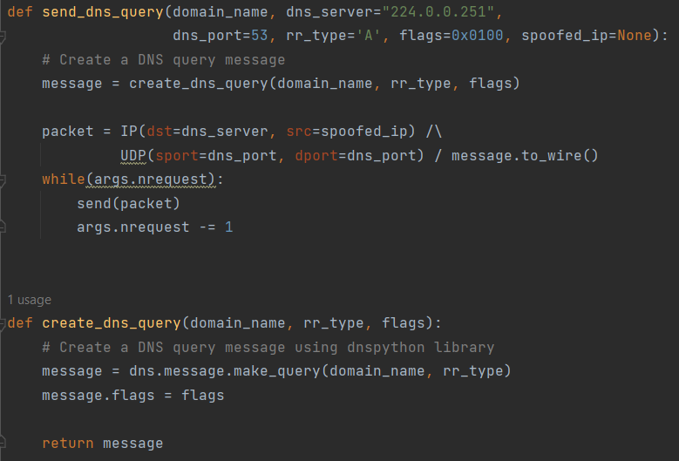
DNS script
The script was created in python using dnspython library to build the DNS packet and Scapy library to handle the IP header.
Notes:
SLIDE 27
Our DNS script is a remarkable creation, crafted using the Python programming language.
It seamlessly integrates the dnspython library, which enables us to construct and manipulate DNS packets with precision and finesse.
Additionally, we leverage the Scapy library to handle the IP headers, allowing us to control and customize every aspect
of the DNS packets we generate.

Slide 28
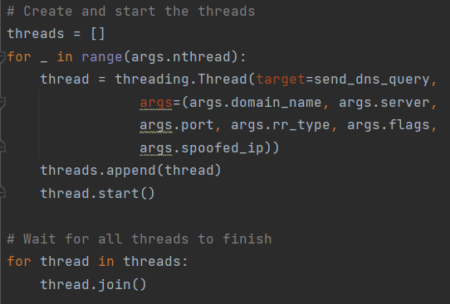
Multithreading
It was implemented using threading python library. By default is disabled, but is possible to specify the number of thread to use for the attack. It is also possible handle the total number of DNS request sent.
Notes:
SLIDE 28
Multithreading plays a pivotal role in our script, augmenting our offensive capabilities.
By harnessing the power of the threading Python library, we have implemented multithreading functionality.
Although disabled by default, we possess the flexibility to specify the desired number of threads to be employed in the attack.
Furthermore, we have precise control over the total number of DNS requests sent,
enabling us to fine-tune our offensive operations for optimal impact.

Slide 29
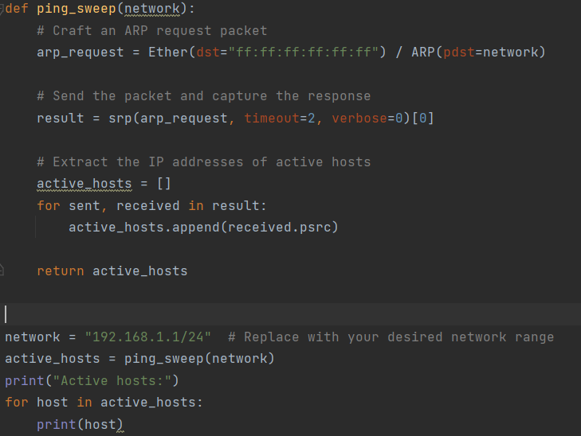
IP Spoofing
Was performed using the ping sweeping technique. Its purpose was to identify active hosts within a specific network range. By crafting Address Resolution Protocol (ARP) request packets and sending them to the network, capture the responses and extract the IP addresses of the active hosts.
Notes:
SLIDE 29
Now, let's venture into the fascinating world of IP spoofing. Our exploration of this technique centers around the ping sweeping approach.
Through ping sweeping, we engage in the process of identifying active hosts within a specific network range.
By crafting and sending Address Resolution Protocol (ARP) request packets to the network,
we capture the responses and extract the IP addresses of the active hosts.
This valuable information empowers us with a deeper understanding of potential targets, enriching our offensive capabilities.

Slide 30
Experimental RESULTS
07
What happened to the DNS server and to the target of the reflection attack?
Notes:
1° vantage point = target with spoofed ip
Ping, dig
Ram, cpu

Slide 31
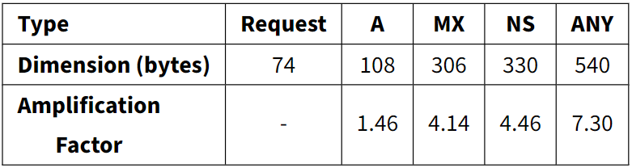
AMPLIFICATION FACTOR
The AF depends on the request type.
A BIG Amplification Factor is beneficial for the attacker, which will need to use fewer resources
10,000 requests per second
Notes:
They give the name to the attack
We used various dimensions

Slide 32
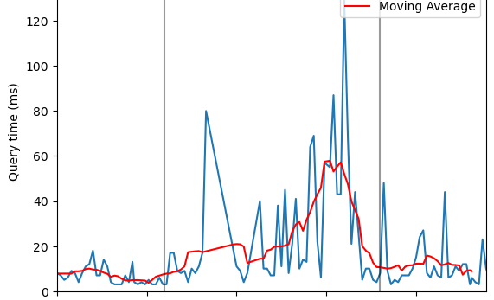
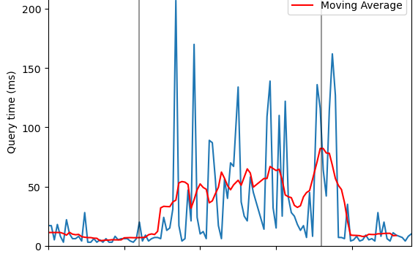
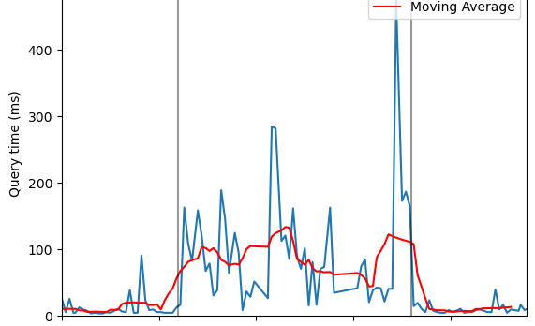
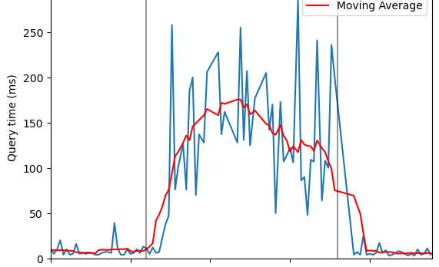
TIME SERIES OF QUERY LATENCY
Type NS
Type A
Type MX
The Data consists of:
1 minute → Baseline
2 minutes → Attack
1 minute → Effects
Type ANY
Moving Average as a visual aid to compensate for the instability of the measurements
Notes:
Time series
3 sections of the attack
Visualization with moving average

Slide 33
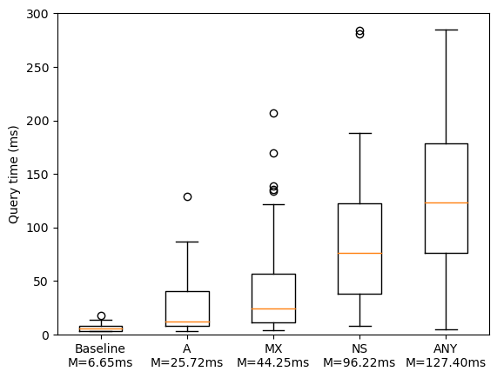
QUERY TIMES
As expected, a bigger amplification factor results in more latency
Notes:
Query times
Boxplot
Compare the mean
Mx and ns are silimar, but different latency, due to configuration?
ANY surpasses 100 ms, disrupts web browsing

Slide 34
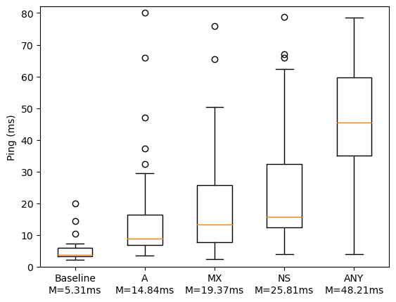
PING LATENCY
The overall system latency isn’t impacted as much as the DNS requests.
Notes:
Ping times
The biggest time is 50
The overall system is not much affected

Slide 35
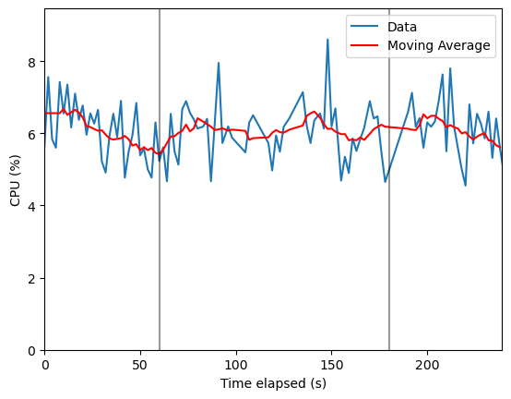
EFFECTS ON SYSTEM RESOURCES
MEMORY
CPU
There were no noticeable effects on CPU usage
Memory is unaffected too
Notes:
Resources
Any request, cpu is the same
Memory also doesn’t change
Probably because of effective management

Slide 36
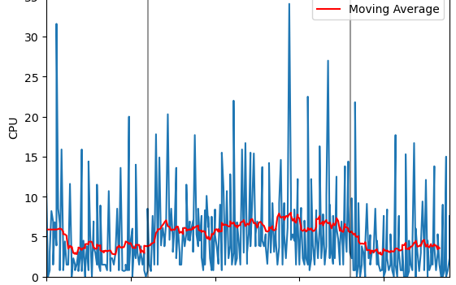
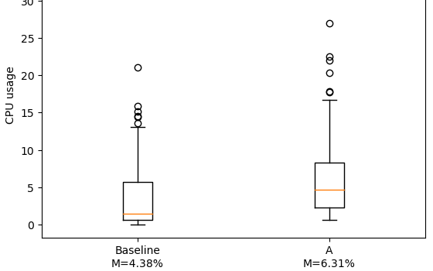
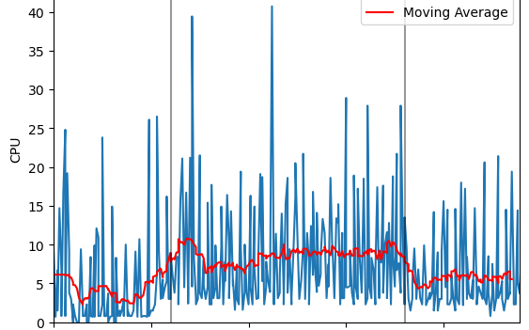
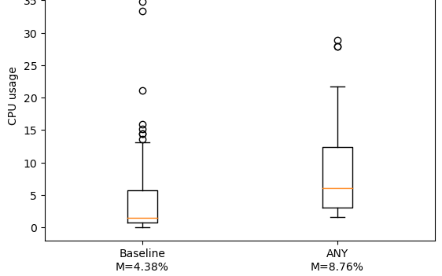
PERFORMANCE OF THE SERVER: CPU
Type A
Type ANY
The impact is quite small, around 2%
The impact is more noticeable, but still just around 4%
Notes:
Server cpu
2nd vantage point = server
Present only type A and ANY, almost no impact

Slide 37
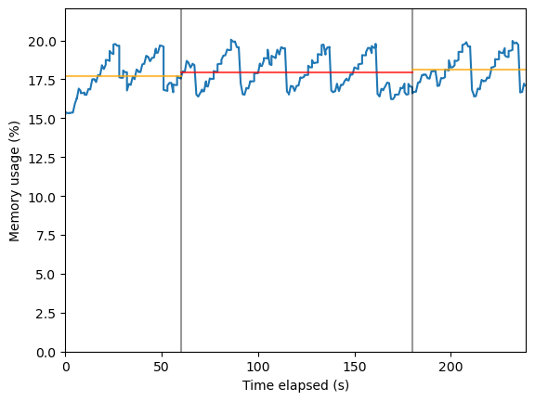
SERVER MEMORY
The memory cleaning mechanisms allow the server to be basically unaffected by the attack
Notes:
Server memory
Oscillating behavior – memory cleaning?
No change

Slide 38
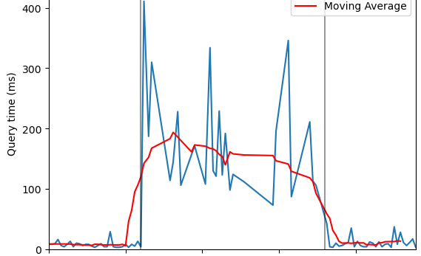
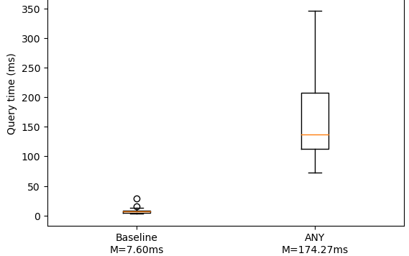
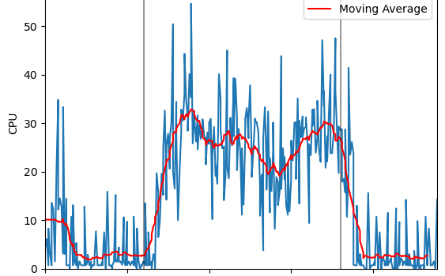
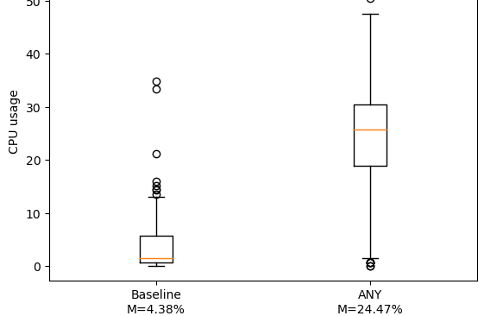
TIME FOR A BIG ATTACK
50,000 requests per second
Query times
The latency reached a mean value of 174 ms. This has a noticeable impact on the user experience.
Server CPU
The server’s processing power was put under great strain, reaching a mean usage of 24.5%. Possibly because of some packet filtering behavior.
Notes:
50k pps
query times increased
Ping not really
server cpu used a lot
Memory not really
Server filtering?
Wireshark packages

Slide 39
Mechanisms for MITIGATION
08
DDoS attacks are quite common, and the implementation of mitigation mechanisms is crucial.
Notes:
As last thing, we made a research about some mitigation mechanisms that can be employed against DDoS attacks.

Slide 40
Proactive measures
Reactive measures
Rate Limiting
Trusted Sources
Firewall
Machine Learning
Anycast Scheme
Caching Behavior
Notes:
They can be roughly classified in two categories.
Proactive measures that tries to prevent and avoid the attack.
Reactive measures aimed at identifying and stop as soon as possible the attack, while increasing the system resilience as well.
Read the measures.

Slide 41
Proactive measures
Rate Limiting
Trusted Sources
Firewall
Limit N. responses to same IP
Reducing reflection effect
Probably exploited by the used server
Trusted whitelist
Reduce available IP to spoof
Risk trusted IP to be spoofed
Traffic control
Traffic filtering
Notes:
The idea behind the rate limiting is to limit th enumber of response a server can provide to a given IP. That way the server can stop providing answer to the spoofed IP and the reflection effect is mitigated.
As regard the trusted sources the idea is to create a whitelist of IP that are legitimated to send queries to the DNS server.
Thereby, the number of IP that can be spoofed to perform attack is reduced and consequentely the probability of an attack.
However there is still the risk of the trusted IP to be spoofed, so it is not a foolproof measure.
Lastly it is possible to set firewall to control and filter traffic to block the queries and prevent the attack.

Slide 42
Reactive measures
Anycast Scheme
Machine Learning
Caching Behavior
Server replication
Traffic distribution (routing)
Hard to push all servers down
Classification algorithms (SVM, Neural Networks, Trees)
Vulnerable to adversarial approach (EAD)
No TTL expired eviction if unavailability
Cached query served even during attack
Notes:
Here are some reactive measures.
The first is the anycast scheme. The idea here is to create replicas of the server all with the same logical IP and use the anycast scheme to choose at any time the best server according to some criteria (like availability and traffic).
Thereby, the attacker would have to run out of service all the server which becomes more diffucult the higher the number of servers.
With machine learning the idea is to train some classification algorithms like SVM, NN and trees (random forests) to discriminate between an attack situation and a legitimate one, according to some features extracted from the queries.
However has been recently shown that using an adversarial approach the classification algorithm can be fooled.
This apporach conists in taking a two netowrk, the classifier and another challenging it. This network can learn to slightly change the features to fool the classifier.
The idea of cahching behavior is to keep providing the cached entry when a relevant server is down, indipentely on the TTL. That way even during an attack the cached entries can be served, increasing the resilience of the system.

Slide 43
CONCLUSIONS
09

Slide 44
Final REMARKS
The attack was successful (DNS queries and Ping)
No complete denial of service (resources limit)
Side effect: impact on server resources (CPU)

Slide 45
QUESTIONS ?

